Slide 1

Integrating Content and Academic Literacy: Perceptions and Practicalities
Paula Villegas, SFHEA
ELTC, The University of Sheffield
Dr Ally Lu, SFHEA
USP, The University of Sheffield
Dr Xin Zhao,
IS, The University of Sheffield
Notes:
Presentation
What do I do
What is this presentation

Slide 2
Outline
The challenge
Our approach
What did the student say?
What did we say?
What did we all learn?

Slide 3
The Challenge
10 ESAP sessions in semester 1 – for international students only
Attendance drops off
  How is this helping me in my studies?
  How can we reach all students that could benefit from our support?

Slide 4
The Challenge – what does the literature say?
EAP courses tend to be independent of academic departments, usually falling within the realm of students’ services -> marginalisation of EAP (Hyatt, 2015)
The split between EAP and content actively contributes to the trivialisation of EAP (Wingate, 2015)
Instrumentalization of EAP (Hyatt, 2015).
A specialist in both language and subject content subject is quite rare (Smith, 2015)
Notes:
As Hyatt (2015) explains EAP becomes a means to an end, with students engaging with knowledge in a compartmentalized manner. On the one hand they look at language and academic skills and on the other one they look at content, thus creating an artificial division. Therefore, this instrumental knowledge could be linked to the consuming, compartmentalizing and regurgitation of information.

Slide 5
The Challenge – what does the literature say?
Reconceptualization of EAP as academic repertoire (Hyatt, 2015).
Positive impact of embedding support (McWilliams & Allan, 2014).
  Enhancing motivation through authentic materials (Dörnyei, Z., & Ottó., I. (1998).
  The ESAP lessons– in line with principle of authenticity (Flower & Peacock, 2001, p. 183).
  Two specialists working together.
Notes:
Allowing students to develop skills, competences, values to be successful in HE while pushing for EAP to not be in the margin of academia

Slide 6
Our approach
In 2019/2020 - ELTC & USP identified a suitable module – TRP 108 Information & Communication Skills (Semester 1)
4x2 hours Team–Taught sessions (Home & International students)
10 hours ESAP sessions (International students)
Language feedback provided at the formative stage of final essay together with content feedback

Slide 7
Applying McWilliams and Allan’s Model (2014)
(1) Students’ Feedback
(2) Institutional Response
(3) Subject Lecturer & EAP tutor close collaboration
(4) Variety of support
Student Centre Focus (1)
Institutional Support (2)
Cooperation & Collaboration (3)
Guidance Approach (4)
Not ‘one size fits all’ (5)

Slide 8
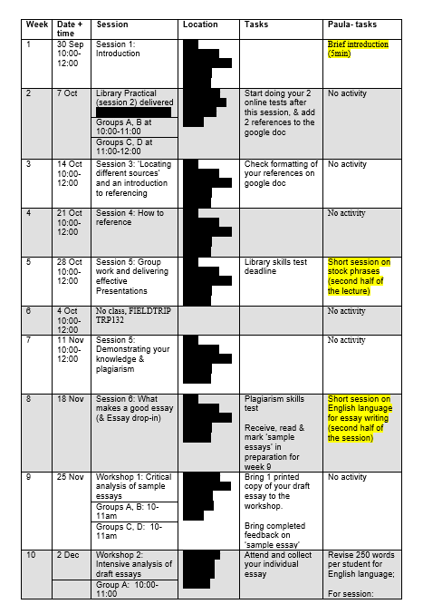
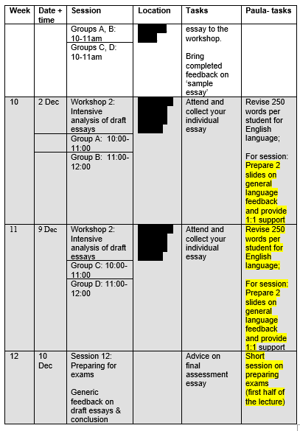
Our approach - Practicalities
Session 1 – brief intro
Session 2 – Language for presentations
Session 3 – Language for compare & contrast (assessed essay)
Session 4 (x2) – workshop general language feedback & Q&A
Session 5 (x1) Exam prep. Unpacking exam questions.

Slide 9
Our approach - Practicalities
Session 0 – brief intro
Session 1 – Language for presentations
Session 2 – Language for compare & contrast (assessed essay)
Session 3 (x2) – workshop general language feedback & Q&A
Session 4 (x1) Exam prep. Unpacking exam questions.
Notes:
Add info on the feedback

Slide 10
Our approach - Practicalities
Discussion of materials for upcoming session (a week in advance)
Quick-follow up chat
  What worked?/ what didn’t?
  What needs covering in the ESAP session?

Slide 11
What did the students say? - Perceptions
Overall Positive Perceptions
They always willing to help students and the module is also suitable for some students with lower foundation.
The module is very helpful in terms of improving our essays (Using the correct structures, word choices, citing etc)
this teaching team has helped my learning
Both of them can explain content well and provide fitting comments
Help me to do my assessment a lot
Both were useful

Slide 12
What did the students say?- Perceptions
Issues highlighted
The ideas in class are clear, but for things like referencing, I need to take some practice to fully be able to grasp it.
Hope more individual tutorials could be provided.
I enjoy the 108 lessons, but not the English Language support as I do not find it very useful for my studies - (one student)
Not super exciting but that is the nature of the module and will be very helpful for future university modules.

Slide 13
What did we say? - Perceptions
Big thumbs up!
  Quality of writing was perceived to have improved in relation to previous years
  Attendance to ESAP sessions was consistent
    Attendance this year in UG2 is better than it has been before

Slide 14
What did we all learn?
Continue to implement it – online in 2020/2021
Strengthen collaboration between EAP practitioner and module lead for all support in USP
Other departments have followed suit and implemented team-teaching and/ or added language specific feedback at the formative stage of assessments.

Slide 15
Reference List
Dörnyei, Z., & Ottó., I. (1998). Motivation in action: A process model of L2 motivation. Working papers in Applied Linguistics, 4, pp. 43-69
Flowerdew, J., & Peacock, M. (Eds.) (2001). Research Perspectives on English for Academic Purposes. Cambridge: Cambridge University Press.
http://dx.doi.org/10.1017/CBO9781139524766
Hyatt, D. (2015) BALEAP PIM Plenary: David Hyatt - Reconceptualising EAP as Academic Repertoire. YouTube. Available at: https://www.youtube.com/watch?v=HZLfgu9ySzg&t=828s [Accessed 28 Mar. 2020].
McWilliams, R., & Allan, Q. (2014). Embedding Academic Literacy Skills: Towards a Best Practice Model, Journal of University Teaching & Learning Practice, 11(3). http://ro.uow.edu.au/jutlp/vol11/iss3/8
Smith (2015) Methodology in English for Specific Academic Purposes. uni-sheffield.adobeconnect.com. EAP Conference Chris Smith_0. [online] Available at: https://uni-sheffield.adobeconnect.com/p484ndpkawy/?proto=true [Accessed 28 Mar. 2020].
Wingate U. (2015) Academic Literacy and Student Diversity. The Case for Inclusive Practice, Multilingual Matters, Bristol.

Slide 16


