Slide 1
Interactive structured collaboration between tutors and students through Padlet
Kinga Maior
University of Glasgow
BALEAP PIM Northumbria University
27th March, 2021.

Slide 2
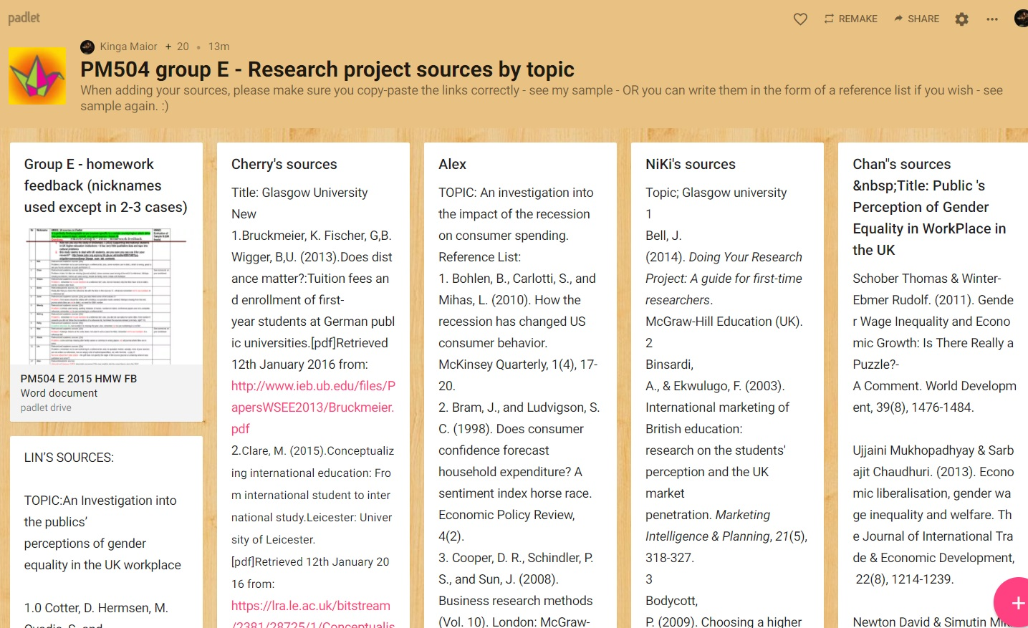
Padlet
Free platform that Ts and Ss can access for online learning purposes
Essentially a virtual wall where Ts and Ss can upload and share their documents/files (Fisher, 2017)
www.padlet.com

Slide 3
Some of the main features
Audience | Current generation of students are the so-called “digital natives” (Prensky, 2001) who grew up with the use of Internet communication tools and are naturally attracted to online environments
Form of engagement and Access (24/7) | Relatively high; text/audio/visual files can be uploaded, incl. different types of collaborative work, especially writing! (Baida, 2014) Ss who are used to T-centred classes probably more comfortable contributing through writing than speaking + anonymous (Fisher, 2017) Although might be 1-2 reluctant students/group who do not wish to use it Convenient, straightforward, most students adapt quickly (after 1-2 uses); can be used on a laptop/tablet/smart phone; although difficult to navigate on small screens; in online classes Ss have to figure it out themselves!
Purposes for learning | Brainstorming; visual and audio presentations; students produce their own work and share it; collaborative writing (Rashid et al., 2019); not suitable for testing/assessment; perhaps informal assessment?
Timing and flexibility | At students’ pace outside the classroom (accessible 24/7), but must have time limits in class for obvious reasons

Slide 4
https://padlet.com/kinga_maior/PM504groupEsources
Interactive structured collaboration – a sample
Group: approx. 20 Chinese Ss
Level: Pre-masters
Classroom: f2f or online
Course/module: Writing a 5,000-word research project
Lesson: Finding academic sources for research topic
Purpose: checking Ss’ progress when searching for information and sources (relevance, academic, acceptable, referencing conventions) through structured collaboration b/w T & Ss
1. T provided sample answers (see Kinga’s sources),
2. Ss uploaded their own sources and references,
3. T provided f/b
*Note: tried and tested 4 times with different pre-masters groups (approx. 80 Ss)

Slide 5
Individual f/b to Ss [~12-15 mins.]
Alone, choose 4-5 Ss (one per box), check their sources – they should be accessible and provide feedback on:
Relevance to topic
Academic
Acceptable for the research project?
Referencing conventions
Remember to time yourself when writing the f/b!
Use the Comments area for f/b or start a new box by clicking the + sign in the bottom right hand corner
Can rate Ss’ answers, too ☺

Slide 6
Group f/b on sample Padlet [~8-10 mins.]
In small groups [in different channels of Room 2], think of how this Padlet could be improved:
layout, content, task, referencing,
or any other ideas that come to you when discussing/working on it

Slide 7
Creating a Padlet [~15 mins.]
Create a Padlet account and a quick Padlet for structured collaboration b/w T & Ss to check their search for sources – how would you do it? Please share your Padlets in the Teams Chat
Creators share their Padlets when ready
Questions and feedback from all

Slide 8
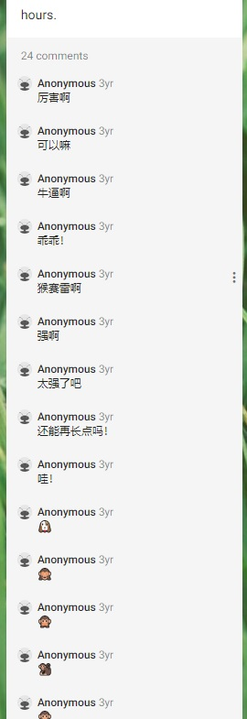
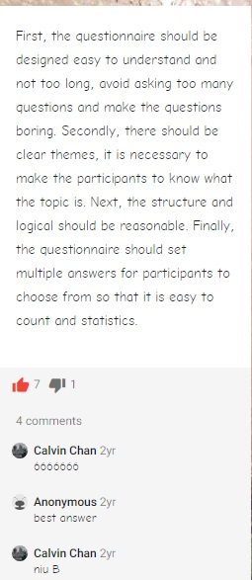
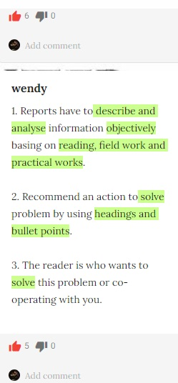
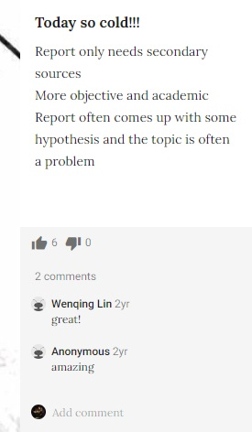
Student comments - examples
https://padlet.com/kinga_maior/PM002Sources2018

Slide 9
References
Baida, M. 2014. Using Padlet wall in cooperative group investigation method. http://eztuir.ztu.edu.ua/bitstream/handle/123456789/1214/88.pdf?sequence=1&isAllowed=y
Fisher, C.D. 2017. Padlet: An Online Tool for Learner Engagement and Collaboration, The Academy of Management Learning and Education, 16(1), pp. 163-171.
Prensky, M. 2001. Digital Natives, Digital Immigrants Part 1. On the Horizon, 9(5), pp. 1-6.
Rashid, A.A., Yunus, M. and Wahi, W. 2019. Using Padlet for Collaborative Writing among ESL Learners, Creative Education, 10, pp. 610-620.

