Slide 1
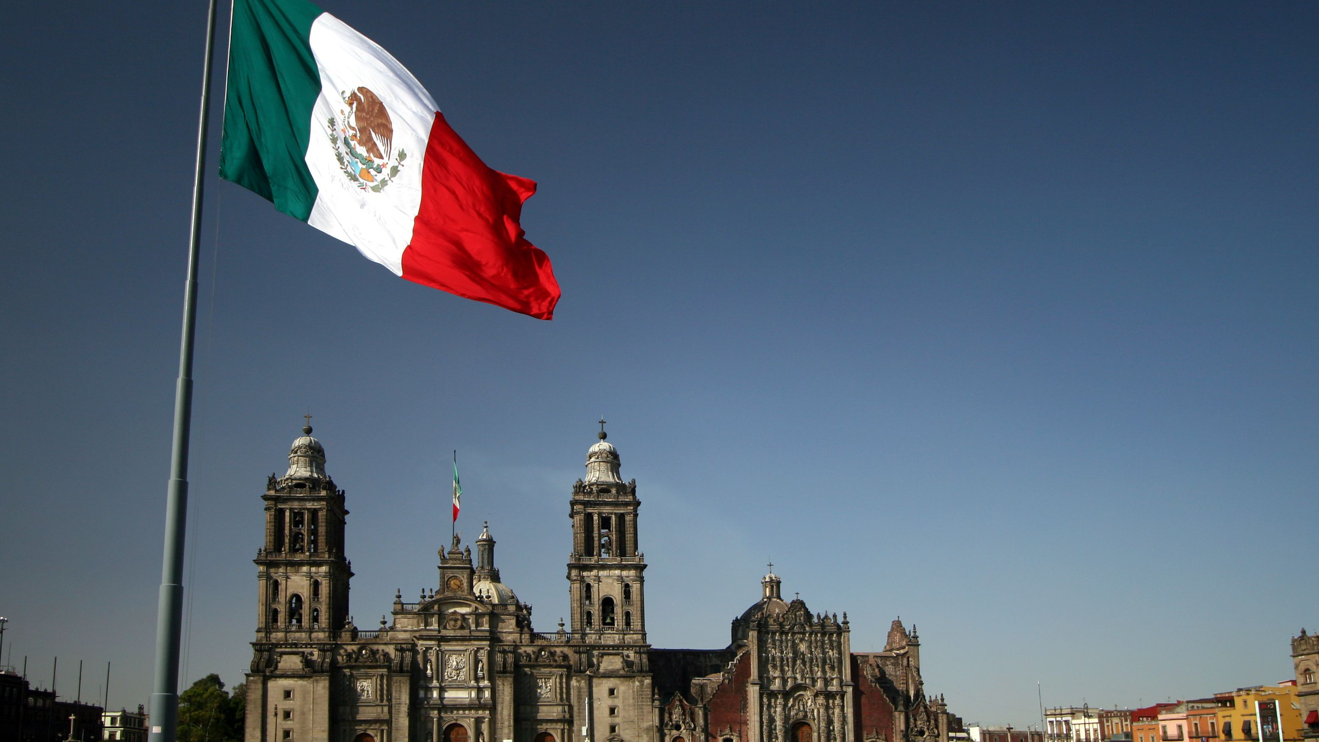
Stakeholder Integration on a Mexican Pre-sessional
Helen Costello
Durham University

Slide 2
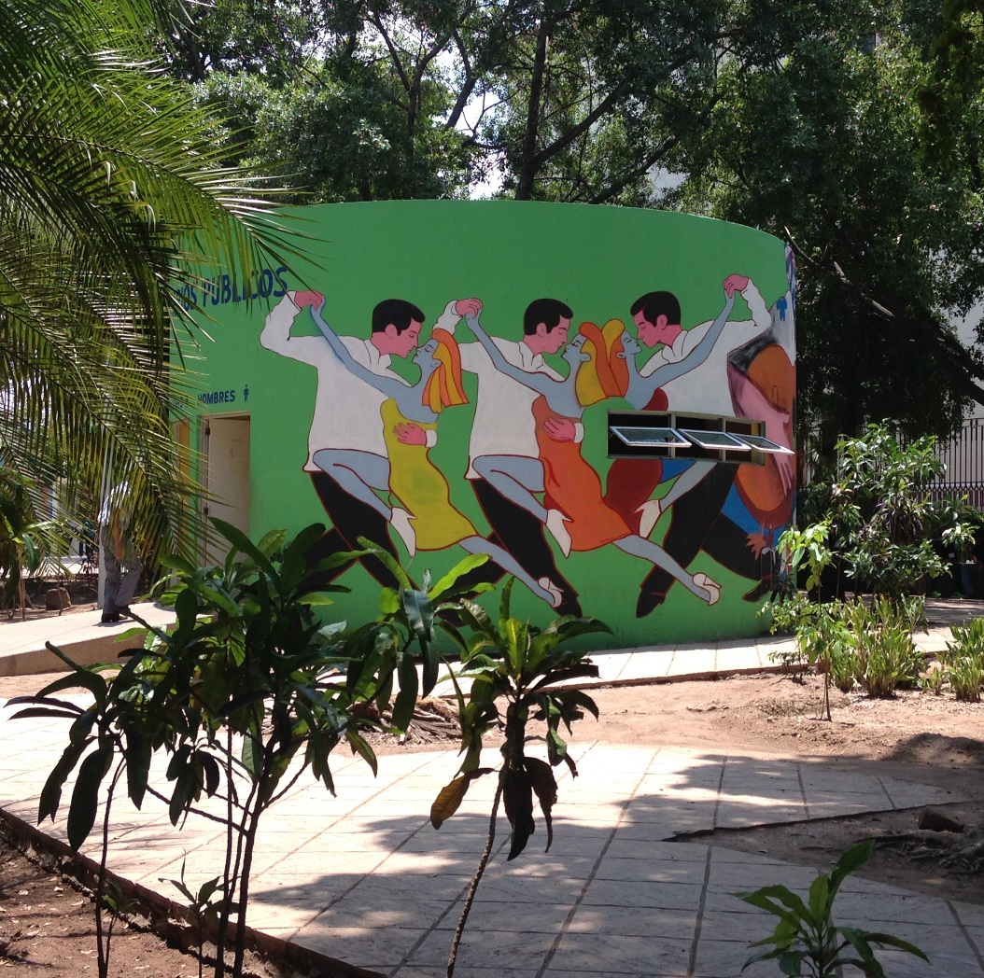
Today’s talk…
Context Overview
The Mexican Energy Partnership
The Mexican Pre-sessional
Integrating the desired outcomes of:
Funding bodies
Pre-sessional management team
Teachers
students

Slide 3
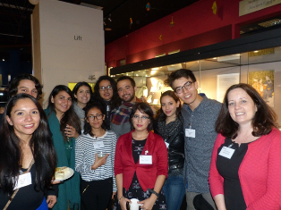
The Mexican Energy Partnership
Durham University (DU) has an agreement with the Mexican Science and Technology Council (Conacyt)
Students are funded by Conacyt and take part in postgraduate training at the Durham Energy Institute (DEI)
Conacyt main source of gov support for sts wanting to study abroad
Provides opportunity for academically excellent Mexican students from disadvantaged backgrounds to undertake postgraduate studies in Durham
High level students increase the diversity of student body at UK universities – especially within sciences
High visibility project – important for UK unis / ‘good news’ project for Mexican governmental agencies
Focus on energy – especially renewables – high priority for Mexican government
https://www.dur.ac.uk/experience/news/?itemno=29799

Slide 4
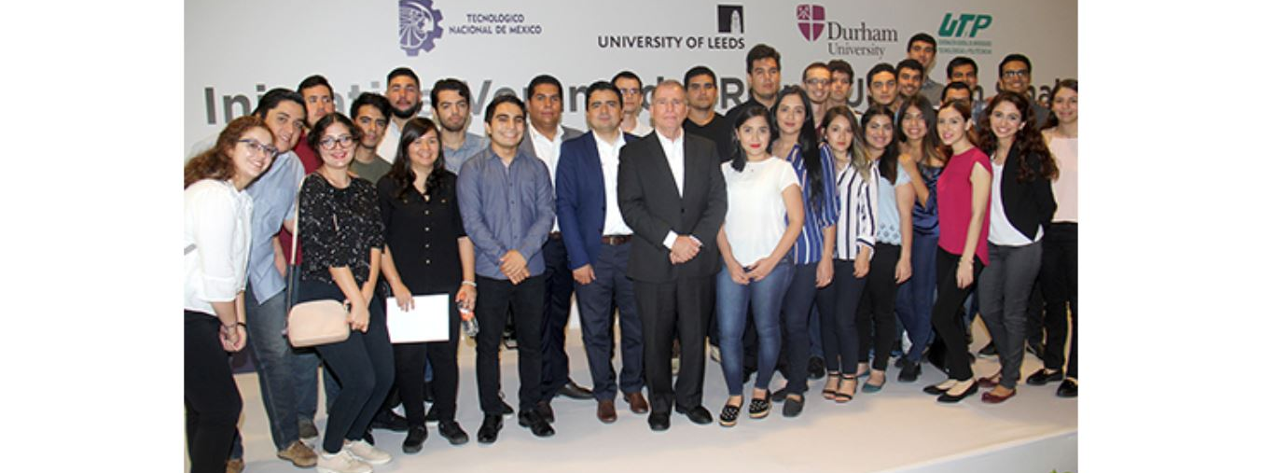
High profile initiative - photo the Mexican Government website

Slide 5
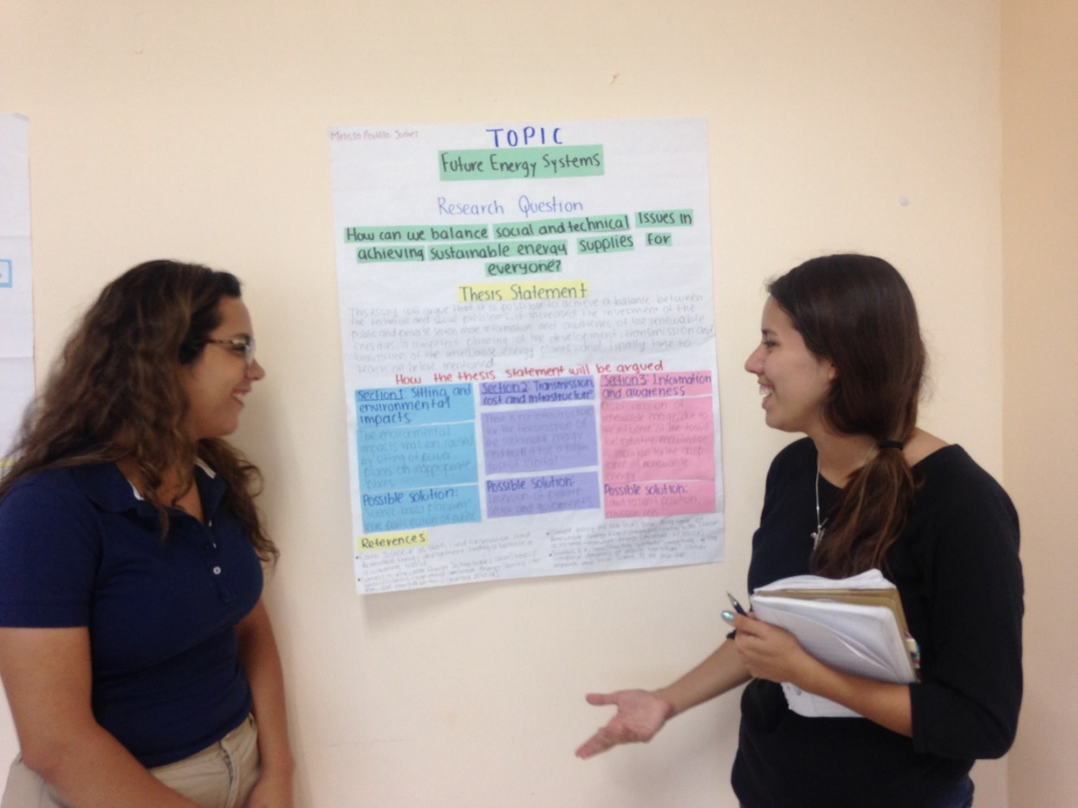
Mexican Pre-sessional
Equality of opportunity for those students with good English but without the language requirement necessary for PG study
Same quality and standard as our on-site provision
Students funded by Citibanemex,the Mexican National Bank
Approximately 300 students completed the programme to date

Slide 6
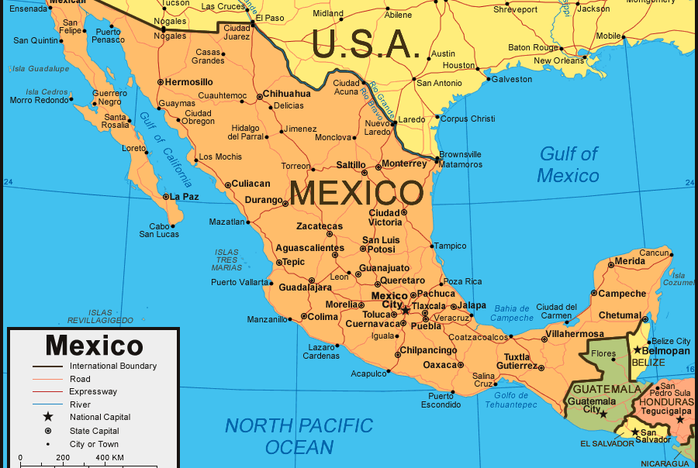



Pre-sessional locations

Slide 7
Pre- sessional management team
International offices of UK universities
Mexican funding bodies
Teaching staff & students
Mexican academic context

Slide 8
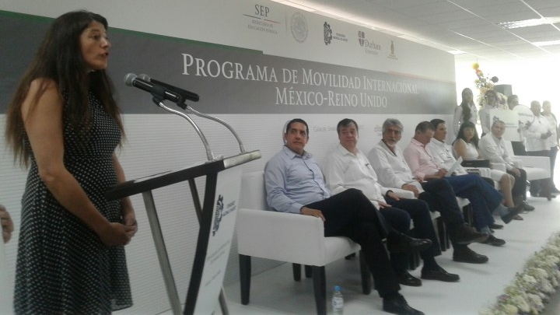
Success for Citibanemex / CONACyT
Sending students from poor regions of Mexico to the UK for post-graduate study at RG universities
Visibility & exposure
Local / national press
Opening ceremony
Closing ceremonies = speeches/dinners v hierarchical

Slide 9
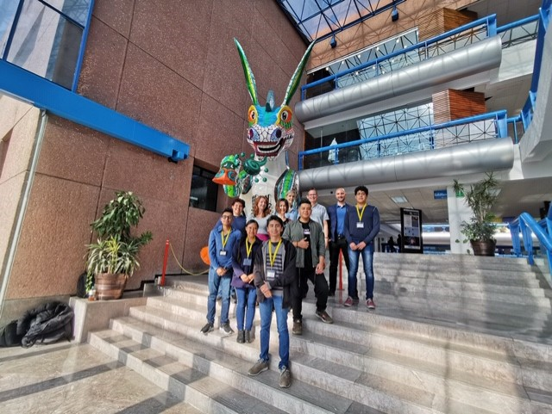
The integration of funding body priorities within our ‘curso de inglés’
Students taking IELTS exams at critical points in pre-sessional
Dealing with students under tremendous pressure from sponsors
Closing ceremonies moved around in final week with little notification – coincided with assessment
Having to release grades mid-course when we’d rather not
How might we better integrate their ideas of success?

Slide 10
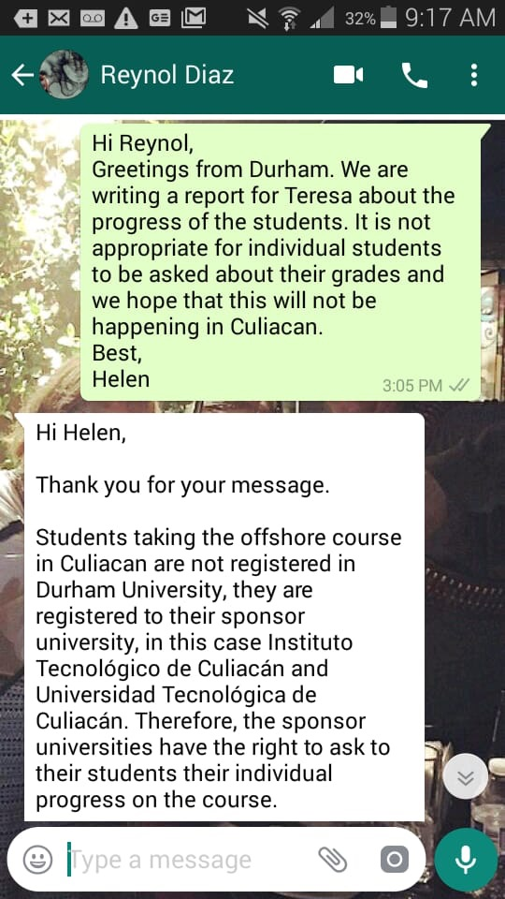

Finding where the power lies…
And how we might be creative in the future…

Slide 11
Integrating the values of the pre-sessional management team
Excellent student outcomes- same high-quality teaching and learning experience as on campus
Positive experience for our teachers working in potentially stressful environments.
Teacher safety in potentially dangerous areas
Fair & transparent recruitment process

Slide 12
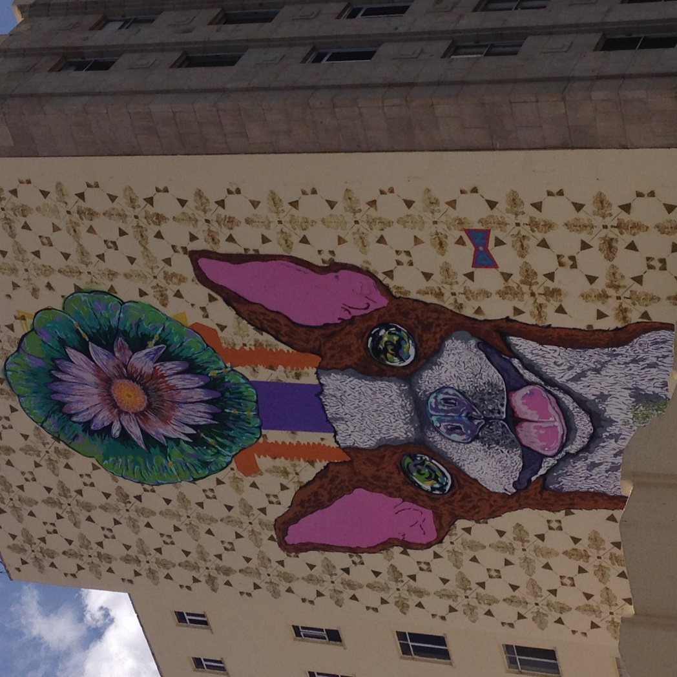
How our ideas of success were leveraged (or not)
Teacher safety – accommodation / robust risk assessment
Student under-recruitment & staffing

Slide 13
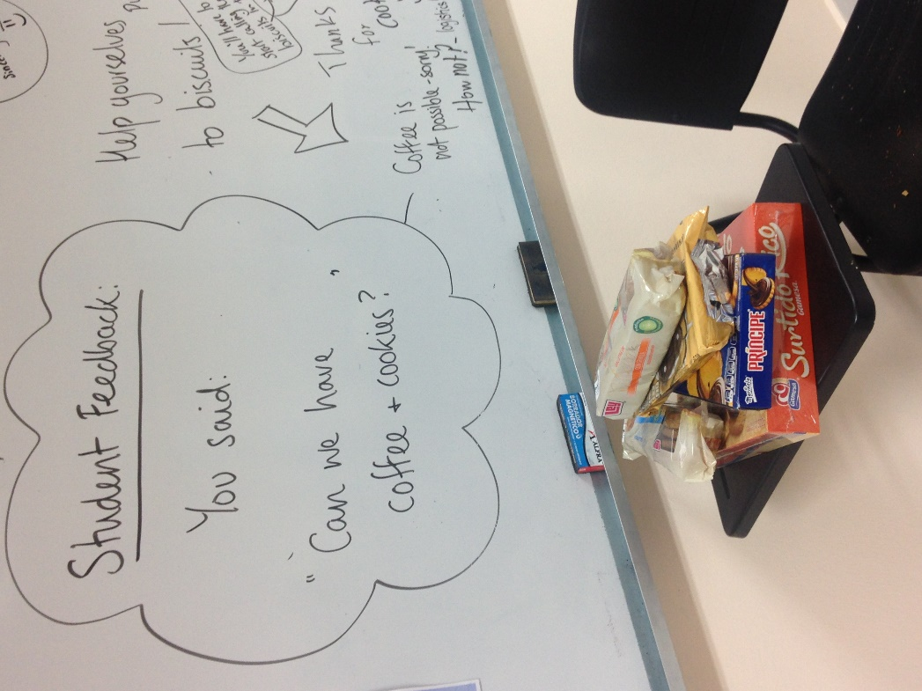
Teachers and Students – integrating the norms and practices of UK academic culture
PS – acculturation of students into UK academic culture
How do you integrate the practices of UK academic culture?
Teachers working directly domestic academic culture
Teaching facilities – course designed for IT use
Students – competing tensions - Long commutes / families / substantial work commitments
Accommodation – inadequate internet / poor IT facilities
Integration of norms of domestic academic culture – an underexplored area and potentially changing yearly

Slide 14
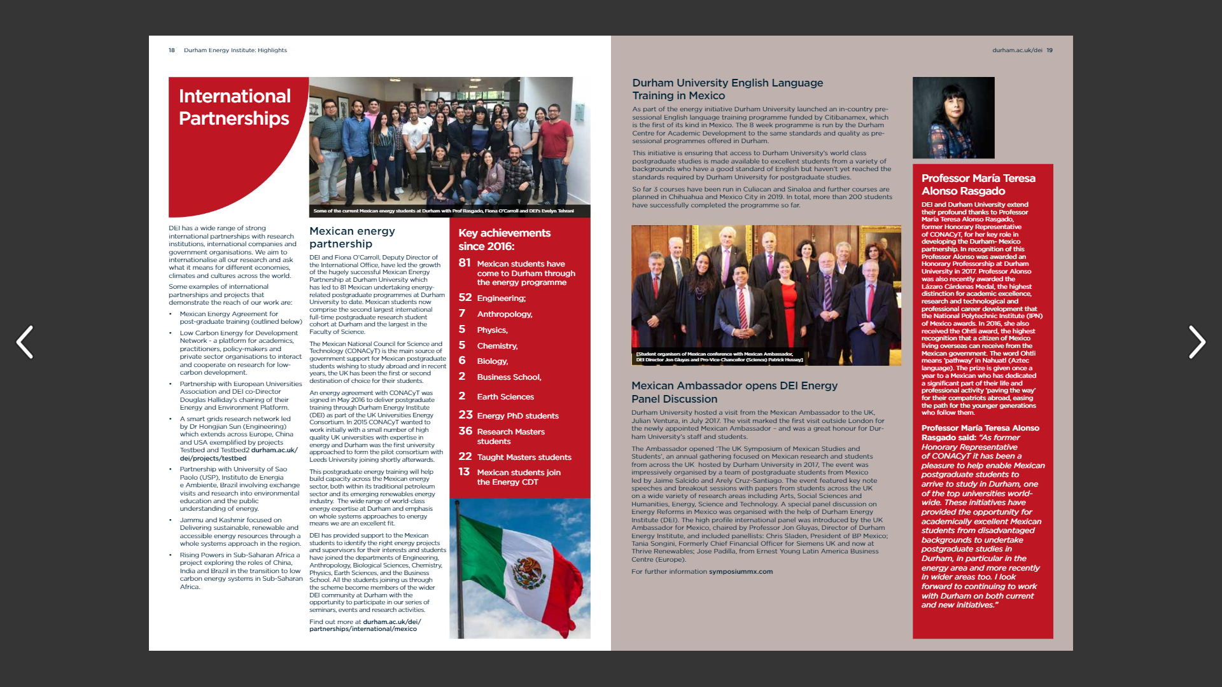
Success for Durham university

Slide 15
Successful Integration …
For us, knowledge of where and how change may best be leveraged
Integrating ideas of success needs an understanding of project evaluation from all parties
Understanding the stakeholders working practices and norms
Where strong dialogue may useful and where we are shouting into the wind
A clear view of financial leverage
Not underestimating the importance of the domestic university context – our needs and their offer

Slide 16
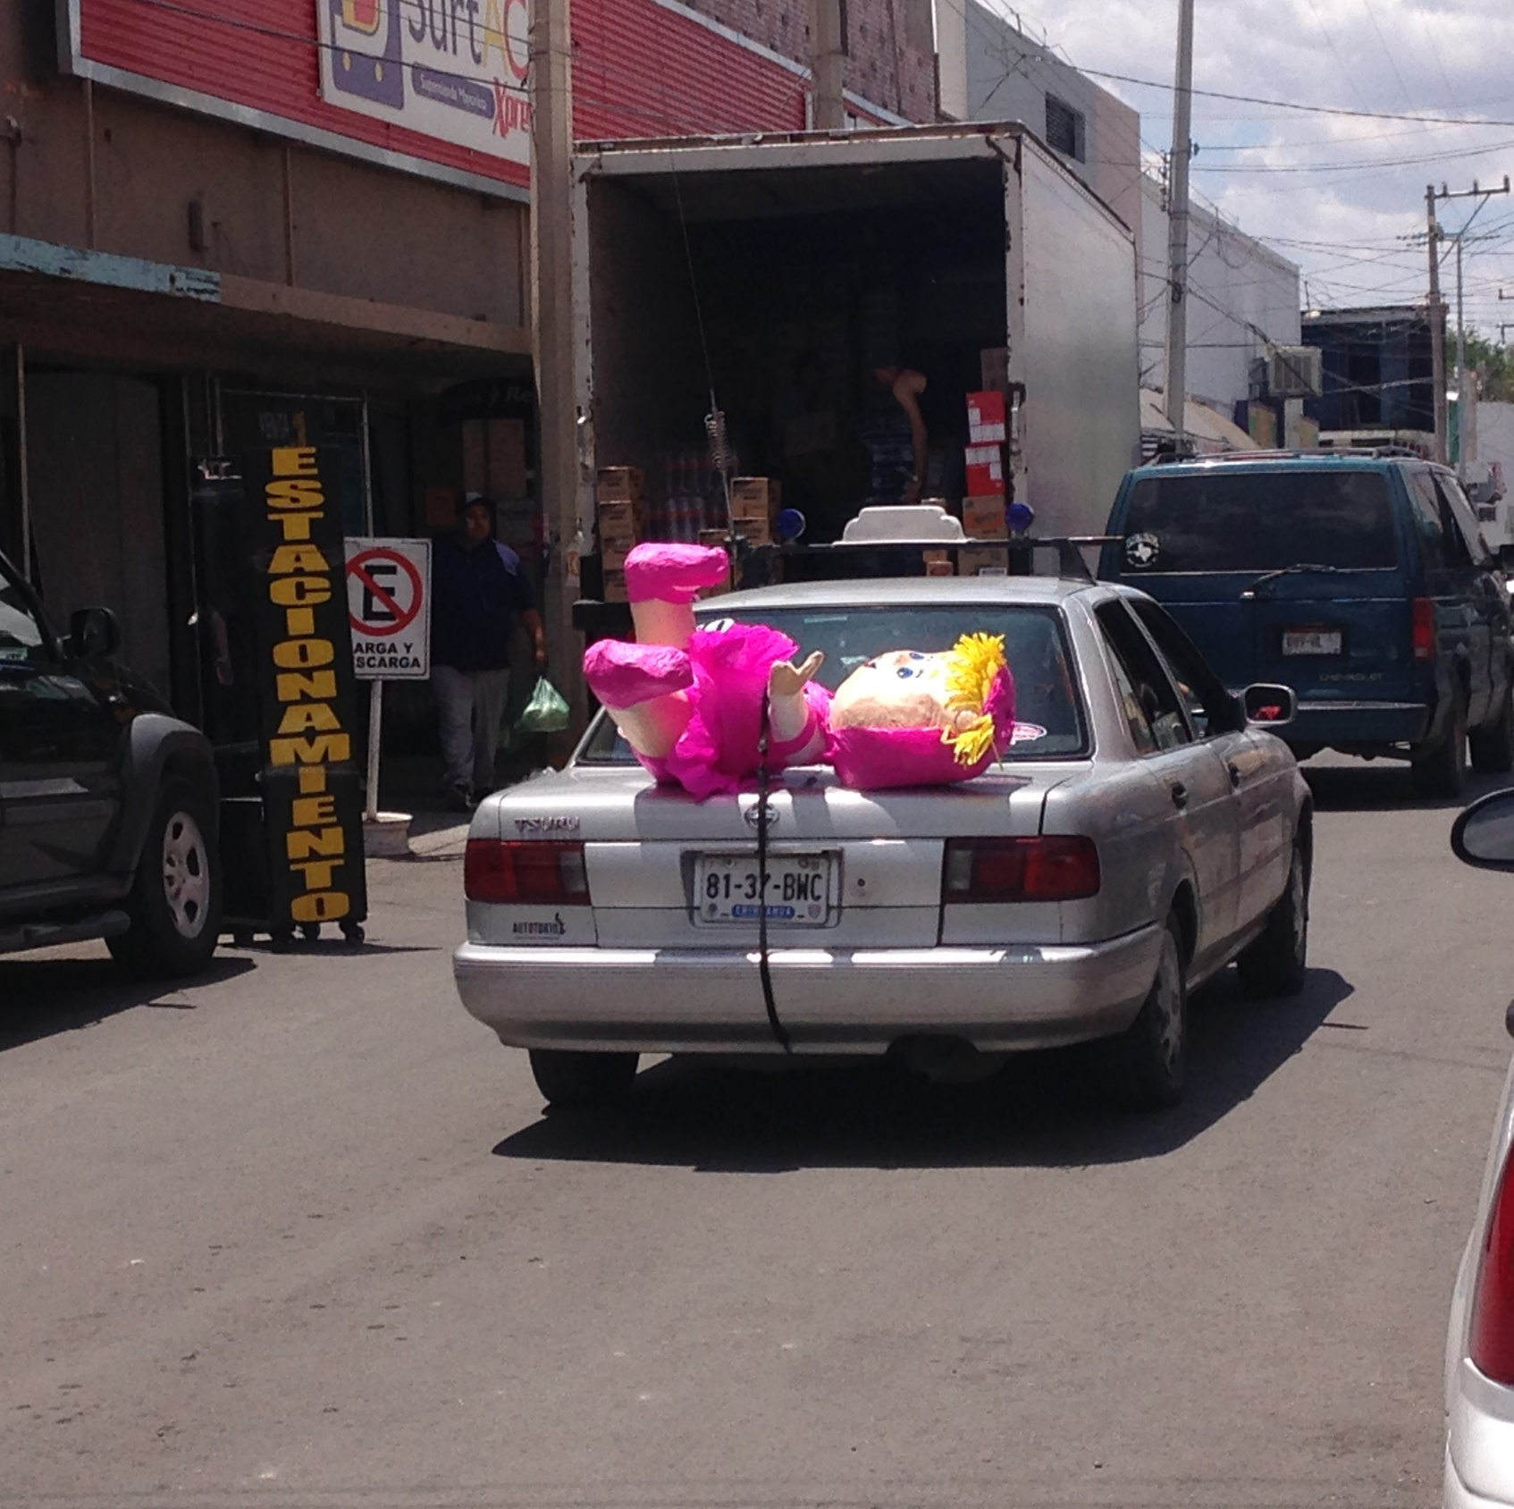
Any questions…?

Slide 17
References
https://issuu.com/communicationsoffice/docs/dei_10th_anniversary_highlights_magazine
https://www.dur.ac.uk/experience/news/?itemno=29799

