Slide 1

Integrating Global North & South via pre-sessional telecollaboration
BALEAP Professional Interests Meeting: Integration
27th March 2021
Bill Guariento

Slide 2
Integration: who?
Most of the presentations at the PIM focus on integration of (potential) students who are already present in the UK
My talk will focus on the potential for the integration of students who are unable to come to the UK (due to the high costs of studying abroad, and / or travel-restrictions)

Slide 3
Integration: what?
There has been a market-led turn in HE over the past 20/30 years
Shor et al (2017:4) suggest that this has led to ‘disqualified discourses’ and ‘subjugated knowledges’ (see also Foucault, re ‘regimes of truth’)
Some (e.g. Morrissey, 2015) see engineering as particularly impacted: he wonders whether this is affecting content
This is important, as engineering is growing in popularity among students and a succession of governments
So this talk will also consider the integration of discourses that might otherwise be sidelined

Slide 4
Imagine:
You run an EAP course every summer at a UK university
You have 180 engineers (from China, Saudi Arabia, Brazil….) who want to join a Masters course, but need to improve their reading, writing, speaking and listening skills in English
You want to involve students from the Global South who are unable to come to study in the UK
How will you involve these Global South students?
What engineering challenges will they engage with?

Slide 5
Telecollaboration as a solution?
‘… bringing together groups of learners from different cultural contexts for extended periods of online intercultural collaboration and interaction. This is done as an integrated part of the students’ educational programmes and under the guidance of educators or expert facilitators.’
O’Dowd and O’Rourke (2019: 1)

Slide 6
A challenge:
….telecollaboration is almost always Global North to Global North (Helm, 2015: 204)
There are two interesting exceptions that link Global North & Global South, and that challenge ‘disqualified discourses’:
1: Soliya….but caters mainly for Arts & Humanities students
2: Engineers Without Borders….but no ‘end-user’ in Global South
The result was the EAS Telecollaboration Project (Guariento et al, 2018) starting in 2015, as part of the University of Glasgow’s pre-sessional EAP programme.

Slide 7



Our Global South partners:
The Islamic University of Gaza
The Malawi University of Science & Technology
Universidad Tecnológica de Chile

Slide 8
Week 1 / Day 1
On Day 1 of the pre-sessional course, we show our students videos prepared by their prospective partner in the Global South, introducing an engineering / societal challenge.
Here’s an example, from Palestine. While you watch, think:
What’s the engineering challenge?
What language practice (Reading, Writing, Speaking, Listening) do you think the subsequent 5 week-collaboration generated?
What intercultural benefits may have resulted?
https://easttelecollaboration.wordpress.com/2015/10/01/another-video-from-gaza/#more-362

Slide 9






The technical details of EAST
Human presence and contact
  Student - student
  Teacher - student(s)
  Coordinator - coordinator
Community building
  get to know each other sessions - timetabled real time
Technology choices
  fit for purpose
  less is more
  familiarity is key

Slide 10
Week 5 / Day 5
On the final day, students present their findings orally. This is live-streamed via facebook, so that the Global South audience can watch / comment.
Here’s an example, from Chile:
3 Chinese students in the UK have worked with 1 student in Chile for 5 weeks, looking at ways to reduce fare-evasion in Santiago

Slide 11
The 3 responses
Of the 3 responses, 2 are engineering, pure & simple:
face-recognition systems
bus-control systems
But response 3 was interesting:

Slide 12
Response 3

Slide 13
The 3rd response
…showed engagement with wider issues, i.e. a new price schedule

Slide 14
Sample projects:
Combating irrigation water theft in Chile
Generating electricity for wastewater treatment
Water drainage and sea pollution in Gaza
Toxicity of pesticides in Gaza
Lack of public toilets in Malawi
Groundwater salinity in Gaza
Development of Arabic OCR
Lack of addresses in Gaza

Slide 15
‘The study of language use, in whatever academic discipline, cannot ignore actors' own concepts, descriptions and understandings of reality. Nor can the study of language use be detached from the social and political context in which language is used.’ (Cameron et al, 1992: 12)
Effective teaching should embrace ‘cosmopolitan subjectivities [which] can be transformative for the individuals concerned.’ (Crosbie, 2014: 97)

Slide 16
What do the students gain?
English language practice
Enhanced content-knowledge
Problem-solving
Team-working
Enhanced digital literacies
A cognitive challenge: ‘pluriliteracies’ (Coyle, 2015)
A cultural challenge…overcome inductively (Bikowski, 2011)

Slide 17
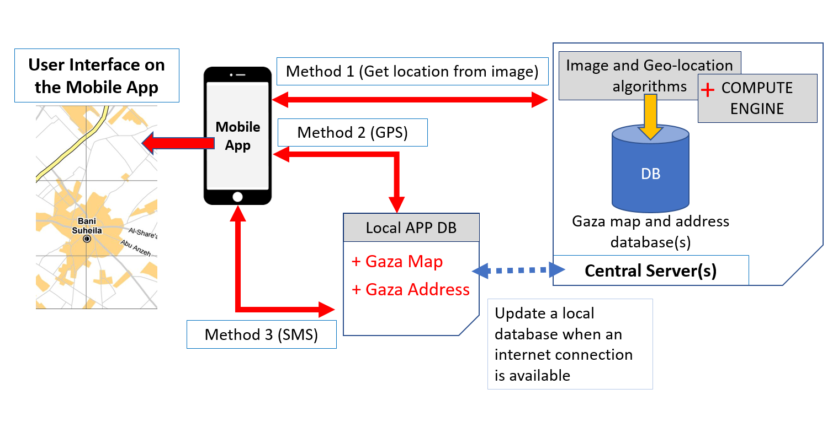
Notes:
Students provide title from slide 14

Slide 18
What do the Glasgow-based students gain?
Access to their Masters course
Knowledge of real-world issues. This may mean facing up to ‘disturbing dialogues’ (Kumaravadivelu, 2008: 181)

Slide 19

Last week…
Steps in conducting an ethnographic study
Developing a research problem/question/theory
Foreshadowed problems
Selecting group/event for study
Access – challenges
Making relationships
Ethics

Slide 20
What do the Global South students gain?
Abeer (her picture is in the previous slide) talks about her experience on EAST (from 19.36):
https://www.teachingenglish.org.uk/article/global-north-south-project-based-learning-student-student-telecollaboration-language

Slide 21
Conclusion
The EAST Project ‘involves’ Global South students, but does it ‘integrate’ them? In terms of intercultural awareness, yes:
‘If you ask me what is the most useful thing that you take it from this project i will certainly say the knowledge about cultures, its great thing to share your ideas and thoughts with other people’ (Gaza: 2016)
‘you have just know them, also you can get a full of useful when you chat with them about their habits, thoughts, living and many thing relating to their lives not just talking about the education or college :)’ (Gaza: 2016)
‘I find out that our group members from different countries think in different way, so it’s hard to understand each other. We have to explain everything in detail’ (Glasgow, Q: 2019)

Slide 22
Summary of benefits
Global North students learn about issues of social justice
Global South students have a ‘witnessing’ (Freire, 1996)
This is not ‘banking’ education (Freire, 1996)….everyone involved takes a risk…and by doing so, grows

Slide 23
Integration: ’Who?’ and ‘What?’
But the inescapable fact remains that the Global South students aren’t able to study in the UK, and there is evidence that many of the students (from Gaza in particular) wanted to discuss underlying political/economic inequities, but felt obliged to avoid this.
Hence I think the main value of EAST lies in the way that the Project integrates an examination of discourses, i.e. of the link between engineering & social impacts that are often neglected.

Slide 24
Further Reading
BALEAP have published a fuller discussion of the issues we have touched on today, within the Social Justice SIG:
https://eap4socialjustice.net/2020/06/06/pre-sessional-english-language-courses-university-telecollaboration-as-a-driver-of-global-north-south-student-contact-for-engineers/

Slide 25
References
Bikowski, D. 2011. Review of ‘Online Intercultural Exchange: An Introduction for Foreign Language Teachers’. Language Learning and Technology, 15(1), 24-28.
British Council ELTRA webinars: https://www.teachingenglish.org.uk/article/global-north-south-project-based-learning-student-student-telecollaboration-language
Cameron, D., Frazer, E., Harvey, P., Rampton, M.B.H., & Richardson, K. (1992) Researching Language: Issues of Power and Method, Routledge, Abingdon, UK
Coyle, D. 2015. Strengthening integrated learning: Towards a new era for pluriliteracies and intercultural learning. Latin American Journal of Content and Language Integrated Learning, 8(2), 84-103
Crosbie, V. 2014. Capabilities for Intercultural dialogue. Language and Intercultural Communication, 14(1), 91-107

Slide 26
References
Freire, P. 1996. Pedagogy of the oppressed, Penguin: London, UK
Guariento, B., Rolinska, A. & Al-Masri, N. 2018 Constructive content-based feedback in EAP contexts: lessons from a cross-border engineering-related pre-sessional course, Higher Education Research & Development, 37:3, 514-532
Helm, F. 2015. The practices and challenges of telecollaboration in higher education in Europe. Language Learning and Technology, 19(2), 197-217
Kumaravadivelu, B. 2008. Cultural globalisation and language education, Yale University Press: Newhaven, CT
Morrissey, J. 2015. Regimes of performance: practices of the normalised self in the neoliberal university. British Journal of Sociology of Education, 36:4, 614-634

Slide 27
References
Engineers without borders annual report. 2018. Retrieved from www.ewb-uk.org/wp-content/uploads/2018/06/EWB-UK_Annual-Review_2017.pdf. Accessed 10/6/19
O’Dowd, R., & O’Rourke, B. 2019. New developments in virtual exchange for foreign language education. Language Learning & Technology, 23(3), 1–7
Shor, I., Matusov, E., Marjanovic-Shane, A. & Cresswell, J. 2017. Dialogic & Critical Pedagogies: An Interview with Ira Shor. Dialogic Pedagogy, 5. https://files.eric.ed.gov/fulltext/EJ1147791.pdf Accessed 2/3/2020
Soliya Program. Retrieved from https://www.soliya.net/programs/connect-program. Accessed 10/6/19

