Slide 1



Adapting to online rubrics in the electronic marking age:
The impact on EAP students’ assessment literacy and writing development
Joy Robbins & Milena Marinkova
j.robbins@leeds.ac.uk m.d.marinkova@leeds.ac.uk

Slide 2
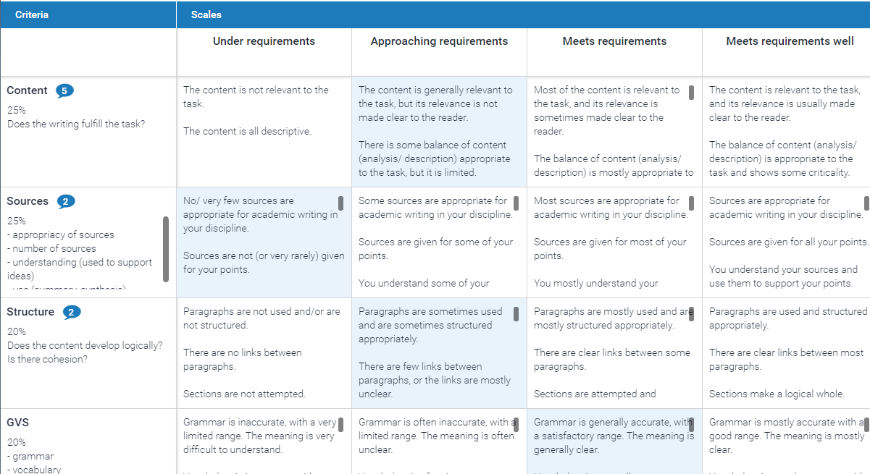
What we talk about when we talk about rubrics
Levels (scales, bands, marks)
Criteria
Descriptors

Slide 3

What the research says about assessment rubrics
Make expectations clear – use of descriptive language and exemplars (Andrade, 2000; Panadero and Jonsson, 2013; Jonsson, 2014; *Sadler, 2014).
Align assessment with learning – develop understanding to avoid instrumentalisation (Brookhart, 2018; *Torrance, 2007).
Support students' learning (Reddy and Andrade, 2010; Andrade and Du, 2005; Andrade, 2010).
Notes:
Transparency of expectations – clarity and digestibility of criteria, ease of use – consistency and comparability of standards/baselines (Andrade, 2000); make it clear what the teacher expects (Jonsoon 2014), which reduces anxiety (Panadero and Jonsson, 2013)
Aligns grading and learning – not an assessment tool only, but can support learning too; so, grading need to be aligned with learning (Brookhart, 2018) and clear understanding of rubrics to be developed to avoid too narrow a view, or the instrumentalisation of learning (Torrance, 2007).
Support students' learning – helps identify learners' needs for formative/developmental purposes (Reddy and Andrade, 2010); improves self-efficacy and self-regulation (Andrade 2010; Andrade and Du, 2005)

Slide 4

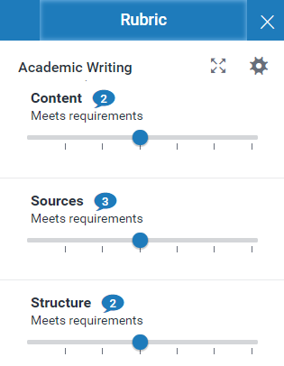



What the research says about online rubrics
Improve accessibility, timeliness and clarity of feedback – annotations/QMs on Grademark® (Watkins et al., 2014).
Enhance the efficiency and effectiveness of marking – sufficient staff support and robust design (Anglin et al., 2008; Buckley & Cowap, 2013; *Reed et al., 2015).
Gaps
Learners' response to online rubrics / feedback (Ene & Upton, 2014)
Use of online rubrics in EAP (Buckley & Cowap, 2013; Kostka & Maliborska, 2016)
Notes:
For students – easier and quicker to access marks and feedback, as well as understand the criteria/rubrics used, due to use of annotations and Quickmarks (Watkins et al, 2014)
For tutors – quicker to mark, avoid the pitfalls of electronic marking without rubric such as boredom and inconsistency (Anglin et al, 2008) and more focus on effective feedback (Reed et al, 2015), as long as the right technical training and support is there (Buckley and Cowap, 2013).
Gaps – little research on the use and impact of online rubrics in EAP or ESL (Buckley and Cowap, 2013, Kostka and Maliborska 2016 study tutors' perspectives to using Tii and Grademark tools for marking on ESL and EAP courses); no study of what learners do exactly with the online rubric and feedback (Ene and Upton 2014 look at teacher e-feedback, but not online rubric)

Slide 5

Redesigning rubrics for online
Simplify
no multiple separate rubrics, no criteria within criteria, no long criteria titles...
Refine descriptors
you can only pick one box online!
And since you're redesigning anyway... revisit:
Alignment with Learning Outcomes
Alignment with standards your programme(s) adhere to
Language – is it student-facing?
Useful for formative?(Assessment for learning rather than assessment of learning)

Slide 6

Our redesign process
Discuss rubric/ agree new criteria
Individually write /edit new descriptors
Discuss descriptors
Draft of new rubric emailed out
Trial
Rubric working group
  Met throughout the year (often email discussions towards the end)
  Establishing new criteria more difficult than fine-tuning new descriptors
Pilot
  Samples of previously marked work marked with new rubrics
  Online marking (with old rubrics) trialed in Term 3, fully launched in summer with new rubrics
  Post-summer analysis and tweaks
Take home point:
Getting everyone to use online rubrics is easy.
Getting everyone to agree about what the rubrics should contain and how they should be applied is hard.

Slide 7


Impact of online rubrics on students?
OUR STUDY:
To what extent is EAP students' understanding of the task/ assessment literacy informed by online rubrics?
Method = semi-structured interviews
To what extent is EAP students' writing development informed by online rubrics?
Method = screencast think-alouds
Two data collection points per term: after formative and after summative feedback (x3 terms)

Slide 8

References
Andrade, H. 2000. Using rubrics to promote thinking and leanring. Educational Leadership: Journal of the Department of Supervision and Curriculum Development, pp. 13-19.
Andrade, H. and Du, Y. 2005. Student perspectives on rubric-referenced assessment. Practical Assessment, Research and Evaluation. 10, pp.1-11.
Andrade, H. 2010. Students as the definitive form of formative assessment: Academic self-assessment and the self-regulation of learning. In: Andrade, H. L. and Cizek, G. J. Eds. Handbook of Formative Assessment. New York: Routledge, pp. 90-105.
Anglin, L., Anglin, K., Schumann, P. L. and Kaliski, J. A. 2008. Improving the efficiency and effectiveness of grading through the use of computer-assisted grading rubrics. Decision Sciences Journal of Innovative Education. 6 (1), pp.51-73.
Brookhart, S. 2018. Appropriate criteria: Key to effective rubrics. Frontiers to Education. 3, pp.1-12.
Buckley, E. and Cowap, L. 2013. An evaluation of the use of Turnitin for electronic submission and marking and as a formative feedback tool from an educator's perspective. British Journal of Educaiton Technology. 44 (4), pp. 562-570.
Ene, E. and Upton, T. 2014.Learner uptake of teacher electronic feedback in ESL composition. System. 46, pp. 80-95.
Jonsson, A. 2014. Rubrics as a way of providing transparency in assessment. Assessment and Evaluation in Higher Education. 39, pp.840-852.

Slide 9
References
Kostka, I., and Maliborska, V. 2016. Using Turnitin to provide feedback on L2 writers’ texts. The Electronic Journal for English as a Second Language, 20(2), pp.1-22.
Panadero, E. and Jonsson, A. 2013. The use of scoring rubrics for formative assessment purposes revisited: A review. Education Research and Reviews. 9, pp.129-144.
Reddy, Y. and Andrade, H. 2010. A review of rubric use in Higher Education. Assessment and Evaluation in Higher Education. 35, pp. 435-448.
Reed, P., Watmough, S. and Duvall, P. 2015. Assessment analytics using Turnitin and Grademark in an undergraduate medical curriculum. Journal of Perspectives in Applied Academic Practice. 3 (2), pp. 92-108.
Sadler, R. D. 2014. The futility of attempting to codify academic achievement standards. Higher Education. 67, pp. 273-288.
Torrance, H. 2007. Assessment as learning? How to use explicit learning objectives, assessment criteria and feedback in post-secondary education and training can come to dominate learning. Assessment in Education. 14, pp. 281-294.
Watkins, D., Dummer, P., Hawthorne, K., Cousins, J., Emmett, C., and Johnson, M. 2014. Healthcare students' perceptions of electronic feedback through Grademark®. Journal of Information Technology Education: Research. 13, pp.27-47.

