Slide 1

Out of our silos, into the streets: introducing EAP²
Edward de Chazal
University of Bristol
Edward.dechazal@Bristol.ac.uk

Slide 2
Abstract
Since its emergence in the 1960s, ESP has evolved predominantly into two major branches: EAP and Business English. These are widely conceived as having distinct purposes and in practice operate independently, from scholarship through teaching communities to materials. This talk argues for a reconceptualization of EAP. By asking – again – what is the purpose of EAP, we can move beyond a focus on ‘next year’, namely a focus driven by meeting our students’ forthcoming academic assessment and study needs. The problems with this model stem from its inefficiency and short-sightedness, given that our students plan to study for one to three or four years but will subsequently work for thirty or forty. From the student perspective, the purpose of their academic study is essentially to facilitate their professional work.
Our reconsidered focus could, and I argue should, lead to an alignment of both academic and professional needs: hence English for Academic and Professional Purposes, EAPP or EAP². By looking beyond the confines of our universities and out into the wider world we can see the logic for this shift, which results from a recognition of the proximity and interrelatedness of academic and professional principles and practice at the most fundamental level. Despite superficial differences, similar cognitive and affective skills drive what we do both academically and professionally. I present a rationale and proposal for core principles and skills – ranging from honesty to analysing and planning a task. If followed through, the result would be a fundamental adaptation, and liberalization, of EAP.

Slide 3
Abstract
Since its emergence in the 1960s, ESP has evolved predominantly into two major branches: EAP and Business English. These are widely conceived as having distinct purposes and in practice operate independently, from scholarship through teaching communities to materials. This talk argues for a reconceptualization of EAP. By asking – again – what is the purpose of EAP, we can move beyond a focus on ‘next year’, namely a focus driven by meeting our students’ forthcoming academic assessment and study needs. The problems with this model stem from its inefficiency and short-sightedness, given that our students plan to study for one to three or four years but will subsequently work for thirty or forty. From the student perspective, the purpose of their academic study is essentially to facilitate their professional work.
Our reconsidered focus could, and I argue should, lead to an alignment of both academic and professional needs: hence English for Academic and Professional Purposes, EAPP or EAP². By looking beyond the confines of our universities and out into the wider world we can see the logic for this shift, which results from a recognition of the proximity and interrelatedness of academic and professional principles and practice at the most fundamental level. Despite superficial differences, similar cognitive and affective skills drive what we do both academically and professionally. I present a rationale and proposal for core principles and skills – ranging from honesty to analysing and planning a task. If followed through, the result would be a fundamental adaptation, and liberalization, of EAP.

Slide 4
Overview
Purposes of EAP
Perspectives
Principles of EAP²

Slide 5
The rise and rise of ESP
EAP
Business English
EOP/EST→
EAP→
1960s 1970s 1980s 1990s 2000s 2010s 2020→

Slide 6
The rise of EAP
IELTS (International English Language Testing System)
Has its roots in the 1960s
Rebranded ‘IELTS’ in 1989
10,000 candidates in 1985 (ELTS test)
→ 43,000 in 1995
→ ½ million by 2003
→ 1 million in 2007
→ 2.2 million in 2014
→ 3+ million in 2018
Accepted by 9000+ institutions worldwide
Source: www.ielts.org

Slide 7
The aims of EAP
Immediate aim
To prepare students for their English-medium academic study (skills, language, academic practices, critical thinking)
↓
The purpose of academic study is to prepare students for their professions
↓
Ultimate aim
To meet these students’ future professional needs

Slide 8
Out of our silos, into the streets: introducing EAP²
It is time to reconceptualize EAP out of its comfort zone in EMI institutions in order to be more outward looking, specifically in terms of a new focus on both academic and professional skills and competences.
This is my imagined future of EAP.

Slide 9
Perspectives
1 School 6 International
2 Business 7 Government
3 Charity 8 University
4 Research 9 EAP teacher
5 Publisher 10 EAP student

Slide 10
A school perspective

Slide 11
Assessment Objectives

Slide 12
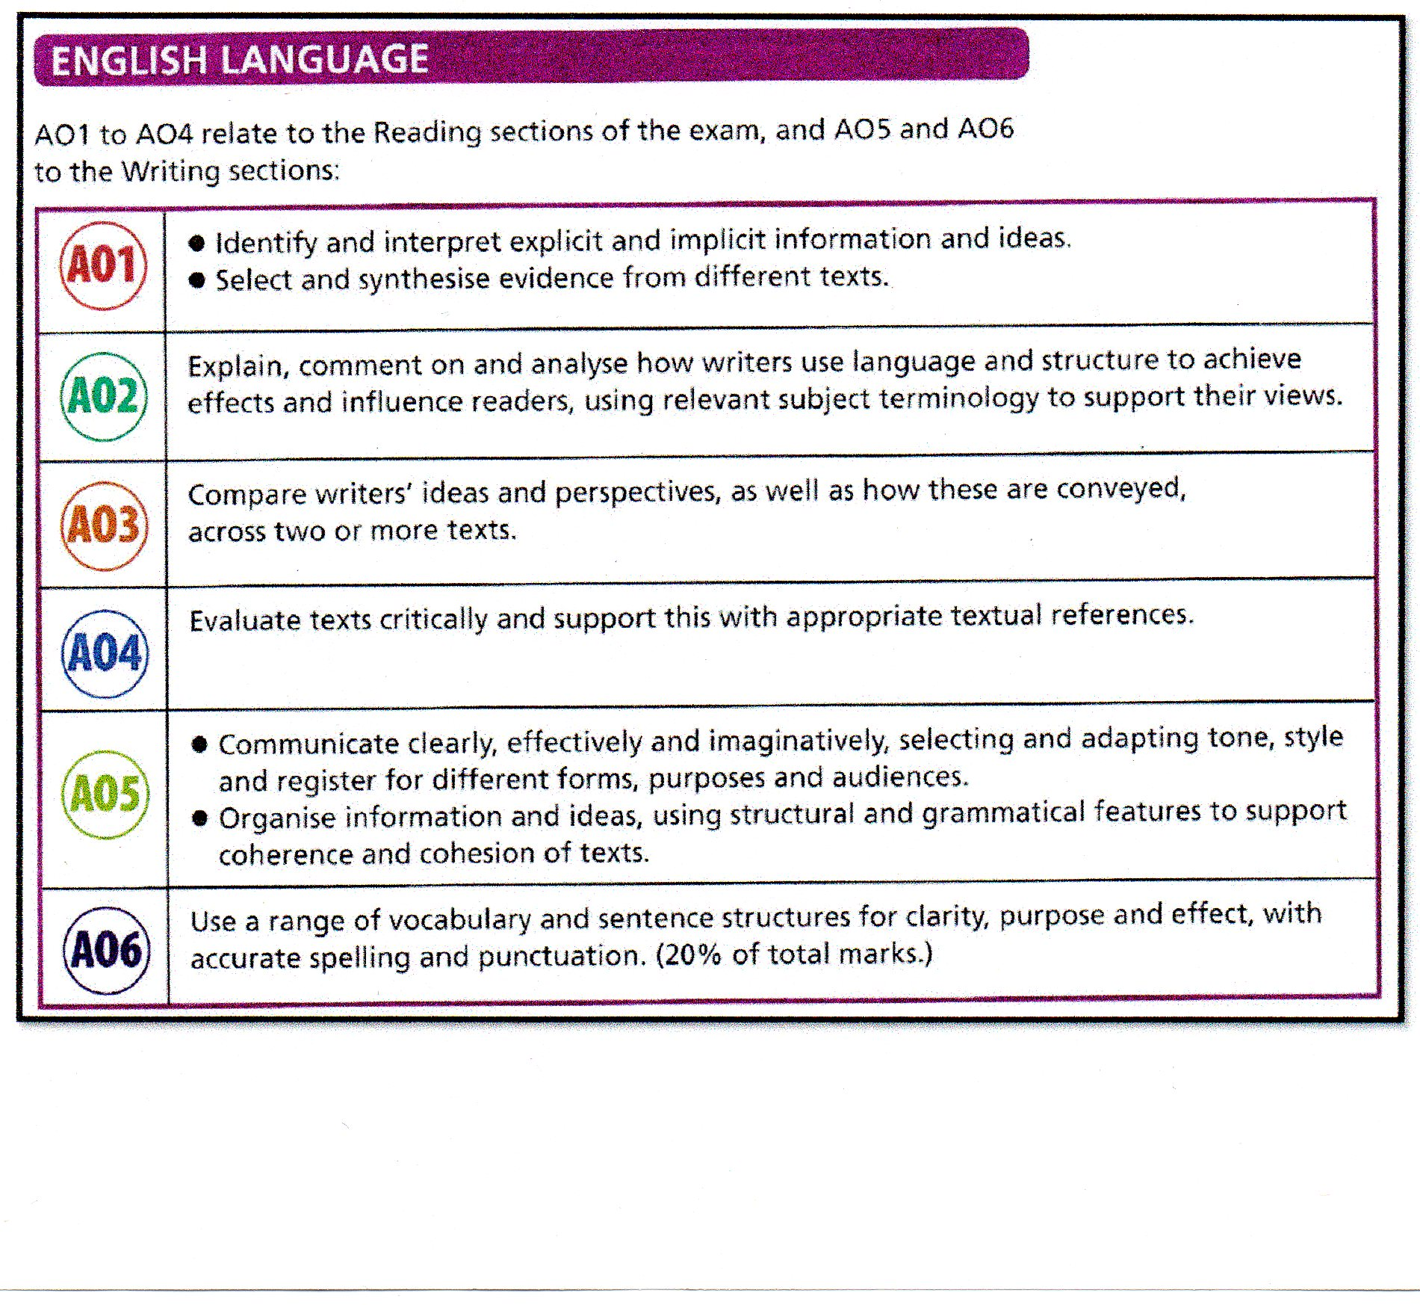

Slide 13
































Slide 14
A business perspective

Slide 15
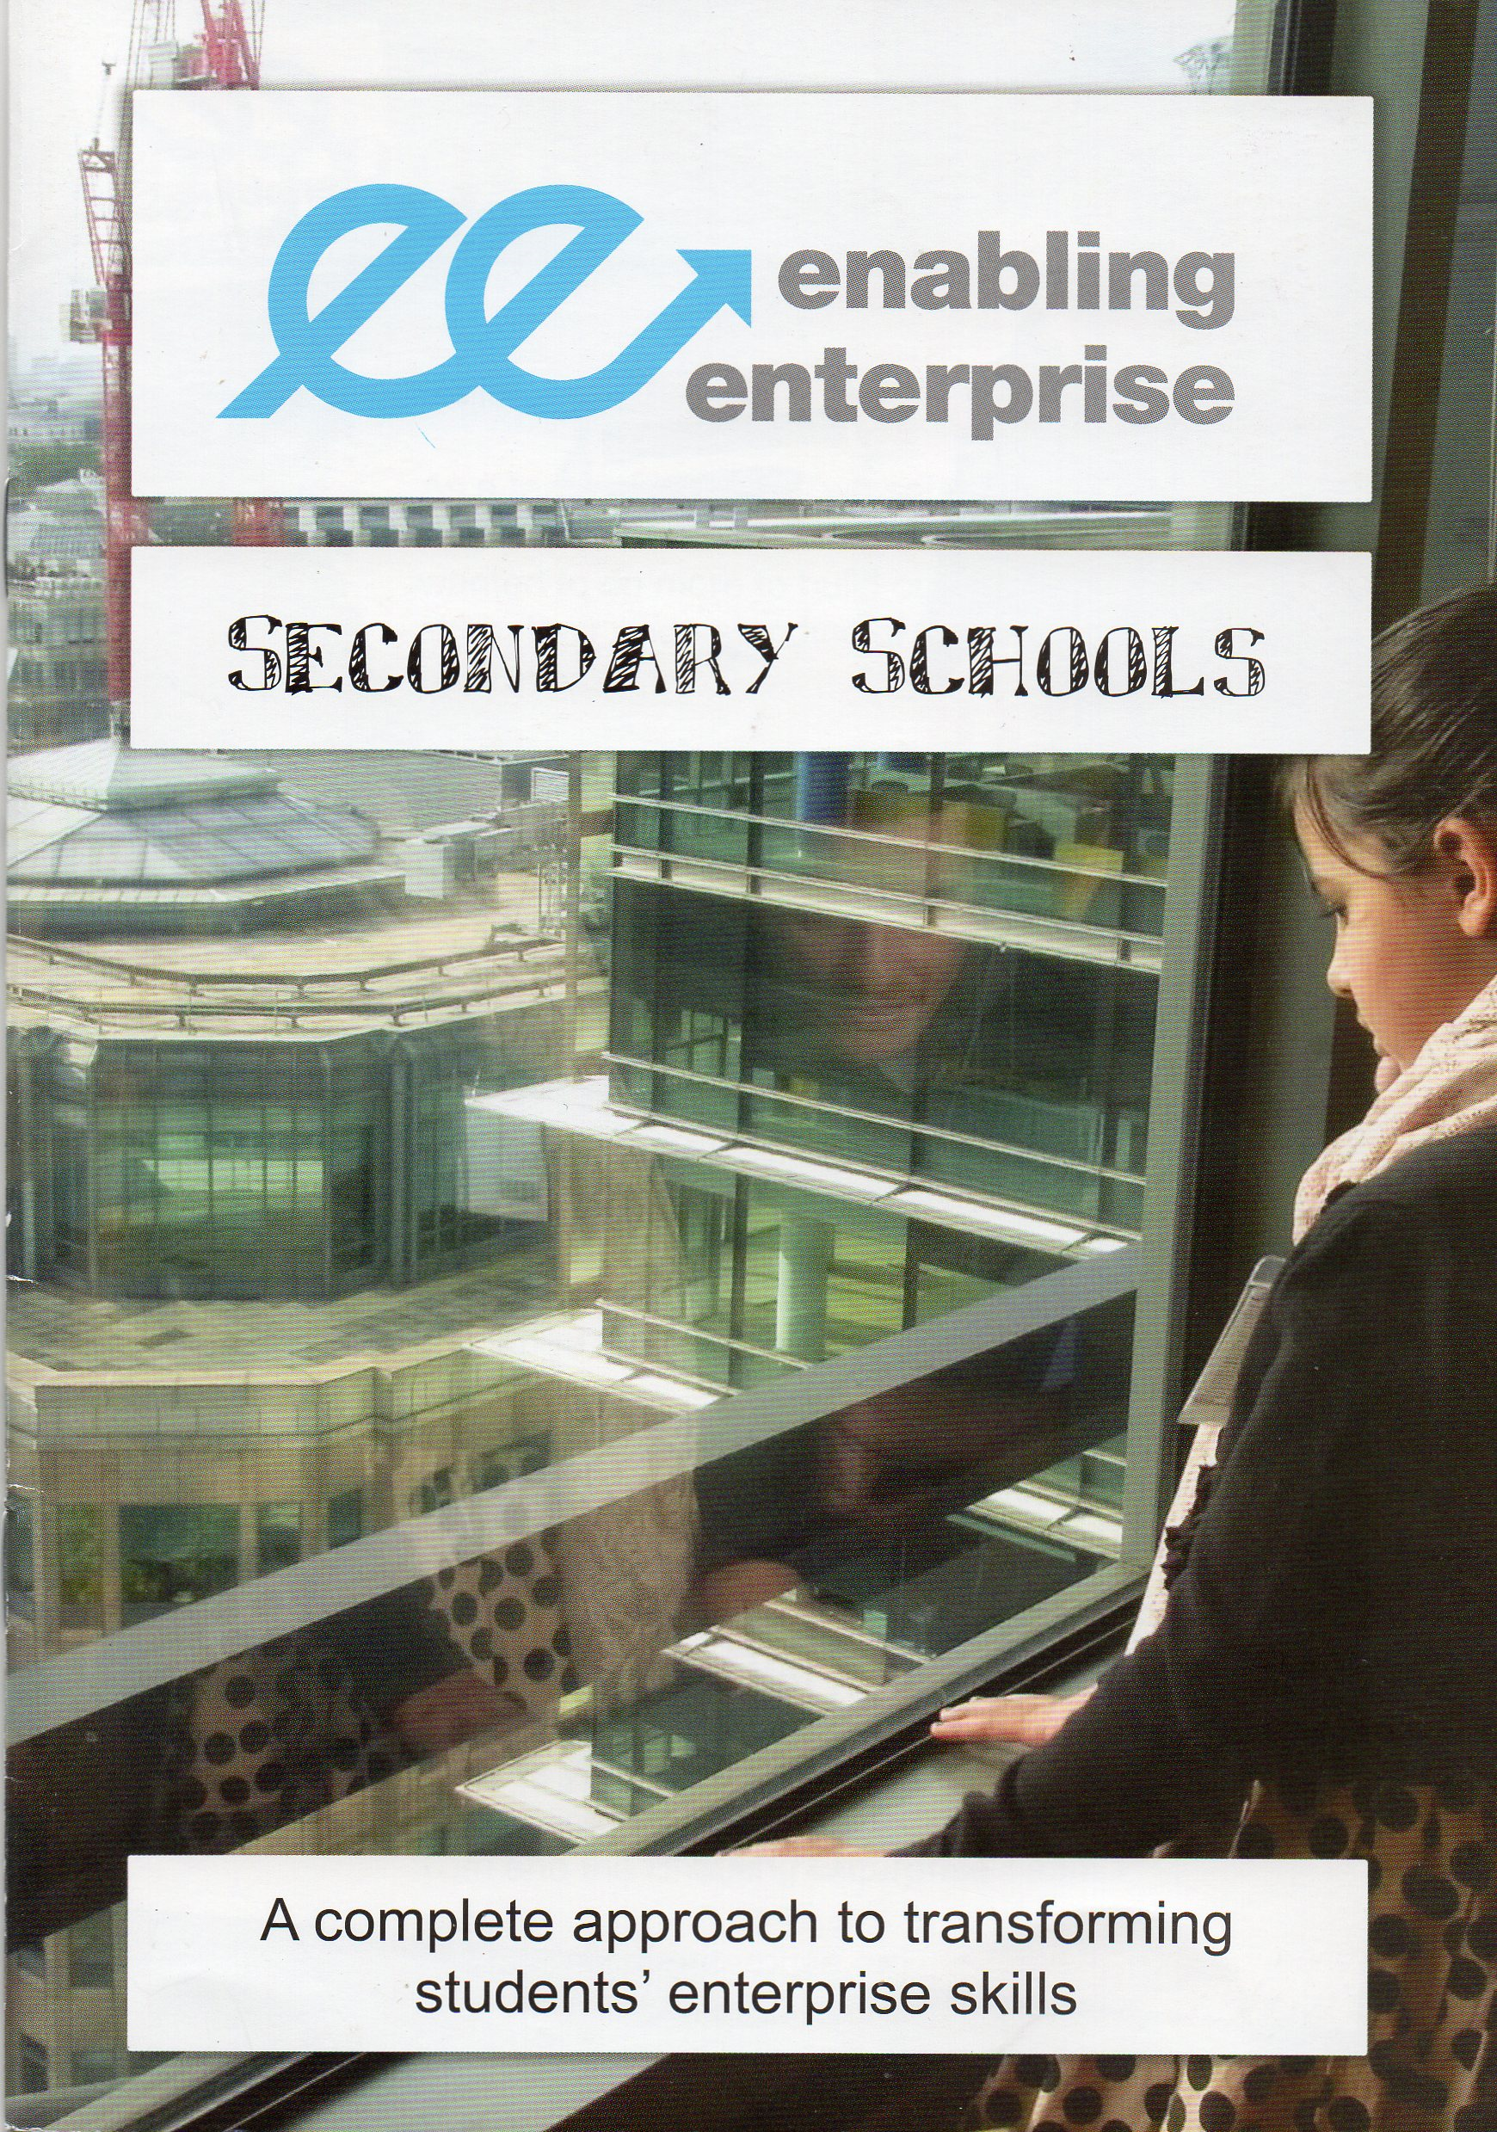

Slide 16
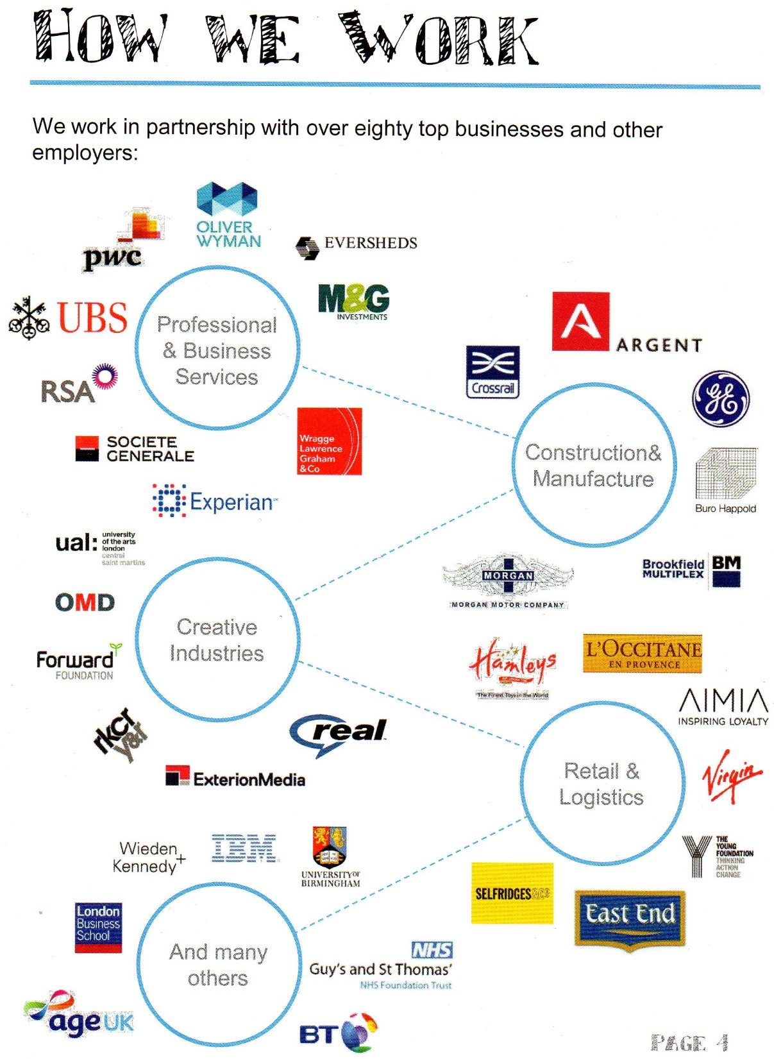

Slide 17
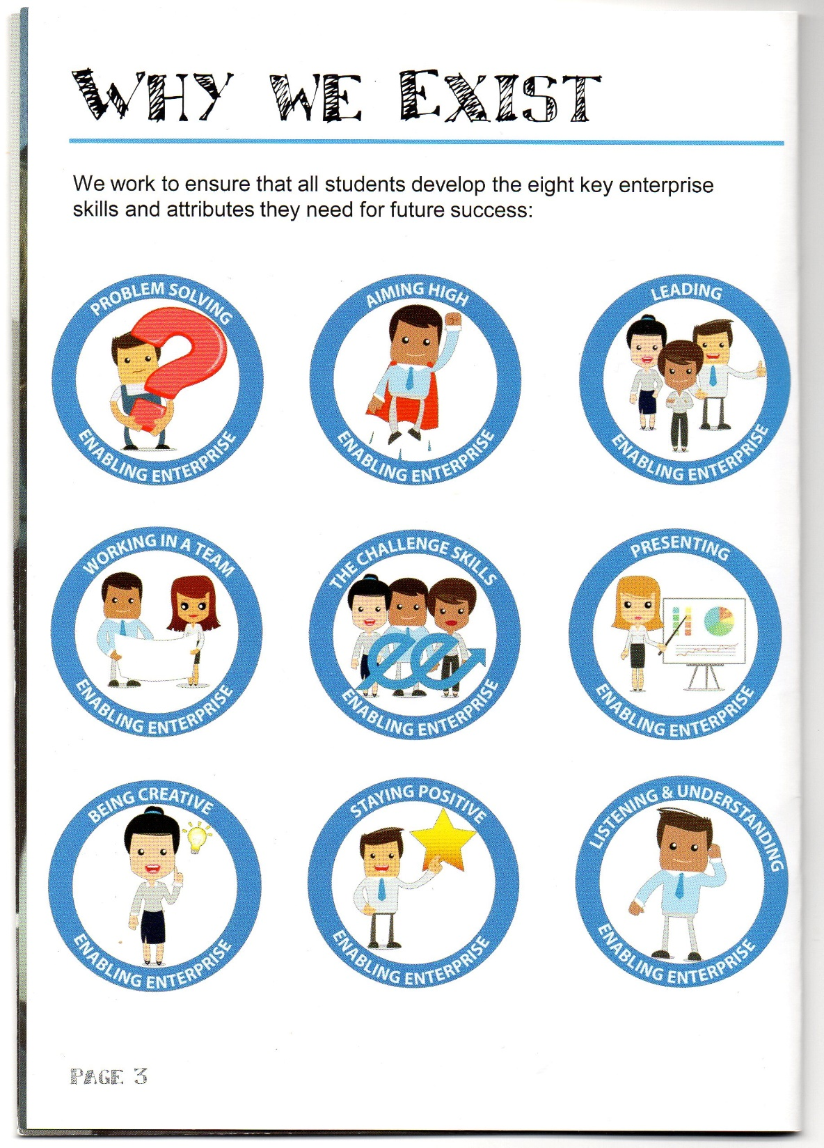

Slide 18
Problem solving
Aiming high
Leading
Working in a team
Presenting
Being creative
Staying positive
Listening & understanding

Slide 19
A charity perspective

Slide 20
What is oracy? 1
Oracy is to speaking what numeracy is to mathematics or literacy to reading and writing. It’s nothing more than being able to express yourself well. It’s about having the vocabulary to say what you want to say and the ability to structure your thoughts so that they make sense to others.
English Speaking Union https://www.esu.org

Slide 21
What is oracy? 2
With employers now rating communication skills as their highest priority, above even qualifications, the ability to express ideas is more important than ever before. Yet oracy receives much less attention in the school curriculum than literacy and numeracy. Indeed, a recent study estimated pupils contributed on average just four words per lesson, while another revealed that children with good communication skills are four times more likely to get five A*-Cs at GCSE.
English Speaking Union https://www.esu.org

Slide 22
A research perspective

Slide 23
Oracy as process | Oracy as product
Focus on importance of teamwork Group work as the major interaction pattern Focus on content of presentation Input on interview techniques Opportunities for asking questions to the teacher Adapted from Heron, M. (2019) Making the case for oracy skills in higher education: practices and opportunities Journal of University Teaching and Learning Practice. | Focus on soft skills needed for the business world Reference to the statistics on top soft skills required by employers Input on professionalism, professional image Rubrics which identify sub-skills for speaking Opportunities for mini-presentations Videos demonstrating strong presentation skills Use of terms such as speaking skills, presentation skills, rubrics, professionalism, soft skills, employability Use of role-plays

Slide 24
The cyclical nature of knowledge production and dissemination
Carrying out new research →
presenting the research at academic conferences →
writing up the research for primary sources,
e.g. academic journals →
delivering the content of the research through institutional lectures →
introducing the content into seminars →
disseminating aspects of the research through other media, e.g. webcasts, videos, MOOCs (massive open online courses) →
incorporating selected content into secondary sources, e.g. textbooks →
synthesizing material from previous sources (journals, textbooks) into new lectures
Source: de Chazal, E. 2014. English for Academic Purposes. Oxford: Oxford University Press (p.218)

Slide 25
The cyclical nature of knowledge production and dissemination
Carrying out new research →
presenting the research at academic conferences →
writing up the research for primary sources,
e.g. academic journals →
delivering the content of the research through institutional lectures →
introducing the content into seminars →
disseminating aspects of the research through other media, e.g. webcasts, videos, MOOCs (massive open online courses) →
incorporating selected content into secondary sources, e.g. textbooks →
synthesizing material from previous sources (journals, textbooks) into new lectures
Source: de Chazal, E. 2014. English for Academic Purposes. Oxford: Oxford University Press (p.218)

Slide 26
A publisher’s perspective

Slide 27
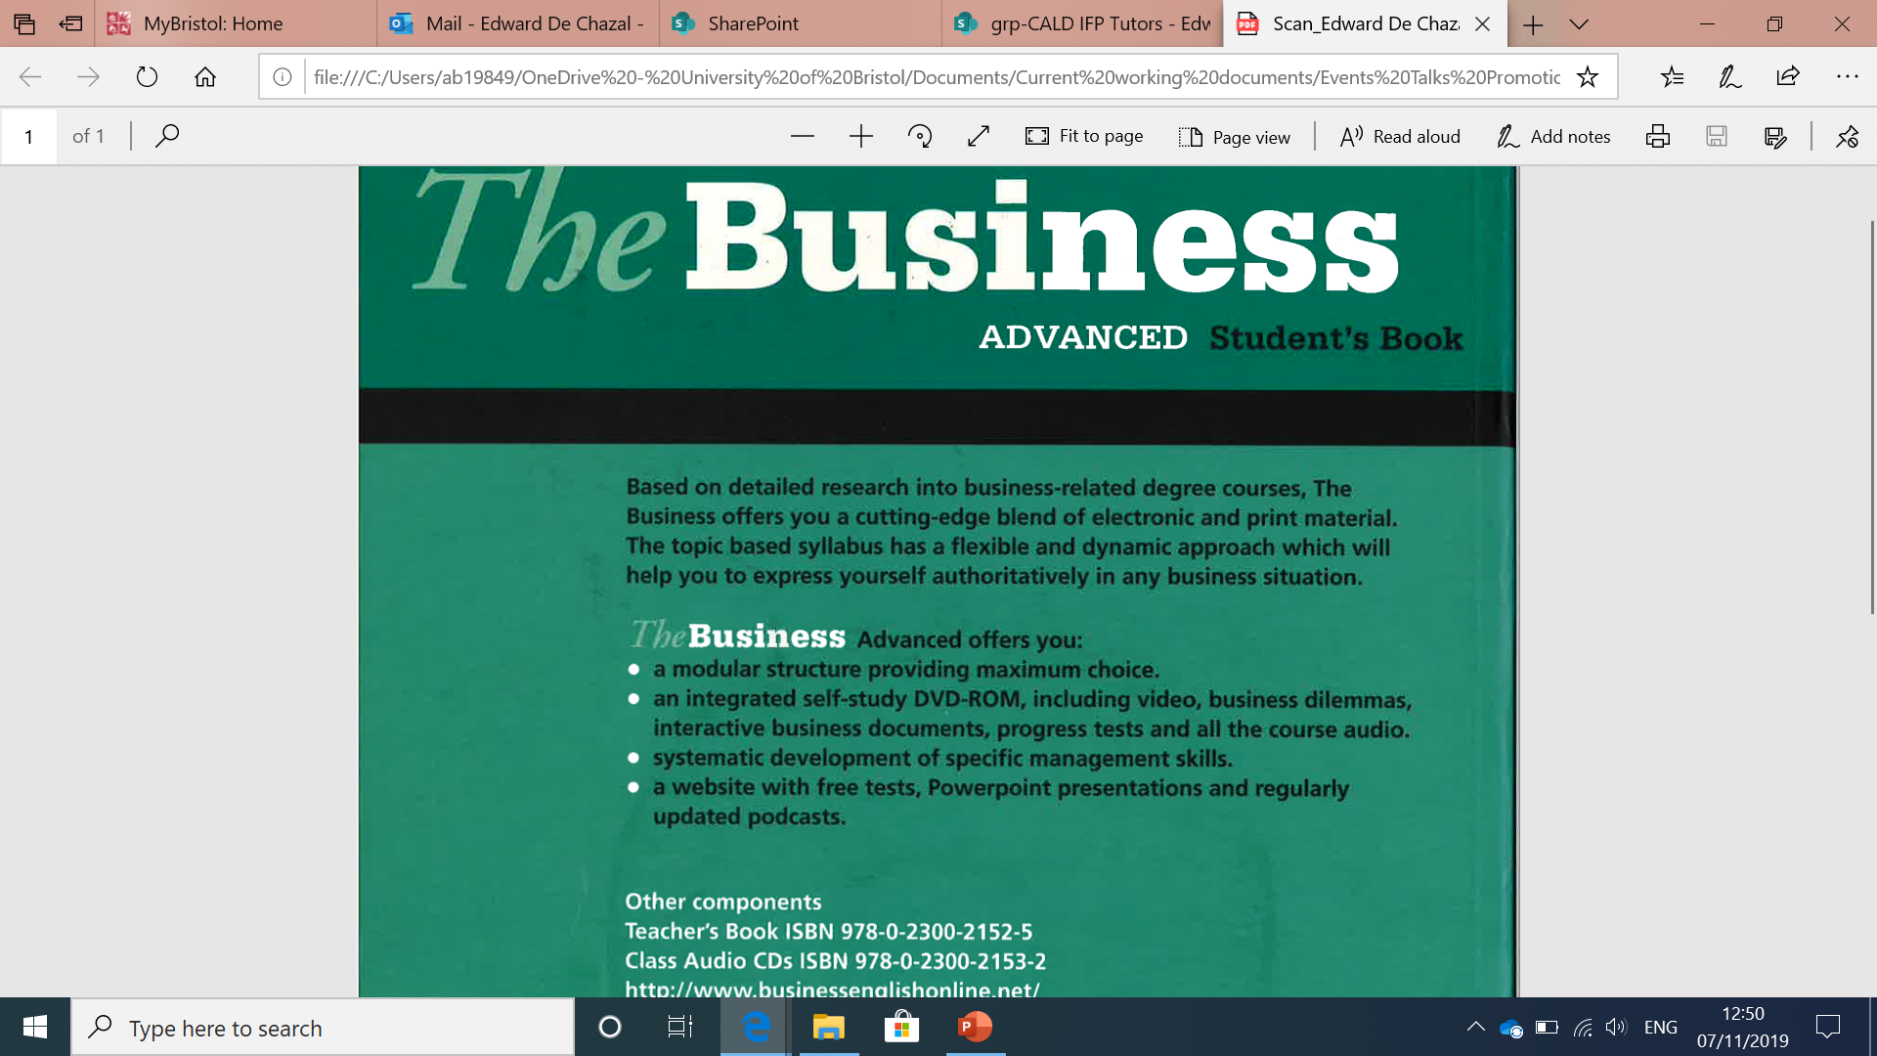

Slide 29
Allison, J., R. Appleby & E. de Chazal. 2009.The Business Advanced Student’s Book. Oxford: Macmillan Education.

Slide 30
An international perspective

Slide 31
Tertiary education plays an important role in lifelong learning: more than three in four 30-39 year-olds in education attend a tertiary programme, on average across OECD countries.
OECD (2019). Education at a Glance 2019: OECD Indicators, OECD Publishing, Paris

Slide 32
The demand for higher-order skills and competencies is both economic and social. The employment rate of adults with a tertiary degree is about 9 percentage points higher than for those with upper secondary education only, and they earn on average 57% more. Tertiary-educated adults are also more likely to be in good health, take care of the environment, or participate in public life.
OECD (2019). Education at a Glance 2019: OECD Indicators, OECD Publishing, Paris

Slide 33
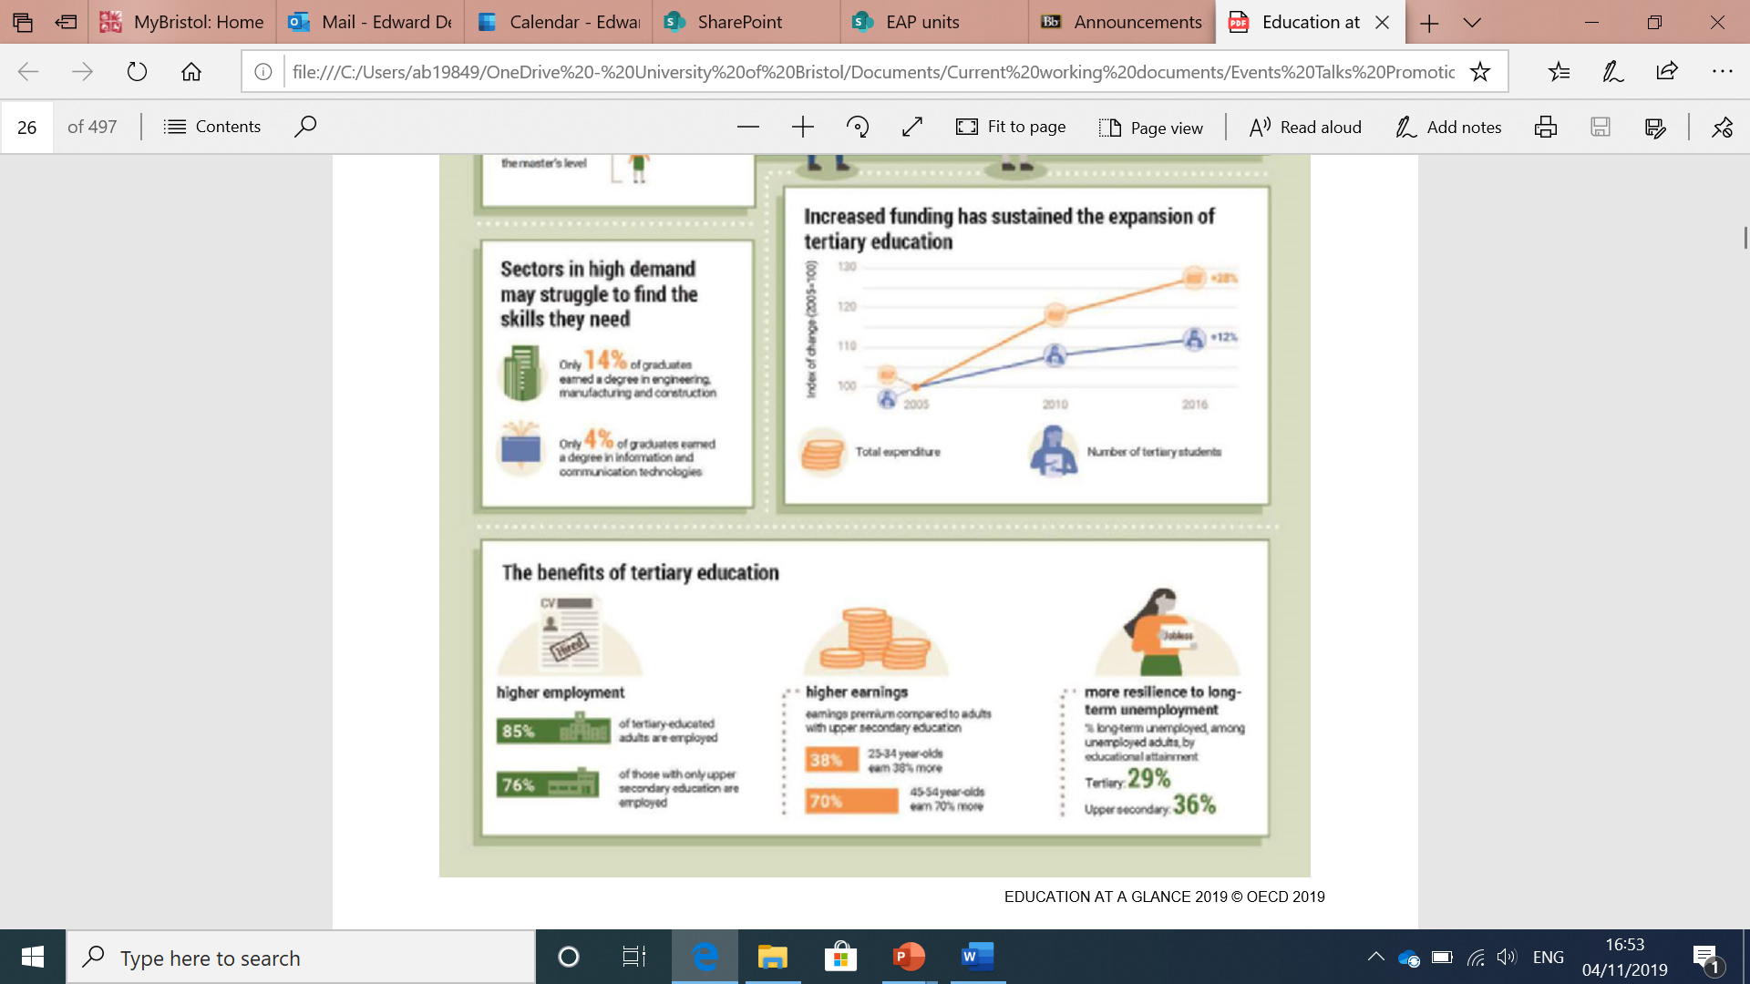

Slide 34
A government perspective

Slide 35
[Background: growing concern over “grade inflation” in UK universities]
Universities are failing to adequately train graduates or provide a fair assessment of their capacities to employers.
Students receiving first-class degrees will be required to demonstrate “exceptional” knowledge and evaluation skills. They should also be able to communicate ideas and solutions “to an accomplished level verbally, electronically and in writing.”
Students achieving a bachelor’s degree with honours should typically demonstrate knowledge and understanding: cognitive, practical and transferable skills; and professional competences where relevant.
[Quotations from UK Standing Committee for Quality Assessment, a coalition of higher education institutions]
Jack, A. (2019, October 10). Universities agree more openness on degree marking guidelines. Financial Times.

Slide 36
[Background: growing concern over “grade inflation” in UK universities]
Universities are failing to adequately train graduates or provide a fair assessment of their capacities to employers.
Students receiving first-class degrees will be required to demonstrate “exceptional” knowledge and evaluation skills. They should also be able to communicate ideas and solutions “to an accomplished level verbally, electronically and in writing.”
Students achieving a bachelor’s degree with honours should typically demonstrate knowledge and understanding: cognitive, practical and transferable skills; and professional competences where relevant.
[Quotations from UK Standing Committee for Quality Assessment, a coalition of higher education institutions]
Jack, A. (2019, October 10). Universities agree more openness on degree marking guidelines. Financial Times.

Slide 37
A university perspective

Slide 38
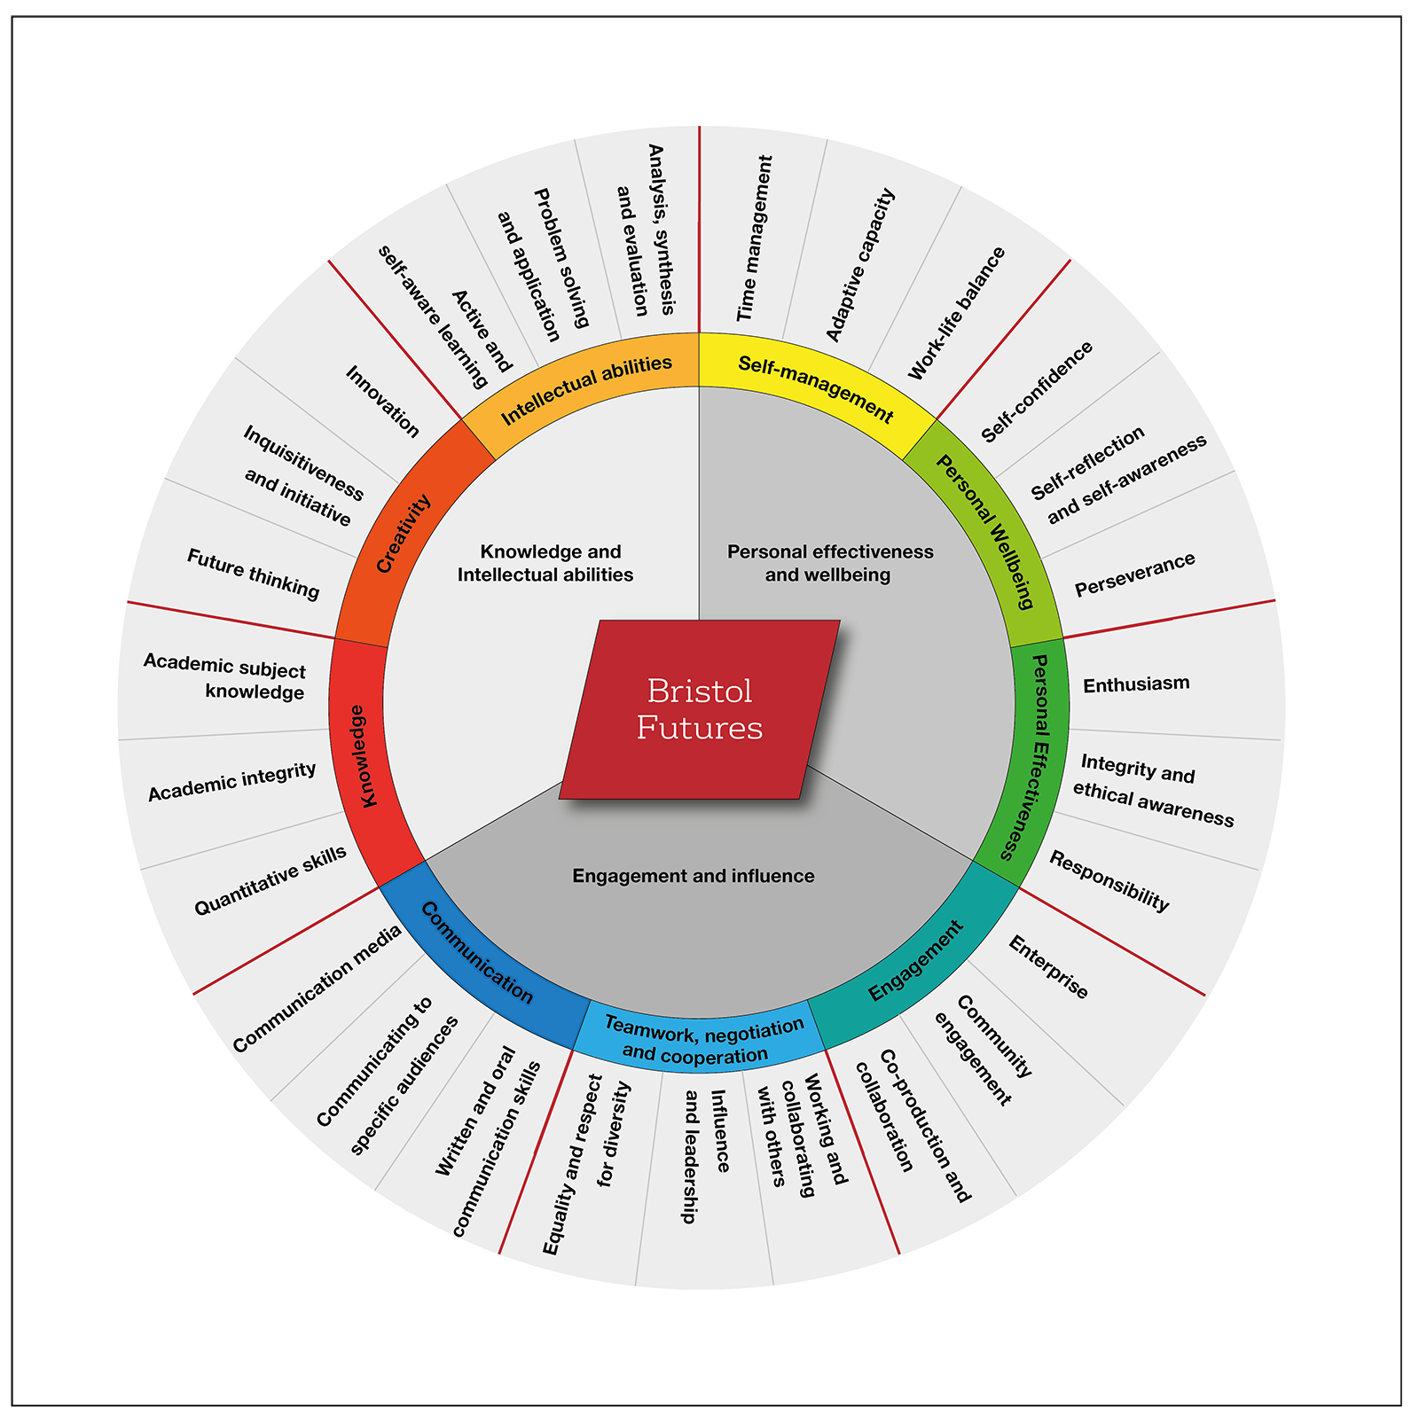

Slide 39
Bristol Futures Bristol Skills Framework. http://www.bristol.ac.uk/

Slide 40
An EAP teacher’s perspective

Slide 41
A student perspective

Slide 42
“Some universities – like Bristol – focus on academic. That’s good if you want to do research. That’s not my style. Others focus on jobs and professions, and they have work internships.”
EdeC current Chinese student, now looking at UAL

Slide 43
EAP² Principles

Slide 44
EAP² Principles
1 Oracy 6 Criticality
2 Persuasion 7 Rationalization
3 Disruption 8 Individual
4 Responsibility 9 Creativity
5 Transferability 10 Reflection

Slide 45
1: Oracy
Skills and communication
Build in oracy / presentation skills in all skills areas, including writing lessons
Focus on fluency and interaction, e.g. students have to negotiate approaches to a task
Summary
Add oral summaries to the curriculum, e.g. 3MT: Three-minute thesis (University of Bristol); One-minute summaries, e.g. of student’s current writing task

Slide 46
2: Persuasion
Genres
Emphasize the persuasive nature of many academic and professional genres
Evidence-based
Build tasks where students always have to offer evidence, which is based on critically-evaluated sources

Slide 47
3: Disruption
Task disruption
Amend parameters during the process of a task, e.g. shorten a presentation at late notice; bring in outsiders to a presentation audience
Interrupt students during spoken and written tasks
Adaptation
Develop tasks where students learn to recognize and meet changing requirements

Slide 48
4: Responsibility
Genre – Audience – Purpose (GAP)
Devise tasks where students learn to recognize and analyse the key features of a genre – including unencountered genres – and produce these
Planning and target-setting
Require students to operate a constantly-developing document expressing their academic and professional targets; interact with this

Slide 49
5: Transferability
Language skills, cognitive skills, study practices
Constantly elicit and emphasize how the skills students are studying in the current lesson can be transferred to both academic and professional contexts
Language
Provide – or ask students to source – examples of the target language (e.g. noun phrases) in both academic and professional texts

Slide 50
6: Criticality
Making and justifying connections
Ask students to work out, explain and justify the connections between A – B – C (and D) – an essential academic and professional critical skill
Task analysis
Broaden tasks so that students learn how to approach a question / rubric / instruction in both academic and professional contexts

Slide 51
7: Rationalization
Tasks and assessments
Be prepared to fully and clearly rationalize all the tasks and assessments your students do no rationale? no task!
Ask students rationalize their work
Start with ‘Why’ (Sinek)
Put the why before the what, thereby creating a gap for students

Slide 52
8: Individual
Personal brand (Simon Barrie, Western Sydney University)
Recognize that many students are building their personal brand, e.g. OH²: integrate this idea into the teaching materials
Stance and voice
Enable and reward students for positioning themselves at the heart of their spoken and written texts – appropriate for many genres in academic and professional contexts

Slide 53
9: Creativity
Originality
Emphasize that students are aiming for originality – academic originality as a prerequisite for the highest grades now/next academic year, and professional originality in the future
Unkeyability
Opt for unkeyable tasks rather than tasks with unambiguous answer keys, thereby unleashing students’ creativity

Slide 54
10: Reflection
Learning as a lifelong pursuit
Provide evidence for students to see that their learning tasks are partial, not complete, learning experiences
Integrated reflection
Build reflection into the curriculum → syllabus → materials: people need to reflect on their learning and performance in a task in both academic and professional contexts

Slide 55


Slide 56
The Big Picture
Painting by Martha de Chazal

Slide 57
Conclusions
Higher order skills are not only the domain of academic contexts; such skills are also integral to the professions, who indeed demand them, leading to a significant overlap
EAP is uniquely placed – as a revenue-generator in the UK and global university structure – to meet students’ academic and professional needs
We need to listen to other perspectives, above all our students

Slide 58
References
Allison, J., R. Appleby & E. de Chazal. (2009).The Business Advanced Student’s Book. Oxford: Macmillan Education.
AQA. n.d. English Literature Scheme of Assessment. Retrieved from: https://www.aqa.org.uk/
University of Bristol n.d. Bristol Futures. Retrieved from: https://www.ole.bris.ac.uk/
de Chazal, E. (2014). English for Academic Purposes (Oxford Handbooks for Language Teachers). Oxford: Oxford University Press.
Enabling Enterprise. n.d. Secondary Schools: a complete approach to transforming students’ enterprise skills. Retrieved from: www.enablingenterprise.org/
English Speaking Union n.d. What is oracy? Retrieved from: https://www.esu.org/oracy/
Heron, M. (2019). Making the case for oracy skills in higher education: practices and opportunities Journal of University Teaching and Learning Practice. 16(2), 2019.
Jack, A. (2019, October 10). Universities agree more openness on degree marking guidelines. Financial Times. Retrieved from https://www.ft.com/
Jackson, D. (2014). Business graduate performance in oral communication skills and strategies for improvement. The International Journal of Management Education, 12(1), pp. 22-34.
Johns, A. & M.A. Snow. (2006). Introduction to special issue: Academic English in secondary schools (Editorial). Journal of English for Academic Purposes 5/4: 251.
OECD (2019). Education at a Glance 2019: OECD Indicators, OECD Publishing, Paris, https://doi.org/10.1787/f8d7880d-en
Swales, J. (1985). Episodes in ESP. Oxford: Pergamon Press.

