Slide 1
Keep, chuck or change?
Adapting Presessional CPD Provision in a Challenging Environment
BALEAP PIM: The Future of EAP Saturday 9 November 2019
Dave Watton & Jane Sjoberg
Birmingham International Academy
University of Birmingham

Slide 2
Workshop outline
Our challenges
Your challenges
Our interventions
Applicability to your context
Notes:
Three main parts to the presentation

Slide 3
Birmingham International Academy:
Challenges in our Context

Slide 4
Programme-related
Diverse presessional programmes: PG EAP, PG BME & UG
Variable entry points: 20-, 15-, 10-, 6-, 4-week courses
Language support programme (some PT staff)

Slide 5
Logistical
Remote working across campus
A/B timetables
Intensive courses: High teaching, assessment & administrative load
Scheduling CPD events

Slide 6
Growth
50% increase in student numbers:
  Summer 2017 ≈ 1200
  Summer 2019 ≈ 1800
Parallel increase in teacher numbers
  2017 ≈ 100
  2019 ≈ 160+

Slide 7

Teacher Experience
Diverse knowledge, skills, backgrounds
British Council Recruitment Restrictions
TEFLQ-qualified teachers with limited EAP
EAP (Masters+ qualified) but no CELTA
Returning /new teachers
Self-Directed
Directed

Slide 8



Teacher engagement

Slide 9


Your challenges
What challenges does your institution face to ensure teacher access to training & developmental opportunities on presessional programmes?
www.popin.live ps5m3c

Slide 10
Birmingham International Academy:
Interventions

Slide 11
Keep
Bringing people/resources together
‘One-stop shop’ VLE course
Initial CPD induction & training
Weekly teacher development workshops
CPD conference

Slide 12
Keep
Bringing people/resources together
‘One-stop shop’ VLE course
Initial CPD induction & training
Weekly teacher development workshops
CPD conference

Slide 13
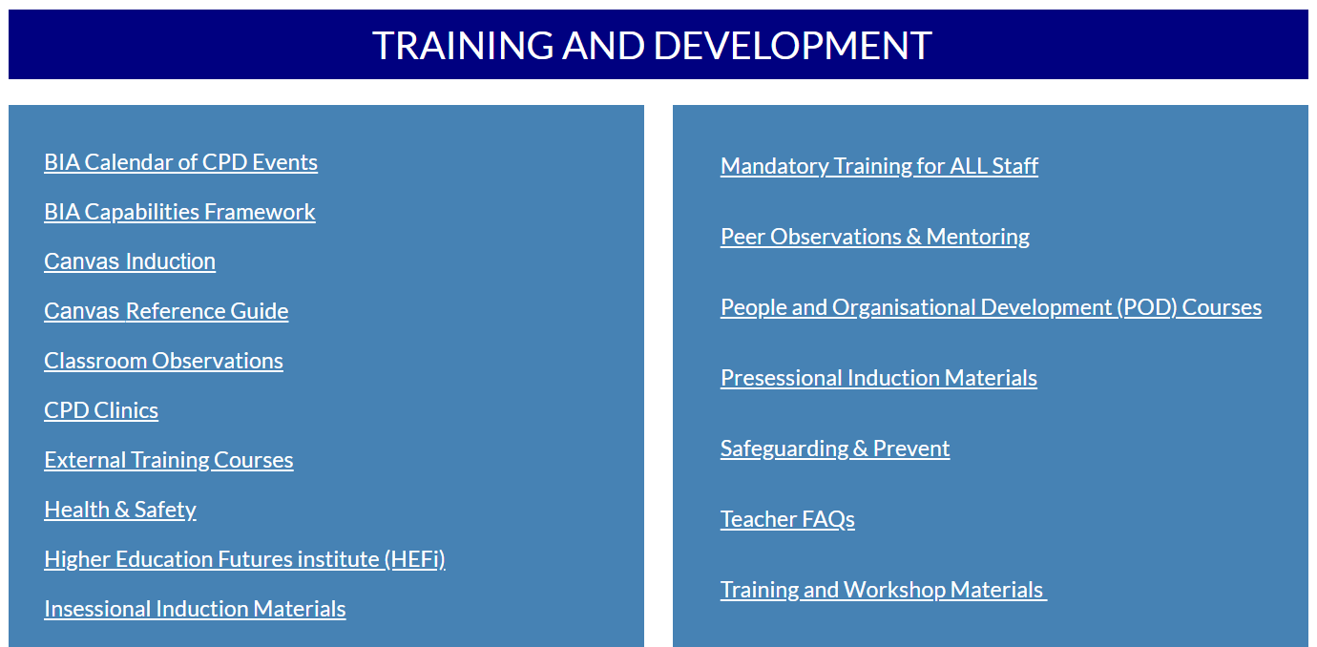

Slide 14



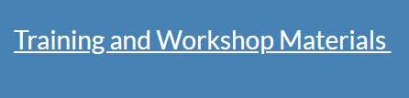

Slide 15
Keep
Bringing people/resources together
‘One-stop shop’ VLE course
Initial CPD induction & training
Weekly teacher development workshops
CPD conference

Slide 16
Keep
Bringing people/resources together
‘One-stop shop’ VLE course
Initial CPD induction & training
Weekly teacher development workshops
CPD conference

Slide 17
Keep
Bringing people/resources together
‘One-stop shop’ VLE course
Initial CPD induction & training
Weekly teacher development workshops
CPD conference

Slide 18
Chuck
Limited take-up & impact
Reading / Writing groups

Slide 19

Chuck
Limited take-up & impact
Reading / Writing groups
Next to go…?
‘Snapshot’ videos?
Mentoring?

Slide 20
Change
Needs-based and reflective
BIA Capabilities Framework
Themed, differentiated workshops
1-1 CPD clinics
CPD Portfolio project (aligned with HEA Fellowship)
A developmental approach to observation
Notes:
Show Capabilities framework front page and workshop schedule

Slide 21
Change
Needs-based and reflective
BIA Capabilities Framework
Themed, differentiated workshops
1-1 CPD clinics
CPD Portfolio project (aligned with HEA Fellowship)
A developmental approach to observation
Notes:
Show Capabilities framework front page and workshop schedule

Slide 22
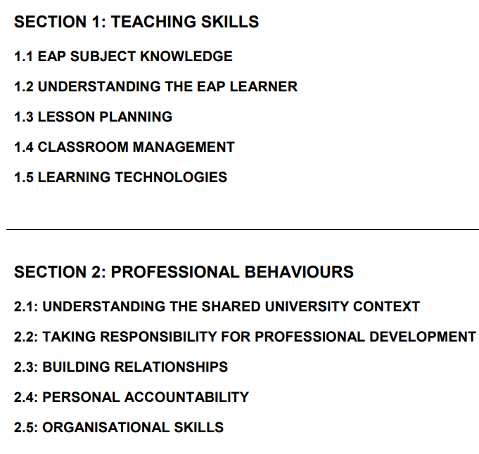

Slide 23
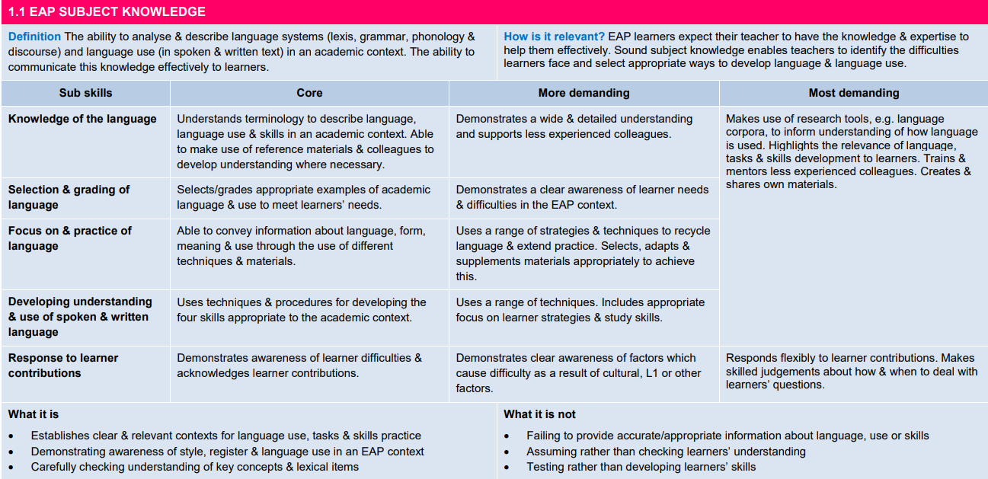

Slide 24
Change
Needs-based and reflective
BIA Capabilities Framework
Themed, differentiated workshops
1-1 CPD clinics
CPD Portfolio project (aligned with HEA Fellowship)
A developmental approach to observation

Slide 25


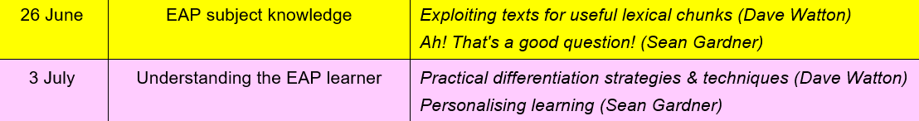

Slide 26
Change
Needs-based and reflective
BIA Capabilities Framework
Themed, differentiated workshops
1-1 CPD clinics
CPD Portfolio project (aligned with HEA Fellowship)
A developmental approach to observation

Slide 27
Change
Needs-based and reflective
BIA Capabilities Framework
Themed, differentiated workshops
1-1 CPD clinics
CPD Portfolio project (aligned with HEA Fellowship)
A developmental approach to observation
Notes:
Reflective writing: What? So what? Now what? (BIA awarded small number of bursaries towards the cost of gaining Fellowship)

Slide 28
Change
Needs-based and reflective
BIA Capabilities Framework
Themed, differentiated workshops
1-1 CPD clinics
CPD Portfolio project (aligned with HEA Fellowship)
A developmental approach to observation

Slide 29
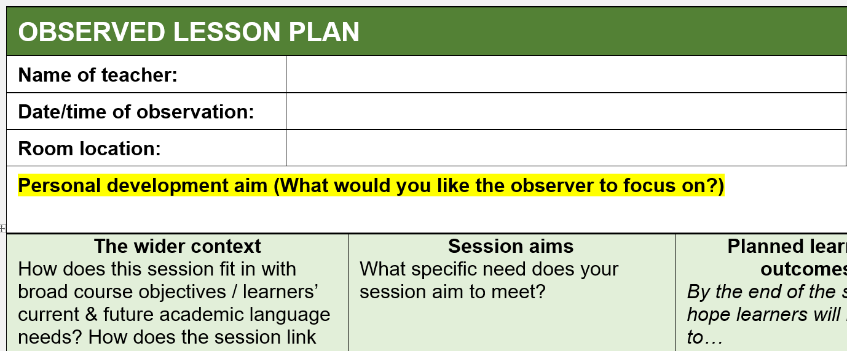

Slide 30

You & your context
How applicable is what we did in your own context(s)? Which (of our interventions) would you keep, chuck or change?
www.popin.live sh4pmp

Slide 31
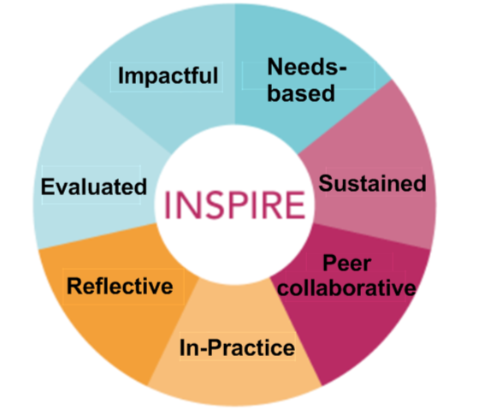
Where we want to improve
Richardson, S. and Diaz Maggioli G. (2018) Effective professional development: Principles and best practice.
More tailoring for very diverse needs
Evaluating impact on T & L

Slide 32
References
Myers, M., & Clark, S. (2002). CPD, lifelong learning and going meta. In J. Edge (Ed.), Continuing professional development: Some of our perspectives (pp. 50–62). Whitstable, Kent: IATEFL.
Richardson, S. and Diaz Maggioli G. (2018) Effective professional development: Principles and best practice. Cambridge Papers in ELT, Cambridge CUP

