Slide 1
Covering all the bases: designing assessments for a bespoke pre-sessional programme
Liz MacDougall
Senior Language and Learning Development Advisor, Abertay University

Slide 2
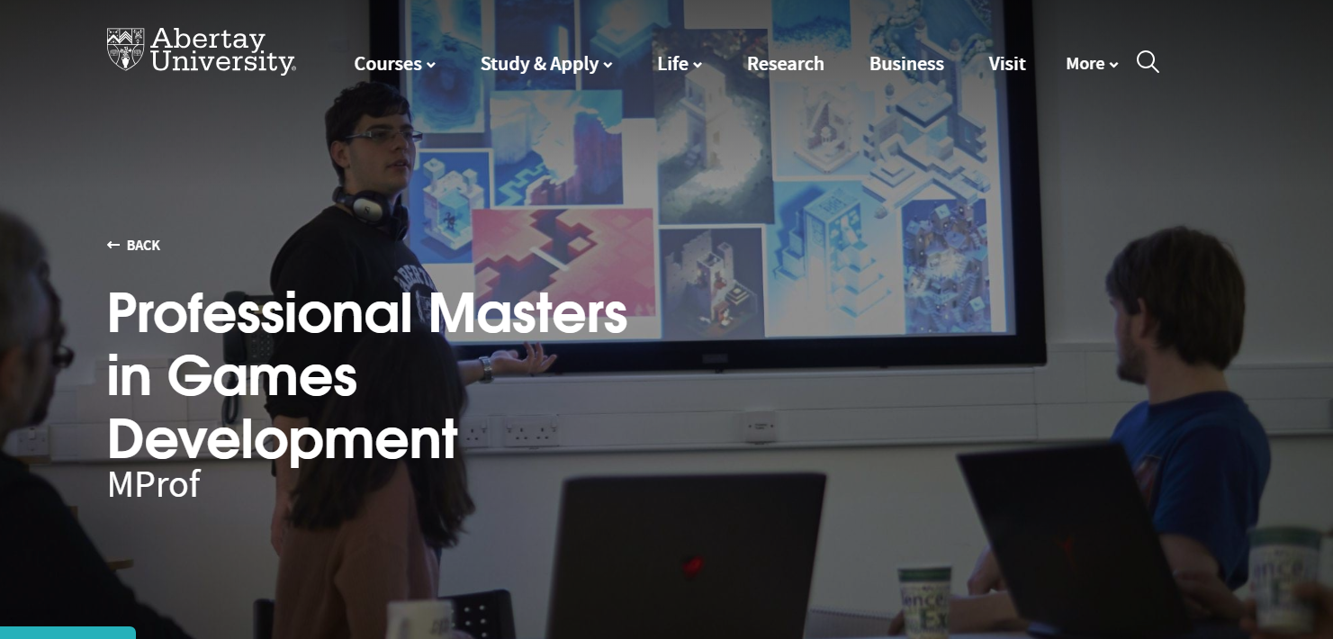



Notes:
MPPOP – a partnership between Abertay University and Perfect World, China’s third-largest media company
Abertay is the only European institution to feature in the Princeton Review’s top 20 unis for games courses
Course designed to prepare Chinese students for very specific demands of the MProf in Games Development, taught at Abertay

Slide 3
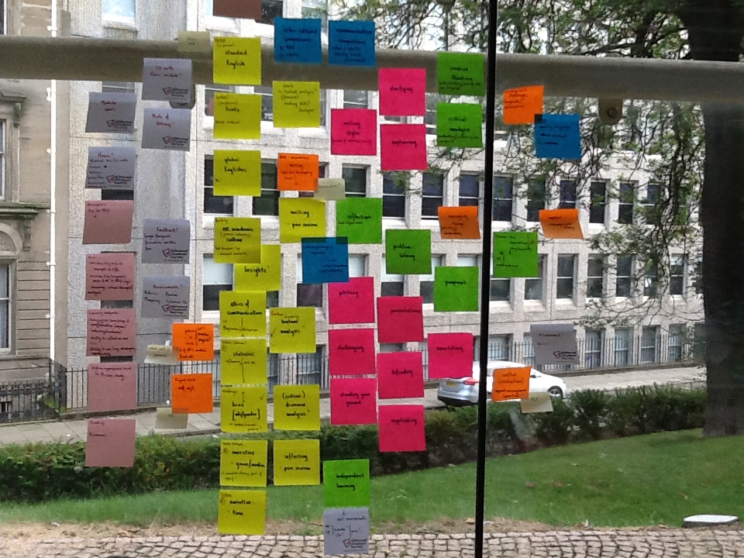
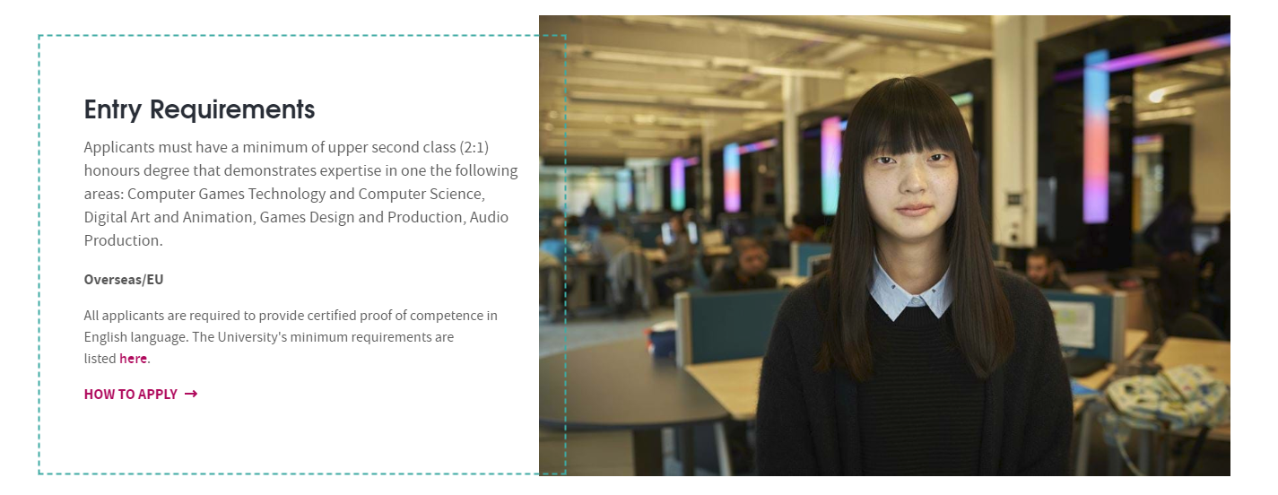
The Masters in Professional Practice Orientation Programme (MPPOP)
The initial planning process! (August 2016)
Lili, one of our first MPPOP students (and currently featured on our website)

Slide 4

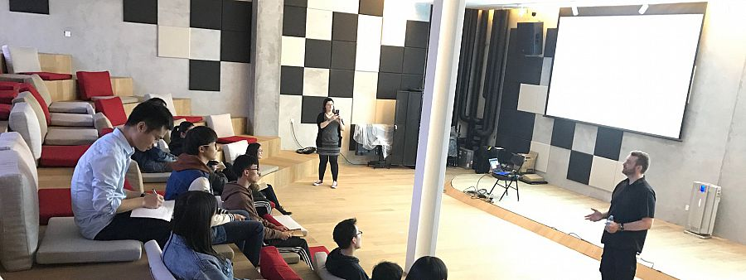

Teaching at Pixseed, Perfect World’s digital arts school in Beijing
The MProf area in the Centre for Excellence at Abertay

Slide 5
Aligning the assessments – considerations
Our students need to be able to demonstrate that they are prepared for postgraduate study in the UK
Can they
work independently
construct arguments using sources and research
present information coherently and appropriately?
Notes:
DES503: Game Design as Culture and Business – analyses games from a range of standpoints, requires students to write a 3000 word essay

Slide 6
They also need to be able to demonstrate that they are prepared for the requirements of the Mprof
collaborative working in multi-national, multi-cultural groups
a high level of cultural as well as linguistic competence
not enough to be a great artist or coder!
Notes:
DES504: Professional Game Design in Context – group projects. What’s produced is less important than the journey taken to get there. Grades are assigned by peers as well as tutors

Slide 7
Other criteria specific to the MProf:
professional behaviours
willingness and ability to respond to constructive criticism (from tutors and peers)
ability to reflect on their own development
Challenging for all students but particularly the Chinese cohort
Notes:
Must be able to demonstrate value to team; must be able to respond to feedback in a positive and constructive way. Cultural issues – eg arriving late, long lunchbreaks, sitting with other Chinese students because it’s more “comfortable”
Very few students have been outside China – many have almost no experience of interacting with non-Chinese English speakers

Slide 8
Finally, they must meet the UKVI English language requirements as
the MPPOP replaces IELTS
the MProf requirements are too specific for an off-the-shelf test to be of much use
our focus is on the skills required for the MProf, not on teaching to a test

Slide 9
Assessments
4 separate assessments – integrated skills
All allow for a degree of preparation in advance (and some require it!)
Designed to reflect skills required/tasks set on the MProf

Slide 10
Timed Writing Assessment
4 authentic sources
Provided to students one week in advance of exam
Expected to read and annotate as required

Slide 11
In the exam:
Students are presented with an essay question
90 minutes to write a response
Must use each source at least once, with correct in-text referencing
Definitely the most challenging assessment.

Slide 12
Interview
Students are asked to
talk about their own experience in games development
reflect on what they’ve learnt on the MPPOP
discuss interesting developments in the games industry

Slide 13
Presentation
7 minutes, plus time for questions
Effectively a pitch, as we ask them to present a game – “Best Chinese game of 2018”
Following appropriate academic conventions

Slide 14
Process writing
The assessment we’ve had the most difficulty with
Should allow students to demonstrate their skills without time/exam pressure
Has taken several forms

Slide 15
Changes
2017: students chose from three questions to write a 1500 word essay
2018 - March: students were asked to reflect on their own development throughout the MPPOP
External Examiner response
One assignment, multiple drafts

Slide 16
2018 – August: Portfolio approach
Combination of assignments (e.g. reflective piece, essay, annotated bibliography)
Shorter preparation time, but more feedback
Grades from midway through the programme

Slide 17
Portfolio – 2019 version
5 pieces of 800 words, submitted at regular intervals throughout the programme
Aims to encourage students to
understand and apply a range of skills
practise a range of assignment types
understand the required standard from early in the programme

Slide 18
University requirements
The MPPOP vs the academic calendar
...and the modular structure
University regulations and commercial pressures
Communication issues
Notes:
on an activity in order to do better next time
To get into this habit!

Slide 19
Perfect World requirements
Selling a commercial product vs providing an academic programme
“Prestige programme”
Parental involvement
Student expectations and feedback
Visit in January 2019

Slide 20
Other concerns
Are we getting the balance right?
Are we setting the standard high enough?
Are we adequately preparing these students for a situation that is so different from their previous experience?

Slide 21
Response
Improved communications
Closer collaboration with Games Division staff
Data and feedback from alumni
Participation in MPPOP by alumni

Slide 22
Thank you for listening!
l.macdougall@abertay.ac.uk

