Slide 1
Human versus Machine: evaluation of the BIA’s ‘Academic Paraphrase Practice’ automated marking application.
Cathryn Overall and Richard Nickalls
Birmingham International Academy
University of Birmingham

Slide 2
Background:
To our current AYAE! Diagnostic
From a paper-based Grammar test (multiple choice) in 2009 to…

Slide 3
Assess your Academic English!
Since 2017, the AYAE has
tested short summary writing skills and re-writing skills
created quizzes for paraphrasing skills, listening skills, and proofreading
Via Canvas, students can:
review scores and feedback
have multiple attempts
access relevant self-access materials

Slide 4
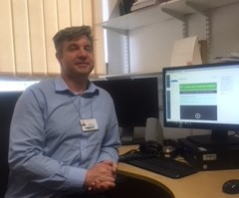
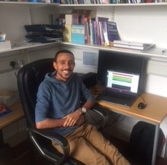
Project funding from Birmingham’s Higher Education Futures institute ( HEFi)
Rationale: Create an ‘Assess your Academic English!’ diagnostic that addresses University strategies:
Increasing outcomes for international students (nns)
Tackling Plagiarism
AMD (Alternative Modes of Delivery)
Ossama Edbali:
UoB student,
Computer scientist
Richard Nickalls
(EAP tutor and
eLearning
coordinator)

Slide 5
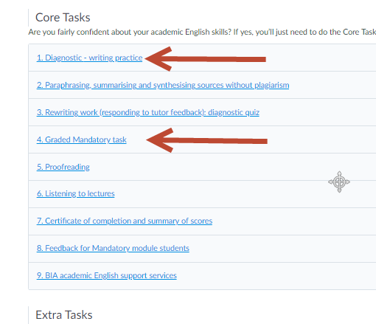
AYAE! Aims:
To develop students’ academic English
To help students diagnose their strengths and weaknesses in EAP

Slide 6
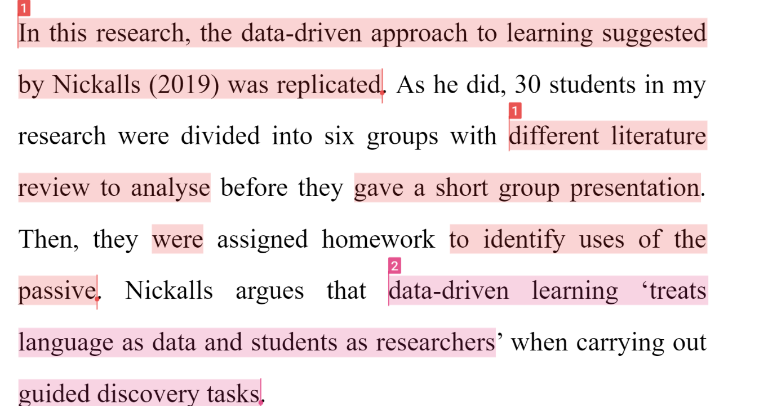
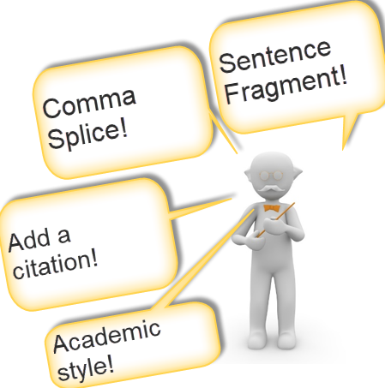
Does this sound familiar?

Slide 7
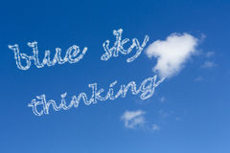
Could a writing LTi (application)...
Enhance the student experience of EAP writing feedback? For AYAE!...and transferable?
Make the diagnostic more formative?
Paraphrase/avoiding plagiarism
Criticality
Language awareness (sentence structure and grammar)
Referencing skills
Academic style
Allow for efficiencies in marking?

Slide 8
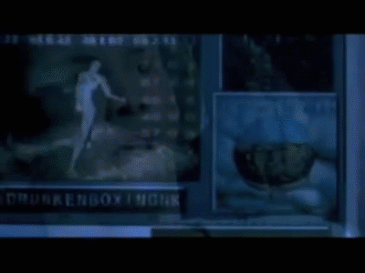
What ‘the Matrix’ predicted in eLearning

Slide 9
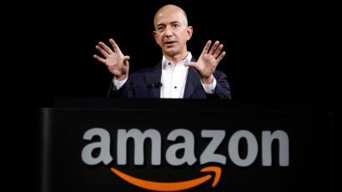
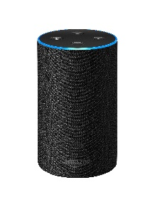
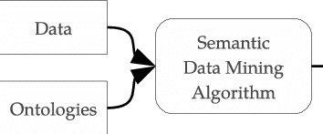
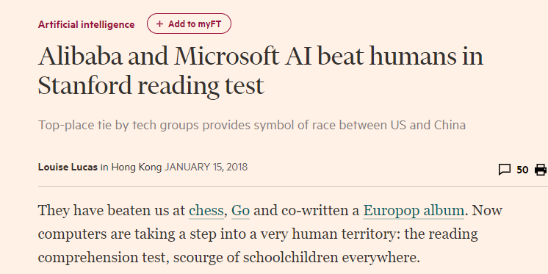
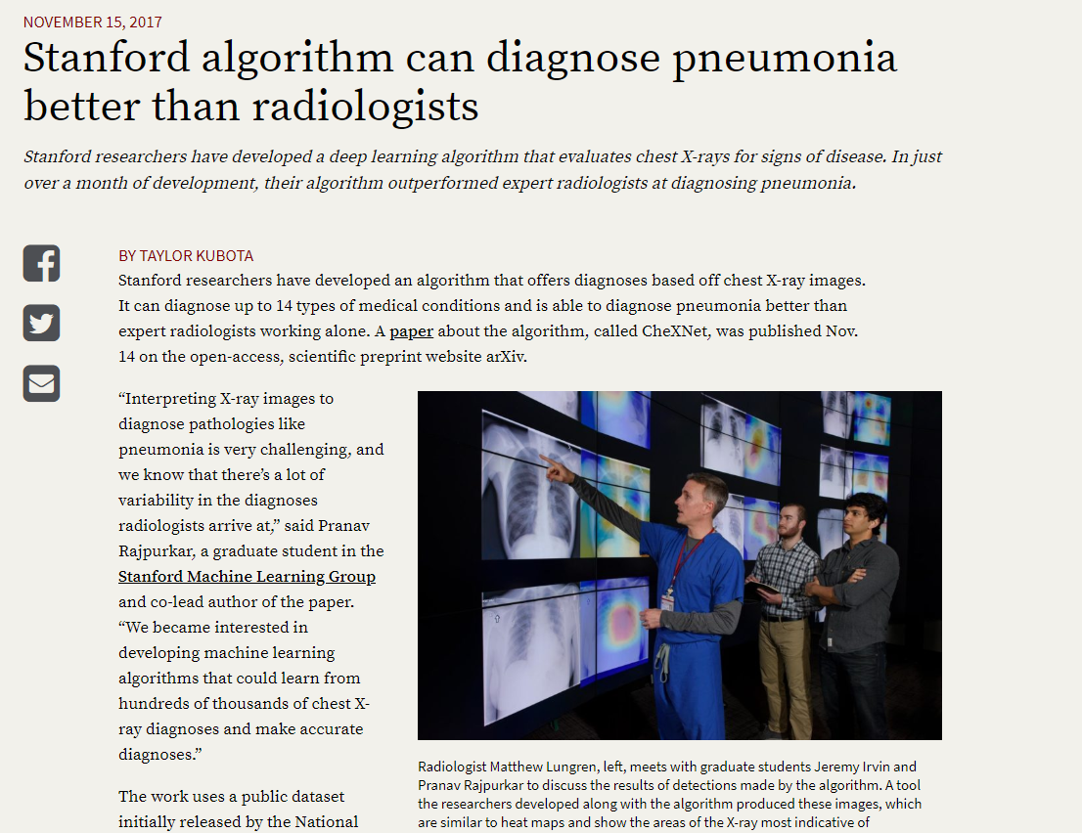
Machine Learning is enhancing
outcomes in other industries

Slide 10
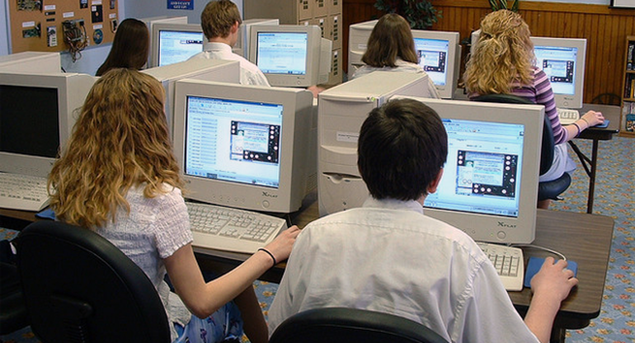
The reality

Slide 11
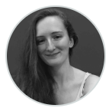
Collaboration
Richard Nickalls
(EAP tutor and
eLearning
coordinator)
Ossama Edbali:
UoB student,
Computer scientist
Use of the ‘Stanford Core NLP’
Amy Pajek
UoB student,
Computer scientist
Launch of AYAE! In 2018 (1,000+ students)
Pilot of Academic Paraphrase Practice APP) in Autumn term 2018

Slide 13
responses (n.=30) to our first evaluation questionnaire.
student experiences/their
Student experience of the APP feedback
55 students agreed to participate (convenience sample)
A stratified sample of 30 students (including 9 flagged for poor paraphrase)

Slide 14
The automated marking tool has helped me learn about plagiarism (copying too much text).
Figure 1: Question 5

Slide 15
The automated marking tool has helped me develop my paraphrasing ability.
Figure 2: Question 6

Slide 16
The automated marking tool has helped me develop my language/grammar accuracy.
Figure 3: Question 7

Slide 17
The automated marking tool has helped me develop my referencing/citation skills.
Figure 4: Question 8a

Slide 18
The automated marking tool has helped me develop my academic style (avoiding informal style).
Figure 5: Question 8b

Slide 19
Preliminary finding 1 (Student Attitudes/experience)
Generally positive
But these students were blended learning (convenience sample, not distance learning)
Several students felt 3-4 seconds was a long time to wait for feedback!

Slide 20
Did humans agree with the computer graded scores? 4 moderators (30 responses)
Two moderators (marking blind of scores, but seeing computer generated flagging of copied language, grammar, citation and style errors)
Two further moderators (marking totally blind)

Slide 21
The APP’s main weaknesses (Preliminary finding 2)
Four human markers often disagreed with the app’s score for semantic meaning/task completion.

Slide 22
Figure1
Strongest Correlation (Anova Intraclass correlation coefficient) of 0.54

Slide 23
All four markers disagreed with two examples of flagged ‘copying’: The APP made two false negative grades for copying
Two of the nine examples of ‘copying’ were judged to be acceptable by human markers

Slide 24
The APP’s main strengths

Slide 25
Table 1. Identification of excessive copied language
Study # | Computer | Marker 1/ computer | Marker 2/ computer | Marker 3 | Marker 4
5 | D | ü | ü | ü | ü
25 | D | ü | ü | ü | ü
2 | D | D | ü | ü | ü
22 | D | D | ü | ü | ü
8 | D | D | D | ü | D
1 | D | D | D | ü | ü
12 | D | D | D | ü | ü
28 | D | D | D | ü | ü
15 | D | D | D | ü | ü

Slide 26
Table 2. What markers missed (without computer help)
Study # | Computer | Marker 1/ computer | Marker 2/ computer | Marker 3 | Marker 4
5 | D | ü | ü | ü | ü
25 | D | ü | ü | ü | ü
2 | D | D | ü | ü | ü
22 | D | D | ü | ü | ü
8 | D | D | D | ü | D
1 | D | D | D | ü | ü
12 | D | D | D | ü | ü
28 | D | D | D | ü | ü
15 | D | D | D | ü | ü

Slide 27
Preliminary finding 3:
Human markers often miss copy and paste plagiarism without computer assistance. The LTi ‘assisted’ identification of poor paraphrase.

Slide 28
Preliminary finding 4
It does some other things fairly reliably:
Citation errors
Academic style
Poor sentence structure/punctuation

Slide 29
Evaluation of main findings
☺ ☺ Students like it (especially if it can be made faster) when used in blended learning approaches.
☹ The APP did not reliably assess for semantic meaning/task completion.
☺ ☺ The APP assisted teachers to mark/moderate writing more reliably.
☺ ☺ The APP more reliably identified copy & paste plagiarism, poor citation skills, poor sentence structure and poor academic style.

Slide 30
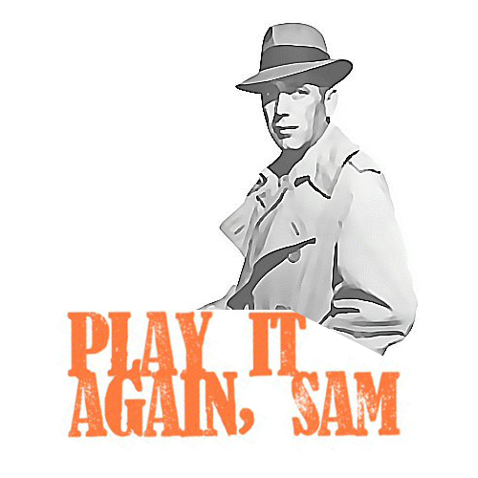
Main conclusions
The tool will not be useful in September for ‘high stakes’ scored summative writing assessment without moderation.
Multiple choice and True/False/NG question types again!

Slide 31
Could assist high stakes summative assessments?
Assists markers/moderators to identify problems they would otherwise miss
Makes marking more efficient

Slide 32
Recommended future role of our English Academic Paraphrase Practice APP
Formative part of our diagnostic
Exciting enhancement in blended learning!

Slide 33
Demonstration of the tool’s potential

Slide 34
Final comments
Watch this space!
Surprising what you can do undistracted!
Surprising what our UoB students can do.

Slide 35
Q & A

Slide 36
References
Davis, M. (2007) The role of Turnitin in the formative process of academic writing: A tool for learning and unlearning? Brookes e-Journal of Learning and Teaching, 2(1). Available at: http://bejlt.brookes.ac.uk/article/the_role_of_turnitin_within _the_formative_process_of_academic_writing/ (Accessed: 17 January 2018).
Davis, M., & Carroll, J. (2009) Formative feedback within plagiarism education: Is there a role for text-matching software? International Journal for Educational Integrity, 5(2): 58-70.
Flowerdew, J., & Li, Y. (2007) Plagiarism and Second Language Writing in an Electronic Age. Annual Review of Applied Linguistics, 27: 161-183.
Hirvela, A., & Du, Q. (2013) “Why am I paraphrasing?”: Undergraduate ESL writers' engagement with source-based academic writing and reading. Journal of English for Academic Purposes, 12(2): 87-98.
Keck, C. (2006) The use of paraphrase in summary writing: A comparison of L1 and L2 writers. Journal of Second Language Writing, 15(4): 261-278.
You can find more information/download the Standford Core NLP at Stanford CoreNLP – Natural language software website: https://stanfordnlp.github.io/CoreNLP/

Slide 37
Appendix

Slide 38
Did the two blind markers agree with the computer (grade/20)?
NO: correlation of 0.28

Slide 39
Did four raters agree with each other (regardless of the LTi)?
Correlation of 0.47: Less than 50/50 chance!

Slide 40
Two raters were given the computer feedback (what the computer thought was copied/wrong)
Correlation of 0.54
Weak agreement, but strongest in study.

