Slide 1
Innovations in developing teacher assessment literacy: A scholarship circle model
Caroline Fletcher
c.j.fletcher@sheffield.ac.uk

Slide 2
Workshop Overview
Defining formative assessment and formative feedback (FF)
Reflection on FF in your context
The scholarship circle model: principles and practice
Challenges and opportunities for scholarship circles in your context

Slide 3
Key Definitions
Formative assessment =
Assessment for learning, in contrast to summative assessment which is for grading and certification purposes
(Seviour, 2015, p.84)
Formative feedback =
Feedback “intended to shape learning” enabling teachers to “support a performance”
(Alexander, Argent, & Spencer, 2008, p.305)

Slide 4
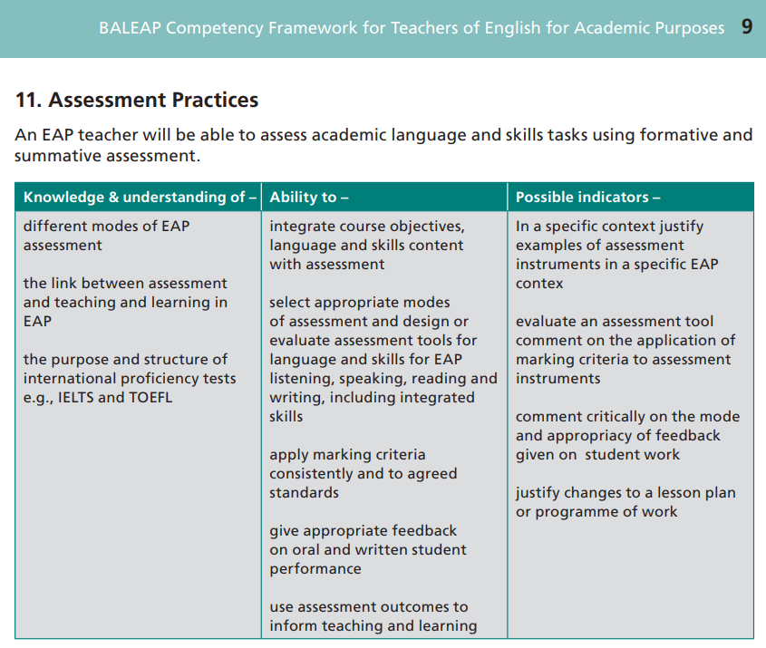
Formative Feedback
Notes:
CORE COMPETENCE

Slide 5
Reflect on your context
How is FF on student writing provided on your programme?
Do students successfully use the FF provided on their writing to revise from one draft to the next?
Do teachers feel competent and confident to provide FF on writing?

Slide 6
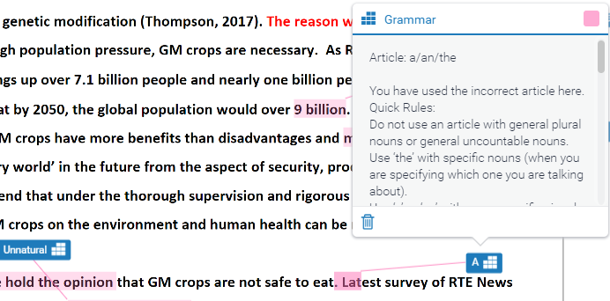
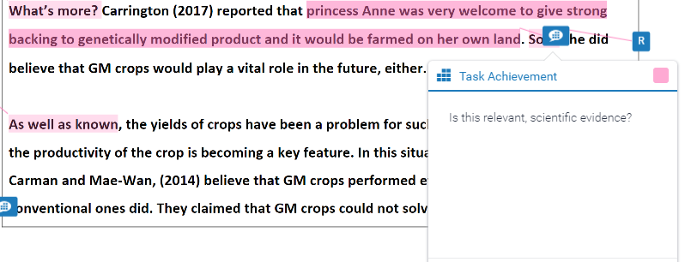
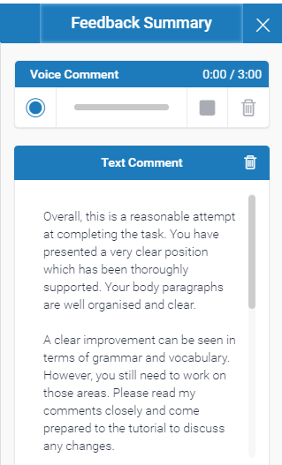
FF on the AES Module
1. QuickMarks (Error correction code)
2. Comments
3. Feedback Summary
4. Grading Form

Slide 7
Findings: Revisions
Text analyses revealed:
Ss attempted revisions for all in-text feedback
Overall revision success rates were high for all
Equally successful revision from QMs & Comments
 | Revision success rates
 | Lilly | Bill | Mo
Overall | 83% | 84% | 79%
QuickMarks | 80% | 100% | 86%
Comments | 85% | 70% | 73%
Notes:
Encouraging – Ss do use our feedback
Indicates that error correction code and Comments are effective means of providing in-text feedback on writing drafts.

Slide 8
Findings: Revisions
Interviews revealed:
Participants did not revise sections of writing without QuickMarks and Comments.
Lilly & Bill: misconception that no feedback on a section of writing meant no revision necessary. “I think I finished these changes in half an hour and then I got nothing to do with this essay.” “fewer mistakes in last paragraphs.”
Mo: Did not know how to correct writing without explicit teacher feedback: developmental readiness (Goldstein, 2006). “I don’t know how to change it because the information is insufficient.”
Notes:
We expect students to independently proofread later sections of their writing and apply the principles given in QMs and Comments to later sections. However, all 3 participants in this study did not do that, demonstrating that their level of behavioural engagement does not extend beyond responding to explicit teacher directions. Thus there appears to be a mismatch between the institution’s expectations and the student’s behavioural engagement.
Developmental readiness = Goldstein, L. (2006). Feedback and revision in second language writing: Contextual, teacher, and student variables. In K. Hyland & F. Hyland (Eds.), Feedback in Second Language Writing: Contexts and Issues (pp. 185–205). New York: Cambridge University Press.

Slide 9
Teacher concerns
How much feedback should I give? How many QuickMarks and Comments?
What can I do to ensure my students read all of my feedback?
What language should I use in my comments to ensure students understand them?
Should I hedge or be more direct?
What should I write in the feedback summary?
What is the most effective balance of praise and criticism?

Slide 10
Scholarship circle principles
Self-managed group
Start & end naturally
Meet regularly
‘scholarly activity’ on topic of mutual interest
At ELTC, it contributes to scholarship time
Notes:
Scholarship time:
In line with the University of Sheffield’s Teaching Pathway Index (i), staff at the ELTC are expected to engage in training, development and structured reflection activities.
In response to this, the ELTC reduced the teaching workloads allocation in 2013. At the ELTC these structured reflection activities are known as scholarship
Teachers have 3 teaching hours reduced per week (pro rata for fractional teachers) to complete Scholarship
This reduction is over a minimum of 30 weeks per year, as non-teaching weeks, annual leave and current summer school workloads, when scholarship and development are limited, have been factored in,

Slide 11
FF scholarship circle
11 teachers
Meet weekly (lunchtime, 1 hr)
to develop own FF awareness and skills:
- Reading academic articles on key FF debates
- Discussing articles in relation to our context
- Sharing own beliefs, practices & experiences

Slide 12
FF scholarship circle
Assessment of FF mechanisms:
- review of error correction code
Collaborative development of formative assessment tools:
reflection document
Collaborative research projects:
- collect data student response to revised error correction code
- interdepartmental research on locus of control

Slide 13
FF scholarship circle
Communicating scholarship circle activities:
Weekly meeting notes published on ELTC portal
Lizzie Pinard’s blog

Slide 14
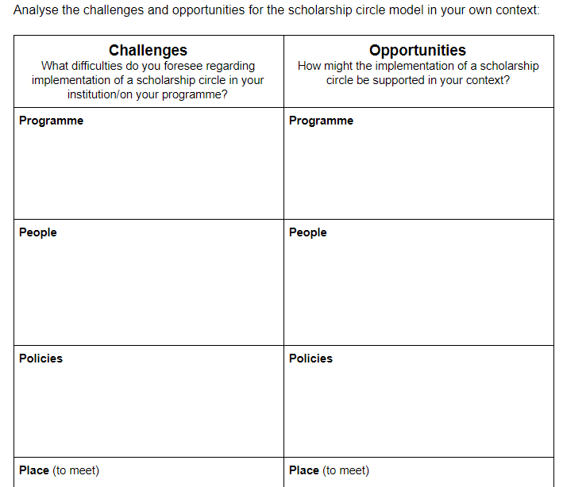
Scholarship circle & your context
Notes:
Think back to the reflection questions

Slide 15
Scholarship circle & your context

Slide 16
Challenges & Benefits
at ELTC
Challenges:
Time
Unequal contribution / reliance on a leader
Benefits:
Raised awareness of formative assessment principles and good practice
Greater teacher ownership and engagement with formative assessment tools
Standardisation of formative feedback

Slide 17
References
Alexander, O., Argent, S., & Spencer, J. (2008). EAP Essentials: A teacher’s guide to principles and practice. Reading: Garnet Publishing Ltd.
BALEAP. (2008). Competency framework for teachers of English for Academic Purposes. [online]. Retrieved from https://www.baleap.org/wp-content/uploads/2016/04/teap-competency-framework.pdf
Goldstein, L. (2006). Feedback and revision in second language writing: Contextual, teacher, and student variables. In K. Hyland & F. Hyland (Eds.), Feedback in Second Language Writing: Contexts and Issues (pp. 185–205). New York: Cambridge University Press.
Seviour, M. (2015). Assessing academic writing on a pre-sessional EAP course: Designing assessment which supports learning. Journal of English for Academic Purposes, 18, 84–89. https://doi.org/10.1016/j.jeap.2015.03.007

Slide 18
To Discover And Understand.

