Slide 1
Audio Feedback: A useful approach for international students ?
Adina Pirtea$ & Karl Nightingale*
$ Birmingham International Academy & * Col. Med. & Dent. Sci.
University of Birmingham.

Slide 2
- Consistently a low area of student satisfaction in National Student Survey - May reflect the structure of assessment in HE e.g. ‘One-way’, ‘high stakes’, infrequent (Perera et al., 2009 ) - But also in specific individual feedback. (Weaver, 2007) e.g. too general & vague, unfamiliar terms, lack guidance, too negative etc. - Often has limited impact on students’ approach e.g. Students do not address area(s) of concern raised (Crisp, 2007) Cannot evaluate their own work. And do not get better at this (Lew et al., 2009) - Students’ emotional response is important e.g. judgement of their work / invested effort (Carless, 2007)
Assessment and feedback has problems in HE ….

Slide 3
- Audio feedback seems to overcome some of these issues: - More engaging (Lunt T & Curran J, 2009) - More convenient, effective & personalised (Carruthers et al., 2009) - More detailed (Voelkel S & Mello, 2015) - More encouraging (Rhind, Pettigrew et al., 2013) - More directed (Nemec & Dintzner, 2016) - Does ‘free flow’ process / tone of voice capture how the assessor is thinking ? (Merry & Orsmond, 2015) - Or perception of personal interaction help in accepting feedback? e.g. ‘Criticism, it seems is easier to accept in the spoken word.’ (Woodcock P., 2017)
Audio feedback. What we know so far …

Slide 4
The learning cycle and written feedback.
Read assessment
guidelines ?
Read marking
criteria ?
Satisfied with
mark ?
Engaged
with feedback ?
Used prior
to next ICA ?
Physiotherapy (PG)
2017-18, n=65
✔
✔
✔
✔
✔
✖
✖
✖
✖
✖
Not to hand / forgot
✖
No use / relevance
Pharmacy (Yr. 2 UG)
2017-18, n=48 / 56
✔
✔
✔
✔
✔
✖
Not to hand/ forgot
✖
✖
✖
✖
✖
No use / relevance
Engagement &
preparation
Substantial dissatisfaction with written feedback

Slide 5
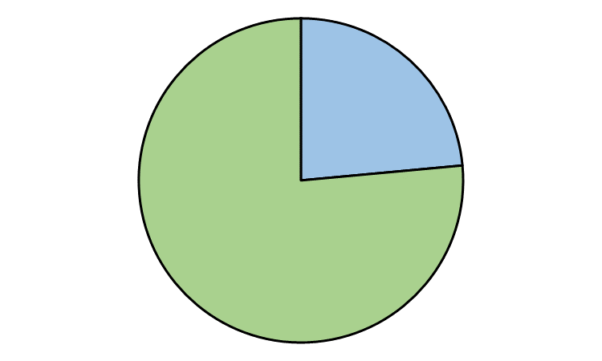
Student (dis)satisfaction …..
Response (%)
Mark lower than expected: 100%
‘I was satisfied
with my mark’
... did not recognise work put in: 40%
… did not recognise the quality of my work: 20%
The assessor was biased: 10%
Not satisfied
24%
Consistency / moderation: 15%
Satisfied
76%
Physiotherapy (PG)
2017-18, n=65
Reflects a complex mix of responses …..

Slide 6
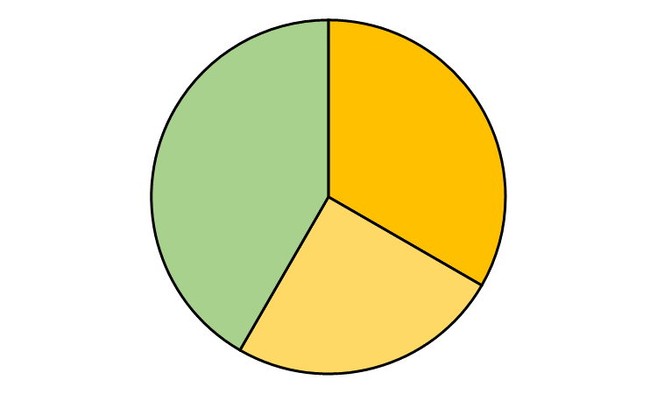
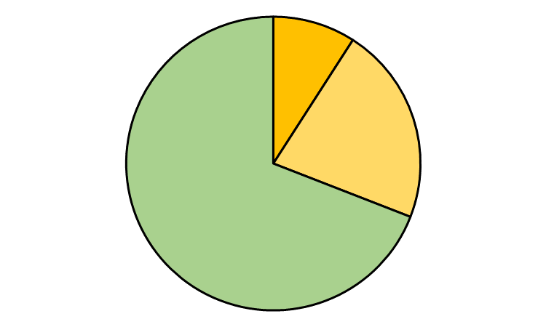
…. and use of it later on.
Re-read prior to ICA
45% 5 / 12
No use / relevance
33% 4/12
But, their engagement with feedback reflect how useful it is in ‘feeding-forward’
Common criticisms
Response (%)
Not to hand / forgot
25% 3/12
I read the feedback thoroughly and thought about what I would do differently next time.
Not clear how to improve: 75%
Re-read prior to ICA
69% 38 / 55
No use / relevance
9% 5/55
Feedback too brief: 65%
No.
17%
Feedback too general: 20%
Not to hand / forgot
22% 12/55
Reading the handwriting: 10%
The mark was sufficient: 10%
Yes.
83%
Physiotherapy (PG)
2017-18, n=66
What about audio feedback …?

Slide 7
Student perceptions …
Response (%)
Feedback is more detailed: 54%
‘I prefer audio feedback
to written feedback’
Feedback is more personal / bespoke: 54%
Feedback is more understandable: 58%
Neutral or disagree.
27%
Feedback is clearer: 62%
But not consistent with all student’s learning preferences ….
Agree
73%
Response (%)
No difference in quality / effectiveness between written and audio: 12%
Pharmacy Yr. 2
2017-18, n = 37 / 56
I prefer a paper copy: 16%
I reflect more easily on written materials: 18%

Slide 8
Focus group themes (Preliminary, n=13)
(1) Audio feedback is more detailed / specific
You could tell he had the essay in front, and was going through it, paragraph by paragraph. And he was saying things like ‘Oh, I like how you wrote…’ and then he would read out the sentence, so it felt more specific.
(2) A recorded voice conveys an emotional / impactful response
One thing that you definitely get from audio feedback that you don’t get from writing is that you can tell by their tone and that does contribute. So if they’re like ’Oh, yeah, it’s really good’ then you feel good, but if it’s .. well like mine, it was ‘Whoah’..….and it had its effect, so I was like ’Oh, God. Ok. Right, I need to try and sort that for the next one.’’
(3) The technology is convenient
The thing I liked about it was that it was uploaded to canvas, so when you’re going back over it, you’re not searching through pages and pages – you just click onto canvas – you know where it is

Slide 9
Focus group themes II
Audio feedback can be less structured
When its written down it seems like they have more time to think about what exactly they want to write, rather than just saying it. So its much more concise and I get more out of it.
(2) A recording can be less convenient and/or less impactful for feed-forward
I would say if I was going to write an essay now, I would be more likely to go back and look at written feedback from my previous essay than go on Canvas and try and find the audio feedback I was given…
‘Less good’ areas ….

Slide 10
Take-homes so far… - Students find audio feedback more useful, and engage with it more - Does this reflect poor experience with written feedback ? (or its novelty ….?) - Not a solution for all students ….
What about international students in the BIA …?

Slide 11
Case study: International students in Foundation academy.
Read marking
criteria ?
Satisfied with
mark ?
Engaged
with feedback?
Used prior
to next ICA ?
Written feedback
✔
✔
✔
✔
✖
✖
✖
✖
No use / relevance
n/a
n/a
✔
✔
Audio feedback
✖
✖
Foundation Academy (EAP)
2017-19, n = 28/35
Open comments
‘It would be useful to meet with the teacher directly to discuss the feedback.’
‘Feedback process is clear and specific, but is a little jarring to read’
‘ Feedback … may be difficult to comprehend and may be too vague’

Slide 12
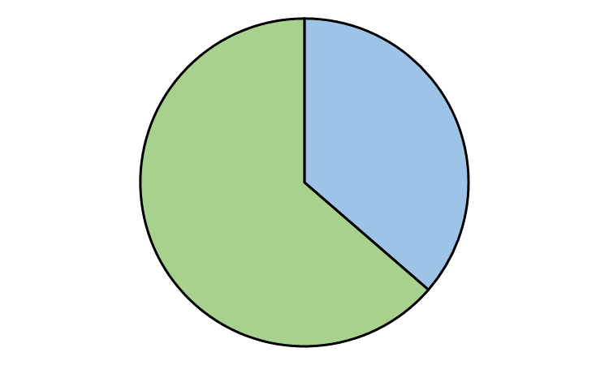
Also prefer audio feedback …
Response (%)
Feedback is more detailed: 60%
‘I prefer audio feedback to written feedback’
Feedback is more personal / bespoke: 42%
Note
Feedback is more understandable: 16%
Feedback is clearer: 42%
Neutral or disagree.
36%
Response (%)
No difference in quality / effectiveness between written & audio: 22%
I prefer a paper copy: 22%
Note
Agree.
64%
I reflect more easily on written materials: 50%
English for Academic Purposes (Foundation)
2017-18, n= 11 / 12
… but not ideal for all students.

Slide 13
A tutor’s perspective on audio feedback
Why
Invitation to join the wider project led by Dr. Nightingale
Professional curiosity (the VLE tool was available and it was time to test it)
Hope that it would be less time-consuming
When
March 2018 – feedback on the first draft of the 1000-word ARP of my Foundation class
What
5-6 minute audio files attached to the individual drafts in SpeedGrader

Slide 14
A tutor’s perspective on audio feedback
How
Students were asked for their preference for feedback (audio or written) -> 10 / 12 students chose audio feedback
I downloaded the essays, checked the similarity scores, and read the essays while paying attention to the 4 key areas set for feedback (task achievement – text organisation – language range and accuracy – use of sources)
I highlighted the parts I wanted to focus on while recording the feedback

Slide 15
A tutor’s perspective on audio feedback
How (continued)
4. I recorded my feedback on the 4 key areas addressing
each paragraph in turn and then uploaded it onto SpeedGrader.
https://canvas.bham.ac.uk/courses/29613/assignments/116164
5. Students were asked to listen to the feedback before coming to the
15-minute tutorial and encouraged to seek clarification during the
session.

Slide 16
A tutor’s perspective on audio feedback
Conclusions
Overall, it took a similar amount of time to the written feedback
It sounded more natural and friendlier
It helped that I had specific comments on each paragraph (easy to follow)
It was more detailed (able to say more than I would be able to type in the same 5 minutes)
Students came prepared with possible solutions to the issues mentioned in my recorded feedback

Slide 17
Focus groups (International student-specific themes ?)
(1) Audio feedback is more detailed / (less ?) specific
I think it was quite effective for me, because I could look at my document whilst going through my audio feedback. So the professor told me ‘Moving on to paragraph ….’ so I knew which paragraph I had to focus on. And content-wise, it was quite clear, and quite specific to each paragraph.
but…
For the audio feedback he was saying ‘You’ve done this good because of this and that’ or ‘This was bad’ but in terms of written feedback, when you’ve done something wrong it’s highlighted exactly what you’ve done wrong.
(2) A voice conveys an emotional / impactful response
I was trying to be observant and take notice of her tone, because when she was talking, I was thinking ‘Ok, she’s being really particular about this thing.’ Its easier for me to interpret when it’s in audio.
(3) A recording can be (less ?) convenient
One thing that I didn’t like, was that if I heard something, and I wanted to go back to hear it again, I didn’t want to go back to listen to the whole tape again.
The bonus with written feedback for students having problems with English is that they can take the text and copy it and translate it into Chinese or their own regional language. With audio feedback you can’t do that.

Slide 18
Audio feedback. A useful approach for international students? A tutor’s perspective.
If more useful = faster…
No, it was not.
If more useful = friendlier…
Yes, it was. To both students and tutor.
If more useful = fairer…
Not necessarily. Preferences over audio / written feedback are still highly variable.

Slide 19
1. Perera J, Lee N, Win K, Perera J & Wijesuriya L. (2009) Formative feedback to students: the mismatch between faculty perceptions and student expectations, Medical Teacher, 30, 395-399
2. Crisp BR (2007) Is it worth the effort? How feedback influences students’ subsequent submission of assessable work, Assessment & Evaluation in Higher Education, 32:5, 571-581.
3. Lew MDN, Alwis WAM & Schmidt HG (2009) Accuracy of students' self‐assessment and their beliefs about its utility, Assessment & Evaluation in Higher Education, 35, 135-156
4. Carless D (2007) Learning‐oriented assessment: conceptual bases and practical implications, Innovations in Education and Teaching International, 44:1, 57-66,
5. Lunt T & Curran J (2009) ‘Are you listening please?’ The advantages of electronic audio feedback compared to written feedback, Assessment & Evaluation in Higher Education, 35:7, 759-769,
6. Carruthers C et al., (2014) ‘I like the sound of that’ – an evaluation of providing audio feedback via the virtual learning environment for summative assessment. Assessment & Evaluation in HE, 40: 352-370,
7. Rhind SM., Pettigrew, GW., Spiller J. & Pearson GT. (2013) Experiences with audio feedback in a veterinary curriculum. J. Vet. Med. Education 40, 12-18.
8. Nemec E.C. & Dintzner M. (2016) Comparison of audio versus written feedback on writing assignments. Currents in Pharmacy Teaching & Learning 8: 155-159
9. Merry S. & Orsmond P. (2015) Students’ Attitudes to and Usage of Academic Feedback Provided Via Audio Files. Biosc. Edu. 11: 1,
10. Woodcock, P. (2017) Towards dialogue: audio feedback on politics essays. Eur. Political Science 16, 193-205.

Slide 20
Interested in joining the study next year ?
Please contact
Karl Nightingale (k.p.nightingale@bham.ac.uk)

