Slide 1
Diversity Awareness Workshop, Pre-sessional Induction
Jane Bell jane.g.bell@hw.ac.uk
Jane Richardson j.Richardson@hw.ac.uk

Slide 2

Session outline
How diverse is UK Higher Education?
Why is change needed?
Benefits of diverse groups
Challenges & barriers to change in HE
Implications
Over to you….

Slide 3
Our teaching context
Assistant Professors in the English Section in Heriot-Watt School of Social Sciences, Edinburgh
Besides EAP, all members of the ‘English’ Section also teach content courses, e.g.
Jane B: LEADS (teacher development), Scottish Studies, Intercultural Issues in Business
Jane R: Global Communication in English

Slide 4
Rationale for induction session
1. Sharing the diverse cultural experience of Pre-sessional teaching staff
2. Facilitating cultural awareness in students requires culturally aware staff
3. Universities keen in principle to maximise the benefits of diversity and produce global citizens,
BUT culture change happens slowly –
Institutional bias staff bias, and
staff bias student bias

Slide 5
To what extent is UK HE designed to accommodate diversity?
Ethnicity: 86% of Russell Group academics white (BBC News (07/12/18)
Income: 45% of uni. students work p/t, 13% f/t (Gil, 2014)
LBGT: 2.7% of 16-24 age group (ONS, 2016)
Language: 8% of UK pop. English L2 or multilingual(ONS 2011)
Age: mature students 31% of UK HE (HESA 2017)
Neurological difference: ↑ 10% of pop. (CIPD, 2018, p.3)
Disability: 1 in 5 in Scotland (University of St Andrews, 2019)
Mental health issues: 1 in 4 people in UK (Mental Health Foundation, 2016)
Religion (or lack of it): differing values & world views
Notes:
Raises the question – who are

Slide 6
Why does HE academic culture need to change?
Notes:
Universities still designed for white, childless, able-bodied, middle class, neurotypical, middle income, males?
Equal opportunities/ Internationalisation - buzz words, but what action is HE taking?

Slide 7
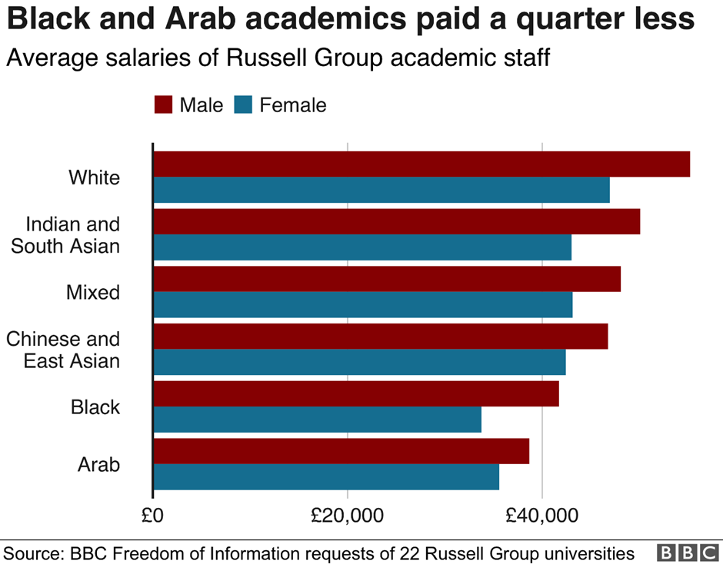
BBC News (07/12/18)

Slide 8
Pay gaps in Russell Group universities
£52,000 for white academics (£55,000 for men)
£38,000 for black academics
£37,000 for academics from an Arab background
On average, compared with white men:
White women,15% less
Asian women, 22% less
Black women, 39% less
Study by Moss-Racusin et al (2012) found that male and female academics in STEM equally biased against women, willing to pay men more
Notes:
Intersectionality - insight that people may experience multiple advantages/ disadvantages/ mix of the two – how these interact
And study by Moss-Racusin et al (2012) found that women academics as biased against women as men. (pay level, also willingness to employ, or to mentor)

Slide 9
Bullying & incivility in HE
‘Bullying ‘is pervasive in academia’ (Everett, 2014)
At a large university in UK, 45% of support staff reported being bullied, 40% reported witnessing it (Thomas, 2005)
Organisational tolerance of incivility (e.g. overt rudeness, lack of respect) can negatively impact employee job satisfaction + mental + physical health (Miner et al., 2012)
Notes:
*Everett (2014

Slide 10
Student issues
Leki (2001): ‘home’ students did not treat NNES students as equals, viewed them as ‘variously handicapped’
27% UK students struggling with mental health issues (UK Gov, 2016), 21% of HWU students (HWU, 2018)
45% of HWU students report learning difficulties (HWU, 2018)
95% of HEIs ↑ demand for counselling services (PPR, 2017)
Student suicides ↑ to 4.7% per 100,00 of population (Mental Health Foundation, 2016/17).
Notes:
The Institute for Public Policy Research’s 2017 survey ‘Not by degrees: Improving student health in UK universities’ revealed that
45% of students at HWU have been diagnosed with a learning difficulty

Slide 11
Why focus on teachers?
Equality Act (2010): responsibility to prevent discrimination
Dissonance between teacher beliefs and practice: learner-centred vs teacher-centred (Assen, Meijers, Otting, Poell, 2016)
Language, culture and pedagogy linked to participation in HE and admittance to chosen academic community (Kettle, 2017)
Institutional approach: examine structures to remove discrimination & barriers to participation at every level

Slide 12
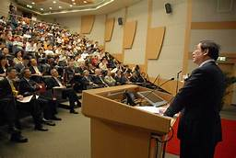
Exploring our own biases
‘I teach Maths, I don’t need to think about culture’
‘too many Chinese students’
‘Students want to learn ‘proper’ English’
Stereotyping, e.g. men ‘better’ at Maths -> fewer women in STEM
Indian or Pakistani English vs British English, e.g. ‘mis’-use of Present Continuous
Arabic students ‘good at speaking, not writing’
‘poor’ English = low cognitive ability
(Leki, 2001)
Chinese students ‘quiet’
Notes:
Links back to self-awareness is the start of intercultural competence. GELT approach raises learners’ awareness of how English has spread and changed. Builds confidence in their different identity as English users and their proficiency in using it for global communication (not as a ‘native speaker’) (Galloway(2017); Dogancay-Aktuna and Hardman (2017) in Matsuda (ed.)

Slide 13

Evolution of attitudes in HE to international students (Kettle, 2017)
International students as:
Deficient
Different but adaptive (“the way we do things here”)
Focus on the institution and its power relations (student has agency and can choose to appropriate some aspects of UK academic culture)
Notes:
Which stage are we/you at?

Slide 14
Potential benefits of diversity:
Better problem-solving – different perspectives
Sharing perspectives, building new understandings (Jackson, 2014)
Increased engagement - people respected for who they are (Lozano & Escrich, 2017)
If accorded dignity, individuals can fulfil their potential and express their ID (Bell, Strani & Ahmad, 2018)
Thinking about counter-stereotypes → more flexible, creative thinking (Goclowska, Crisp & Labuschagne, 2012)
Notes:
But exposure to different cultures does not automatically improve intercultural communication skills (ICC)
Important to highlight the benefits of diversity and, e.g., diverse student groups, to students. Reduction of group think [REF]

Slide 15
Challenges & Barriers:
Criticism of HE for ‘othering’ some students from Day 1, via student categories (e.g. Dippold et al, 2018)
BUT, if no recognition of different groups, how to target different types of support?
HE ostensibly meritocratic: but this based on faulty premise of equal opportunities for all – may in fact perpetuate inequality (Johansson & Sliwa, 2014)
Tension between a) highlighting benefits of diversity to students and b) encouraging them to see beyond superficial differences, e.g. nationality (Holliday, 2016)
Creating learning environments based on mutual respect, despite sometimes conflicting cultural values
Notes:
Also - often unclear procedures for victims of discrimination

Slide 16
Conclusions
For students to view diversity as a strength, institutions & teaching staff must also do so – evidence of benefits
Teaching staff cultural self-awareness key to development of student self-awareness
Helping student groups to find common interests is key to facilitating development of negotiated cultures based on mutual respect
HEIs must manage diversity pro-actively: clear procedures to address discrimination and increase participation – cultural mainstreaming?

Slide 17
Over to you….
In small groups, choose topics in Q1, Section A to discuss (8 minutes)
2. Report back some key ideas (7 minutes)
3. Choose cultural misunderstandings in Section B to discuss (8 minutes)
4. Report back some key ideas (7 minutes)

Slide 18
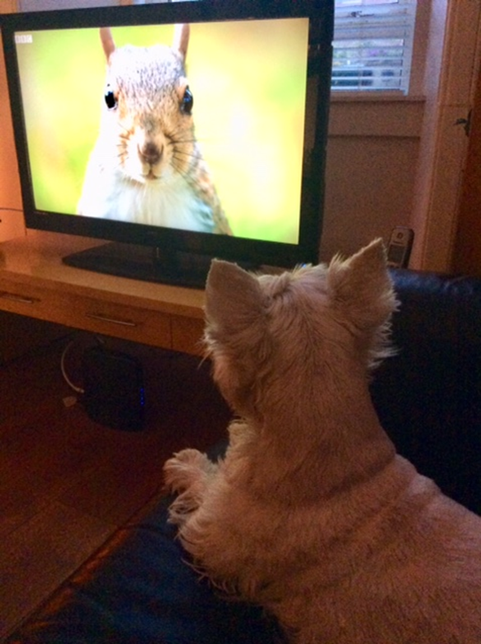
Thank you for taking part!
‘‘Cultural diversity is as necessary for humankind as biodiversity is for nature” (UNESCO, 2001, Article 1)

Slide 19
References
ACAS (2018) Mental Health in the Workplace. http://www.acas.org.uk/index.aspx?articleid=1900
Bell, J., Strani, K. & Ahmad, J. (2018), Dignity and Diversity in the Workplace in M. Nic Craith & K. Strani (eds.) Intercultural Issues in Business Management. In press. Edinburgh: HWU
Dogancay-Aktuna, S. & Hardman, J. (2017) A Framework for Incorporating an English as an International Language Perspective into TESOL Teacher Education. In Matsuda, A. (ed) Preparing Teachers to Teach English as an International Language Bristol: Multilingual Matters
Deardorff, D.K. (2006) Indentification and Assessment of Intercultural Competence as a student Outcome of Internationalization. Journal of Studies in International Education Volume 10, No. 3, 241-266
Everett, J. (2014, May 31) Bullying. Message posted to https://lists.asu.edu/cgi-bin/wa?A0=WPA-L
Galloway, N. (2017) Global Englishes for Language Teaching: Preparing MSc TESOL Students to Teach in a Globalized World. In Matsuda, A. (ed) Preparing Teachers to Teach English as an International Language Bristol: Multilingual Matters

Slide 20
References, cont’d
Gil, N. (1/08/14) One in seven students work full-time while they study. Guardian https://www.theguardian.com/education/2014/aug/11/students-work-part-time-employability
Goclowska, M. Crisp, R., Labuschagne,K. (2012) Can counter-stereotypes boost flexible thinking? Group Processes & Intergroup Relations 16(2), 217-231
Harvard University (2018) Project Implicit: Harvard Unconscious Bias Test https://implicit.harvard.edu/implicit/takeatest.html
Holliday, A. (2016) Difference and awareness in cultural travel:
negotiating blocks and threads, Language and Intercultural Communication, 16:3, 318-331
Jackson, J. (2014) Introducing language and intercultural communication London: Routledge
Johansson, M and Sliwa, M (2014) Gender, foreignness and academia: an intersectional analysis of the experiences of foreign women academics in UK business schools. Gender, Work & Organization 21(1), 18–36.
Keim, J., & McDermott, J.C. (2010). Mobbing: Workplace in the academy. The Educational Forum, 74, 167-173.
Kotthoff, H. and Spencer-Oatey, H. Eds (2009) Handbook of Intercultural Communication Berlin: Mouton de Gruyter

Slide 21
References, cont’d
Lozano, J. F., & Escrich, T. (2017) Cultural Diversity in Business: A Critical Reflection on the Ideology of Tolerance. Business Ethics 142:679-696
McWilliam, Erica L. (2009) Teaching for creativity: from sage to guide to meddler. Asia Pacific Journal of Education, 29(3). pp. 281-293.
Mental Health Foundation (2016) Fundamental Facts About Mental Health 2016. Mental Health Foundation: London. file:///C:/LocalStore/lanjgb/Downloads/fundamental-facts-about-mental-health-2016.pdf
Metzger, A. M., Petit, A. & Sieber, S. (2015) Mentoring as a Way to Change a Culture of Academic Bullying and Mobbing in the Humanities. Higher Education for the Future, 2 (2), 139-150
Miner, K. N., Settles, L. H., Pratt-Hyatt, J. S., & Brady, C. C. (2012) Experiencing incivility in organisations: The buffering effects of emotional and organisational support. Journal of Applied Psychology, 42 (2), 340-372
Peña, F., Martin, B., López, H., & Moheno, L. (2014). Graduate students as proxy mobbing targets: Insights from three Mexican universities. Workplace, 24, 19–32.
ONS (2016) Sexual identity, UK: 2016; Statistical Bulletin. Office for National Statistics. file:///C:/LocalStore/lanjgb/Downloads/Sexual%20identity,%20UK%202016.pdf
The Complete University Guide (2018) Scotland Bursary and Scholarship. https://www.thecompleteuniversityguide.co.uk/media/4835861/scotland_bursary_scholarship_2018.pdf

Slide 22
References continued
Spencer-Oatey, H. (2011). Achieving Mutual Understanding for Effective Intercultural project Management. Centre for Applied Linguistics, University of Warwick Global People Resource Bank Available at: http://www2.warwick.ac.uk/fac/cross_fac/globalpeople/resourcebank/researchpapers
Strani, K., Bell, J., Castillo, P. and Karanasiou, P. (2018) Multicultural Communication in the Business Workplace, in M. Nic Craith & K. Strani (eds.) Intercultural Issues in Business Management. In press. Edinburgh: HWU
The Chronicle of Higher Education (2009, June 11). Mobbing can damage more than careers, professors are told at conference. Retrieved 30 June 2014, from http://chronicle.com/article/Mobbing-Can-Damage-More/47736#c042164
Thomas, M. (2005) Bullying among support staff in a higher education institution. Health Education, 105 (4), 273-288
University of St Andrews (2019) Facts on Disability. Human Resources, University of St Andrews https://www.st-andrews.ac.uk/hr/edi/disability/facts/
Van Camp, D., Sloan, L. R., & ElBassiouny, A. (2016) People notice and use an applicant’s religion in job suitability evaluations. The Social Science Journal, 53, 459-466
Wachtel, T. (2016) Defining Restorative. IIRP. Accessed (28/11/18) from https://www.iirp.edu/restorative-practices/defining-restorative/

Slide 23
Some responses from Pre-sessional teachers to induction task:
Session useful - a need for more education & diversity training for HE staff, e.g., unsure recently how to deal with a student with social anxiety
The induction session helped us to reflect on the social aspect of teaching
Students would benefit from cultural awareness workshops and doing unconscious bias tests too
Cultural ID varies according to context: ‘I am not the same ‘I’ across groups, institutions, lessons…
Students find trying to learn HE rules ‘unnerving’
Notes:
Younger student able to discuss her social anxiety – older staff more at a loss, new experience

Slide 24
More HWU teacher responses:
‘No English L2 student or staff member has ever sought our help for depression’ (staff at HWU Health Centre) – stigma or lack of awareness of mental health issues in some countries
My initial desire for a career in Mathematics frustrated by a lack of recognition at school of my dyspraxia & dyslexia
Will Brexit lead to loss of many brilliant researchers in UK? (loss of diversity)
Neo-liberal commodification of HE – negative effects
Lack of diversity in HE positions of power: usually white, middle class, heterosexual and male
The workshop showed the need to highlight cultural diversity in HE
Link between student autonomy and confidence?

Slide 25
Staff session comments cont’d
We can’t change the world but can influence what goes on in the classroom, i.e. trying to develop a negotiated class culture based on mutual respect
But “imperative that we do this in a way that does not ‘other’ our students or indeed promotes Western modes of thinking (and educating) as superior”
I’m ‘ready to discard my own assumptions about the cognitive and academic challenges of producing research based assignments’ [prior to Pre-sessional]
Intersectionality an important consideration
Shocked by lack of diversity in UK HE staff

