Slide 1
Creating an eap management network together
International Study and Language Institute
Sarah Brewer and Liz Wilding
BALEAP 2017

Slide 2
Today’s outcomes
Understand shared issues and concerns in EAP leadership and management
Identify avenues for collaborative activity and/or sharing of best practice
Shape a new network
the first question now.
Using mentimeter
Go to http://www.menti.com or download the Menti app.
Input the code to enter.
Try the first question now.

Slide 3
Why a new network?
An EAP gap?
Our experience
Research/ Lit review*
Comparison with other sectors
BALEAP SURVEY
*See especially Gillett (2016)
Notes:
Our Experience:
Current roles SB = PD and LW = DHOS. Years of experience leading/managing modules, courses, programmes, teachers, teams
Keen personal and professional interest in this area
Discussion with each other and colleagues → need for more regular sector-wide activity with an EAP L&M focus
Research:
Gillett 2016
Other mainly on ELT and in US
Comparison with other sectors:
AULC Management SIG and May meeting to launch an Administration SIG;
IATEFL Leadership and Management SIG
ELT further ahead? Also see qualifications in ELT: eg DELTA/MA modules and distinct MA with ELT management [find exs]
EAP Gap:
Timely to bring colleagues together to consider ISSUES and POSSIBILIITES, elicit INTEREST in network, and SHAPE it.

Slide 4
Baleap survey
To gather information about the range of leadership and management roles across the EAP sector.
Why leadership AND management?
“…they frequently shade into each other, so that distinguishing between them becomes a semantic exercise that is unhelpful to apply in concrete situations.” (Bryman, 2007)
[In our survey, over 80% of respondents stated that their management role allowed for ‘a significant element of leadership.’]
Notes:
“While the tasks and functions of management and leadership are unique, there is a link between them. It is clear that different problems require different solutions at different times. Rather than being mutually exclusive, these two competencies are interdependent.” (Dembowski, 2006)

Slide 5
Baleap survey
A survey using BOS was distributed in January and February 2017.
18 questions focused on:
  Areas of responsibility
  Institutional context
  Professional relationships
  Training/development
  Challenges/issues
91 Responses highlighted the considerable range and diversity of the activity EAP professionals engage in.

Slide 6

Job titles
Notes:
Q1. What is your job title? (87 responses)

Slide 7
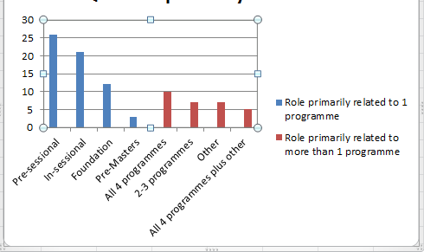
Areas of responsibility
2. Percentage of role (average) given to:
3. Role primarily related to:
Management | 48.9%
Teaching | 36.7%
Research/Scholarship | 10.3%
Notes:
Q2 Overall, what % of your role is given to the following activities? Mgt, Teaching, Research, Other
OTHER: please specify: top answers =
Admin (10)
Materials creation and development (9)
Recruitment/marketing (6)
Q2b re leadership (already mentioned earlier) over 80% felt mgt role allowed for significant element of leadership

Slide 8
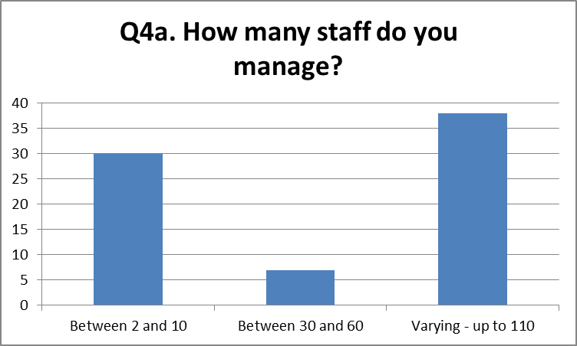
Areas of responsibility (2)
4. Are you required to manage staff?
5. If so, how many?
Yes | 75 (82.4%)
No | 26 (17.6%
Notes:
Q4: significant proportion manage staff.
Q5: significant fluctuations throughout the year in some cases.

Slide 9
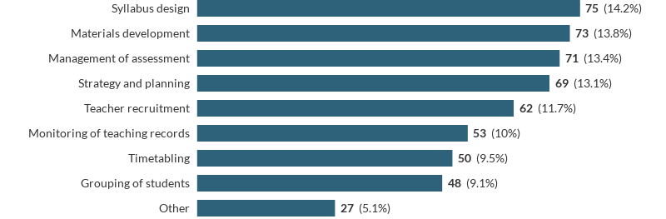
Areas of responsibility (3)
6. Do you have responsibility for any of the following?
Notes:
Q6a –
OTHER areas: respondents gave wide range of other areas: from marketing/recruitment (8) to one-off answers such as room booking
Note Q7
Do you have Teacher development responsibility? Yes = 70, No = 21

Slide 10

Institutional context
9. How would you define your institutional context?
10. Institutionally, where does your unit/centre/department sit?
University/HE | 82/90
Notes:
Q10. Broad range, with the top groupings being:
15 academic depts
21 schools
(of 36 above, 19 referred to languages)
16 academic/student services
13 language centres
7 ‘independent’

Slide 11
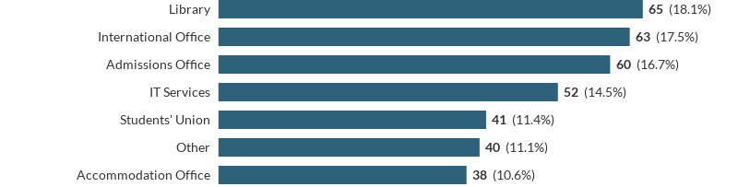
Professional relationships
11. Which services in your institution do you have an active relationship with?
Notes:
11a Other services listed =
Visa compliance/immigration (8)
Student and academic support (7)
Student Services (5)
Other departments (5)
Careers (5)
11b anything you would like to change?
No particular theme
No/not really (10)
Greater awareness/understanding/be understood/recognition (6)

Slide 12
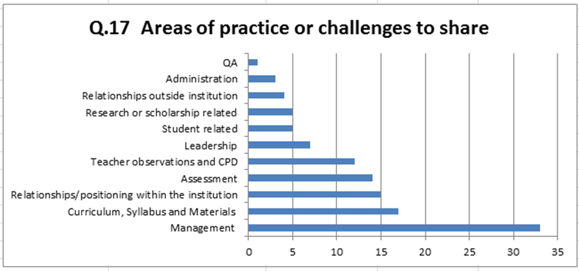
challenges
Notes:
3 main issues identified by Gillett 2016:
People management
Curriculum management
(Resource management)

Slide 13

challenges

Slide 14
the network
Does BALEAP need a L/M network?
What scope/goals should it have?
What next?
Notes:
1. Q16 indicated an interest in the network
Yes 74 (82.2%); No 16 (17.8%)
Hyperlink ink to Mentimeter
2. Possible goals
Hyperlink to next slide.
3. What next = Shape and activities

Slide 15
Network goals
People management
Curriculum management
Resource management
Sharing practice
Influencing policy
Profile-raising/strengthening
Mapping the sector
Cross-institutional collaboration/initiatives
Small group activity
  Discuss these goals and add others to the list.
  Decide which two or three goals the network should prioritise (from the list or your suggestions).
  Add them to the poll (one at a time).
Notes:
Sharing practice: Three areas highlighted by Gillett in his research.
Group activity: (5-10 mins)
suggest re-grouping into L/M streams.
Things to add to the list:
STUDENTS!
International activity such as branch campuses or TNE
Income generating activities
Finance (possibly included in resource management?)
Training

Slide 16
What next?
What shape should the network take and what activities can we engage in? For example:
Regular meetings – virtual or F2F
A BALEAP PIM
Etc
Small group activity
Add your suggestions to the poll.
This has been an idea of mine for a long time –
I think we need to find ways to improve our status in and service to our respective institutions, share best practice, and work to take EAP forward in innovative and collaborative ways
Notes:
Mentimeter
Other ideas:
Follow-up questionnaire
Email discussion group
Blog/website to share info
Mentoring of those new to L/M roles
Dedicated workshops or training sessions
CoP
SIG

Slide 17

Stay in touch
Thank you!
    Sarah Brewer s.m.brewer@reading.ac.uk
    Liz Wilding e.a.wilding@reading.ac.uk
We will send a summary of our talk and of the Menti responses to the BALEAP discussion list.
Please leave us your email if you would like to be involved in the next steps in the development of the network.
We will be in touch.

Slide 18
Select bibliography
Bryman, A. (2007). Effective Leadership in higher education: Summary of Findings. London: Leadership Foundation for Higher Education. https://www.lfhe.ac.uk/filemanager/root/site_assets/research_resources/research/series_1/S1-4%20Bryman%20-%20Effective%20Leadership%20-%20Summary%200f%20Findings.pdf
Christison, M. A. & Murray, Denise E (Eds). (2009) Leadership in English Language Education: Theoretical Foundations and Practical Skills for Changing Times. New York & London: Routledge.
Christison, M. A. & Stoller, F. L. (Eds), (2012) A handbook for language programme administrators. (2nd ed ). Miami Beach, FL: Alta Book Center Publishers.
Coombe, C., McCloskey, M., Stephenson, L., & Anderson, N. (Eds). (2008). Leadership in English Language Teaching and Learning. Ann Arbor, MI: University of Michigan Press.
Gillett, A. J. (2016). EAP management. In K. Hyland & P. Shaw (Eds), The Routledge handbook of English for academic purposes (pp. 530-546). London: Routledge.
White, R., Martin, M., Stimson, Ml & Hodge, R. (1991). Management in English Language Teaching. Cambridge: Cambridge University Press.

