Slide 1
What do Mathematics students need to write at university and how can we assess them?
Chloe Courtenay and Sophia Vanttinen-Newton
Centre for English and World Languages

Slide 2
Working with SMSAS
The School of Mathematics, Statistics and Actuarial Science (SMSAS) has recognised the need for students to be able to communicate about their subject to non-specialists.
The assessments reflect this need to write
plainly for a lay audience
clearly for an educated non-specialist audience
Gain experience of extended academic writing

Slide 3
School objectives for Mathematics and Actuarial Science Foundation students:
To take students out of their comfort zone and challenge them
To introduce the students to extended academic writing
To apply analysis and critical thinking in their writing
To move beyond IELTS style descriptions of data
To produce written work in line with expectations on other Stage 0 courses at the University

Slide 4
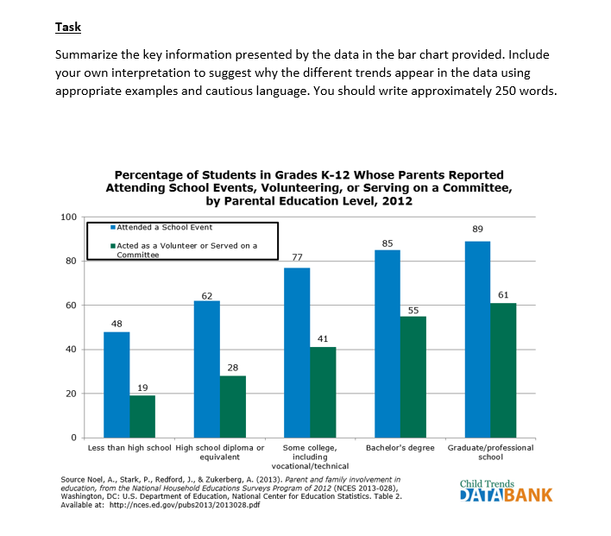
Academic Skills for Maths Students: In-course test
Notes:
Print the original report used in the assessed seminar but do not hand it out
You will see that it looks like an IELTS exam question but where IELTS penalises students for discussing information not included in the data we wanted the students to think critically about what the data recommended. The report was used in assessed seminar preparation and the students then had practice talking about the data offering suggestions, using cautious language to suggest alternative opinions while also interpreting the data. This meant that they had experience of evaluating data in both spoken and written form

Slide 5
Technical Report - Example topics provided by SMSAS
Who should claim the most credit for inventing calculus, Leibniz or Newton?
In an evaluative analysis of the roles of Leibniz and Newton in the invention of calculus, write a report on the ways in which we can view their respective contributions.
The Bridges of Konigsberg
In offering his solution to the famous Seven Bridges of Königsberg problem in 1736, Leonhard Euler is said to have established the basis of both graph theory and the idea of topology. Write a report outlining the problem and Euler’s solution as well as evaluating that solution both mathematically and in terms of its contribution to mathematical science.
Notes:
1,200 word report Titles are provided from SMSAS

Slide 6
Technical report
Notes:
The objective was to give students experience of writing . The School requested that students write up to 1,200 words in line with expectations on other Stage 0/ Level 3 modules across the University.
The two examples show the difference in work that students produced for SMSAS and the work produced on the Academic Skills module.

Slide 7
School objectives for Actuarial Science Masters students:
To write plainly for a lay audience
To use the correct degree of formality when writing and consider the appropriateness of their style
To recognise cultural differences in writing- considering directness and politeness and professional style
To identify linguistic strengths and weaknesses in students’ own writing with regard to grammar, structure and tone and be able to check and edit their own work
Notes:
Approached by SMSAS to help their international Masters students with their weaknesses in English language. The objectives above were identified for the course. This course was quite different in its focus on writing plainly and avoiding technical jargon and specialist terms which was quite opposite to what most EAP writing courses focus on. In the autumn term the syllabus focussed on writing style- tone and formality and writing plainly as well as a session on sentence types and a review of relevant key grammatical elements. The spring term sessions focussed entirely on writing an actuarial letter.

Slide 8
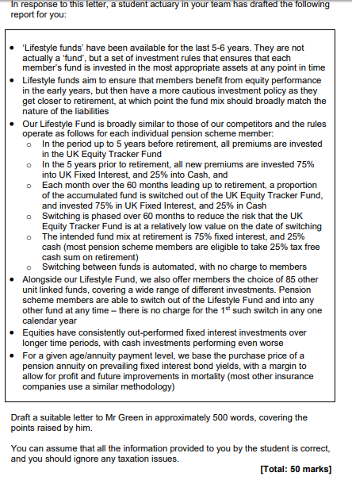
Example Letter Task
Notes:
Here is an example of a typical actuarial letter task. Students must write a response to this question in 2 hours. This task forms 50% of their overall mark for their actuarial communications module.

Slide 9
A Typical Example of a Masters Student’s Actuarial Letter
Notes:
This is an example of a strong response to the task which you have a copy of. We used a peer review feedback form to assess this focussing on: structure and organisation; plainness of writing; grammar and tone and formality.

Slide 10
Assessments
Assessment of the students took the form of the student writing a response to the task in timed conditions in their SMSAS classes which they then brought to our spring term sessions
Peer-review in class of students’ actuarial letters
Feedback on assessments through Individual Writing Tutorials in which we provided detailed feedback to the students on style and grammar
Notes:
The final assessment for the SMSAS module in their own school is to write an actuarial letter under timed conditions as explained earlier therefore where this course supported that final assessment was through feedback on the practice assessments. We used peer review in class together as a class as well as in smaller student-led groups to support students with their final assessment on their main module. In CEWL we also support international students with writing through 30 minute individual writing tutorials so I encouraged students to book an IWT if they wanted further written feedback on their individual letters.

Slide 11
Summary
Embedding academic writing and speaking skills
Exploring graduate attributes
Challenging the notion of academic literacies and widening the definition of what these are
This includes taking students out of their comfort zone which is an important part of the university experience
Notes:
In summary, the course for Masters Actuarial Sciences students personally widened my own notion academic literacies (not having taught students from this School before) as the assessment at the heart of this course teaches students to write plainly and without specialist terms. This is quite the opposite of the traditional academic literacies of essay writing and report writing. More importantly, it also helped the students to understand and learn the necessary graduate attributes and skills that they require for their onward actuarial careers after studying the Masters course when writing to international clients in English.

Slide 12
Notes:
This

