Slide 1
We have to assess the students, but how do we do that? The case of an e-portfolio approach to assessing Graduate students’ development in scientific writing
Gerard P Sharpling
Centre for Applied Linguistics
University of Warwick
Coventry CV4 7AL

Slide 2
Context
PGT Chemistry students (core modules)
PGR STEM students (self-selecting)
Attend for 9 x 1.5 hours sessions per term (extended articles in term 1, short/focused articles in term 2).
Credit-bearing for MSc
Contributes towards PGR transferable skills award
Mix of L1 and L2 writers
Tutor is language specialist, not science specialist

Slide 4
Sub-genres
Research paper
Fact sheet
Press release
Abstract
Standard operating instructions
Letters to editor of a journal
Peer review

Slide 5
Assessment product
For each module, students produce an on-line portfolio of four pieces of work.
Each piece of work will generate self-evaluation, peer discussion and tutor comments.

Slide 6
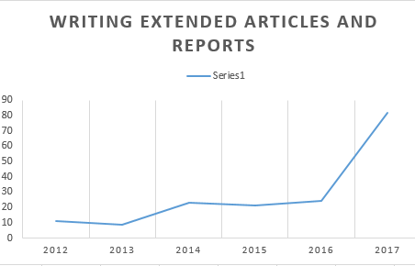
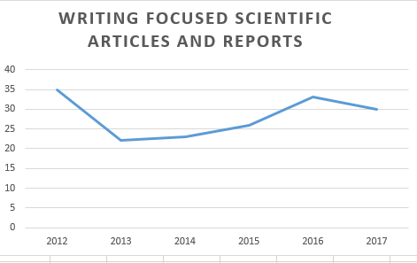
Demographics

Slide 7
Sample band descriptor

Slide 8
Key issues/ questions
How should the modules/portfolios be assessed?
Do the Science faculty marking criteria give sufficient information/detail to mark work meaningfully?
Are there more comprehensive and less time consuming ways of assessing the participants’ work?

Slide 9
Review of the literature (1)
Avoid micro-strategies that lead to error (Sionis, 1995).
Define the competencies needed (Brinkman & de Geest, 2003).
Measure effectiveness of intervention using control group (Luttrell et. Al., 2010).
Identify 'public science' writing skills (Baram-Tsabari & Lewenstein, 2013).
Use reflection to assess (Waschle et al., 2015).
Use pre- and post- questionnaires (Cargill et al., 2018).
Deal with scientific argumentation patterns (Cope et.al, 2013).

Slide 10
Limitations (1)
Relatively 'hierarchical' role and status of tutor
'Top-down' approach - tutor/teacher decides what is needed
Is it legitimate to search for universal criteria? Do they work?
Is the learning too 'directed'?

Slide 11
Review of the literature (2)
Socio-cognitive model (Weir, 2005).
Social ecological model (Bronfenbrenner, 1979).
Human rights based interventions (Shohamy, 2001).
Self-assessment (Boud, 2013).
Co-construction of truth, dynamic assessment (Poehner, 2009).
Portfolio assessment (Hamp-Lyons and Condon, 1993).

Slide 12
Limitations (2)
Construct definition may be perceived as vague/ ill-defined
Students may be unsure of what the ‘standard’ is
Lack of guidance/'directiveness'

Slide 13
Social-ecological perspective: tensions
EXOSYSTEM (Wider social
System)
MESM
MESOSYSTEM (interactions between two microsystems)
WRITER

Slide 14
Some rejected strategies
Strategy | Reasons for rejection
The work is not 'marked' at all | Students will not feel motivated to complete the work and there is no 'pay-off' at the end. This may impact in improvement
Only subject specialist 'marks' the work – EAP tutor plays a supporting role | Language is an important part of communication and EAP tutors have something to contribute to this discussion. EAP tutors can also develop their interests in STEM subjects.
EAP tutor and subject specialists 'jointly' mark the work ​ | It is difficult to operationalize this and not enough interest in doing so. It might also be unnecessarily time-consuming, and still leaves peer- & self-assessment out of the equation ​

Slide 15
1. Needs analysis
Subject lecturers
Students
ESP developments
Personal experience
Literature/ Science writing guides

Slide 16
Available documentation& archives
Semi-structured interviews (recorded)
Reflective accounts (circ. 100 samples)
Students’ work/assignments (8 years)
Departmental documentation, course web sites, etc
Artefacts from personal study of UG chemistry & biochemistry modules (OU)

Slide 17
Meso- and exosystems
Reviewers
Journal
Jusgements
PhD examiners
Summative
World of the classroom
Facilitation
Reflective
Formative
EXOSYSTEM
MESOSYSTEM
WRITER

Slide 18
2. Defining constructs
What are the sub-components of each sub-genre of writing?
How can the sub-components be operationalised through appropriate tasks? How can they be linked to wider faculty marking criteria?
Does task design effectively assess the constructs? Can we effectively extrapolate performance to the 'external world'?

Slide 19
Abstracts

Slide 20
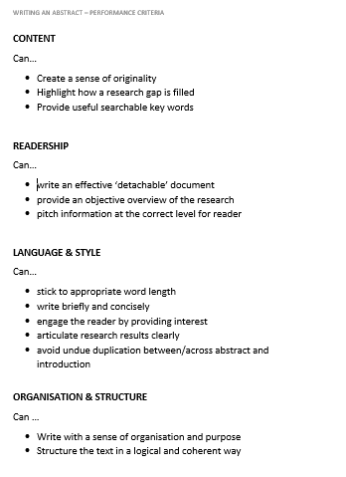
Abstracts: Self-assessment criteria

Slide 22
3. Operationalising the construct
A rationale for abstract writing
Submit/upload an abstract that you have written. Write an accompanying rationale of between half a page and one page to outline the procedures you took when writing this abstract. Do you think these procedures were effective? Use academic references where needed to back up any facts and claims about your writing procedure. Note that we are not grading you here on the abstract itself; the abstract is designed simply to support your rationale/reflection, which is the main focus of this assignment.

Slide 23
Writing a fact sheet
Writing an accessible scientific fact sheet
Using between one and two pages of A4, produce a fact sheet for an area of science that you are currently interested in, or researching. Add a paragraph to specify whom you are writing for, and the purpose of the communication.

Slide 24
3. 'Calibration' between self, peer and tutor evaluation

Slide 25
Calibration of self-, peer- and tutor assessment to holistic scales

Slide 26
Marking procedure
Currently:
Students submit the 'product' text (e.g. abstract, fact sheet, section of research paper) as well as a self-evaluation (commentary) and an action plan based on the evaluation.
Where possible students include comments from peers/ awareness of peer feedback in their commentary.
Peer and self- assessment are not given a mark (but we plan to do so in the future).
Mark not based on the 'absolute quality' of the product text but on the degree of reflection and critique.
Mark linked to holistic faculty-wide marking criteria.

Slide 27
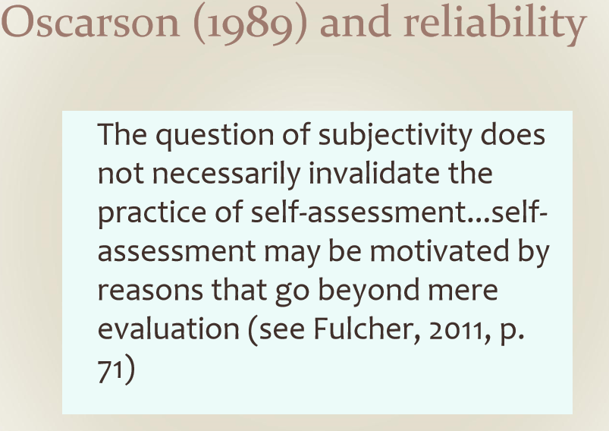

Slide 28
4. Final marks or pass awarded
Numerical marks for MSc students
Pass/resubmit for PhD students

Slide 29
5. A posteriori validation
We have:
Summative course evaluation(students)
Tutor comments/remarks
Reflective journals (three pieces reflection
Perception of faculty members as to the usefulness of the modules

Slide 30
Final comments: You can't win them all
A lot of material covered is more focussed on fact sheets or chemistry/medical applications , some of which are not covered by my course (maths). It would be nice to have more relevant material. Don't really need the editing work either – I think far too much time was spent on these areas.
I think the class could very easily cover much more and go much more in-depth into the differences. It feels very wishy-washy advice that is given, and seems to progress at a snail's pace.
It has helped me critique my own work but I do not feel I have learned much in the seminars (they are a bit vague). My degree had a very heavy focus on writing though. I do find the sessions enjoyable.

Slide 31
But there are some positives...
This module has enabled me to look at my own academic writing and find ways to make it more engaging. I often use a lot of passive style of writing throughout all sections of report writing and have no seen how this comes across to the reader. It has also highlighted the use of tenses, which I know I often muddle when report writing, and when it is appropriate to use past tense and when present is better. Overall I think this module has enabled me to look criticially at my own writing style but has also shown me the wide variety of styles used in papers even within Life Sciences.

Slide 32
I feel the module helped me to write more concisely and to be more conscious of sentence structure and building an argument. I have learned how to structure a journal article in my field and what I need to write in each section of the article.
To extend my academic writing:
I would like to practice writing more regularly, such as writing an abstract for my PhD and beginning my literature review to put in place things I’ve learned. To further improve my writing I would like to get regular feedback on this work from my supervisors.
I would also like to read more about academic writing in science, in particular from the resources recommended to us during the module.

Slide 33
References
Baram-Tsabari, A., & Lewenstein, B. V. (2013). An instrument for assessing scientists’ written skills in public communication of science. Science Communication, 35(1), 56-85.
Brinkman, G. W., & van der Geest, T. M. (2003). Assessment of communication competencies in engineering design projects. Technical Communication Quarterly, 12(1), 67-81.
Boud, D. (2013). Enhancing Learning through Self-assessment. Routledge
Bronfenbrenner, U. (1979). The ecology of human development. Harvard university press.
Cargill, M., Gao, X., Wang, X., & O'Connor, P. (2018). Preparing Chinese graduate students of science facing an international publication requirement for graduation: Adapting an intensive workshop approach for early-candidature use. English for Specific Purposes, 52, 13-26
Cope, B., Kalantzis, M., Abd-El-Khalick, F., & Bagley, E. (2013). Science in Writing: Learning Scientific Argument in Principle and Practice. E-Learning and Digital Media, 10(4), 420–441. https://doi.org/10.2304/elea.2013.10.4.420
Hamp-Lyons, L., & Condon, W. (1993). Questioning assumptions about portfolio-based assessment. College Composition and Communication, 44(2), 176-190.
Luttrell, V. R., Bufkin, J. L., Eastman, V. J., & Miller, R. (2010). Teaching scientific writing: Measuring student learning in an intensive APA skills course. Teaching of Psychology, 37(3), 193-195.
Poehner, M. E. (2009). Group dynamic assessment: Mediation for the L2 classroom. Tesol Quarterly, 43(3), 471-491.
Shohamy, E. (1993). The Power of Tests: The Impact of Language Tests on Teaching and Learning. NFLC Occasional Papers.
Sionis, C. (1995). Communication strategies in the writing of scientific research articles by non-native users of English. English for Specific Purposes, 14(2), 99-113.
Wäschle, K., Gebhardt, A., Oberbusch, E. M., & Nückles, M. (2015). Journal writing in science: Effects on comprehension, interest, and critical reflection. Journal of Writing Research, 7(1).
Weir, C. J. (2005).. Language testing and validation: An Evidence-based Approach. Hampshire: Palgrave McMillan.

