Slide 1

Exploring student and teacher beliefs about writing conferences on international foundation programmes
Dr Zulfi Qureshi
University of Liverpool
BALEAP 2019, Leeds
Z.Qureshi@liverpool.ac.uk

Slide 2
What am I going to talk about?
Key terms: beliefs, conference
Why did I want to explore this issue?
How did I investigate it?
What did I learn? Using the participants’ own words
Implications for international students, EAP practitioners and course providers
References
Questions

Slide 3
Key term: Belief and Conference
Belief: ‘a form of thought, construction of reality, ways of seeing and perceiving the world and its phenomena which are co-constructed within our experiences and which result from an interactive process [with] the world and … with others’ (Barcelos 2014)
Conference: a term used more commonly in US literature to what we might call a ‘tutorial’, viz. a face to face meeting between a teacher (or tutor in a writing centre) and a student writer to discuss a written draft. Advocates see it as a place to promote ‘dialogic feedback’, explain complex issues and give students a space to express their voice and ownership over their writing. Critics highlight the challenges it presents for L2 writers in particular, viz. to listen, speak and understand in real time

Slide 4
Why did I want to explore this issue?
Me: ‘Did you like the conference?’
St: ‘It was OK but you don’t tell me what I
want for my essay – you only want me
talk!’

Slide 5

B
E
L
I
E
F
S
Student
Teacher

Slide 6
How did I investigate it? The research context
Doctoral study
UK university setting
Year round International Foundation Programme (IFP)
Students had to write one long essay per semester with two drafts
Department exercised a process-oriented approach blended with a genre-oriented one
Students received written and spoken feedback on every draft (4 conferences over 2 semesters)
4 international students - 2 from each IFP stream (high and low)
2 EAP writing teachers
Questionnaires and follow up interviews at the start
Each conference was audio recorded, transcribed over the year (16 conferences)
Post stimulated-recall interviews to discuss the conference
Data analysed to uncover beliefs students and teachers had about conferences
Case studies

Slide 7
How did I investigate it?: The participants
Students:
  Layla: 24, graduate from Saudi Arabia. She wanted to do a Masters in Business the following year. IELTS 4.5-5.0
  Alex: 20, completed 2 years of a Business degree in China. He wanted to do final year in the UK but English level was too low, so joined IFP. IELTS 4.5-5.0
  Kazumi: 21, exchange student from Japan studying Intercultural Communication. He wanted to improve his academic English. IELTS 5.5-6.0
  Maria: 26, graduate from Cyprus. She joined the IFP to improve her academic English skills. IELTS 5.5-6.0
Teachers:
  Joan: 36, Cert. Tesol, over 10 years EFL/EAP experience. Taught Layla + Alex
  Derek: 37, Cert. & Dip. Tesol, over 7 years EFL/EAP experience. Taught Kazumi + Maria

Slide 8
The students’ beliefs

Slide 9
What did I learn? Layla’s beliefs about conferences
'I expect [the teacher to] give me more example'
‘I like it the teacher talk but I think the balance between the teacher and the student [is important]'
'It [written and spoken feedback] helps me to avoid my mistakes’
'If I need I will [speak up]’
‘I understand but just I want check this sure'
'I feel relaxed because I know my teacher'

Slide 10
What did I learn? Alex’s beliefs about conferences
‘tell me what’s wrong’
‘two peoples have thinking and we can get more idea’
‘I want to show my mind’
‘If the teacher tell me everything that essay is not mine - it's the teacher’s
‘Joan ask more question for me - it can help me to remember’
‘I must want to know why, why I have to’

Slide 11
What did I learn? Kazumi’s beliefs about conferences
'I needed more help'
'The good thing I found is he followed the structure'
‘If the relationship is like close, I think students will be able to talk more'
'I think culture could be the problem'
'I ran out of time'
'I thought this is the western style ... it's up to me'
'I agreed with this so yeah I change it – it doesn’t mean I followed him'

Slide 12
What did I learn? Maria’s beliefs about conferences
'spoken feedback is an opportunity for both to talk'
'the aim of the feedback to know what is wrong with my essay'
'it is not clear if I have to change it'
'the aim of these conferences is to resolve my questions about writing'
'I can’t accept my teacher’s feedback if I don’t agree with him'
'I want [him] to give me more examples'

Slide 13
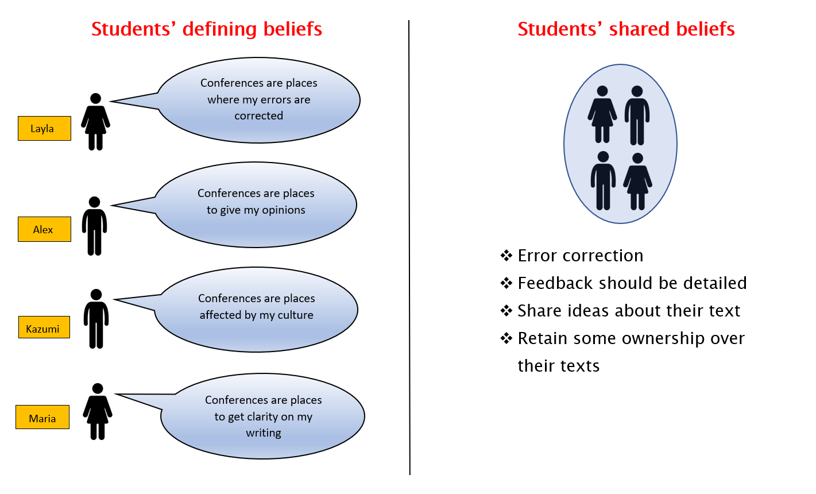

Slide 14
The teachers’ beliefs

Slide 15
What did I learn? Joan’s beliefs about conferences
‘ideally we want the students to take some kind of control’
‘I’m aware that I won’t probably get as much from a Japanese or a Chinese student’
‘I’ve got a responsibility to direct them in the way that I think is best for their essay’
‘I don’t want to do it for her but if she can’t do it herself …’
‘on balance I will speak more usually’
‘I was thinking about my answers last week and I kind of felt it doesn’t kind of maybe fit what I think a conference should be like’

Slide 16
What did I learn? Derek’s beliefs about conferences
‘there is a danger of teachers stamping their own authority on student’s work’
‘Ideally I would prefer the student to control the direction of the conference although in reality this would rarely happen’
‘it is important to allow students to take ownership for their writing’
‘my own approach centres around coaching rather than traditional teaching’
‘teacher and student fit in to roles encapsulating certain expectations with regards to who does what’
‘I think you’ve got to adapt yourself to each individual’

Slide 17
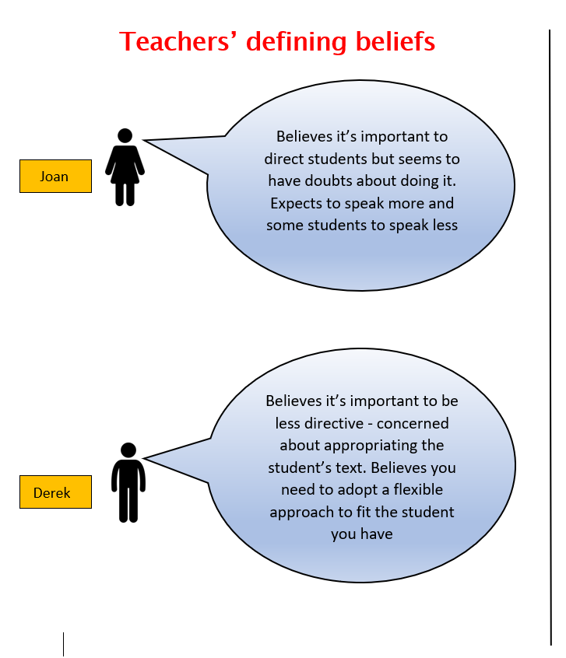
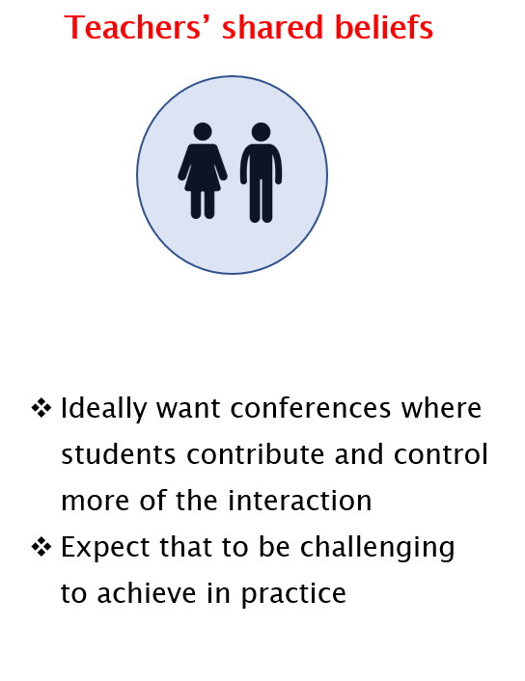

Slide 18
Student vs. Teacher beliefs about writing conferences
Students’ shared beliefs
Teachers’ beliefs
I want my errors fixed
I want feedback to be detailed
Joan was more accepting of this than Derek but neither teacher was keen
Less alignment here between students and teachers’ beliefs
I want to share my ideas
I want to keep some ownership over my text
Both Joan and Derek were willing to do this because it fit their view of conferencing
More alignment here between students and teachers’ beliefs

Slide 19
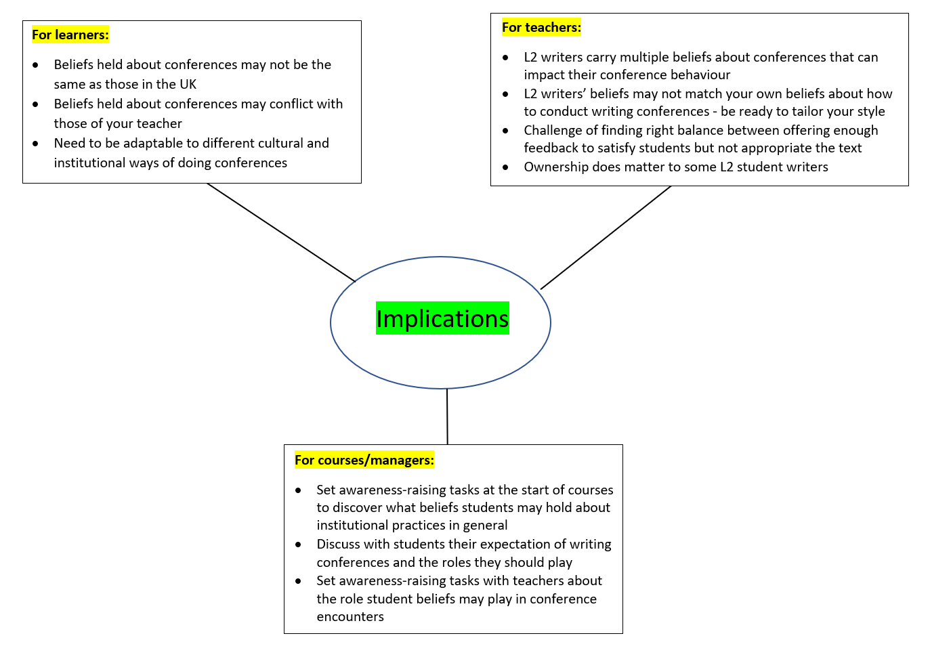
Implications
Other beyond IFPs?
Others kinds of 1:1 interactions such as dissertation supervisions, speaking tests with an interlocutor
Uncovering student beliefs about a range of academic practices including classroom practice, assessment, on-line or blending content, projects, portfolios etc.

Slide 20
References
Black, L. (1998). Between Talk and Teaching: Reconsidering the Writing Conference. Logan, MT: Utah State University Press.
Goldstein, L. M., & Conrad, S. M. (1990). 'Student input and negotiation of meaning in ESL writing conferences'. TESOL Quarterly, 24(3), 443-460.
Harris, M., & Silva, T. (1993). 'Tutoring ESL students: issues and options'. College Composition and Communication, 44(4), 525-537.
Kalaja, P., & Barcelos, A. M. F. (Eds.). (2003). Beliefs about SLA: New Research Approaches. New York: Springer.
Maliborska, V., & You, Y. (2016). 'Writing conferences in a second language writing classroom: Instructor and student perspectives'. TESOL Journal, 7(4), 1-24.
Nan, F. (2012). 'Bridging the gap: Essential issues to address in recurring writing center appointments with Chinese ELL students'. The Writing Center Journal, 32(1), 50-63.
Ried, J. (1994). 'Responding to ESL students' texts: The myths of appropriation'. TESOL Quarterly, 28(2), 273-292.
Tobin, L. (1990). 'Productive tension in the writing conference: Studying our students and ourselves'. In T. Newkirk (Ed.), To Compose: Teaching Writing in High School and College (pp. 95-112). Portsmouth, NH: Heinemann.

