Slide 1
Feedback as a developmental process
Richard, Lee, Sandra Leigh & Lisa Robinson

Slide 3
Raising Awareness - which persona are you?
The Rusher
Doctor General
The Markinator
Passive Aggressive, right?
The Riddler
The Chef

Slide 4
Theory on Good Practice
Effective, useful
Cognitive:
Developmental
dialogic
Socio-affective: motivational
personal
Structural:
Mobilise resources

Slide 5
Recap on Good Practice
In groups, briefly identify 1 or 2 practical tips that makes feedback . . .
developmental and informative (feedback for learning)
I think this is a good opportunity to use the word multifactorial here
motivational and supports learners
If you remove this, it makes the next sentence link better
Very good range (references)
contextualised and personalised
For this submission . . .
dialogic and flexible
What do you think? Do you agree with them?
creatively and effectively mobilise resources
The info you showed me on mindfulness and QMC?

Slide 6
Sample Feedback 1- Clinical Nutrition
Read sample 1; what are your first impressions of the feedback?
Is it:
developmental and informative?
contextualised and personalised?
Dialogic and motivational?
Does it:
support learners and feed forward into later learning?
Any other comments?

Slide 7
Sample Feedback 2 – Information Management
Read the second sample by the same tutor to a different student. What aspects could you comment on in relation to genre, criticality and language? (See ‘suggested areas’ sheet.)
Looking at the feedback the student received, has the marking tutor picked up on any areas you identified?
Are there any similarities and differences between the 2 feedback samples? For example, in style, number of comments, type of comments, etc.

Slide 8
Plenary Discussion
What are the challenges with providing effective feedback to our EAP students?
How can feedback also be a developmental process for the tutor?
Are there any gaps in your feedback practice that you would like to address?

Slide 9
Top tips
Read the whole text first to inform genre and criticality comments
If using a correction code, make sure the students have access to it and understand it!
Notes:
Read submission first – don’t get bogged down with language errors!

Slide 10
When to correct? When to suggest? (Direct/indirect feedback) Dana Ferris (2006)
Treatable (Indirect) | Untreatable (Direct)
Verb tense form | Word choice
Run-on sentences | Style
Fragments | Sentence structure
Noun endings
Articles
Pronouns

Slide 11
‘unclear’
Give ‘em a clue!
fdhd
I don’t know what you mean. What do I have to change?

Slide 12
Different styles
It makes me happy. At least I did something good.
Positive/negative balance
Some tutors highlight the good things you did, for example ‘nice academic sentence’ and that’s helpful. I keep doing that.
It makes me feel proud and I remember to repeat this kind of thing.

Slide 13
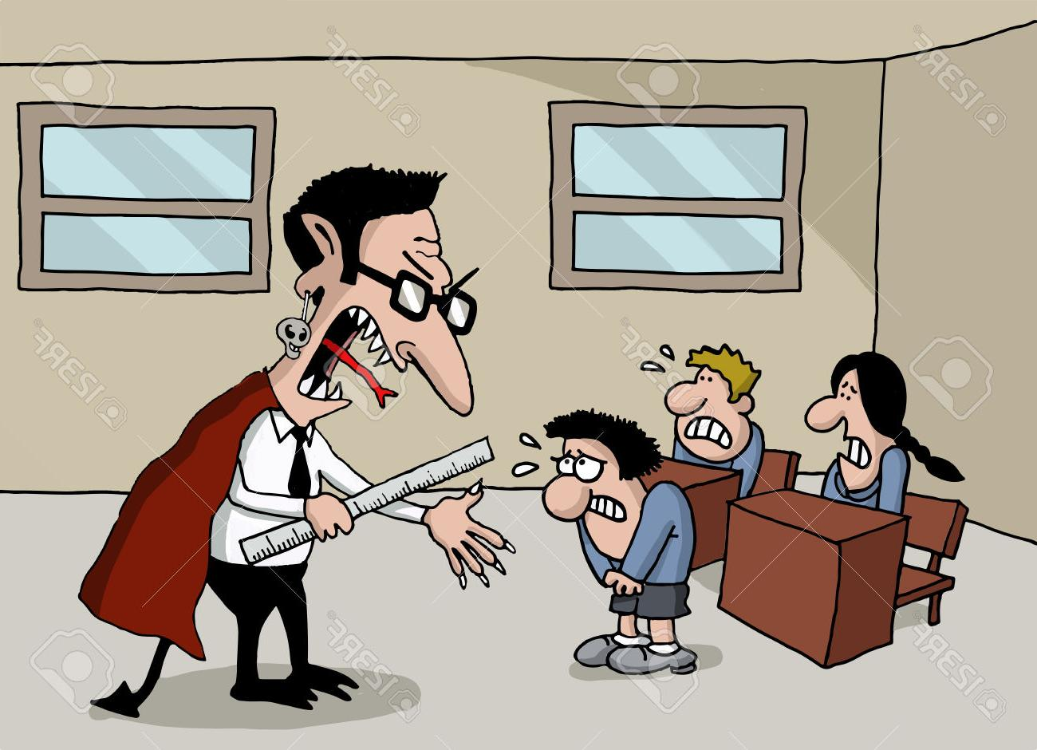
Tips
Praise the positive
Re-read your feedback when you finish before sending it to the student
Consider colour-coding common errors

Slide 14
Dialling back . . .
It frustrates me when I get a lot of comments related to one grammar point. Just give one comment.
If it’s wrong once, don’t write the same thing over and over or I don’t think about it. I don’t discover the mistake for myself. If it’s written each time, I correct it without thinking. I can’t notice it.

Slide 15
And…
Process writing: interim submission are drafts, and not the final piece

Slide 16
Finally, . . .
Each student and each submission is different and (hopefully) represents a lot of hard work. Be open to different approaches and styles both in terms of student submissions and your own feedback.

Slide 17
Bibliography
Bitchener, J., Young, S., & Cameron, D. (2005). The effect of different types of corrective feedback on ESL student writing. Journal of Second Language Writing, 14 (3), 191-205.
Chandler, J. (2003). The efficacy of various kinds of error feedback for improvement in the accuracy and fluency of L2 student writing. Journal of Second Language Writing, 12 (3), 267–296.
Dawson, P., Henderson, M., Mahoney, P., Phillips, M., Ryan, T., Boud, D. & Molloy, E. (2019) What makes for effective feedback: staff and student perspectives, Assessment & Evaluation in Higher Education, 44:1, 25-36, DOI: 10.1080/02602938.2018.1467877
Ellis, R. (2008). A typology of written corrective feedback types. ELT Journal, 63 (2), 97–107.
Ferris, D. (1996). The Case for Grammar Correction in L2 Writing Classes: A Response to Truscott (1996). Journal of Second Language Writing, 8 (1), 1-11.
Ferris, D. & Roberts, B. (2001). Error feedback in L2 writing classes: How explicit does it need to be? Journal of Second Language Writing, 10 (3), 161–184.
Ferris, D. (2006). Does error feedback help student writers? New evidence on the short- and long-term effects of written error correction. In K. Hyland & F. Hyland (Eds.), Feedback in Second Language Writing (pp. 81-104). Cambridge: Cambridge University Press.
Steen-Utheim, A. & Hopfenbeck, T. (2019) To do or not to do with feedback. A study of undergraduate students’ engagement and use of feedback within a portfolio assessment design. Assessment & Evaluation in Higher Education, 44:1, 80-96, DOI: 10.1080/02602938.2018.1476669
Yang, M., & Carless, D. (2013). The feedback triangle and the enhancement of dialogic feedback processes. Teaching in Higher Education, 18(3), 285–297

Slide 18
It’s good to talk….
richard.lee@nottingham.ac.uk
sandra.leigh@nottingham.ac.uk
lisa.robinson@nottingham.ac.uk

