Slide 1
Learner engagement with teacher-generated electronic formative feedback on EAP writing:
A multiple case study of international foundation students
Caroline Fletcher
carojfletcher@gmail.com
twitter.com/Caro_Fletcher

Slide 2
Session Overview
Context
Conceptual framework
Qualitative data collection method
Key findings on affective engagement
Looking forward

Slide 3
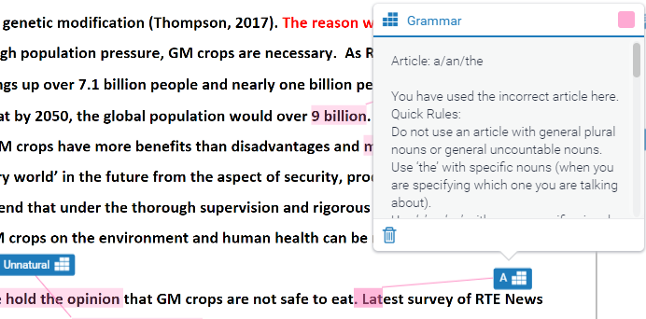
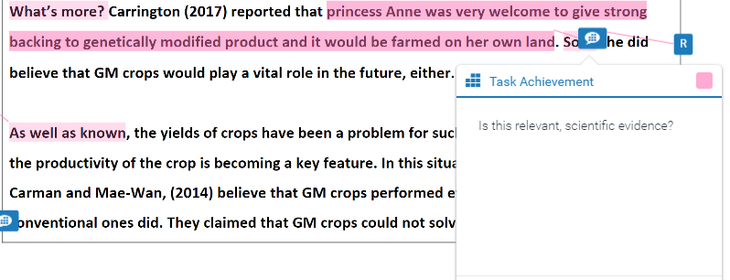
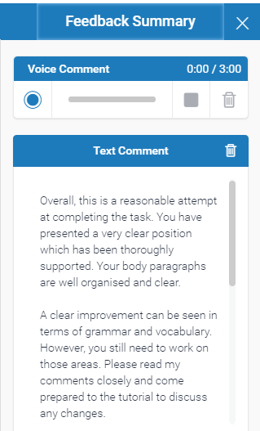
FF on Assessed Writing
1. QuickMarks
(error correction code)
2. Comments
3. Feedback Summary
4. Grading Form
Notes:
The study was conducted on the EAP module of a Foundation course.
The study looked at how students responded to FF on their final assessed writing task.
3 IFY students: Chinese, 18 years old, IELTS 5.5, same teaching group.
GradeMark functions in Turnitin were used to provide formative feedback on writing.
In-text feedback = QuickMarks & Comments
End comments = Feedback summary and Grading form.
This is a lot of information for students and I wanted to know how Ss responded.

Slide 4
Conceptual framework
Text analyses
Dimensions of engagement | Indicators of engagement
Behavioural engagement | Revisions to writing
Affective engagement | Emotional reactions Attitudinal responses
Cognitive engagement | Cognitive operations Metacognitive operations
Framework adapted from Ellis (2010) and Han & Hyland (2015)
Prompted interviews

Slide 5
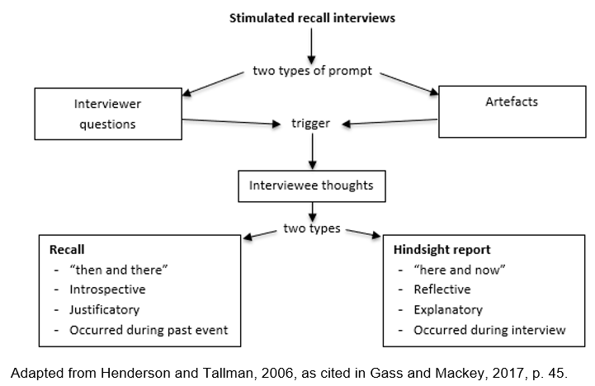
Methodology: Interviews
Notes:
Stimulated recall is a widely used technique for investigating cognitive and meta-cognitive processes. On a smaller scale, it has been used to explore affective factors - attitudes and beliefs.
Artefacts:
- Traditionally video and audio artefacts. However, Gass and Mackey (2017) recently advocated wider use of the technique, for example using writing drafts as prompts to explore student responses to feedback.
Interviewer questions: e.g. How did you feel/What did you think when you read that Comment from your teacher?
Interviewee thoughts: Interviewee recall their thoughts during a past activity with increased vividness and accuracy.
Recall: strict SR focuses only on this.
Hindsight report:
hindsight reports could also provide useful information about attitude and beliefs
follow-up questions were asked, e.g. ‘which of the four types of feedback do you find most useful?’
Advantages:
it requires very little learner training compared with other introspective data collection methods, e.g. think-aloud protocols.
Limitations:
Timing. The closer an interview is to the event, the more accurate and therefore reliable the data will be. Bloom (1953) the originator of SR advocated that interviews be conducted within 48 hours of the event. In this study interviews were conducted within 48 hours of final draft submission. However FF was available one week prior to final submission deadline, so participants may have engaged with FF more than 48 hours before the interview.
Self report data inherently has issues of reliability as it is not possible to confirm whether what a participant reports they thought/felt is exactly what they did think/feel at the time.
Furthermore introspective data collection methods assume that participants can articulate their thought processes, which is particularly problematic in a second language.

Slide 6
Findings: Affective Engagement
13 different emotions reported, including:
☹ confusion, dissatisfaction, nervousness, guilt
☺ confidence, happiness, pride
Attitudes ranged from overwhelming positivity to predominantly negative
3 very different profiles
Lilly | Bill | Mo
☹ | ☺ | 😐

Slide 7
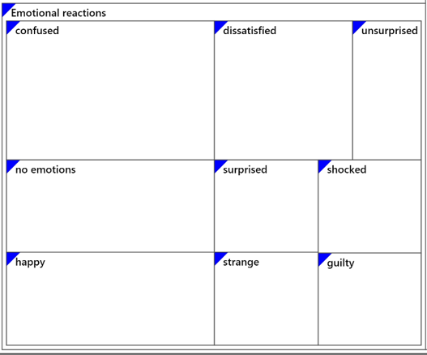
Affective Engagement: Lilly ☹
Mixed/negative emotional response
Notes:
Dissatisfied that the feedback focussed on surface-level issues.
Guilt that she was making mistakes with ‘And’ and ‘But’ at start of sentence.

Slide 8
Affective Engagement: Lilly ☹
Mixed attitude tending towards negativity
Rejection of feedback points:
- “apparently that does not work for [the teacher]”;
- “I already knew she would give one to this.”
Rejection of overall evaluation: “appears to be more positive than the fact so I lowered down the comments”
QMs & Comments most helpful: “I get to know my mistakes”; “she mentioned it here, then I learnt it.”
Turnitin is a “convenient tool” in general, but meaning of icons is not clear
Notes:
Lilly received three points of praise and two improvement suggestions in Feedback summary.

Slide 9
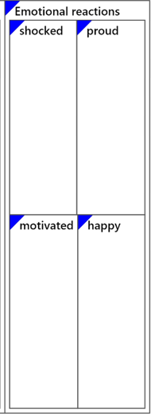
Affective Engagement: Bill ☺
Predominantly positive emotional response

Slide 10
Affective Engagement: Bill ☺
Overwhelmingly positive attitude
Keen to see feedback: “when I get back home, I immediately log into Turnitin...I much want to know how I performed”
Acceptance of all feedback points: “I will read every comment and based on that comment, I will correct to a satisfied one”
Feedback is “very useful”, especially QMs and Comments
Turnitin is “almost a perfect platform”

Slide 11
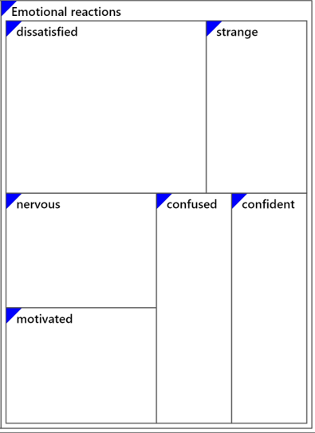
Affective Engagement: Mo 😐
Mixed emotional response
Notes:
Lilly and Mo received substantial praise in their feedback summaries. Mo received four points of praise and four improvement suggestions. Lilly received three points of praise and two improvement suggestions. Bill, on the other hand, the only participant that accepted his teacher’s overall evaluation received two points of praise and four improvement suggestions. There is literature that shows how students view excessive praise as insincere.

Slide 12
Affective Engagement: Mo 😐
Mixed attitude tending towards positivity
Acceptance of individual feedback points: the teacher is “quite right!”
Rejection of Feedback Summary: “When I really read my comments and then I realise maybe it’s just not really true”
QMs & Comments are helpful: “I’ll be happy if I have more”
Turnitin is “a good software”.

Slide 13
Conclusions: Affective Engagement
Positive attitude toward Turnitin.
- Consistent with Watkins et al. (2014)
QMs and Comments = most helpful feedback functions.
Excessive generic praise in Feedback Summaries appeared to negatively impact attitude in the cases of Lilly and Mo.
Specific praise in Comments created positive emotions for all.
- Consistent with Hyland & Hyland (2001)
Negative affective response did not have an obvious detrimental effect on revision success (Lilly = 83%; Bill = 84%; Mo = 79%) - Contrasts with Storch & Wigglesworth (2010)
Notes:
Both Lilly and Mo received substantial praise in their feedback summaries. Mo received four points of praise and four improvement suggestions. Lilly received three points of praise and two improvement suggestions. Bill, on the other hand, the only participant that accepted his teacher’s overall evaluation received two points of praise and four improvement suggestions. There is literature that shows how students view excessive praise as insincere.
Previous studies (e.g. Storch & Wigglesworth, 2010) state that those with negative attitudes towards FF attempt less revisions, but this study shows that that may be too simplistic and that the link between attitude and revision is not necessarily so straightforward.

Slide 14
Looking forward
Internal replication of text analysis with more participants
More in-depth case studies on TEFF
Longitudinal study following students into academic departments

Slide 15
Key references
Ellis, R. (2010). Epilogue: A framework for investigating oral and written corrective feedback. Studies in Second Language Acquisition, 32, 335–349. https://doi.org/10.1017/S0272263109990544
Gass, S., & Mackey, A. (2017). Stimulated recall methodology in applied linguistics and L2 research (2nd ed.). New York: Routledge.
Han, Y., & Hyland, F. (2015). Exploring learner engagement with written corrective feedback in a Chinese tertiary EFL classroom. Journal of Second Language Writing, 30, 31–44. https://doi.org/10.1016/j.jslw.2015.08.002
Hyland, F., & Hyland, K. (2001). Sugaring the pill: praise and criticism in written feedback. Journal of Second Language Writing, 10, 185–212. https://doi.org/10.1016/S1060-3743(01)00038-8
Storch, N., & Wigglesworth, G. (2010). Learners’ processing, uptake, and retention of corrective feedback on writing. Studies in Second Language Acquisition, 32, 303–334. https://doi.org/10.1017/S0272263109990532
Watkins, D., Dummer, P., Hawthorne, K., Cousins, J., Emmett, C., & Johnson, M. (2014). Healthcare Students’ Perceptions of Electronic Feedback through GradeMark®. Journal of Information Technology Education: Research, 13, 27–47. Retrieved from http://www.jite.org/documents/Vol13/JITEv13ResearchP027-047Watkins0592.pdf

Slide 16
To
Discover
And
Understand.

