Slide 1
Can academic Reading empower EAP students?
Anna Murawska
Into Newcastle University
Anna.murawska@newcastle.ac.uk
EAP Masters Dissertation Award

Slide 2
outline
Rationale & definitions
Barriers to empowerment: L2 readers in HE
Does EAP teach reading in an empowering way?
Research
Implications
Discussion & questions

Slide 3
Rationale & definitions
Rationale: personal & professional
Empower: access, equality, voice, confidence, resistance

Slide 4
Barriers to empowerment - l2 readers in postgraduate study
Misunderstanding of what the purpose of academic reading on PG level is
  Disempowering: text as an objective carrier of “correct” knowledge (Erdreich and Rapoport (2002), Gamache (2002)
Students´ previous experience of reading in English
  Disempowering: text as a linguistic object (Maclellan, 1997)
Reading naturalised as pre-writing
  Disempowering: invisible / assessed (Mann, 2000)
  OVERALL: reading = playing a game, which rules you don’t know
  There is a need for explicit reading pedagogy

Slide 5
Does eap teach reading in an empowering way?
3 broad approaches to academic literacy → different empowering potential (table 2)
  Traditionalist: skills oriented
  Social: text oriented
  Critical: practices oriented
No EAP reading research in critical paradigm
Research question: Can academic reading empower EAP students?

Slide 6
research
Context: 8-months pre-masters programme, 85% Chinese students
Entry requirements: IELTS: 5.5
18 participants: 3 x group interview and 6 individual interviews
Qualitative research paradigm: Narrative Inquiry
Data analysis and presentation: 1 reading story
Focal participant: Bea
Story title: “Reading in a second language is like doing ……….. but it can help me break …..……………”

Slide 7
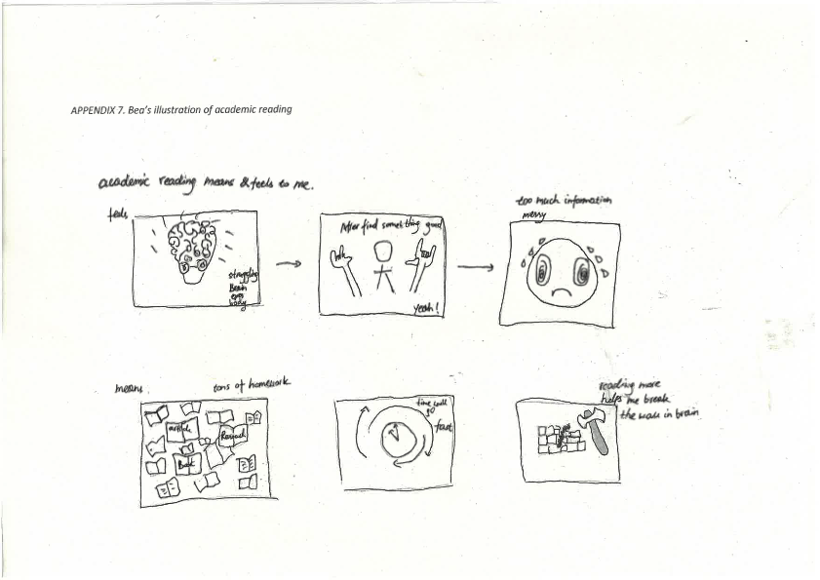
“Reading in a second language is like doing mathematics but it can help me break the wall in my brain”

Slide 8
Can academic reading empower eap students?
3 reading identities
  A reader of English
  A reader of Western Worlds
  A reader of Academia

Slide 9
identity 1. a reader of English
DISEMPOWERING
Powerlessness
“sometimes it’s not clear what the author means”, “I don’t know why, I thought I’d understood…”
Technical skill
“I have to find a subject, verb. It is like doing mathematics”
EMPOWERING
Independence
“with writing nobody can help […] by reading again and again you can check yourself”
Frustration
“and if you check all the new vocabulary you forget what the previous part said”
Prisoner of text
“when I get the task, I read a lot, many times”, “all my day on reading” , “the day is gone”
Physical effort / discomfort
“my brain, eyes and body struggle”
Resistance
“it’s just language, it won’t stop me from learning things”

Slide 10
identity 2. a reader of western worlds
DISEMPOWERING
Meaningless: “if the topic is totally new, maybe it doesn’t speak to me”
Irrelevant: “British articles are often not applicable to my context”
Unable to exploit inner capital: “I sometimes read in Chinese but there’s a drawback. When I use <English> key words from these articles I only get Chinese researchers, not the foreigners.
Agentless: And sometimes when I have my own idea and want to find evidence, this evidence is only in Chinese” so “If I want <my teachers> to think it’s rational and makes sense I need to change my logic”.
EMPOWERING?
Resistance: “<With topics such as> freedom or else, <there’s> different understanding and values. I found some articles online, in which they will think it’s correct and totally right and want to communicate to other westerners and just enjoy their world” (soft laugh).

Slide 11
identity 3. a reader of academia
DISEMPOWERING
Anxiety
“if there’s a strong argument against my own I’ll be worried”
EMPOWERING
Active reading
“if I read actively by offering my idea and questions then I can get more”
Drawing on experience
“With Culture Shock essay, because you might think what the author says is wrong or not perfect and you have a lot of your own ideas against it, it will help you find other sources”
Transformative (”disruption of knowledge”)
“interesting content breaks the wall in my brain”

Slide 12
Can academic reading empower eap students?
Complex phenomenon
Academic reading can be empowering, but for the most part it was not
Empowering practices by-product of students’ learning rather than teaching / curriculum design
THEREFORE
There is a need for a systematic reading curriculum
Although traditionalist & social approaches facilitate empowering reading experiences to some extent, there is more empowering potential yet to unlock in critical paradigm

Slide 13
Implications: EaP & beyond
EAP curriculum
  Culturally inclusive course readings and assignment topics
  Comprehension as well as reactions to text
  Allowing texts in L1
  Using online “non-academic” sources (e.g. academic blogs)
  More reflective approach to reading & learning
  Alternative assessment
Classroom practice
  Text as a usable resource and not a lingustic object
    Disassembling texts (Gimenez and Thomas, 2015)
  Reading as a group activity
Wider context
  Subject teachers’ role

Slide 14
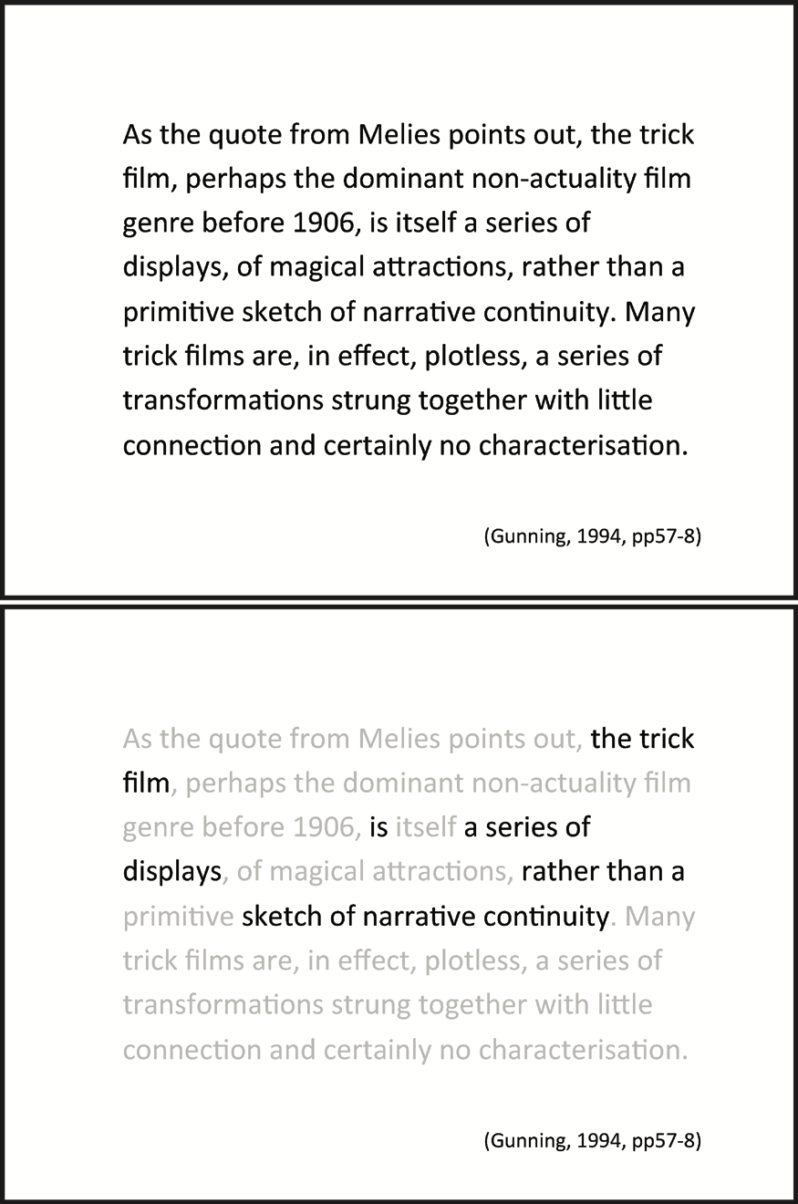

Implications: classroom practice
  Text as a usable resource and not a lingustic object
    “objectifying text”

Slide 15
on my programme
Explicit reading instruction
Encourage annotations / marginalia (Asimakopoulos, 2015)
Critical reading worksheets
Reflective journals with structured questions
Reflective essays

Slide 16
Conclusion
EAP mission: “access to ways of knowing” (Hyland, 2018)
It is our responsibility to make academic reading practices more visible

Slide 17
Discussion and Questions
Please share examples of good practice / relevant research (Anna.murawska@newcastle.ac.uk)
What can we do to go beyond study skills and genre approaches? (see: table 2)

Slide 18
References
Asimakopoulos (2015) Reading in Reading
Erdreich, L., & Rapoport, T. (2002). Elaborating ethnonational awareness via academic literacy: Palestinian Israeli women at the university. Anthropology & education quarterly, 33(4), 492-515.
Gamache, P. (2002). University students as creators of personal knowledge: An alternative epistemological view. Teaching in higher education, 7(3), 277-294.
Gimenez, J. & Thomas, P. (2015). A framework for usable pedagogy: case studies towards accessibility, criticality and visibility. In: T. Lillis, K. Harrington, M. Lea & S. Mitchell, S. (Eds.). Working with academic literacies: Case studies towards transformative practice (p.29-44). The WAC Clearinghouse/Parlor Press.
Hyland, K. (2018). Sympathy for the devil? A defence of EAP. Language Teaching, 51(3), 383-399. doi:10.1017/S0261444818000101
Mann, S. J. (2000). The students' experience of reading. Higher Education, 39(3), 297-317.
Maclellan, E . (1997) ‘Reading to Learn’, Studies in Higher Education 22: 277–88.

