Slide 1
BALEAP PIM
Talking about Texts:
Using Reading and Listening Circles to provide students with a meaningful purpose to engage with texts in seminars and presentations.
Christine Lee and Elizabeth Allen
Notes:
25 mins

Slide 2
Overview
Why did we use Reading and Listening Circles?
What are they?
How do they help students to talk about texts?
What do tutors and students think?

Slide 3
Advanced English Language Skills (ADV)
UG, 1 term, 20 credits
Erasmus and Study Abroad
Theme: Roots and Routes
Reading and listening texts on culture and language
- Redrafted coursework on the theme
But… students were not engaging with the texts

Slide 4
ADV Skills
Reading and Listening Circles introduced 2016-17
Much higher engagement with texts – increased engagement in seminars deeper understanding - evidenced in assessed presentations & coursework
What are Reading and Listening Circles?

Slide 5
Literature Circles for EFL (Furr, 2004)
Literature Circles (Daniels, 1994, 2002)
High school students, USA, ‘book club’:
Each student has a role e.g. Connector, Questioner, Passage Master, Illustrator
Later, roles evolved into to ‘reading logs’ (2002)
Adapted roles, included Culture Collector
Adapted roles, included Contextualiser (research in the text)
Academic Reading Circles (Seburn, 2016)
Notes:
Different cognitive lenses, reflect different purposes for reading and provide a purpose to interact
Furr, Yokohama City Uni, Japan

Slide 6
ADV: Reading and Listening Circles: Version 1
Adapted roles (reduced to 4):
  Language
  Context
  Meaning
  Visualisation
4 texts: 2 listening, 2 reading
4-week cycle
Notes:
Breakdown different approaches to texts and SS able to focus on just one, instead of all of them, and develop their ability to do each one
4 texts – all SS do all roles, and later 1) choose and present own texts incorporating the different roles/perspectives 2) incorporate into redrafted coursework

Slide 7
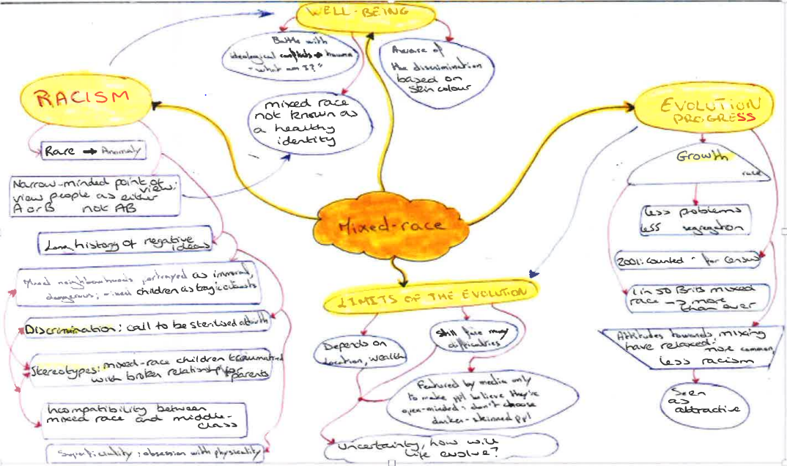
ADV: Example visualization

Slide 8
International Foundation Programme (IFP)
Accelerated Text Response
High level English
Poor engagement with texts in seminars & presentations:
Synthesizing ideas
Critically evaluating ideas
Reading and Listening Circles introduced 2017-18

Slide 9
IFP: Reading and Listening Circles: Version 2
Process:
Each student finds 2 academic texts related to their discipline: 1 written + 1 oral
Students justify text selection to their group
Group selects 4 of the 8 texts with similar themes:
  Theme 1: reading x1, listening x1
  Theme 2: reading x1, listening x1
Allocate 4 roles (1 for each text) and prepare

Slide 10
IFP: Reading and Listening Circles: Version 2
Adapted roles:
Language and structure: vocab, coherence & cohesion
Context: author, references to other texts, counter-arguments, critiques
Meaning: key points, audience, purpose, format, author’s stance, bias
Visualisation: diagram/picture/mind map

Slide 11
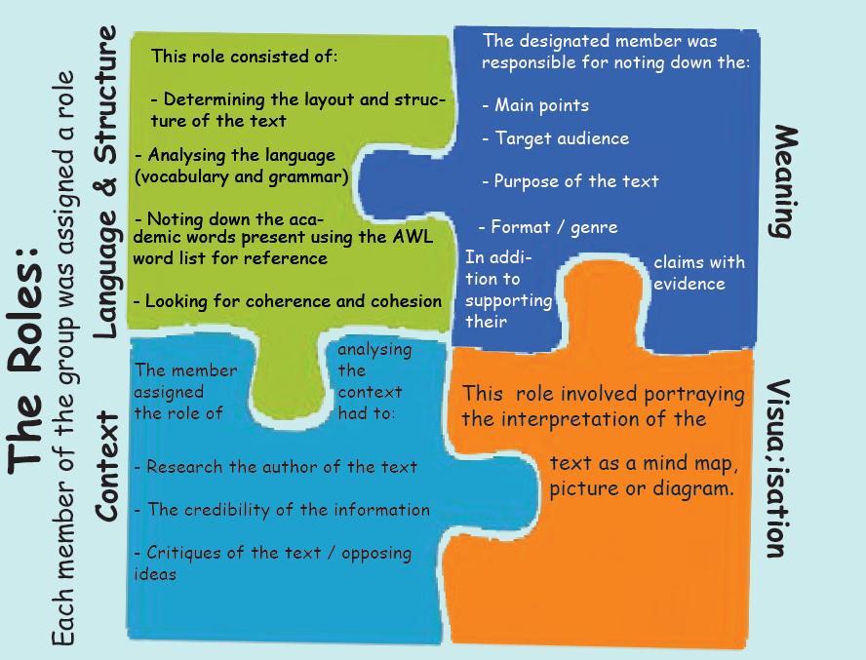
Students’ visualisation of the roles (IFP, 2017)
IFP students 2017-18

Slide 12
IFP: Reading and Listening Circles: Version 2
Seminar discussion - each text from their perspective and then synthesize 2 texts
Group presentation - a critical response of the 2 texts
Repeat for next 2 texts
Group synthesize all 4 texts & the process - present as a poster:
  What did we do?
  What did we learn?

Slide 13
Feedback
ADV (24 students, 58% response rate)
R&L Circles helped to develop:
  Seminar skills: 72%
  Presentation skills: 86%
IFP (39 students, 73% response rate)
R&L Circles helped to develop:
  Seminar skills: 74%
  Presentation skills: 82%
‘The role allocation of the Reading and Listening Circles made it possible for us to debate and argue more systematically’ (IFP, 2018)
Tutors: positive, implementing it in other programmes e.g. PS 2018
Notes:
% agree or strongly agree on likert scale 1-5

Slide 14
References
Daniels, H., 1994. Literature circles: Voice and choice in the student-centered classroom. Stenhouse Publishers.
Daniels, H., 2002. Literature circles: Voice and choice in book clubs and reading groups. Stenhouse Publishers.
Furr, M., 2004. Literature circles for the EFL classroom. In Proceedings of the 2003 TESOL Arabia Conference.
Seburn, T., 2016. Academic reading circles. Createspace Independent Publishing Platform.

Slide 15
Thank you for listening
Questions?
mlcpl@bristol.ac.uk (Christine Lee)
Elizabeth.Allen@bristol.ac.uk
@EAllenUoB

