Slide 1
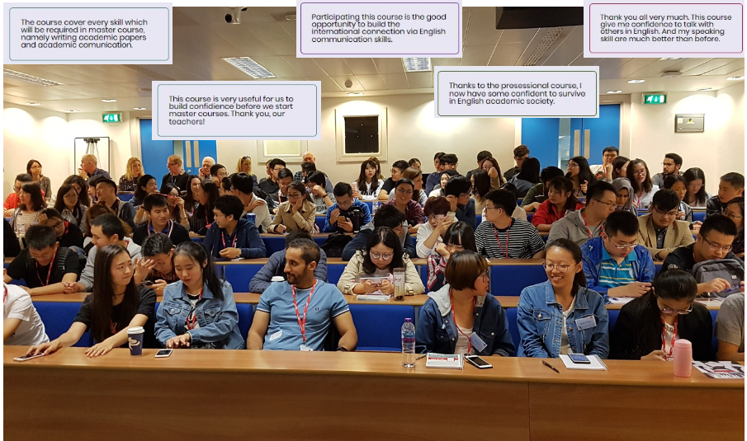
Pre-sessional assessment
of spoken English for STEM postgraduates
12-week course - approx. 25 students 6-week course - 80 – 100 students

Slide 2
Pre-sessional assessment of spoken English for STEM postgraduates
Liz Chiu

Slide 3
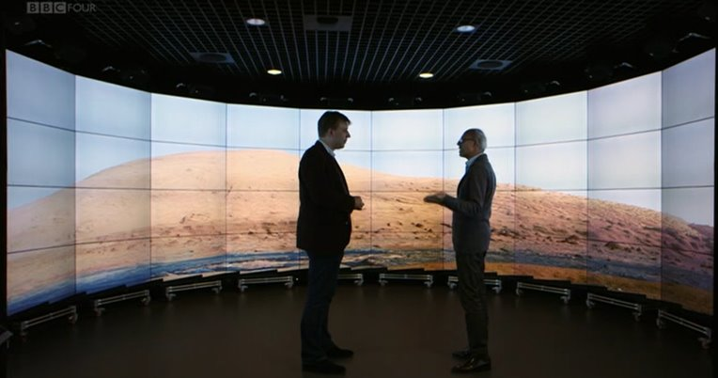
Our context Science Technology Engineering Maths Medicine

Slide 4
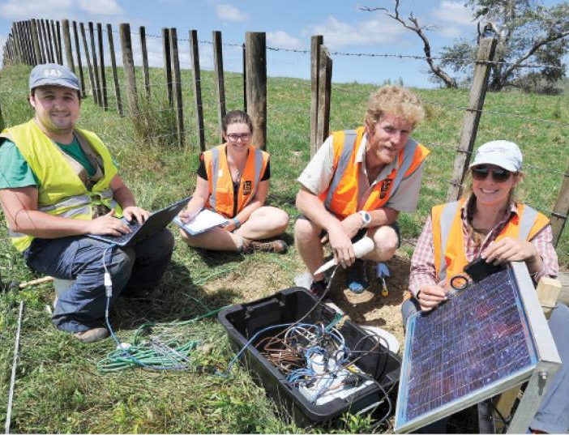
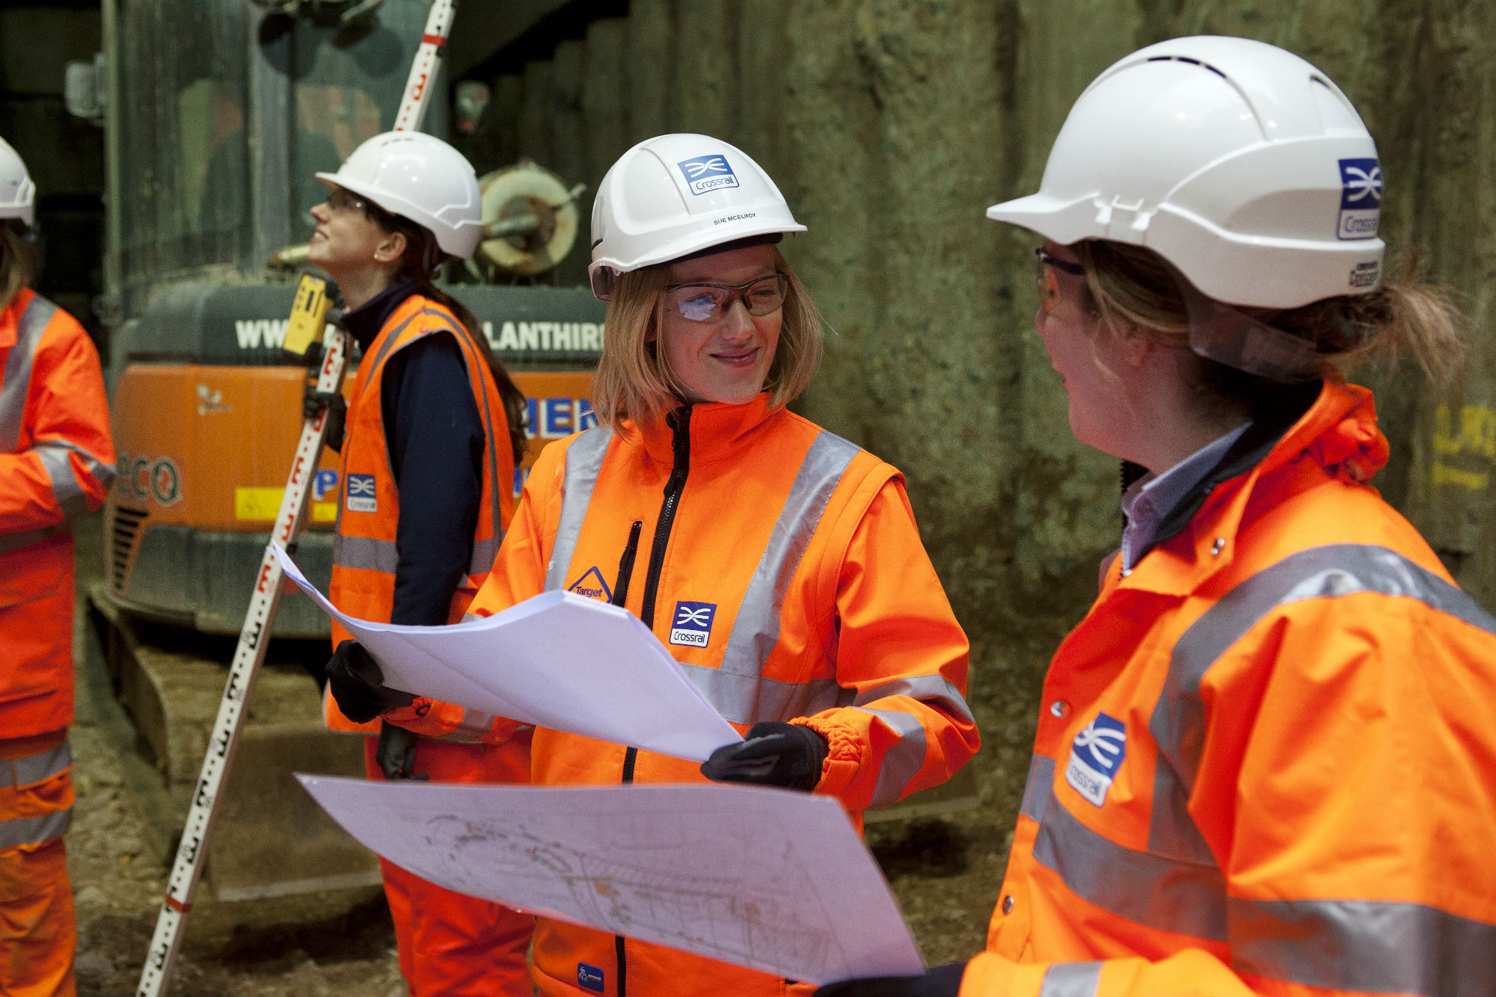
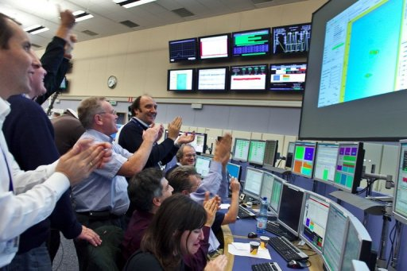
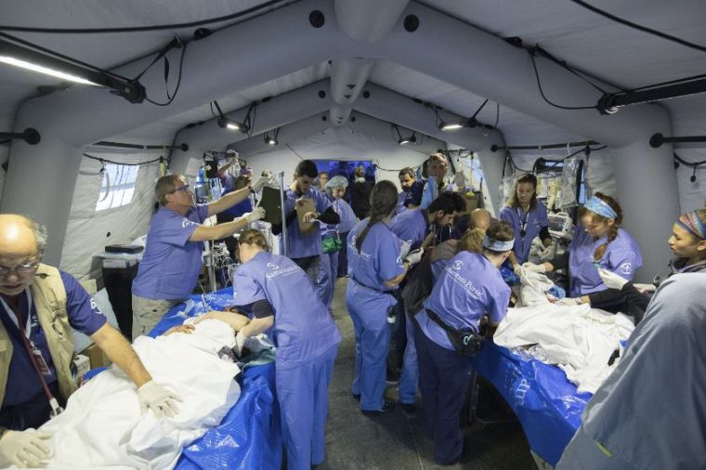
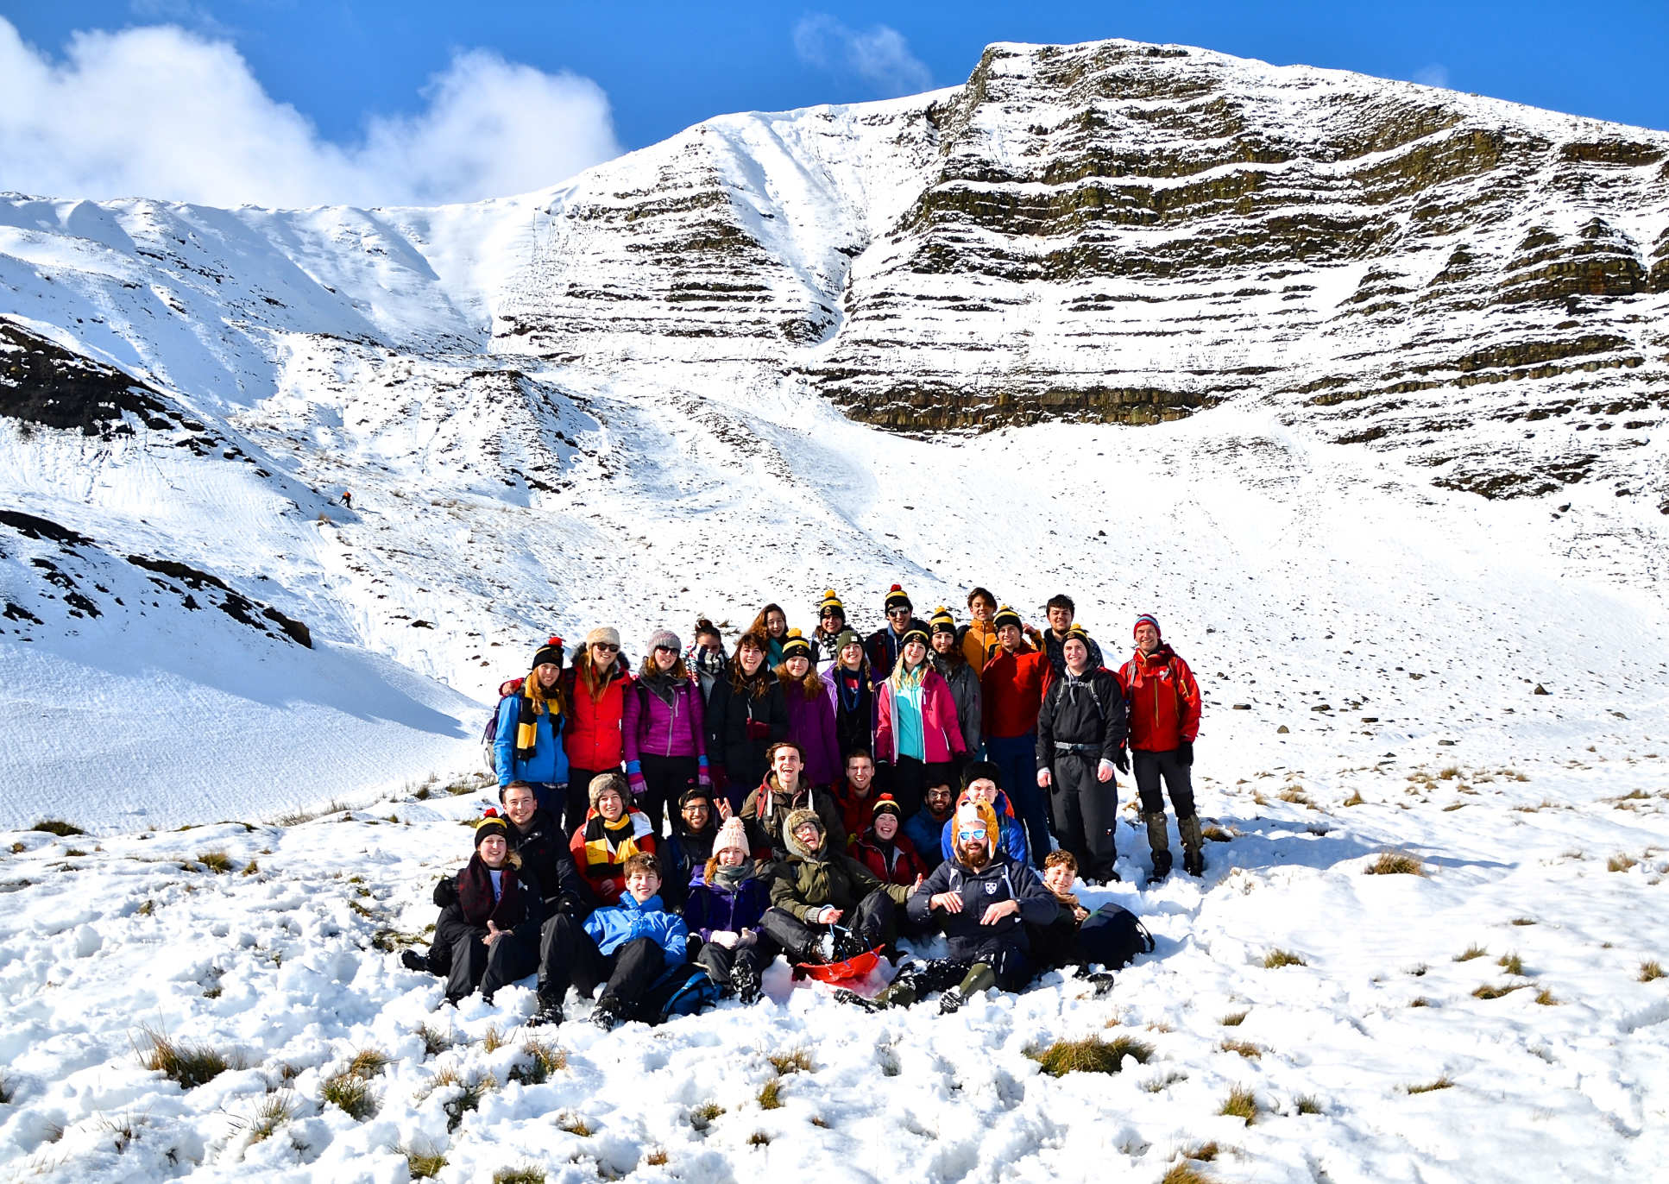

Slide 5
English: fit-for-purpose?
We wanted to …
enable students to demonstrate
that their English is fit-for-purpose
(for PG study at Imperial College)
under assessment conditions

Slide 6
Pre-sessional assessment of spoken English for STEM postgraduates
What do you need to do to pass a speaking assessment?
What speaking skills do STEM postgraduates need?
Does preparation for assessment build useful skills?

Slide 7
IELTS 6.0
Describe a book you have recently read.
Describe a happy childhood event.
Describe something you own which is very important to you.
Part 1 | Answer questions about yourself and your family.
Part 2 | Speak about a topic.
Part 3 | Have a longer discussion about the topic introduced in Part 2
Describe a piece of advice you recently received.
Describe a piece of art you like.
Describe a time of the day you like.

Slide 8
Huge gap to fill

Slide 9
Presentations course
allowed choice of topic
required complex science content
‘enabled’ good performers
inhibited nervous performers
demonstrated limited skills
no interaction or communicative competence

Slide 10
Playing the assessment game
IELTS | EAP Presentation
memorisation is a good strategy for success | memorisation is a good strategy for success
topics undemanding, not academic, not scientific (IELTS) | science topic chosen by student HIGH FACE VALIDITY
no interaction / false interaction | marks for performance (but affected by nerves )
low face validity - no feed-forwards | assessment creates negative washback throughout the course

Slide 11
What speaking skills do STEM postgraduates need?
flexibilty
team discussion
communication
paraphrase
check meaning
control
explanations
negotiation
clear description
precision

Slide 12
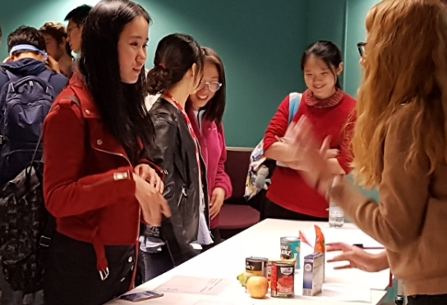
Two points about EAP for STEM
Explaining complex science takes a lot of processing
hard to be fluent with limited language
Student-as-Expert is non-negotiable
students need experience of science interaction

Slide 13
New assessment of spoken English
to assess the skills they need

Slide 14
Assessment by viva
Taking diagram(s) and technical term(s) from their presentation and personal research topic
1:1 with class teacher
class teacher as interlocutor + separate assessor
12-minute format
similar stages to IELTS but with appropriate level of complexity

Slide 15
Aortic valve stenosis
(Presessional student: Lamia Al Saikhan)
Stenotic Aortic Valve
Aorta
Left Ventricle
How do you know the original cross-sectional area of the aortic valve?
LVOT
Left ventricular Outflow tract
Flow dynamics in stenotic aortic valve

Slide 16
Fit-for-purpose?
Precision - Control - Flexibility
show us what they can do
have a genuine desire to make teacher understand
are able to draw on their own communication skills
Students find their voice

Slide 17
Assessment criteria
Interaction, communication, language, delivery
(not memorisation or performance)
Learning-oriented assessment
Practice for the viva creates positive washback
Cycles of observe > practice > feedback > improvement
These skills feed-forward to future studies

Slide 18
TO PREPARE FOR THE VIVA …
We kept the Presentations event …

Slide 19
Quantum Teleportation
18 September 2017
A completely safe way to transfer information
Presessional student 1
Xiaojun Xu
MSc Physics with extended research Department of Physics

Slide 20
The application of desulphurization gypsum
to saline-alkali soil
Dike Wu
Presessional
student 2
3A: Adele’s Group

Slide 21
Receptor Selection and Targeting Evaluation of Glioma Treatment
Shunping Han
Presessional student 3
2017.09.18
Pre-sessional English course

Slide 22
We kept the Presentations Event
Challenging for teachers!
How?
Student-as-expert in Specialist Subject Workshop
peer-to-peer teaching and learning of content
English teacher as language facilitator

Slide 23
TO PREPARE FOR THE INDIVIDUAL PRESENTATION…
We held 2 paired poster events:
presenting to new students (on non-assessed course)
visiting reciprocal event
https://web.microsoftstream.com/video/e248feff-a94e-4f22-b0d2-833073b28a70

Slide 24
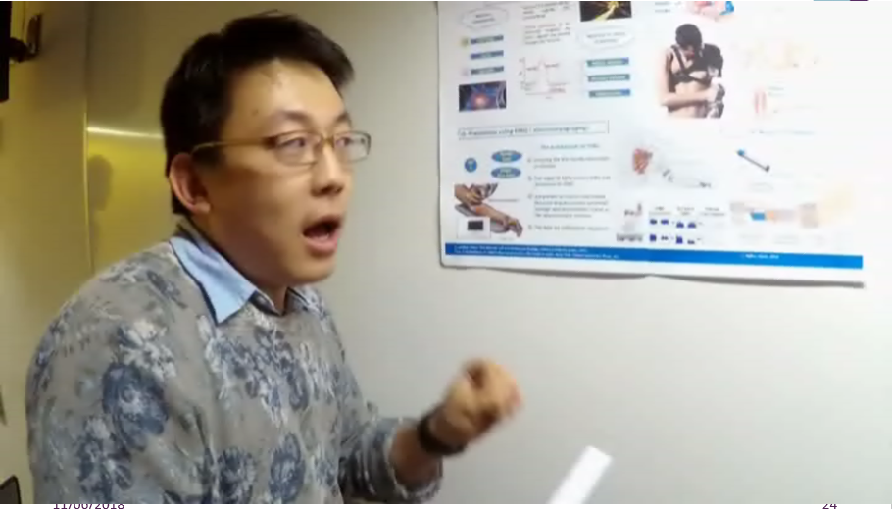
Robotic Arm Presessional student: Chen Wang (poster prizewinner)
https://web.microsoftstream.com/video/e248feff-a94e-4f22-b0d2-833073b28a70

Slide 25
TO PREPARE FOR THE POSTER PRESENTATION…
ResearchFest!
We invite researchers from across Imperial College
Students interact with model speakers

Slide 26
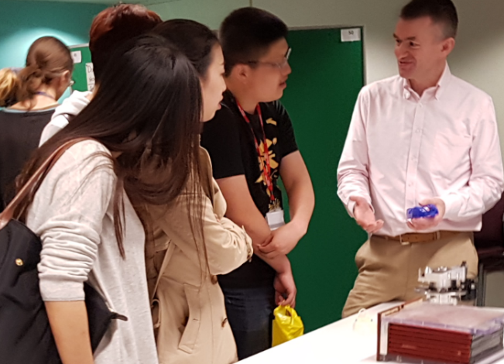
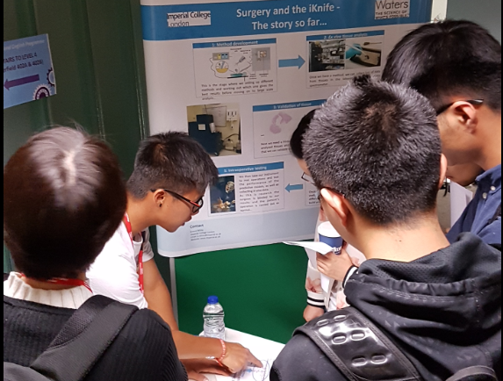
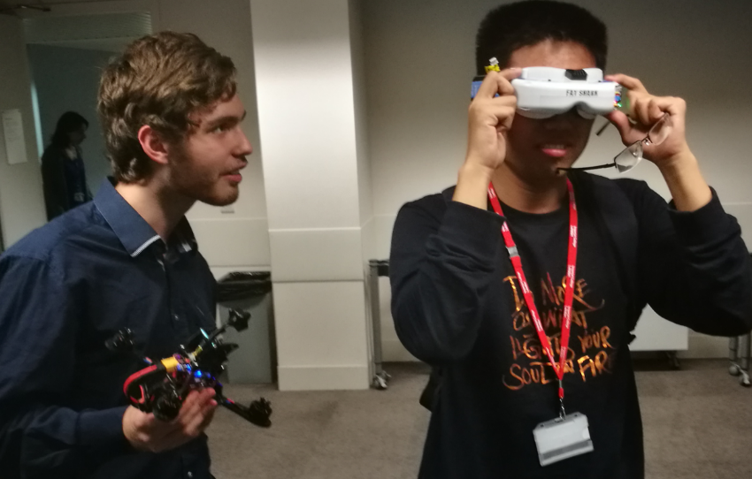
ResearchFest!

Slide 27
ResearchFest!
https://web.microsoftstream.com/video/7408b01f-b750-4397-a423-0542a11e86f3

Slide 28
IN THE FIRST HALF OF THE COURSE…
Café Scientific x 2
https://web.microsoftstream.com/video/6d7b8e19-ab17-49a7-9302-a4ef1b76bdeb

Slide 29
To prepare for the viva…
1. Held interactive events which require spontaneous, unprepared speech for communicating science in English
2. Kept a final presentation event
valuable speaking opportunity without the worry of assessment
3. Introduced a focus on
groupwork and collaboration
cultural orientation towards the use of spoken English rather than L1

Slide 30
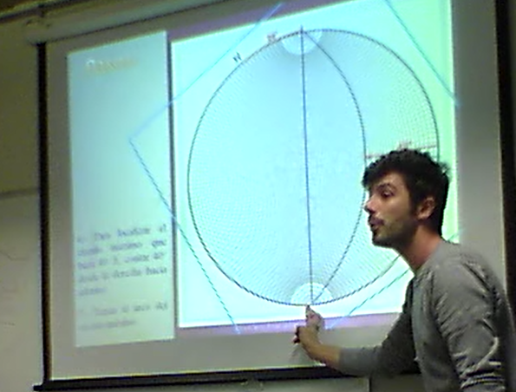
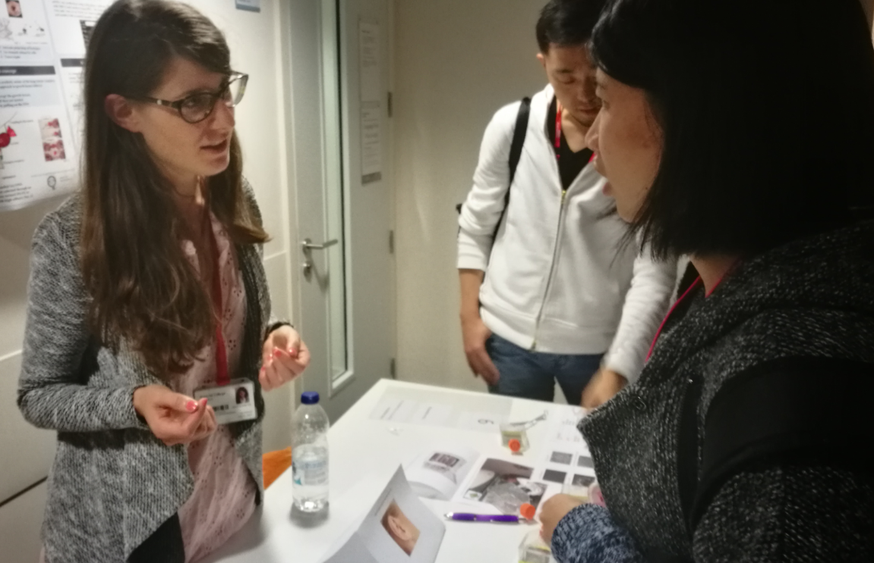
Preparation for PG studies
Students have the chance to behave like scientists
ability to explain their own field
interaction with different fields
Develop confidence to communicate complex topics
courage to speak at events

Slide 32
From experience …
Our viva needs interlocutor + assessor
it would be impossible to do both things satisfactorily

Slide 33
From experience …
Changing role for the teacher
handing over control to students
increasing effectiveness as language teacher

Slide 34
Teacher quotes
“Students did quite well in the viva who may have been at risk of failing the presentation.”
“the viva was a truer measure of the students’ ability to communicate their science”
“Best of both worlds - they get the benefits of the experience of presenting without the pressure of being assessed on that basis.”

Slide 35
Does preparation for assessment build useful skills?
Only if it’s the right assessment!

Slide 36
Thanks for listening
Playing the assessment game
memorisation is a good strategy for success (but inhibits communication)
marks for performance, and nerves affect performance (presentations)
no interaction / false interaction
topics undemanding, not academic, not scientific (IELTS)
low face validity - no feed-forwards
assessment creates negative washback throughout the course

Slide 37
Thanks for listening – Any questions?
Playing the assessment game | Observed benefits of viva assessment
memorisation is a good strategy for success (but inhibits communication) | 'student-as-expert’ really wants to make teacher understand complex topic
marks for performance, and nerves affect performance (presentations) | preparation through peer learning and teaching develops PG skills and confidence
no interaction / false interaction | research topic feeds into PG study and is not ‘dumbed-down’ – good face validity
topics undemanding, not academic, not scientific (IELTS) | students recognise the importance of the listener and become more flexible speakers
low face validity - no feed-forwards | teachers are freed up to observe and guide language and communication
assessment creates negative washback throughout the course | viva produces a realistic sample of speech with genuine interaction

