Slide 1
INTO Newcastle PIM
9th June 2018
Does Beyoncé Float Your Boat?
Improving discipline-specific speaking skills for international foundation students
Katherine High
EAP Tutor
F_{B} = ρ_{f} V_{f} g
Notes:
Physics Link anecdote: Beyonce v Buoyancy

Slide 2
Outline
Background and context
Materials design
Speaking tasks
Evaluation: method & results
Lecturer reflections
Course development
Q&A / Discussion

Slide 3
Background & Context
IFP at Bristol – pathways and course options
BCH – British Constitutional History
  20 students
    18 applied to do Law at UOB
    13 received offers / 5 offered criminology
    2 non-law: History / International Relations
  IELTS speaking level
    5 to 8.5
  Nationalities
    x 9
Notes:
My remit – the challenge to design weekly materials liaising with content lecturer – make it as relevant as possible for ALL – both for assessment in BCH but also highlight transferability to other disciplines / units
Nationalities – implications re turn taking, not speaking out, being educated in Eng at international schools – how course is perceived remedial v developmental

Slide 4
Materials Design
Collaboration
  Timing: CEM (Sloan & Porter, 2010)
  Sample writing (Tribble & Wingate, 2013)
  Cases / Statutes
  Topics and reading materials
Speaking task types
  Discipline-specific content
  Transferable speaking skills
Homework tasks
  Negotiated
  Required
Notes:
dialogic approach to learning: both teacher and learner can make valuable contributions without necessarily having consensus (Mutusov, 2011 p.115)
Rhizomatic Learning – HEA – Dave Cormier
HEA conference last year – Gold in TEF strong focus on creativity / play in learning
SS had voted at start of course to do 1 hour Link Class 1 hour self-guided study – this would feed into the following week’s reflection task

Slide 5



Speaking Tasks (1)
Linked explicitly to the BCH assessment
  Presentations
    using the assessment criteria
    speed-dating for a scaffolded approach
    3MT – 3 minute thesis: technique and engagement
    Happy Human v. Boring Robot
  Speaking an essay
    fish-bone as a planning tool
    The hot-seat –active listening, questioning, challenging
Notes:
Reflection on TASK – re Delta tutor – task v activity – task is what happens in real world – in EAP = IN the discipline / or at university
Revision and clarification of content – I could act as a model student asking qs as the non-expert listener – helped SS think re audience and purpose
SS evaluate 3MT – found a law PhD student who won 3MT so SS engaged with both delivery and content

Slide 6

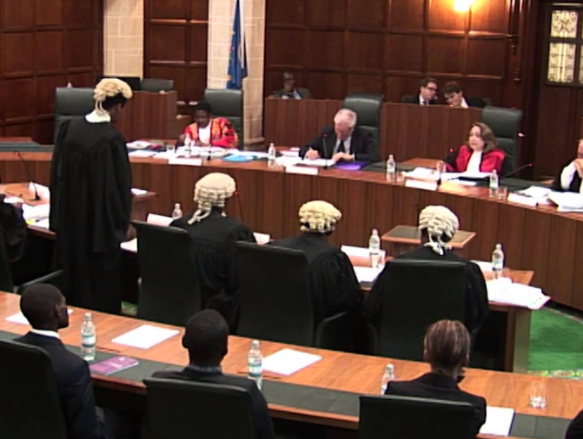
Speaking Tasks (2)
Going beyond the BCH assessment
  Legal scenarios
    Jigsaw photo activities
      being specific, concise and precise
      critical response
      managing uncertainty
  Moot debates
    Discourse analysis: Brunel Moot Court finals (Basturkmen, 1999)
    Devil’s advocate (Parrot & Cherry, 2011)
      Responding to others
      Interrupting and disagreeing
      Interpretation of legislation
Notes:
Brunel Moot Court finals held at UK supreme court – offered pupillages at the end!
Need to exploit the Brunel debate further – i.e. non-verbal language / CONFIDENCE – limitation is that presenters are proficient speakers i.e. using eng as L1 BUT this is often the reality when they move into their disciplines
First moot: more a diagnostic – most students present, didn’t prepare BUT surprised me at how well they responded to the Judge’s questions – gave them confidence – didn’t really know how the Judge would intervene
Constraints: couldn’t book the court room
Second moot: only 2 students turned up BUT was the last lesson before Easter – industrial action – SS morale low – some said they didn’t feel confident enough

Slide 7
Speaking Tasks (3)
Extending discussion outside the classroom
  Padlet:
  https://en-gb.padlet.com/kh15349/gxit0szxpmxe
    Enabled quieter students to share their opinions / ideas
    Fluid genre – like a blog post – merging written and spoken discourse (Kuteeva, 2016)
    Served as a repository for revision
    Encouraged critical thinking – challenging / questioning
    Preparation for the next link class – ideas in mind
Notes:
Need to exploit the Brunel debate further – i.e. non-verbal language / CONFIDENCE – limitation is that presenters are proficient speakers i.e. using eng as L1 BUT this is often the reality when they move into their disciplines

Slide 8
Evaluation: Method & Results
Bristol Online Survey (BOS)
Completed on phones in last lesson
n=14
Confidence ranking questions: 0 – not improved – 3 really improved
Learning outcomes measured
EGAP
being specific by referring to the relevant legal points in group discussions
disagreeing and offering counter-arguments
rebutting a counter-argument with legal points in group discussions
ESAP
presenting key points in a moot which are supported with legal evidence
Responding to key points in a moot
Rejecting the key points of others in a moot
Responding to the Judge’s questions in a moot

Slide 9
Results

Slide 10
Results
6 further comments referred to the Moot Court:
  “Moot is a good opportunity to practice speaking, especially when answering questions. If there are more presentations to practice, speaking will improve more”.
  “Moot court was really useful as I could increase my confidence in debating. Maybe, negotiating activities would also be interesting as they may relate to corporate law where negotiating and agreeing the best deal is important”.
  The moot court was a great experience for the development of my speaking skills, especially because it was related to the activities that I am going to be doing next year. However, I do think that being in a place which resembled more a tribunal would’ve enhanced my responsibilities and consequently my performance”.

Slide 11
Lecturer Reflections on Speaking Skills
Speaking Genre | Skills Improved | Skills to develop
Presentations | Much more specific referring to legal points Use of correct legal terms | Understanding roles of the government, parliament, The Crown and The Queen Conclusions – summarise and restate thesis rather than offer solution to a problem
Seminars | More participation overall | Over reliance on proficient speakers who tend to dominate Need to understand that it's ok to be wrong Still confusion over the UK – grammatically, geographically, legally
Tutorials | More students made use of office hour in 2nd term | Mainly less-proficient speakers coming in groups to ask about essay titles

Slide 12
Lecturer Reflections on Speaking Skills
Speaking Genre | Skills Improved | Skills to develop
Moots | Terminology used well in arguments 2nd moot argued better against peers Verbally asserted their points in a timely and articulate manner Could hold their ground against the judge Those who attended were much more confident | Attendance, confidence and participation

Slide 13
Course Development
More activities that encourage responding and rejecting
More authentic moots – student judges? (Štěpánek, 2017)
Use student samples from this year’s summative assessment – both written and spoken
Simulate effective tutorials to promote dialogue with lecturer
Use focus groups for student evaluation at different points in the academic year
Notes:
Some SS relied TOO much on tutorials while others didn’t attend or attended in groups – can simulate tutorial in the link class – determine role both T and S – what is appropriate – promote dialogic approach to feedback
Examples of Sophie and Yousef – low level speaking = top result in the year – 80s as she applied her learning AND BEYOND
Bordieau – academic language is nobody’s mother-tongue – Sophie a good example of this
SS had participation fatigue at the end of the course – lots of looking at screens

Slide 14
Conclusion
Speaking skills are transferable to other disciplines
Discipline-specific content engages students more
Value of multi-language level needs to be explicit to students
Scaffolded approach boots confidence
All speaking activities could be adapted for other EAP provision
Tutor engagement in content can improve student engagement

Slide 15
References
Basturkmen (1999) Discourse in MBA seminars: towards a description for pedagogical purposes. English for Specific Purposes, 18:1, 233-242
Kuteeva, M., (2016) Research Blogs, Wikis, and Tweets in Hyland, K., and Shaw, P., eds The Routledge Handbook of English for Academic Purposes. Routledge. Abingdon pp. 431-443
Parrot, H., & Cherry, E. (2011) Using structured reading groups to facilitate deep learning. Teaching Sociology 39:4 pp 354-370
Sloan, D., and Porter, E., (2010) Changing international student and business staff perceptions of in-sessional EAP: using the CEM model, Journal of English for Academic Purposes (9) pp. 198-210
Štěpánek, L. (2017) Creative EAP [Online] Available at: https://www.youtube.com/watch?v=Wd0JqyuE5pc [Accessed 30/06/17]
Tribble, C. and Wingate, U. (2013) From text to corpus – A genre-based approach to academic literacy instruction. System, 41(2), pp.307-321

Slide 16
Q&A / Discussion
Any questions?
What is your experience of developing speaking skills for ESAP?

