Slide 1
Assessing Seminar Responses through Recorded Audio
Blair Matthews

Slide 2
Introduction – the problem with seminars
Seminars are difficult to assess
Depend on the dynamics of the group (cultural norms, gender norms) – not a level playing field
Difficult to train/standardise markers
Practically difficult to organise

Slide 3
Seminar Response
To assess seminar skills (and content knowledge)
Ss watch a 5 minute excerpt of a seminar (on Blackboard)
They stop at any point during the video and respond directly to the speaker as if they were in the same room
They record a 3 minute response

Slide 4
http://www.bristol.ac.uk/english-language/media/BALEAP-PIM/index.html

Slide 5
Context
Intercultural Communication
  Content course
  Assessed through speaking (and listening) skills
Pre-Master’s students (n=19)
15 female, 4 male
18 Chinese, 1 Saudi Arabian

Slide 6
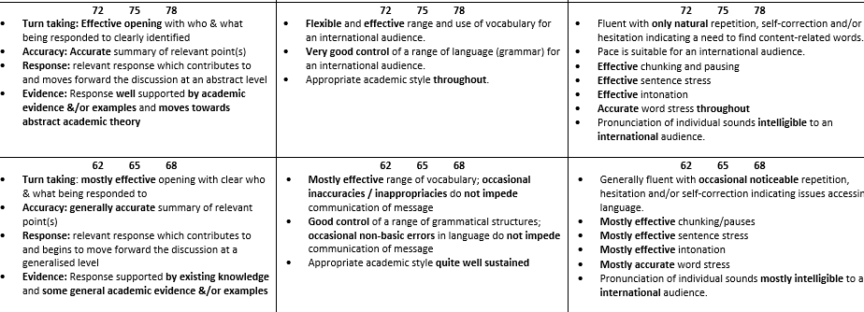
Criteria
50%
25%
25%

Slide 7
Research Questions
RQ1 How practicable is this assessment?
RQ2 To what extent can we assess language using this method?

Slide 8
Limitations
Small sample size (n=19)
Participants are researchers’ own students (availability bias)

Slide 9
RQ1 – how practicable is this assessment?
No students missed the submission
Record of student work
Recordings can be used for training, standardisation, teaching
In terms of practicability – very useful

Slide 10
RQ2 To what extent can we assess language using this method?
Helped students use and apply learned concepts
Washback effects on use of vocabulary/grammar (collocations, colligations)
Pronunciation did not improve – responses were memorised or read aloud
http://www.bristol.ac.uk/english-language/media/BALEAP-PIM/index.html

Slide 11
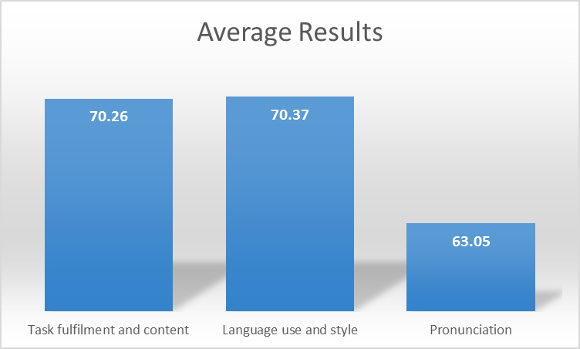

Slide 13
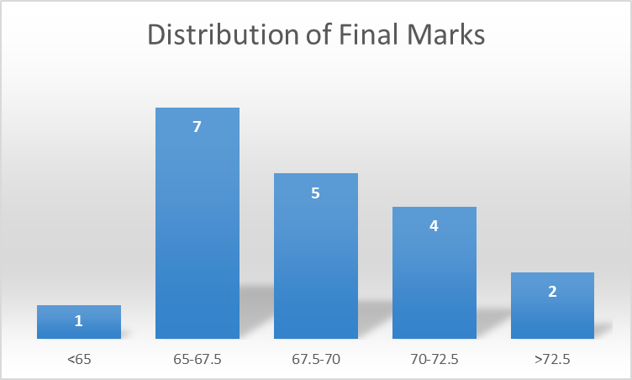

Slide 14
Problems
Minor technical issues (volume)
Inauthenticity of task
  Pronunciation
  Turntaking

Slide 15
Can recorded responses help students become better performers in seminars?
Perhaps, in terms of being able to use content knowledge, and being able to develop an idea or a contribution
Perhaps not, in terms of turn-taking and pronunciation
Seminars require so much in terms of intuiting what other people think or mean, that it may be impossible to teach/assess them completely

Slide 16
Suggestions
Don’t assess pronunciation (or turntaking)
Have spare audio recorders available
Make a room available for recording (if students need a quiet place to record their responses)
Perhaps make it an authentic task, such as an oral abstract/summary

Slide 17
/ˈkwesʧənz/

