Slide 1
Teaching Pronunciation in an EAP Context Gareth Jones

Slide 2
PSE Course Aims
Using technology to enable learners to tackle pronunciation independently
Using Macmillan Sounds, Macmillan Online Dictionary and Google Voice to empower learners
To assist students in being able to work independently during their studies and to be able to self-reflect on their learning

Slide 3
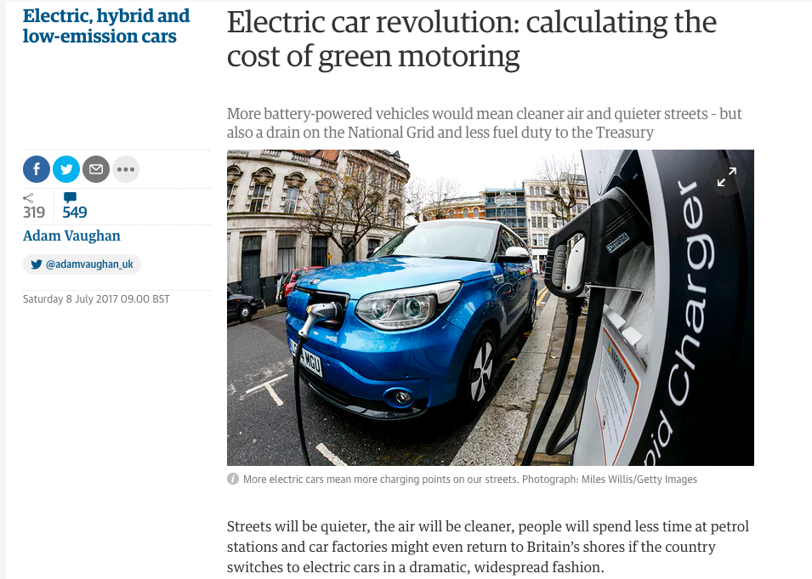
Pre-class Homework
Students are asked to read an article in preparation for the next day’s seminar lesson
Students are asked to highlight points they agree with in green & disagree with in red
Students are also asked to highlight words that they think will be important to the discussion or difficult to say in yellow

Slide 4
Discuss the following statement in groups:
‘Governments should ban sales of petrol and
diesel cars within the next 25 years’
Please refer to the article you read for homework as many times as you can

Slide 5
Students asked to reflect on the discussion and decide if they thought any of the words they had highlighted as being important in the homework task had been difficult to say or hear.
Tutor shares list of words that he/she thought were difficult to understand on the board and compares with students’ choices.
(Tutor guides first time but students start to select their own lexis from lecture slides, readings and seminar discussions in future lessons.)

Slide 6
Pre-reading task given as homework: Pronunciation issues from task

Slide 7
http://www.macmillandictionary.com/
Listen
Copy

Slide 8
Students are asked to download Sounds: The Pronunciation App on their phone and complete the free activities at the beginning of the course
Students can use Sounds to spell out the individual sounds of the target lexis
http://www.macmillaneducationapps.com/soundspron/

Slide 9
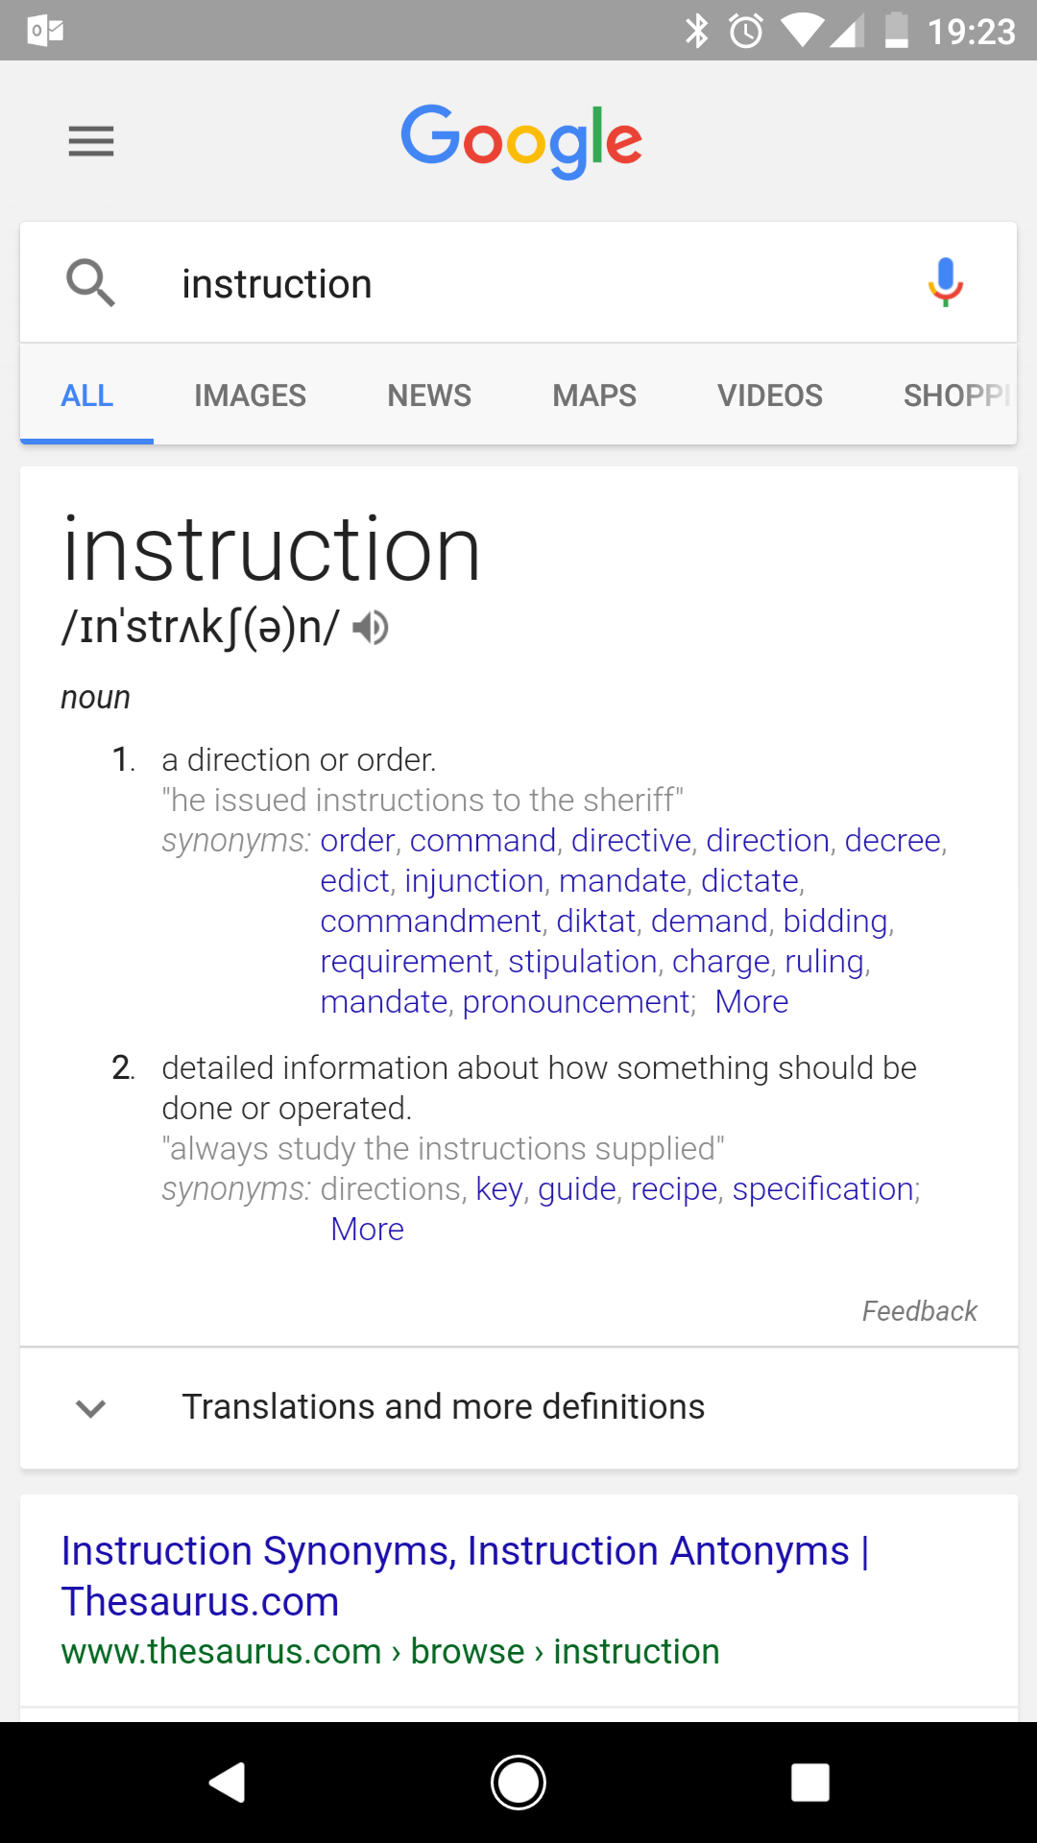

Slide 10
Students break the target word down into syllables and notice the similarities and differences between it and their result
What I wanted to say
What Google thinks I said

Slide 12
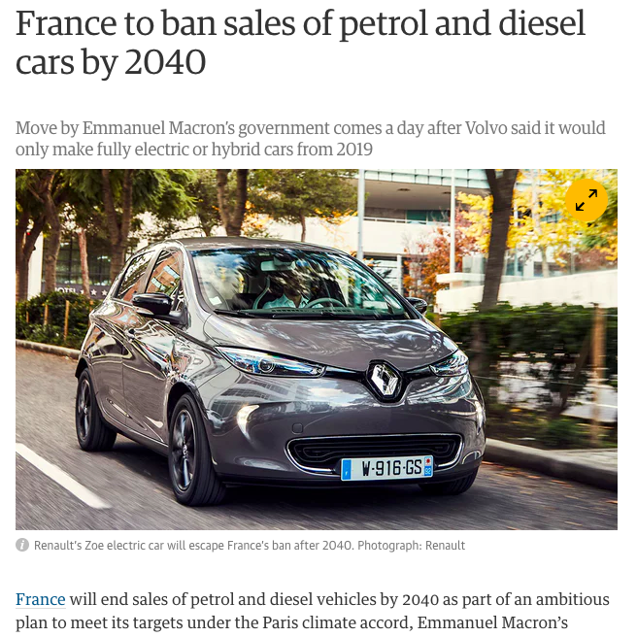
Students given the opportunity to repeat the process independently (but in an environment with support)
Students were given a second text with a different perspective
They read the text, highlighted statements they agreed/disagreed with
They highlighted key words and repeated the steps of using technology to tackle pron

Slide 13
Students given the opportunity to use the target lexis again
Discuss the following statement in groups:
‘Governments should ban sales of petrol and
diesel cars within the next 25 years’
Please refer to both articles you read for homework as many times as you can

Slide 14
Students were motivated, they could tackle pronunciation without the embarrassment of doing it publicly
Students used Google and Macmillan Dictionary to check the pronunciation of new words throughout the rest of the course without prompting
By the end of the course, students were preparing for seminars by predicting difficult words in pre-reading or PowerPoint slides and practising the pronunciation at home
Students reported that they felt more confident using new words in seminar discussions once they had checked it with Google

