Slide 1
Getting started with your BALEAP TEAP Fellow application
Walter Nowlan
May 2017
Notes:
Very affirming. If I can do it, you can. I’m nothing special, in fact I’m a bit of a bore …
How I did it. Also mention some of the pitfalls so that you don’t make the same mistake. No one way to do this.

Slide 2
COMMIT TO DOING IT!
Notes:
NOT LINEAR!!!
Commit – set a time scale. Add to annual career dev. / appraisal system. Find out the deadlines and commit to finishing it before then.

Slide 3
COMMIT TO DOING IT!
UNDERSTAND THE CRITERIA
DECIDE ON ACCREDITATION PATHWAY
DECIDE ON TOPIC OF CASE STUDY/-IES
Notes:
NOT LINEAR!!!
FIRST STEPS – CRITERIA / INITIAL PLANNING AND DECISION-MAKING – did these at same time. Understand criteria crucial – had buddy (c/f BALEAP TEAP Facebook page). I was not very systematic about this. Started without understanding some of the criteria. Meant I had to keep going back to the criteria and kept finding ‘gaps’. Might help to understand all criteria at this stage – but don’t let the criteria become a stumbling block. Help guide other choices at this stage. SUFFICIENCY – amount, range and validity of evidence
CASE STUDY TOPIC– thought about SUFFICIENCY. Thought about the projects I'd worked / was working on that touched upon most of the broad areas (Academic Practices, Student Needs and Learning, Teaching and Assessment, Quality Assurance and CPD).

Slide 4
COMMIT TO DOING IT!
UNDERSTAND THE CRITERIA
DECIDE ON ACCREDITATION PATHWAY
DECIDE ON TOPIC OF CASE STUDY/-IES
CONSIDER EVIDENCE YOU ALREADY HAVE
START TELLING THE ‘STORY’ OF THE CASE STUDY
FILE THE EVIDENCE
REFER TO LITERATURE
COMPLETE THE RAPP
CONSIDER MISSING EVIDENCE AND HOW TO COLLECT IT
Notes:
STORYTELLING - CASE STUDY - Started to sketch out the 'story' of the project and thought about evidence I had that I already had (and evidence I would need to collect!). This is where I really started engaging deeply with the criteria. Also mention that I started filing evidence at the earlier decision-making stage, too.
FILING – FILING evidence. Used Padlet as a way of organising evidence and telling the story. Just a suggestion – find a system that works for you.
COLLECTING EVIDENCE – (Olwyn’s suggestion)Used Excel spreadsheet to record what I had and what was missing.
READING – weakness in my RAPP – not linked to EAP literature. Literature relating to specific criteria to ground your practices. Set up a reading group. Mention David Munn’s excellent blog/reading group.

Slide 5
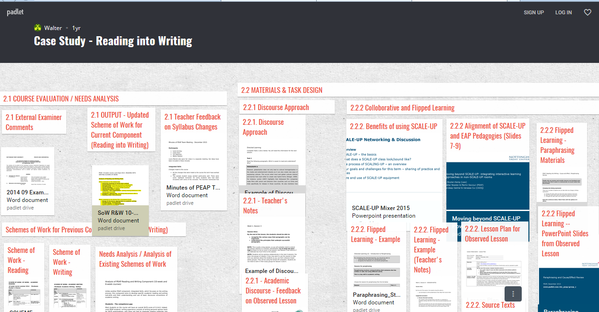

Slide 6
COMMIT TO DOING IT!
UNDERSTAND THE CRITERIA
DECIDE ON ACCREDITATION PATHWAY
DECIDE ON TOPIC OF CASE STUDY/-IES
CONSIDER EVIDENCE YOU ALREADY HAVE
START TELLING THE ‘STORY’ OF THE CASE STUDY
FILE THE EVIDENCE
REFER TO LITERATURE
COMPLETE THE RAPP
CONSIDER MISSING EVIDENCE AND HOW TO COLLECT IT
Notes:
STORYTELLING - CASE STUDY - Started to sketch out the 'story' of the project and thought about evidence I had that I already had (and evidence I would need to collect!). This is where I really started engaging deeply with the criteria. Also mention that I started filing evidence at the earlier decision-making stage, too.
FILING – FILING evidence. Used Padlet as a way of organising evidence and telling the story. Just a suggestion – find a system that works for you.
COLLECTING EVIDENCE – (Olwyn’s suggestion)Used Excel spreadsheet to record what I had and what was missing.
READING – weakness in my RAPP – not linked to EAP literature. Literature relating to specific criteria to ground your practices. Set up a reading group. Mention David Munn’s excellent blog/reading group.

Slide 7
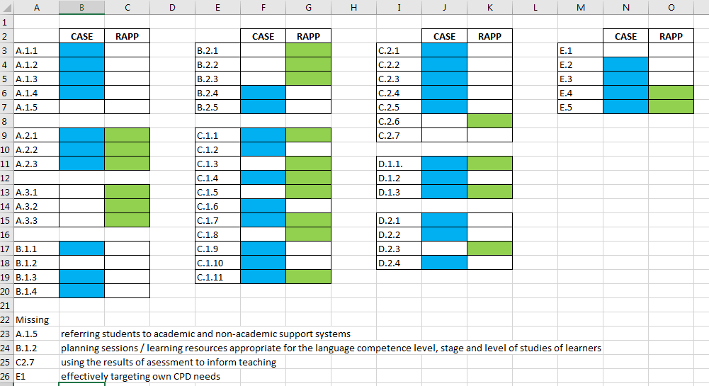

Slide 8
COMMIT TO DOING IT!
UNDERSTAND THE CRITERIA
DECIDE ON ACCREDITATION PATHWAY
DECIDE ON TOPIC OF CASE STUDY/-IES
CONSIDER EVIDENCE YOU ALREADY HAVE
START TELLING THE ‘STORY’ OF THE CASE STUDY
FILE THE EVIDENCE
REFER TO LITERATURE
COMPLETE THE RAPP
CONSIDER MISSING EVIDENCE AND HOW TO COLLECT IT
Notes:
STORYTELLING - CASE STUDY - Started to sketch out the 'story' of the project and thought about evidence that I already had (and evidence I would need to collect!). This is where I really started engaging deeply with the criteria. Also mention that I started filing evidence at the earlier decision-making stage, too.
FILING – FILING evidence. Used Padlet as a way of organising evidence and telling the story. Just a suggestion – find a system that works for you.
COLLECTING EVIDENCE – (Olwyn’s suggestion) Used Excel spreadsheet to record what I had and what was missing.
READING – weakness in my RAPP – not linked to EAP literature. Literature relating to specific criteria to ground your practices. Set up a reading group. Mention David Munn’s excellent blog/reading group.

Slide 9
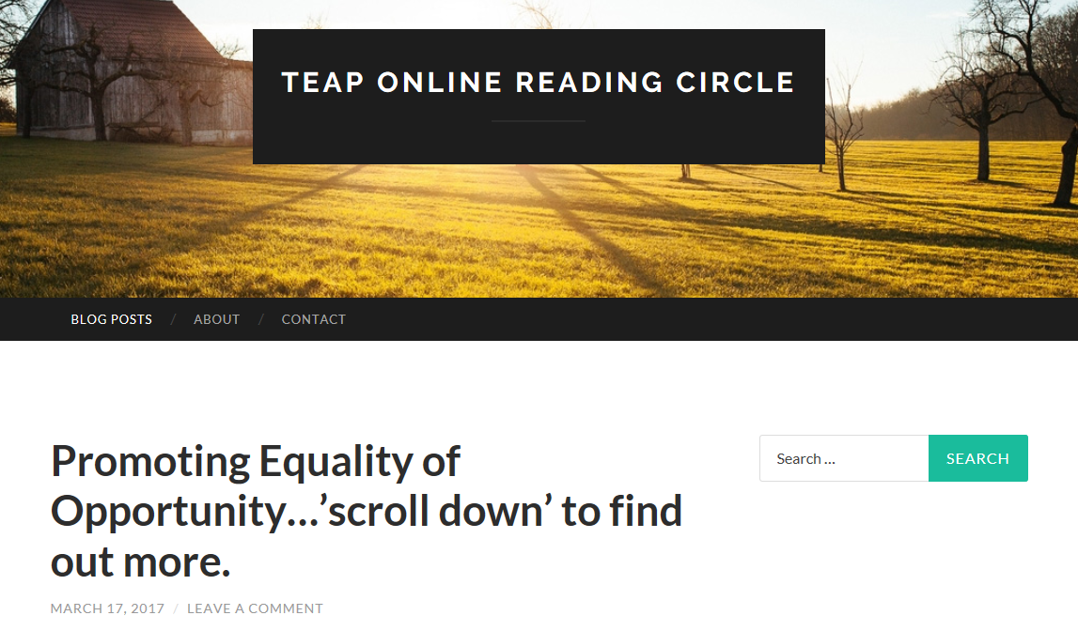
https://teaponlinereadingcircle.wordpress.com/

Slide 10
COMMIT TO DOING IT!
UNDERSTAND THE CRITERIA
DECIDE ON ACCREDITATION PATHWAY
DECIDE ON TOPIC OF CASE STUDY/-IES
CONSIDER EVIDENCE YOU ALREADY HAVE
START TELLING THE ‘STORY’ OF THE CASE STUDY
FILE THE EVIDENCE
REFER TO LITERATURE
COMPLETE THE RAPP
CONSIDER MISSING EVIDENCE AND HOW TO COLLECT IT
Notes:
STORYTELLING - CASE STUDY - Started to sketch out the 'story' of the project and thought about evidence that I already had (and evidence I would need to collect!). This is where I really started engaging deeply with the criteria. Also mention that I started filing evidence at the earlier decision-making stage, too.
FILING – FILING evidence. Used Padlet as a way of organising evidence and telling the story. Just a suggestion – find a system that works for you.
COLLECTING EVIDENCE – (Olwyn’s suggestion) Used Excel spreadsheet to record what I had and what was missing.
READING – weakness in my RAPP – not linked to EAP literature. Literature relating to specific criteria to ground your practices. Set up a reading group. Mention David Munn’s excellent blog/reading group.

