Slide 1

Peer Dictation & Missing Sounds
Michaela Seserman
m.seserman@Liverpool.ac.uk
Notes:
These are two activities which I have used with my pre-sessional students. I have chosen them because they are fairly easy to adapt and use with different groups, making it easier to address individual student needs.

Slide 2

Peer Dictation
Teacher preparation
Identify ‘challenging’ sounds
Prepare lists of common words containing chosen sounds
Prepare example sentences containing chosen words
Notes:
The first activity I’m going to talk about focuses on the identification and practice of specific ‘challenging’ sounds. It does not take much preparation and it can be adapted depending on students’ needs.
In a previous session, or sessions, the teacher should identify sounds that the students find particularly challenging to pronounce. I usually choose about 4 to 5 sounds to prepare the activity, depending on the students’ L1.
The next step is making a list of words containing those sounds, and a list of example sentences containing the chosen words.

Slide 3
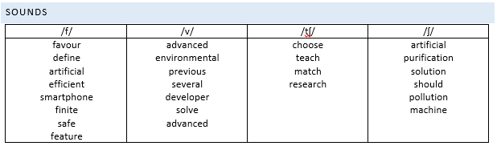
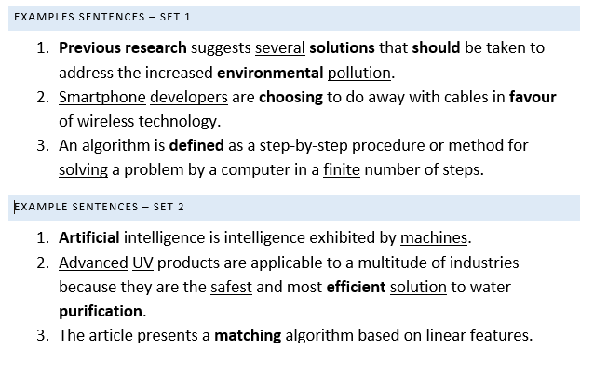
Peer Dictation
Notes:
So, for example, I’m actually going to use this activity with a group tomorrow, and in preparation, these are the words that I’ve chosen and the example sentences. Some of the words are from previous sessions, but some came up as I was preparing the example sentences. I’ve tried to use example sentences related to students’ subject areas.

Slide 4
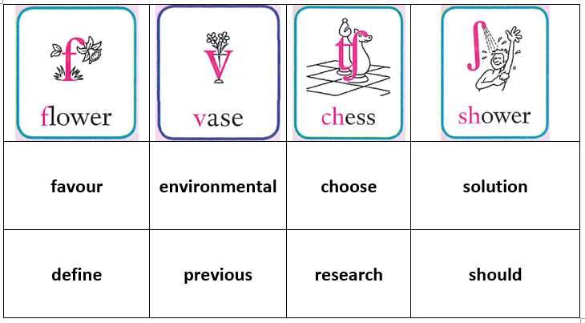
Peer Dictation
Activity
Match words to chosen sounds
Drilling (in pairs)
Example sentences (set 1) – pair practice
Example sentences (set 2) – peer dictation
Notes:
The activity itself can be either quite scaffolded or allow for more free practice depending on the students’ level and ability.
SS would first match given words to the chosen sounds, and then practice the pronunciation of those words in pairs, with the teacher monitoring.
The teacher then hands out a list of examples sentences containing the drilled words, and students practise saying the sentences. I’ve found this to be quite useful for raising students’ awareness of words pronunciation in context, as they can at times be able to pronounce a specific word on its own but not when surrounded by other words, sounds.
Finally, another set of sentences is handed out to allow for further practice. Students are given a bit of time to read the sentences, identify words that contain the practised sounds and then they dictate the sentences to their partner. The idea here is that students need to pronounce the words clearly for their partner to understand and be able to write down.
Overall, I have found this activity successful for making students more aware that they need to make themselves understand by other non-native speakers, like themselves, and not just to their English teachers.

Slide 5
Missing Sounds
Teacher preparation
Write a short text that includes examples of elision
Make two recordings of the text, one using elision and another one without elision
Notes:
This activity could be an extension to the previous one, or done entirely separately.
The text would preferably be based on something already done in class, so that students are already familiar with the topic and thus only focus on the pronunciation.

Slide 6
Missing Sounds
Activity
Listen to the two recordings and decide which one sounds more natural
Read the text and identify the ‘missing sounds’
Practice in pairs
Generate own examples
Practice in pairs
Notes:
As with the previous activity, this can be adapted to the level and needs of the group, and to the length of time you want to allow for practice. Last time I used this activity, I asked my students to write a short paragraph about their subjects, then identify potential elision, and then we practised reading it. That overall took about half an hour, which might not always be possible.
I think this activity is more useful for improving students own pronunciation but also for making them more aware of features used by native speakers, and thus improving their listening comprehension.

Slide 7
Peer Dictation & Missing Sounds

