Slide 1


BALEAP Webinar 12th July 2017
Pronunciation in EAP Contexts
An Introduction to the
Articulatory Approach with special thanks to
Piers Messum (www.pronsci.com) Roslyn Young
tpd.moderators@gmail.com
jonwordie@gmail.com

Slide 2


What change was made to the Cambridge CPE Exam in 1932?
The compulsory
90-minute phonetics
paper was dropped!

Slide 3

Which is the only UK university to offer summer pronunciation courses for teachers and students?
Leading to the ‘IPA Exam’ –
‘Certificate of Proficiency
in the Phonetics of English’

Slide 4
Some core axioms of the Articulatory Approach
Pronunciation is a motor skill
Raising awareness of the role of the articulators in the vocal tract and the ‘mechanics of speech’ is essential
The ‘articulatory setting’ of English needs to be actively taught
‘Listen and Repeat’ / ‘imitation’ is not the most effective way to teach pronunciation
‘Performance Pieces’ are recommended to help students improve their pronunciation

Slide 5
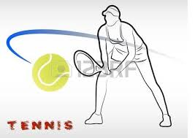


The tongue is a muscular hydrostat. Note the unusual default articulatory setting of English.
English
French

Slide 6
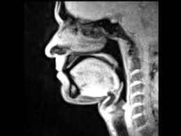
MRI scans of vocal tracts:
Chinese vs. English
Video 1 – Chinese -
Video 2 – English -

Slide 7
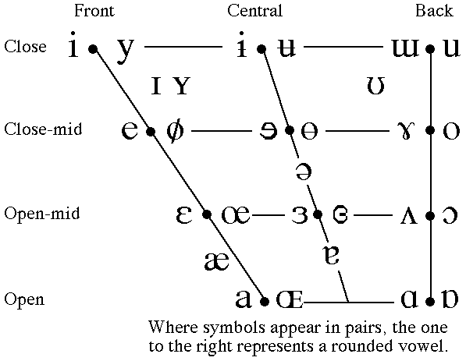
100 years of the Cardinal Vowels Diagram – Acoustic or Articulatory?

Slide 8
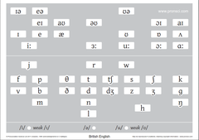
A Phonemic Chart on Articulatory Principles

Slide 9
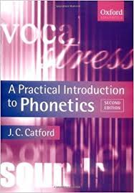
The Articulatory Approach:
An influential text
“If Catford had entitled his book ‘A Practical Introduction to Pronunciation’
instead of ‘A Practical Introduction to
Phonetics’, it might have sold millions”
Piers Messum

Slide 10
A closing analogy
ENGLISH to a phonetician is like WATER to a chemist.
WATER, though commonplace, is a compound with very unusual properties.
ENGLISH, though widespread, is a language with very unusual phonetic properties, both in its articulatory setting and in its speech breathing patterns.
tpd.moderators@gmail.com

