Slide 1
BALEAP Webinar
EAP Pronunciation Activities
Laura Foster
University of Leeds

Slide 2
Contrasting areas and activities
Diphthongs
Why?
Contrast across languages, particularly Arabic and Chinese
Existing learner phonological systems
What?
Visual/physical cues
Immediate and unobtrusive
Indication not repetion

Slide 3
Contrasting areas and activities
Nuclear stress
Why?
Can cause strain on listener and alter meaning
Difficult to ‘pick up’
Part of LFC (Lingua Franca Core)
What?
Learner training
Integrated into assessment preparation
Transferable to other features of prosody

Slide 4
Diphthongs in real-time
Situation
During any normal class
Activity
Using non-verbal, physical cues to unobtrusively correct diphthongs
Example
Student mispronounces “fair” /feə/ as “fear” /fɪə/
Teacher highlights correct sound by pointing to their hair and indicates mouth shape/movement without speaking.

Slide 5
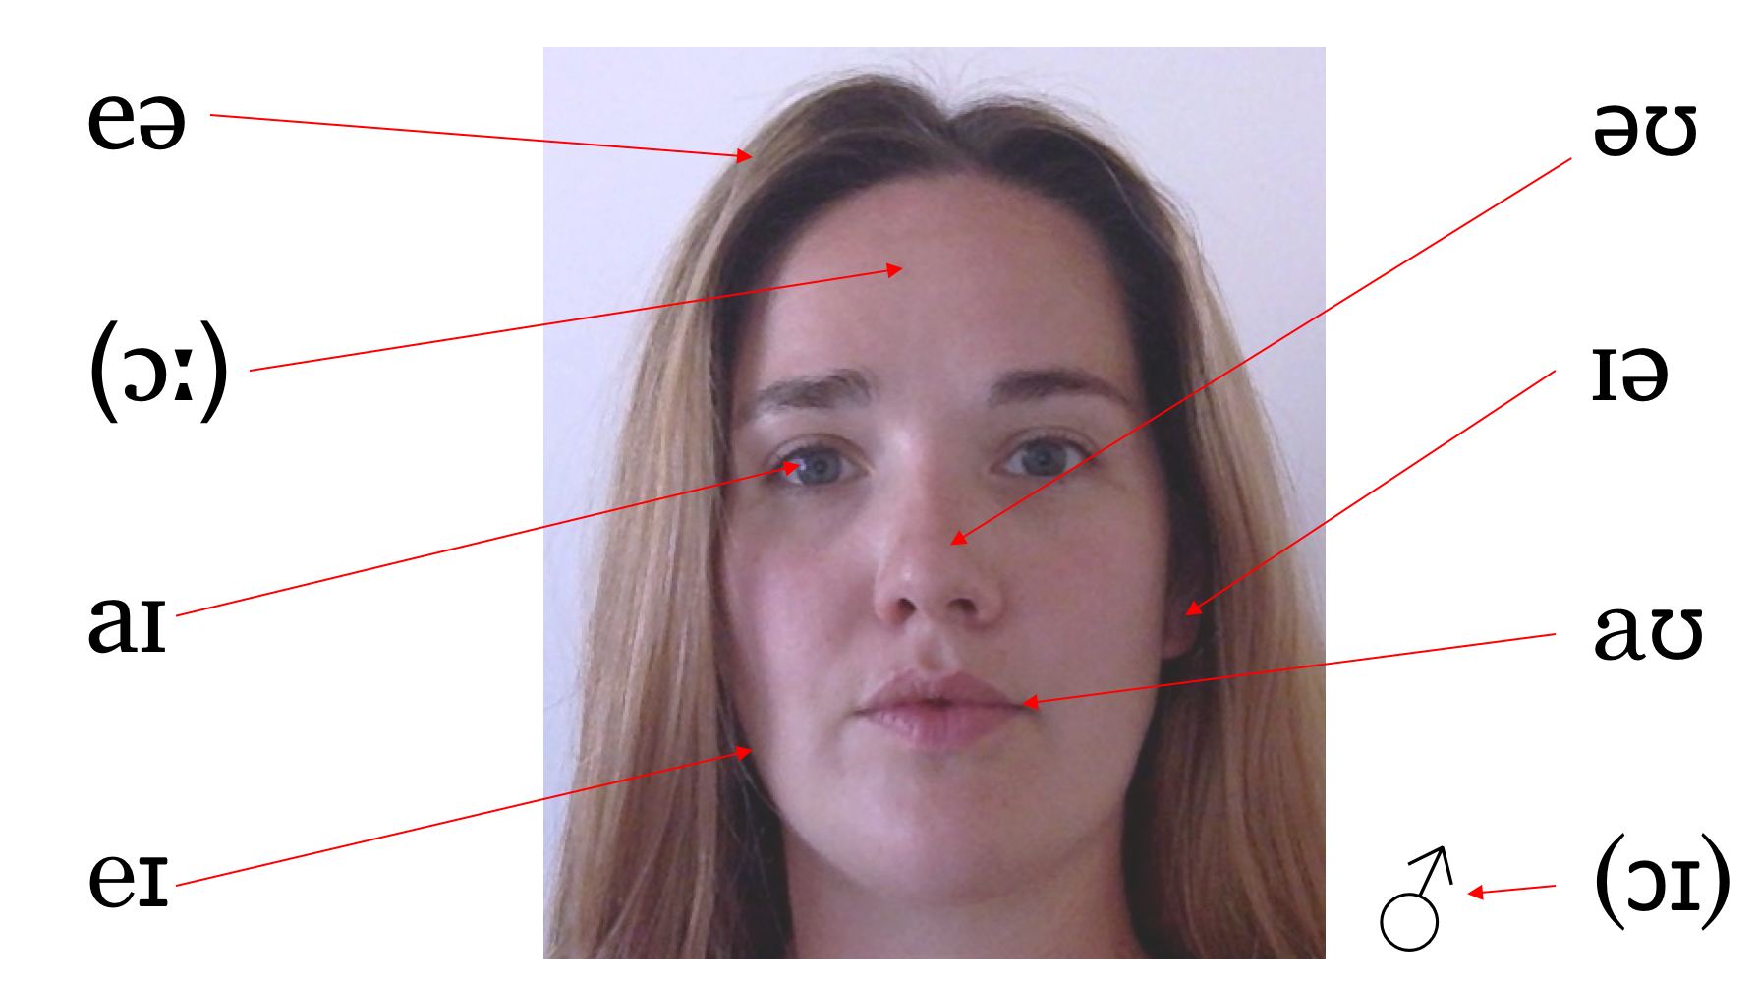
Face diphthongs
This method allows students to access their own individual diphthong production using familiar vocabulary, rather than imitating the tutor’s production of the diphthongs.

Slide 6
Nuclear stress in assessment task prep
Situation
During preparation for presentations/seminars
Activity
Awareness raising activity to correct sentence stress
Example
Students are at the practice stage in preparing for assessed presentations but delivery is impeded by inappropriate stress.
Students analyse their own speech for nuclear stress then check, correct and practice with corrected stress.

Slide 7
Procedure
Record
Transcribe
Analyse for nuclear stress
Check against recording
Practice
Using their phone
Grammar/lexis only
Transcription, not recording
With correct stress
This procedure assumes no prior knowledge of prosodic features but integrates space into assessment preparation for addressing these features in class.

Slide 8
Alternatives
Intonation and pitch contouring
Rhythm and pace
Weak forms

