Slide 1
Reflective writing for academic discussion: students’ own perceptions
Bob Morrison
University of Glasgow
brian.morrison@glasgow.ac.uk
https://glasgow.academia.edu/BrianMorrison

Slide 2
Overview
Course
Purpose
Structure
Reflective writing – guided reflections
Students’ evaluation of
  Reflective writing
  Progress
  Any questions

Slide 3



Course purpose

Slide 4
Course structure
2 x 5-weeks 10 credits = 100 hours
In-class (2 x 50 mins/week) + out-of-class (8 hours)
Thur Mon Thur Mon
Preparation
Input
Reflection
Output
Preparation
Input
Reflection
Output

Slide 5
Course structure
2 x 5-weeks 10 credits = 100 hours
In-class (2 x 50mins/week) + out-of-class (8 hours)
Thur Mon Thur Mon
Select & read an academic text
Academic discussion skills
Written reflection
Discussion around (an) academic text(s)
Select & read an academic text
Academic discussion skills
Written reflection
Discussion around (an) academic text(s)
Functional language
Functional language
Teacher response
St response

Slide 6




Reflective writing
Dadds (1993)
Brookfield (1995) Convery (1998)
Notes:
It seems simple enough – looking in a mirror? – looking at ourselves? - looking back at what we’ve done?
Perhaps it depends on the discipline

Slide 7
Reflective writing
‘a meaning making process that involves participation in a systematic inquiry that contributes to the interpretation of experience in order to learn from the experience’
(Smith, 2008:76)
‘praxis stance – a habit of mind that would ensure careful consideration about how … [one] … would act more wisely when faced with similar circumstances in the future’
(Smith, 2008:81)
Notes:
discomfort (‘surprise’) during practice as triggering reflection, which expert practitioners utilise to negotiate the ‘swampy lowland [of their practice] where situations are confusing “messes” incapable of technical solution’ (p.42). He attempts to address what he sees as the dichotomy of academic knowledge and practice by positing that skilled professional practice is not the technical application of academic knowledge for pre-defined problem solving but rather that skilled professional practice develops over time through a combination of knowing-in-action and the ability to set problems as well as solve them. Each situation is recognised as unique and requires the reflective practitioner to consider this situation through its similarity to others but to acknowledge the differences. This is done through a process of reflection that, like Dewey’s reflective thinking, includes hypothesis testing to achieve an outcome.

Slide 8
Reflective writing
Student-student & student-teacher
Shines light
Guided
                What was done well
            What could have been improved
        How can this improvement be developed in the future?
Notes:
discomfort (‘surprise’) during practice as triggering reflection, which expert practitioners utilise to negotiate the ‘swampy lowland [of their practice] where situations are confusing “messes” incapable of technical solution’ (p.42). He attempts to address what he sees as the dichotomy of academic knowledge and practice by positing that skilled professional practice is not the technical application of academic knowledge for pre-defined problem solving but rather that skilled professional practice develops over time through a combination of knowing-in-action and the ability to set problems as well as solve them. Each situation is recognised as unique and requires the reflective practitioner to consider this situation through its similarity to others but to acknowledge the differences. This is done through a process of reflection that, like Dewey’s reflective thinking, includes hypothesis testing to achieve an outcome.

Slide 9
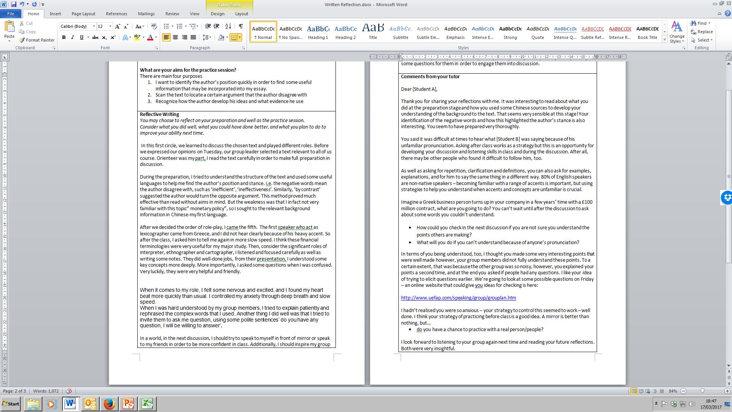

Slide 11

Reflective writing
Notes:
discomfort (‘surprise’) during practice as triggering reflection, which expert practitioners utilise to negotiate the ‘swampy lowland [of their practice] where situations are confusing “messes” incapable of technical solution’ (p.42). He attempts to address what he sees as the dichotomy of academic knowledge and practice by positing that skilled professional practice is not the technical application of academic knowledge for pre-defined problem solving but rather that skilled professional practice develops over time through a combination of knowing-in-action and the ability to set problems as well as solve them. Each situation is recognised as unique and requires the reflective practitioner to consider this situation through its similarity to others but to acknowledge the differences. This is done through a process of reflection that, like Dewey’s reflective thinking, includes hypothesis testing to achieve an outcome.

Slide 12
Students’ evaluation
Before this course, what was your experience of reflective writing? (n=42)

Slide 13
Students’ evaluation
Before this course, did you think this reflective writing would help your speaking? Please explain. (n=47)
I do not believe writing could help my academic speaking because I feel oral
and written are totally two kinds. But
actually writing is beneficial to
clearing thoughts.
First I was sceptical about that
method but after doing it I
changed my point of view and
think it is quite helpful.

Slide 14
Students’ evaluation
Now you are halfway through this course, do you think reflective writing has helped your speaking? Please explain. (n=47)
A little. It depends on how much effort you make after the class
Yes, it pushed me to improve myself and I will try to do
better next time.
Not much. Speak well just need practice and talk.
Yes, knowing the strength
and weakness can help me to get the study direction.

Slide 15
Students’ evaluation (progress)
(N = 74)

Slide 16
Students’ evaluation (progress)
(N = 74)

Slide 17
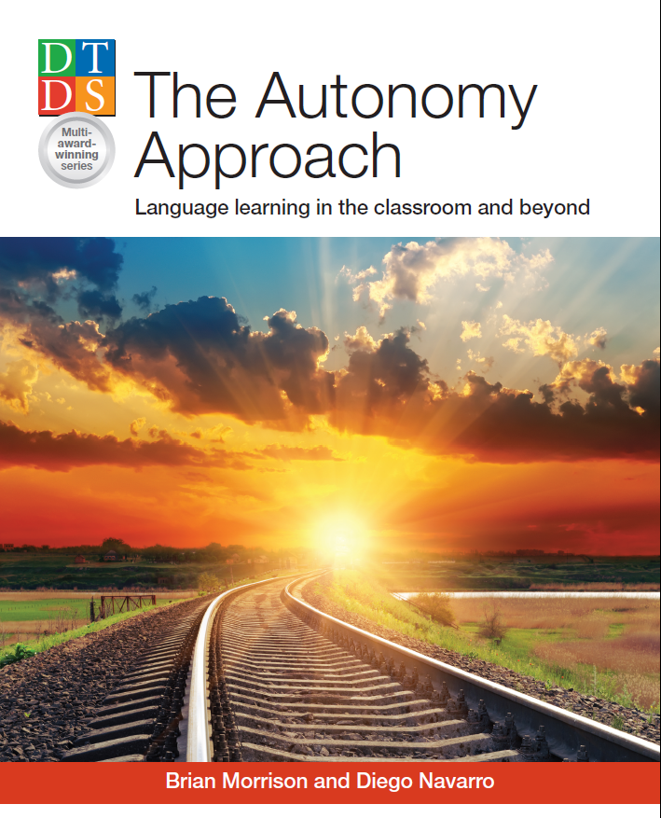
Thank you for listening
Any questions?
Brian R. Morrison
Bob Morrison
University of Glasgow
brian.morrison@glasgow.ac.uk
https://glasgow.academia.edu/BrianMorrison

Slide 18
References
Brookﬁeld, S. D. (1995) Becoming a critically reﬂective teacher, San Francisco, Jossey-Bass.
Convery, A. (1998) ‘A teacher's response to “reflection‐in‐action”‘, in Cambridge Journal of Education, vol. 28, no. 2, pp. 197-205.
Dadds, M. (1993) ‘The feeling of thinking in professional self study’, in Educational Action Research, vol. 1, no. 2, pp. 287-303.
Dewey, J. (2008) ‘How we think: a restatement of the relation of reflective thinking to the educative process’, in J. A. Boydston (ed.), The later works, 1925 - 1953 - John Dewey - volume 8: 1933 - essays and how we think, revised edition, Carbondale, Southern Illinois University Press, pp. 105-352.
Husu, J., Toom, A. and Patrikainen, S. (2008) ‘Guided reflection as a means to demonstrate and develop student teachers’ reflective competencies’, in Reflective Practice, vol. 9, no. 1, pp. 37-51.
Schön, D. A. (1983) The reflective practitioner, United States, Basic Books.
Smith, T. J. (2008) ‘Fostering a praxis stance in pre-service teacher education’, in S. Kemmis and T. J. Smith (eds.), Enabling praxis: challenges for education, Rotterdam, Sense Publishers, pp.65-84.

Slide 19
Course integration
enlightened
AEfBS
Leadership workshop
engaged
Alumni workshop
Ceilidh
enterprising
Business Simulation Workshop
Selling yourself workshop

