Slide 1
Cultivating Language Assessment Literacy as Collaborative CPD
Glenn Fulcher
http://languagetesting.info

Slide 2
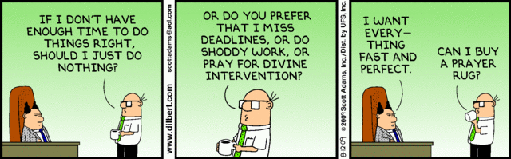
“We need a test for our pre-sessional by the end of next week. Can you write it and I’ll find someone who can give you a bit of feedback when you’re done”

Slide 3
Two Questions
What assessment literacy do we need for the successful practice of EAP assessment?
How can the practice of assessment form a key component CPD and programme development?
Working Together = Learning Together

Slide 4
Current working definition of LAL
The knowledge, skills and abilities required to design, develop, maintain or evaluate, large-scale standardized and/or classroom based tests, familiarity with test processes, and awareness of principles and concepts that guide and underpin practice, including ethics and codes of practice. The ability to place knowledge, skills, processes, principles and concepts within wider historical, social, political and philosophical frameworks in order understand why practices have arisen as they have, and to evaluate the role and impact of testing on society, institutions, and individuals.
(Fulcher, 2012)

Slide 5
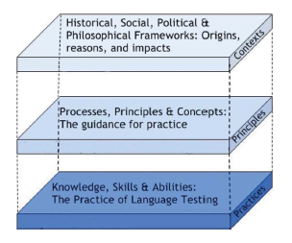
Elements of LAL for EAP Professionals

Slide 6
Elements of LAL for EAP Professionals
History and Philosophy
Ethical Practice
Mandates and policy
Washback and impact
Validity & Reliability
Setting standards
Conducting statistical analysis
Interpreting scores
Using scores
Deciding what to test
Writing specifications
Writing items and tasks
Designing scoring models
Evaluation

Slide 7
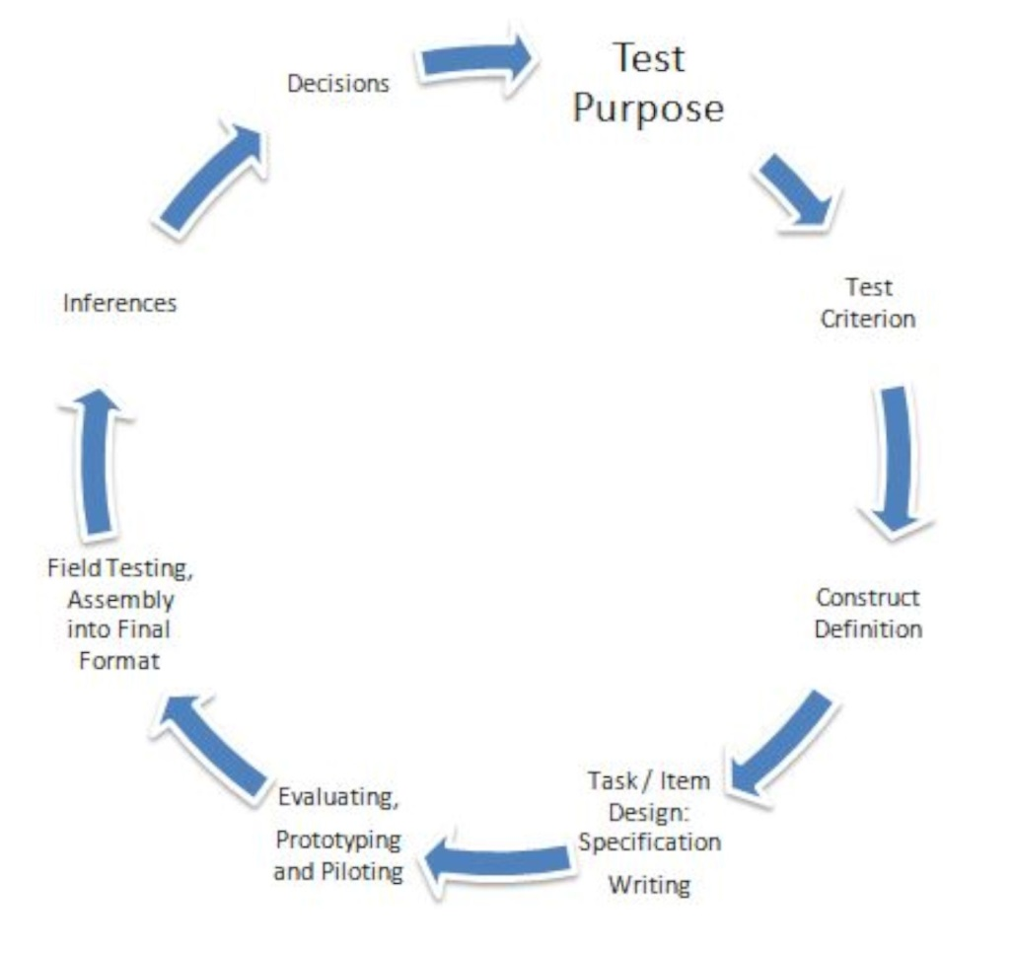
Embedded within the
Design Cycle

Slide 8
The Second Question
How can the practice of assessment form a key component of CPD and programme development?

Slide 9
A Preliminary: Tests and Forms
A “test” or “assessment” IS
its current specification,
NOT a form
Test Version
Spec 4
Spec 3
Spec 2
Test Form
Spec 1

Slide 10
Item / Task Specifications
Assessment Specifications
Title
General Description
Prompt Attributes
Response Attributes
Scoring Model
Sample Items / Tasks
Assembly
Presentation
Delivery
Universal Design

Slide 11
Example 1: Principles
Construct Driven CPD
Do we know what we’re talking about?
Can we define what we intend to teach or assess?
What kinds of tasks help learners to acquire a construct?
What kinds of tasks generate evidence for acquisition?
Can we make sound inferences from performance summaries (scores) that legitimately support decisions?
Collaborative Definition and Common Understanding

Slide 12
What are constructs?
Abstract nouns
Concepts
Associated with something observable
Measurable
Fluency

Slide 13
Fluency: The Great Debate Begins
Brumfit (1984)
Filing time with talk
Production of coherent sentences
Selecting appropriate content for context
Being creative with the language
Not accuracy

Slide 14
Fluency: Observable Phenomena
Lennon (1990)
Temporal Aspects
  Words per minute *
  Words per minute pruned ☑
  Filled/unfilled pauses as percentage of delivery time
  Mean length of speech runs between pauses *
  Percentage of T-units (main + subordinate clauses) followed by a pause * ☑
Dysfluency Markers
  Repetitions per T-unit *
  Self-corrections per T-unit
  Filled pauses per T-unit * ☑
  Percentage of repeated and self-corrected words
Notes:
Pruned = removal of all repeated and self-corrected words
4 participants over 23 weeks. * = 3 improved. ☑ = Core as all 4 improved

Slide 15
Fluency: The Metaphorical Turn
Kaponen & Riggenbach (2000)
Language is motion
Fluidity like a liquid
Flowing like a river
Smooth
Rapid
Effortless

Slide 16
Fluency: Cognitive Linguistics & Automation
Segalowitz (2004; 2010) & The Amsterdam School (De Jong, 2013)
Utterance fluency (following Lennon, 1990)
  Timing
  Pausing/hesitation phenomena
  Repair features
Cognitive fluency
“…it is hoped that it will be possible to identify a reasonably small set of cognitive processes that can be reliably associated with an equally reasonably small set of utterance fluency phenomena.”
  Lexical access (deciding if nouns in a list are animate or non-animate)
  Attention control (selecting a word from a list that matches a stimulus word)
  Key findings:
  Mean length run of speech without fillers and lexical access: r = .37
  Speech rate and attention control: r = -.48

Slide 17
Fluency: High Inference Interpretations
Fulcher (1987; 1993; 1996; 2003; 2016)
Pausing as a turn taking mechanism (with falling intonation)
Pausing as content planning
Pausing as “oral parenthesis” in enumeration of examples or arguments
Indication of propositional uncertainty
Word search
Repair and correction
Communication breakdowns

Slide 18
Fluency phenomena as culturally determined meta-communication
Impressions, attitudes, emotions, intentions (including humour and contemplation)
  (Bruneau, 2008; Nakane, 2007)
Establishing rapport; politeness indicators
  (Scollon & Scollon, 1989; Fiksdal, 2000)
Indicating social status
  (Nakane, 2012)

Slide 19
What is your definition?
Do you share this understanding with colleagues?
If you score “fluency” do you interpret the phenomena your observe in the same way?
If you design “fluency activities” for a speaking class what are the key task variables that you would include?

Slide 20
Example 2: Practices
Task Design
Construct: The integration of knowledge and ideas in short written texts
Task type suggested:
Translate quantitative or technical information expressed in words in a text into visual information (e.g., a table or chart) and translate information expressed visually or numerically into words.

Slide 21
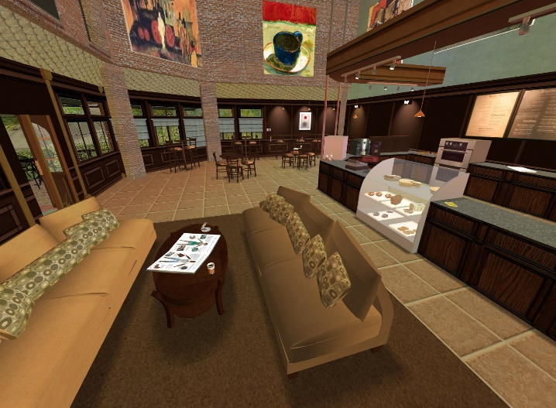
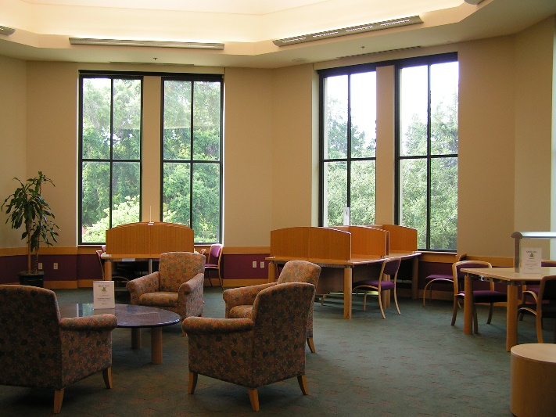
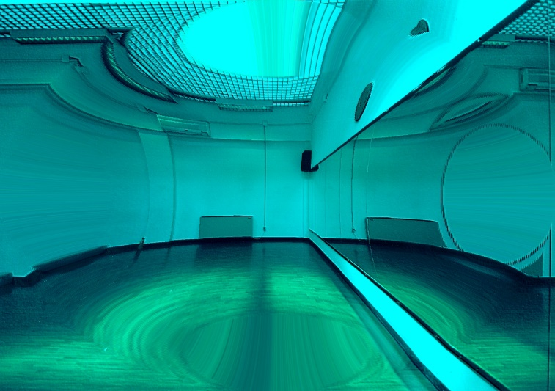
The Prompt

Slide 22
Department | First Choice | Second Choice
English | Coffee Shop | Reading Room
Modern Languages | Coffee Shop | Discotheque
Mathematics | Reading Room | Coffee Shop
Computing Science | Discotheque | Reading Room
Media Studies | Coffee Shop | Discotheque
Physics | Discotheque | Reading Room
History | Reading Room | Coffee Shop
Politics | Coffee Shop | Reading Room
Medicine | Discotheque | Coffee Shop
Archaeology | Reading Room | Coffee Shop
Philosophy | Coffee Shop | Discotheque
Law | Discotheque | Coffee Shop
Education | Reading Room | Discotheque
Sociology | Coffee Shop | Reading Room

Slide 23
Sample Response (Level 4)
The first step was to make a raw count of the preferences across all departments and creating a new table. It seemed reasonable that the first choice should be given double weighting in arriving at a decision, so the “preference score” was calculated with the first choice multiplied by 2. Following this process the clear winner is the coffee shop, and so I will recommend this option to the Entertainment Committee of my Student Union.
 | Coffee Shop | Reading Room | Discotheque
No 1 | 6 x 2 = 12 | 4 x 2 = 8 | 4 x 2 = 8
No 2 | 5 | 5 | 4
Total ((No 1 x 2) + No 2) | 17 | 13 | 12
The integration of knowledge
and ideas in short written texts

Slide 24

Scenario-based assessment design: http://languagetesting.info/whatis/scenarios/list.php
Exploring Issues in Intercultural Communication

Slide 25
Example 3: Society, Policy & Impact
News Tasks
http://languagetesting.info
Live or from “features”
Roles:
Producer: Overall responsibility for content and production
Journalist: Selects the most interesting stories from those collected
Presenter: Introduces stories and guests; asks questions
Editor: Edits the various recordings and produces the final product
Guests: Assigned to stories and required to prepare statements for interview

Slide 26
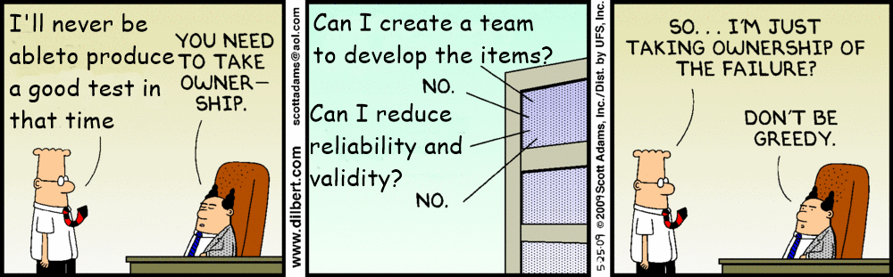
Good Assessment is achieved through local shared meaning and practice
Working Together = Learning Together

