Slide 1

Life in the EAP Lane
Student Perceptions of the Effectiveness of EAP
Iona Dawson
Tracie MacKenzie
Chris Dawson

Slide 2

Outline
FUS context
Research objectives
Student satisfaction
Interpreting results
Conclusions
Notes:
Change this slide once we decide final content?

Slide 3


Total students in Fall 2016: 352
Number of students with dual or multiple nationality: 51
Number of classes: 108
Average class size: 15
Notes:
Small but diverse

Slide 4
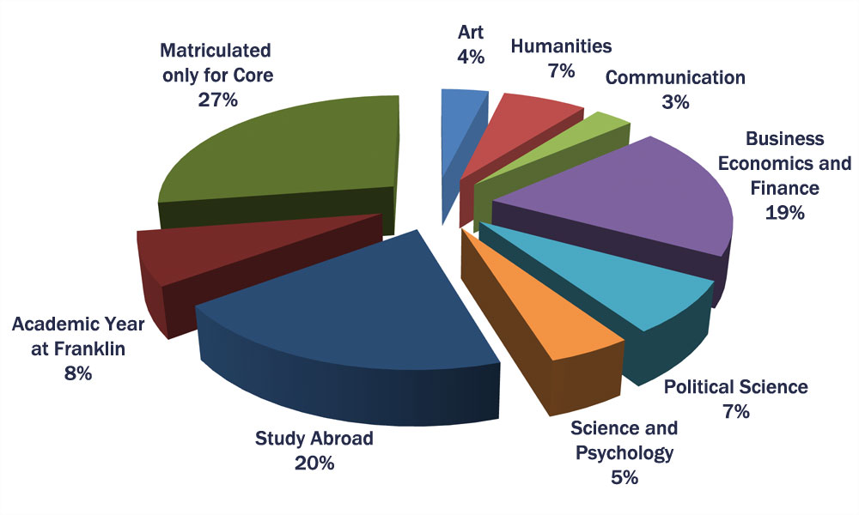
Academic programs/ declared majors
Data from www.fus.edu/about/basic-facts-and-figures

Slide 5
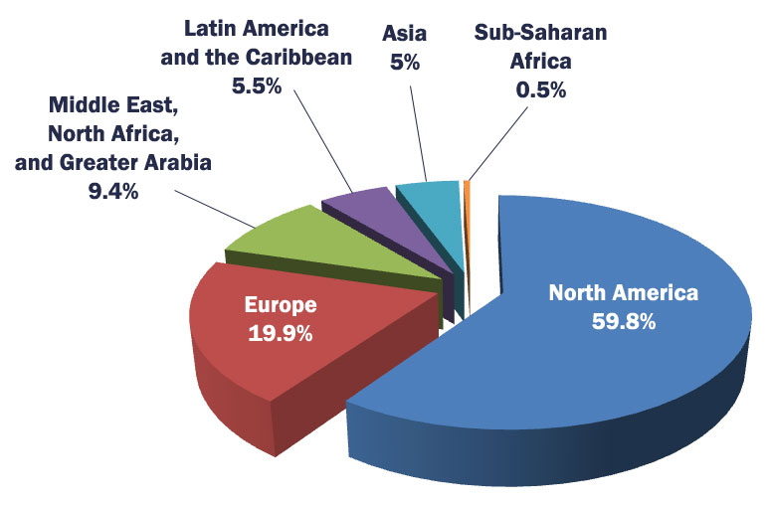
Student Overview
Countries represented

Slide 6

EAP Program
Placement: writing sample
Purpose: awareness of academic skills
  Approaching academic texts
  Developing academic writing
Consecutive one-semester courses
Two main levels:
    EAP 120
    EAP 130
Notes:
NB: added EAP 128 this semester
Start them thinking critically – not easy!

Slide 7
Objectives
Investigate effectiveness of the EAP program through:
Questionnaires to current and former EAP students
  Reaction to placement
  Student evaluation:
    Effectiveness/impact of EAP courses (global and skill-wise)
    Assignments (difficulty, quantity, type)
Interviews with Faculty and Students
Course evaluations
Notes:
Remember to say that we cannot measure impact of EAP for students who were placed into EAP but did not take EAP courses with those who were placed but did not participate. by comparing results with and without EAP courses, because students who are placed into EAP are obliged to participate in the EAP program. Therefore - Necessary to use self-assessment
Questionnaires: looking at Emotive response
Interviews: looking at Pragmatic response

Slide 8
Sample population of EAP students
19 Current EAP students: first & second year (Age: 17-20)
19 Former EAP students: first to final year (Age: 19-22)
Notes:
Diverse group – in just 2 classes = 23(?) nationalities. (see map)

Slide 9
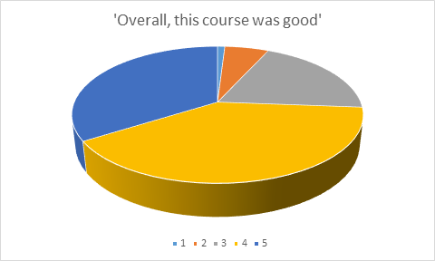
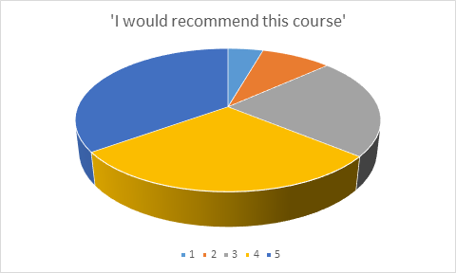
EAP Program Course Evaluations 2009-2016
“Overall, this course was good”
“I would recommend this course to another student”
Notes:
IONA
Why we set out to do this pilot study:
Need to assess program (its current global iteration)

Slide 10

Satisfaction
1. Placement level
  Does degree of satisfaction vary according to starting level?
  2. Academic skills
  Number and type
  Relevance
  Improvement
  3. Assignments
  Quantity (work load)
  Type and application (usefulness to own development and transfer to other courses)
  Difficulty
Notes:
And now, Heeeeeere’s Iona!
Break down data according to 3 “lenses” hoped would reflect Ss’ satisfaction best both for course itself and its effectiveness.
We were puzzled about why a lot of students were not doing their homework, weren’t participating in class and weren’t even submitting the major assignments, and were consequently failing when they could have passed. So we decided to conduct our own research to try and get more information about these issues.

Slide 11
Satisfaction: placement level
Student responses on 7-point Likert Scale
1 = strongly disagree 7 = strongly agree
Starting Level: | EAP 120 | EAP 130
Overall, EAP is helpful for other courses | 6.00 | 4.95
I feel regularly engaged in the work we do in class | 5.77 | 3.67
Improving my academic skills is important to me | 6.47 | 5.32
I feel more confident about doing WTG 100 because of EAP | 5.65 | 4.53
Notes:
Nos = mean on 7 point Likert scale.
RQ 1 – small but noticeable difference – EAP 120 Ss more positive on average about where placed
(NB – Fall 2016 first time we switched to online PT, shorter piece of writing)
Nos representative of a pattern we found in the data generally.

Slide 12

Satisfaction: skills
Initial reaction to placement
Adjective chosen: | Positive | Negative
The number of skills covered in each course | 5.93 | 4.50
The relevance of the skills covered to improving my academic performance | 6.07 | 4.30
The improvement in my awareness of fundamental study skills | 6.14 | 4.10
Notes:
Overall ppl satisfied
Ppl happy with placement got more out of course
Skills – got it right re: balance of skills
Positive adjective – Ss had a more positive perception of the effectiveness of the course

Slide 13
Why did students choose these adjectives?
“Since I was new to the system, I couldn't figure out if I "did good" or "failed" the placement test.”
“Because EAP classes are always very difficult, but interesting and useful in the future.”
“I was at first disappointed with myself, and didn't know how to react.”
“I saw placement test as pass/fail – why did we do IB if got hard things?”
Notes:
Wide range of reactions to placement – hard to find any consistent data except that see it as pass/fail
Some curious as not sure what to expect
Source: Ss questionnaires and interviews

Slide 14
Satisfaction: assignments
Current vs. former EAP students
 | Current Students | Former Students
The quantity of work assigned | 5.00 | 3.83
I often don’t understand the point of individual EAP assignments | 2.83 | 4.22
The type of assignments | 5.28 | 4.44
The difficulty of the work assigned | 4.94 | 4.67
Notes:
We were trying to work out why students weren’t very engaged, and hoped they’d appreciate the hard work later, because some students have told us that they really appreciated EAP in later years when they started using the skills more. Surprisingly, we found the opposite – despite skipping classes and not submitting assignments, current students are happier overall than former students. Could be because we’ve made a few modifications over past year e.g. textbook, type of assignments, though changes haven’t completely solved the problems of students failing, the students seem to appreciate them.
Ss happier now, not proved initial theory that will get happier after use skills in CC.
NB Q2 on agree/disagree scale, not satisfied/dissatisfied

Slide 15
Interpreting results - issues
Subjective qualitative evaluation
Self image (perception) causes potential bias
Small sample
  We did not remove outliers
Limited time frame
No objective test results to measure effectiveness (Kashef et al. 2014)
Notes:
1 - Cannot measure impact of EAP objectively because a student placed in EAP has to take the course
2 - Potential bias tends to show on the negative side: some students that are placed in 130 tend to feel that they were evaluated unfairly and chose not to work on EAP
3 – with a small sample space it is difficult to remove outliers because the histogram does not approximate the statistical distribution, however, from the example we can see that there are outliers that tend to bias the evaluation on the negative side
4 – Pilot study so not yet developed objective test to measure performance before and after EAP

Slide 16
Interpreting results - issues
Notes:
with a small sample space it is difficult to remove outliers, however, from the example we can see that there are outliers that tend to bias the evaluation on the negative side. These are likely to be the students that feel that they were wrongly placed into EAP due to self-image. In the presence of negative outliers, mean shifts downwards, while the mode stays put
People that are placed in 130 exhibit fewer linguistic problems and tend to be more touchy about being placed in EAP in the first place. Some of them are upset and tend to become outliers. The mean goes, consequently, down, and we need to look at the (main) mode to figure out whether the results would be the same after outlier removal
Outliers show up as a secondary low peak in the histogram (a local mode)
If the histogram had just one mode (no outliers), the mean would be closer to the mode
In the presence of outliers, the mode tends to tell us more about how the mean should be after outlier removal
However, in the summary tables we reported the mean, which would change (upward) if we removed the outliers

Slide 17

Interpreting results - findings
Academic skills
  Students feel academic skills important
  EAP 120 students feel academic skills more important vs. EAP 130 students
Reaction to placement
  Positive adjective: ALL satisfied with skills improvement.
  Negative adjective: less
  satisfied on all questions
Notes:
Heeeeeeeere’s Tracie!
120 students know they need a language course: does this make them more accepting? Does this affect their attitude and thus their motivation?
Unifying factor: motivation: idea of quantity vs. Quality. (this was in my notes, don’t remember what referring to precisely)
Those who chose an initial negative adjective were less satisfied across the board, and I think that’s what you need to emphasise – on every question except quantity of work they came in lower on average, and quantity of work was the question on which the whole population was least satisfied. The fact that on that particular question only the group who had chosen neutral adjectives were on average slightly more negative still even than those who were more generally less satisfied is certainly curious – but what does it show? I don’t think it’s something to make too much of.

Slide 18


Interpreting results - findings
Attitude
  Positive: self-report more
  improvement
  Negative: least engaged in class
Notes:
Motivation = key to success
Students need both intrinsic and extrinsic motivation to succeed (Elhaj et al ? – check)

Slide 19

How EAP is perceived
FACULTY
STUDENTS
Developing academic skills
Target population generally NNS with limited exposure to the type of academic skills expected
Developing language skills (especially in 120)
Placement in EAP formal declaration of lack of knowledge/ability
“Ghetto-isation”
Notes:
Faculty - EAP courses as developing academic skills
Target population generally tends to be nns as they are tendentially the students (as a group) who have not had or who have had limited exposure to the type of academic skills expected
SS - Tend to see EAP as Language course/developing language skills
Thus placement in EAP a formal declaration of lack of knowledge/ability
“Ghetto-isation”
EAP ss tend to see EAP as addressing Language issues.
Faculty – those teaching in EAP program and those teaching “curricular courses” tend to see EAP as addressing academic skills. (necessary and often lacking not only for EAP students, but for entire student population).
NB – Glasses pic as staff see it as one thing, Ss another, put together has deeper picture.

Slide 20
Conclusions
“Negative attitudes […] block students’ affective filter, so that students cannot understand the input, and this causes failure in language learning.” (Krashen 2006, p.15 qtd in Elhaj & Al Amin Ali, 2015 p. 71)
Notes:
Loop: Motivation seems to be essential factor – influences satisfaction, which influences effectiveness. Especially motivation at outset.
Attitude: at placement, and towards EAP program. Affected by a) self-image/self assessment of level. b) perception of exactly what EAP is:

Slide 21
“Our students’ interest in language may not be a focus misplaced on the superficial instead of the content, rather … [it] may be an interest in efficiency [...]” (Leki & Carson, 1994, p. 92)
Notes:
Continuing loop: attitude affects motivation which affects (perception of ) effectiveness.
But also goes other way.
Can address any of the three points of the loop:
Attitude at outset AND attitude throughout courses
Effectiveness of course affected by attitude and by motivation.
Motivation – perhaps the easiest to address, as can be addressed at multiple points, in multiple ways: overall face validity - course contents (course description and promotion, assignments, skills addressed, transfer to curricular courses.
Question: HOW TO MOTIVATE DISENGAGED STUDENTS? With neighbor: 2-3 ideas for motivating the disengaged EAP student at any point throughout a course.

Slide 22
References
Elhaj, A.A & Al Amin Ali, N. (2015) “Effects of Attitudinal Factors on Language
Performance among Sudanese EAP Medical Students”. English Linguistics Research. Vol. 4, No. 4. 2015 pp.69-87
Franklin University Switzerland “Basic facts and figures”. www.fus.edu/about/basic-facts-and-figures. Last accessed 8 Mar 17
Kashef, S.H., Pandian, A. & Khameneh S.M. (2014) “Toward a Learning-
centred EAP Instruction: An Attempt to Change Students’ Reading Attitude”. Theory and Practice in Language Studies. Vol. 4, No. 1 pp. 39- 45
Leki, I. & Carson, J (1994) “ Students’ Perceptions of EAP Writing Instruction
and Writing Needs Across the Disciplines”. TESOL Quarterly. Vol. 28, No. 1 pp.81-101

