Slide 1
EMI in Higher Education
Implications for EAP

Slide 2
EMI in Higher Education
Outline
EMI – what, where and why?
What can EAP learn from EMI?
What can EMI learn from EAP?
Conclusions

Slide 3
Part 1
EMI - what, where and why?

Slide 4
EMI: what is it?
Definition
“[t]he use of the English language to teach academic subjects in countries or jurisdictions where the first language (L1) of the majority of the population is not English” (Dearden 2015: 2).

Slide 5
EMI: what is it?
The language-content continuum
Learning outcomes
Only language
Language and content
Only content
EAP
CLIL
EMI
Type of course
(Airey 2016)

Slide 6
EMI: what is it?
Geopolity and educational level in range
 | EAP | CLIL | EMI
Geopolity | English-dominant Global | Non-English-dominant Mainly Europe | Non-English-dominant Global
Level | Tertiary | Mainly secondary Some tertiary (ICLHE) | Primary Secondary Tertiary

Slide 7
EMI: where?
EMI in European higher education
(Wächter and Maiworm 2014)

Slide 8
EMI: where?
North-south divide
(Wächter and Maiworm 2014)

Slide 9
EMI: where?
Disciplinary differences
(Wächter and Maiworm 2014)

Slide 10
EMI: where?
MA and BA
(Wächter and Maiworm 2014)

Slide 11
EMI: why?
Agency
Structure
EMI is a deliberate choice
EMI sneaks in the back door

Slide 12
EMI: why?
Agency
Sharpen international profile
Abolition of language obstacles for enrolment of foreign students
Improvement of international competences of domestic students
Compensation of shortages of the institution
Brain gain
Altruistic motive
(Wächter and Maiworm 2014)

Slide 13
EMI: why?
Structure
Neoliberalist ideologies
  EU standardization, e.g. EHEA (the Bologna Declaration)
  University ranking lists, international benchmarks and other performance indicators
(Hultgren 2014)

Slide 14
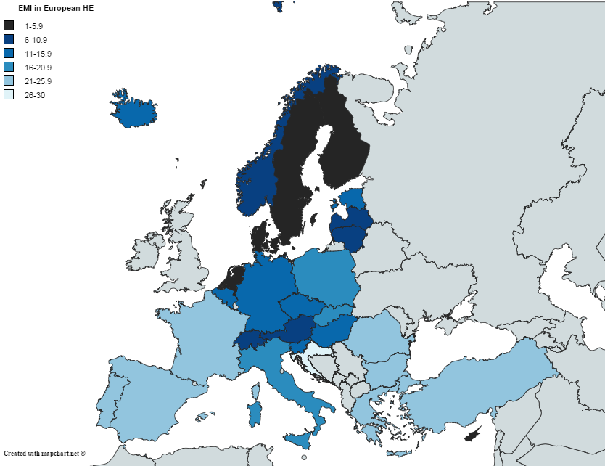
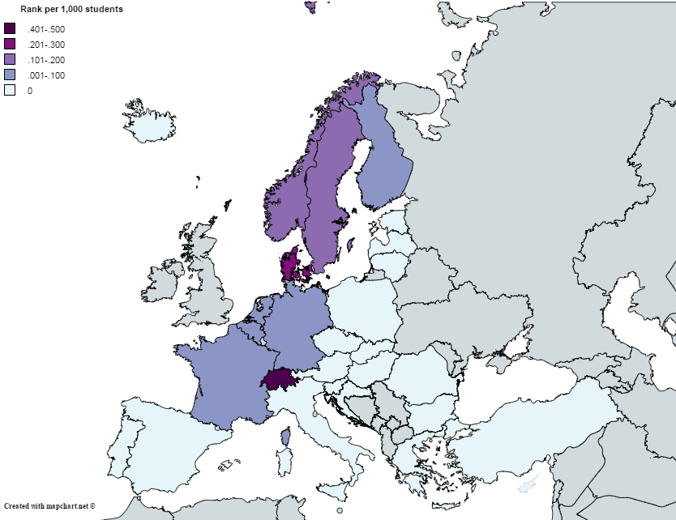
EMI: why?
Correlation between EMI and rankings
EMI
Rankings
Spearman, coefficient =-.551; P=.002, N=28

Slide 15
Part 2
What can EAP learn from EMI?

Slide 16

What can EAP learn from EMI?
Making language needs visible

Slide 17
What can EAP learn from EMI?
 |  | Writing | Speaking | Listening | Reading
Teaching | Teachers
 | Students
Research
Admin

Slide 18
What can EAP learn from EMI?
Language needs in EAP
 |  | Writing | Speaking | Listening | Reading
Teaching | Teachers
 | Students | X | X | X | X
Research
Admin

Slide 19
What can EAP learn from EMI?
Language needs in EAP
 |  | Writing | Speaking | Listening | Reading
Teaching | Teachers
 | Students | X | X | X | X
Research
Admin

Slide 20
What can EAP learn from EMI?
Language needs in EAP
Language needs in EMI
 |  | Writing | Speaking | Listening | Reading
Teaching | Teachers
 | Students | X | X | X | X
Research
Admin

Slide 21
What can EAP learn from EMI?
Language needs in EAP
Language needs in EMI
 |  | Writing | Speaking | Listening | Reading
Teaching | Teachers |  | X
 | Students | X | X | X | X
Research
Admin

Slide 22
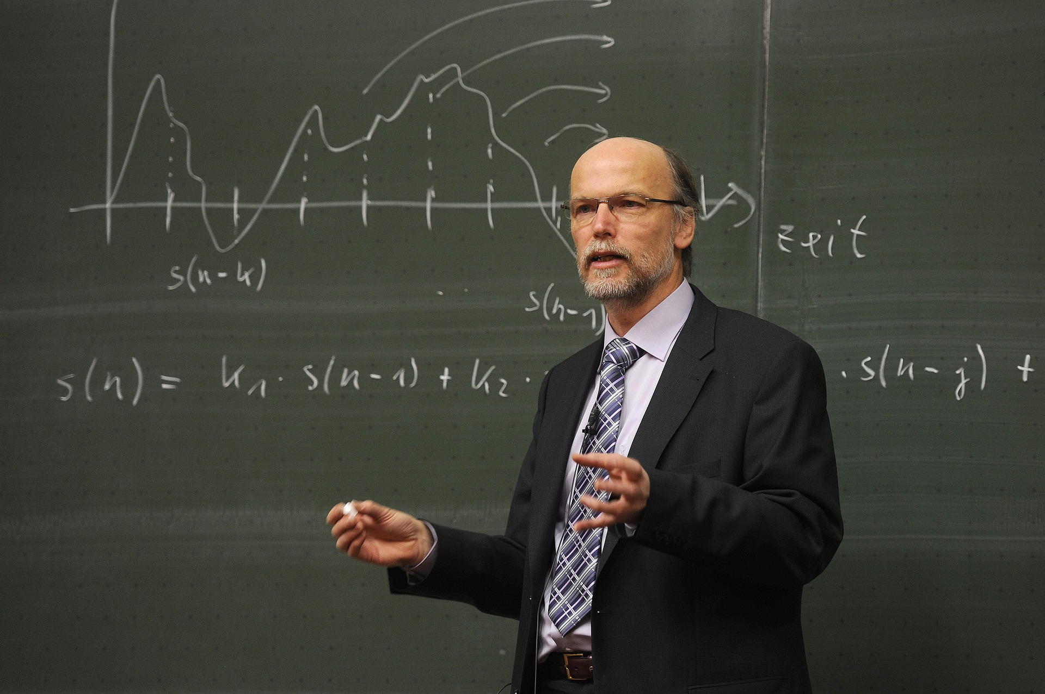
New EAP needs
Training for lecturers?

Slide 23
EMI lecturers’ thoughts
Themes
Theme 1: Short notice
Theme 2: No training
Theme 3: More preparation
Theme 4: Less detail
Theme 5: Less flexibility
Theme 6: Less fluency
Theme 7: No correction
Theme 8: Few differences
Theme 9: Confidence boost
(Airey 2011)

Slide 24
Students’ thoughts on EMI lecturers
Correlation between students’ perceptions of lecturers’ English proficiency and their perception of the lecturers’ competence in the subject taught
English proficiency
I found the teacher’s English fluent
I found that the teacher often struggled to find the appropriate words
I found that the teacher had too many long hesitations
I found that the teacher had good English grammar
I found that the teacher has good English pronunciation
I found that the teacher sounds like a native speaker of English
Subject competence
I found the teacher very knowledgeable about the subject
I found the teacher to be a real expert in this field
I found that the teacher was good at explaining the subject
I found the teacher engaging
I found that the teacher kept my interest
I found the teacher enthusiastic about the subject
I found the teacher pleasant
(Jensen et al. 2013)

Slide 25
What can EAP learn from EMI?
Language needs in EAP
Language needs in EMI
 |  | Writing | Speaking | Listening | Reading
Teaching | Teachers |  | X
 | Students | X | X | X | X
Research
Admin |  | X | X

Slide 26

New EAP needs
Training for admin staff

Slide 27






New EAP needs
How different are the academic language needs of a first language and non-first language user?

Slide 28
What can EAP learn from EMI?
Language needs in EAP
Language needs in EMI
 |  | Writing | Speaking | Listening | Reading
Teaching | Teachers | XX | XX | XX | XX
 | Students | XX | XX | XX | XX
Research |  | XX | XX | XX | XX
Admin |  | XX | XX | XX | XX

Slide 29
Part 3
What can EMI learn from EAP?

Slide 30
How EAP can inform EMI
Attention to language
Learning outcomes
Only language
Language and content
Only content
EAP
CLIL
EMI
Type of course
(Airey 2016)

Slide 31
How EAP can inform EMI
The EAP knowledge base is
Mature
Practically oriented
Research-informed

Slide 32
How EAP can inform EMI
Three options for integrating language and content:
  Language teachers could teach both content and language
  Content teachers could teach language along with their content
  Language teachers and content teachers can cooperate.
        (Airey 2016)

Slide 33
How EAP can inform EMI
Language and content teacher collaboration?
  EMI supported by EAP classes
  Content and language lecturers in the same classroom
  Content teacher takes responsibility for both content and language teaching, but with help from EAP teachers.
        (Airey et al. in press; Airey 2016)

Slide 34
How EAP can inform EMI
An example
EAP teacher to
  Observe EMI classes
  Identify academic speech/writing act functions in a lecture (or class teaching), e.g. explaining, stating, asking students to reflect, compare and contrast, etc.
  How many of these occurrences are there in the corpus?
  What are the many linguistic forms of these academic functions?
      (Martin del Pozo 2015)

Slide 35
What can EAP learn from EMI?
Language needs in EAP
Language needs in EMI
 |  | Writing | Speaking | Listening | Reading
Teaching | Teachers | XX | XX | XX | XX
 | Students | XX | XX | XX | XX
Research |  | XX | XX | XX | XX
Admin |  | XX | XX | XX | XX

Slide 36
Part 4
Conclusions

Slide 37
Conclusions
  With the growth of EMI there will be a lot more – not less – for EAP to do!
  EMI has helped visibilise language needs
  EAP has the knowledge base for successful EMI implementation
Need for collaboration
  Between subject and language teachers (Airey et al. 2016; Airey 2016)
  Between EMI and EAP community (Shrestha 2015)
  Between EAP decision makers, practitioners and researchers
Need to think outside of the box
  To identify those opportunities
  To overcome institutional and disciplinary obstacles
  The opportunities and the needs are there!

Slide 38
Selected References
Airey, J. (2016). CLIL and EAP (Content and Language Integrated Learning and English for Academic Purposes). In K. Hyland & P. Shaw (Eds.), Routledge Handbook of English for Academic Purposes (pp. 71-83). London: Routledge.
Airey, J. (2015) From stimulated recall to disciplinary literacy: Summarizing ten years of research into teaching and learning in English. In S. Airey, J. (2011). Talking about Teaching in English. Swedish university lecturers' experiences of changing their teaching language. Ibérica, 22(Fall), 35-54.
Dimova, A.K. Hultgren & C. Jensen (eds) English-Medium Instruction in European Higher Education. Mouton. 157-176.
Hellekjær, G. O. (2010) Lecture comprehension in English-medium higher education. Hermes – Journal of Language and Communication Studies 45: 11–34.
Hultgren, A. K. (2014) Whose parallellingualism? Overt and covert ideologies in Danish university language policies. Multilingua: Journal of Cross-Cultural and Interlanguage Communication 33(1–2): 61–87.
Hultgren, A. K., F. Gregersen & J. Thøgersen (eds). 2014. English in Nordic Universities: Ideologies and practices. Benjamins.
Hultgren, A. K., C. Jensen, S. Dimova (2015) English-medium instruction in European higher education: From the north to the south. In S. Dimova, A.K. Hultgren & C. Jensen (eds) English-Medium Instruction in European Higher Education. Mouton. 1-15.
Jensen, C. & J. Thøgersen (2011) University lecturers’ attitudes towards English as the medium of instruction. Iberica 22: 13–33.
Klaassen, R. G. & M Bos (2010) English language screening for scientific staff at Delft University of Technology. Hermes–Journal of Language and Communication Studies 45 (2010), 61-75.
Mortensen, J. (2014) Language policy from below: language choice in student project groups in a multilingual university setting. Journal of Multilingual & Multicultural Development 35(4). 425–442.
Nordic Council (2006) Declaration on Nordic language policy. Copenhagen: Nordic Council. http://urn.kb.se/resolve?urn=urn:nbn:se:norden:org:diva-607
Smit, U. (2010) English as a Lingua Franca in Higher Education. A Longitudinal Study of Classroom Discourse. De Gruyter.
Söderlundh, H. (2012) Global policies and local norms: sociolinguistic awareness and language choice at an international university. International Journal of the Sociology of Language 216: 87–109.
Thøgersen, J. & J. Airey (2011) “Lecturing undergraduate science in Danish and in English: A comparison of speaking rate and rhetorical style”. English for Specific Purposes 30: 209-221.
University of Copenhagen (2012) Mission Statement. Copenhagen: University of Copenhagen.
Wächter, B. & F. Maiworm (2014) English-Taught Programmes in European Higher Education: The State of Play in 2014. Lemmens, ACA Papers on International Cooperation in Education.

Slide 39
Thanks to:
John Airey
Prithvi Shrestha
Joan Turner

