Slide 1
Exploring the role of non-native teachers in English for Academic Purposes (EAP) in the UK
Kaz Yamamoto
ky14506@bristol.ac.uk
Julia Gardos
julia.gardos@bristol.ac.uk

Slide 2
Outline
Non-native identity & our experience
Advantages of non-native tutors
Research & findings

Slide 3
Intro
Who is a native speaker?
Define
Problematic:
dichotomy or scale (Llurda 2009)
Krashen: acquisition vs learning (1981)
distinction useful to explore advantages of both groups

Slide 4
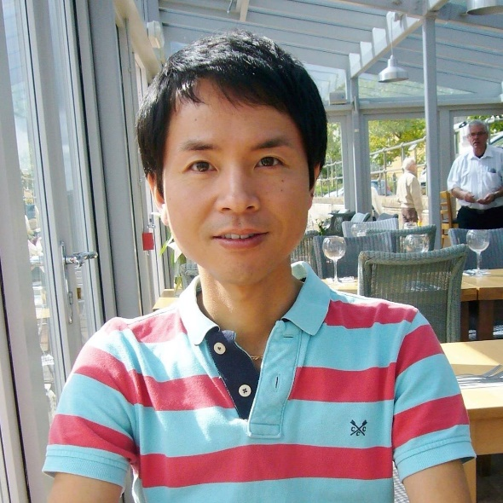
Kaz’s background
“Learnt” English & French as a kid
Lived in the US, Canada and France as an adult

Slide 5
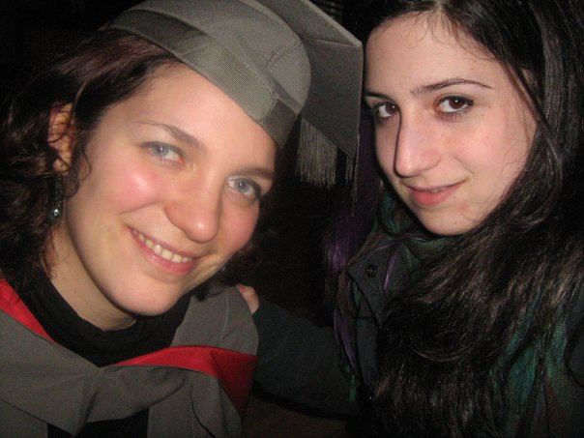
Julia’s background
Born in Hungary, first moved to England aged 7 for 3 years
Back in the UK since 2007

Slide 6
Racial appearance

Slide 7
Appearance and accent
Generation 1.5
Born outside Canada and US or born to immigrant parents, but received most of their secondary and/or elementary education in North America (Faez 2012)
Ss evaluate Ts by their “accent” & “ethnicity” (Lindemann 2002, Rubin 1992)
Ts fear not being accepted as “native” due to their racial identity

Slide 8
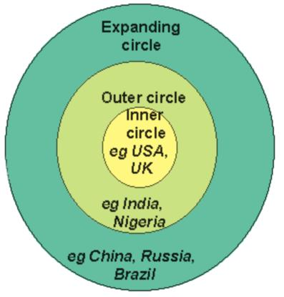
Accent
Accent
Idiolect
Sociolect
Dialect
World Englishes
Louwerse (2004)
Kachru (1997)

Slide 9
Identity
Native speaker fallacy – deficit view
(Phillipson, 1992)
Identity problems: “pathology discourse” (Richardson, 2016)
Inferiority complex (Medgyes, 1994)
I’m not a NS syndrome (Suarez, 2000)
Stockholm syndrome (Llurda, 2009)
Impostor syndrome (Bernat, 2008)

Slide 10
Identity
“Impostor in the writing centre – Trials of a Non-native tutor” (Wahlstrom, 2013)
Language use: hide, conceal, allows me to pass, at the very least be a NS, should the truth surface…
Appearance, accent
Student expectations – both foreign and home
What is your experience?

Slide 11
NEST vs Non NEST – Differences in EFL
Non NESTs can;
serve as imitable models of the successful learner of English.
teach learning strategies effectively.
provide learners with information about the English language.
anticipate language difficulties.
have empathy towards students.
benefit from sharing the learners’ mother tongue.
Medgyes (1992)

Slide 12
Non-native teachers in EAP
Non-native teachers more empathetic? Panayotova (2016)
transition from result-oriented learning to process-oriented learning
critical thinking
rationale for pair work / group work
independent learner training

Slide 13
Non-native teachers in EAP
“Academic language is nobody’s mother tongue”
(Bourdieu, 1994)
Native speaker also 2nd language learner
Easier for NS to learn academic language?
(Jenkins, 2016)
EAP: teaching language AND academic culture
→ Non-natives as model learners on several levels

Slide 14
Our experience at UoB
KAZ:
Understanding students’ academic challenges
Sharing cultures
JULIA:
In-sessional EAP support for international graduate students → sharing own experience
Model for Ss in learning new academic culture

Slide 15
Our research
Research gap: non-native teachers in EAP
Context: Pre-sessional summer course at UoB, majority of Ss Chinese
Based Walkinshaw & Hoang Duang (2012)
72 PS (out of 920) students rated 8 factors of a “good PS teacher”
Avoiding bias

Slide 16
Our research
8 important factors of being a good teacher
Enthusiasm for teaching
Friendly personality
Native speaker of English
Delivers interesting / informative classes
Familiar with local culture
Appropriate qualifications
Teaching experience
Linguistic fluency
Can you guess:
Top factor
Bottom factor
Where the native speaker ranked
1=most important
8=least important

Slide 17
Results
Participants: 72 Pre-sessional students
Modes
1 Enthusiasm for teaching
8 Native speaker of English/Familiar with local culture
Results
Enthusiasm for teaching
Friendly personality
Delivers interesting / informative classes
Teaching experience
Linguistic fluency
Appropriate qualifications
Native speaker of English
Familiar with local culture
The number of participants who chose “Native speaker of English”
Most important factor: 3 participants (4.2%)
Least important factor: 30 participants (41.7%)

Slide 18
Thematic analysis of students’ comments
Native speaker of English
Pronunciation
Language fluency
Enthusiasm for teaching
Lively/enjoyable
Interesting
Patience
Passion
Preparation (well prepared)

Slide 19
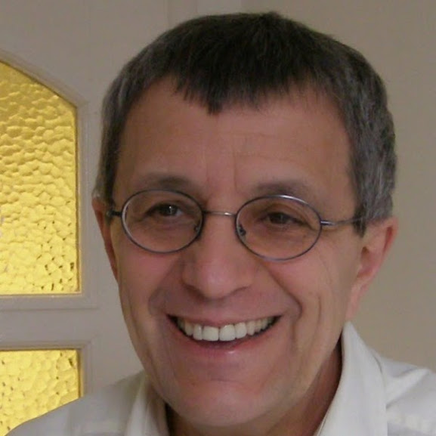
A message from Peter Medgyes
My message for Bristol University is very simple: native and non-native teachers are different but serve an equally useful purpose. The best way to move forward is to have both kinds of animals who work in close collaboration with each other - and love each other too. Simple, isn't it?

Slide 20
University of Bristol
Supportive towards non-native tutors
PS course
- diversity of tutors
- pairings
Summer 2016: CPD session → Blog post → webinar
Leading to conference…

Slide 21
Collaboration
How can native and non-native EAP tutors collaborate effectively?

Slide 22
QUESTIONS?

Slide 23
References I
Bernat, E. 2008. Towards a pedagogy of empowerment: The case of ‘impostor syndrome’ among pre-service non-native speaker teachers in TESOL. ELTED, vol. 11
Bourdieu, P. and Passeron, J.-C. 1994. Introduction: Language and the relationship to language in the teaching situation. In P. Bourdieu, J.-C. Passeron & M. de Saint Martin, Academic discourse (pp. 1-34). Cambridge: Polity Press
Canagarajah, A.S. (1999) Interrogating the ‘Native speaker fallacy’: Non-linguistic roots, Non-pedagogical results. In G. Braine (ed.) Non-Native Educators in English Language Teaching (pp. 77–92). Mahwah, NJ: Lawrence Erlbaum.
Cheung, Y. L. (2002). The attitude of university students in Hong Kong towards native and non-native teachers of English.
Chiba, R., Matsuura, H., & Yamamoto, A. (1995). Japanese attitudes toward English accents. World Englishes, 14(1), 77-86.
English-speaking teaching assistants. Research in Higher Education, 33, 511-531.
Faez, F. (2012). Linguistic identities and experiences of generation 1.5 teacher candidates: Race matters. TESL Canada Journal, 29, 124.
Jenkins, J. 2016. Closing remarks. BALEAP PIM – EMI in Higher Education: the challenges and the opportunities. University of Southampton.
Kachru, B. B. (1997). World Englishes and English-Using Communities. Annual Review of Applied Linguistics, 17, pp 66-87.
Kramsch, C. (1997). Guest column: The privilege of the nonnative speaker. Publications of the Modern language Association of America, 359-369.
Krashen, SD. 1981. Second Language Acquisition and Second Language Learning. Pergamon Press.
Lindemann, S. (2002). Listening with an attitude: A model of native-speaker comprehension of non-native speakers in the United States. Language in Society, 31, 419-441.
Lippi-Green, R. (1997). English with an accent: Language, ideology, and discrimination in the United States. Psychology Press.
Llurda, E. 2009. The decline and fall of the native speaker. In L. Wei & V. Cook (Eds.) Contemporary Applied Linguistics: Language Teaching and Learning.
Louwerse, M. M. (2004). Semantic variation in idiolect and sociolect: Corpus linguistic evidence from literary texts. Department of Psychology / Institute for Intelligent Systems The University of Memphis.

Slide 24
References II
Medgyes, P. (1992). Native or non-native: who’s worth more? ELT Journal, 46(4), 340–349.
Medgyes, P. 1994. When the teacher is a non-native speaker. In M. Celce-Murcia (Ed.),Teaching English as a second or foreign language, Third edition (pp. 415-428). Boston: Heinle & Heinle.
Native English-speaking teachers: always the right choice? | British Council. (n.d.). Retrieved 27 March 2016, from https://www.britishcouncil.org/voices-magazine/native-english-speaking-teachers-always-right-choice
Pacek, D. (2005). ‘Personality Not Nationality’: Foreign Students’ Perceptions of a Non-Native Speaker Lecturer of English at a British University. In Non-native language teachers (pp. 243-262). Springer US.
Panayotova, D. 2016. Non-native teacher contributions to EAP practice. BALEAP PIM – EMI in Higher Education: the challenges and the opportunities. University of Southampton.
Parekh, M. (2012, April 10). India’s teachers face ‘native-only’ bar. Retrieved 15 May 2016, from http://www.theguardian.com/education/2012/apr/10/india-teacher-prejudice-employment-bar
Phillipson, R. (1992). ELT: The native speaker’s burden. ELT Journal, 46(1), 13-18.
Richardson, S. 2016. The ‘native factor’, the haves and the have-nots. IATEFL, Birmingham. https://iatefl.britishcouncil.org/2016/session/plenary-silvana-richardson
Rubin, D.L. (1992). Nonlanguage factors affecting undergraduates’ judgments of non-native English-speaking teaching assistants. Research in Higher Education, 33, 511-531.
Suarez, J. 2000. ‘NATIVE’ AND ‘NON-NATIVE’: not only a question of terminology. Humanising Language Teaching Year 2; Issue 6.
Wahlstrom, H, 2013. Impostor in the Writing Center – Trials of a Non-Native Tutor. The Writing Lab Newsletter, Volume 38 3-4, pp. 10-13.
Walkinshaw, I., & Duong, O. T. H. 2012. Native- and Non-Native Speaking English Teachers in Vietnam: Weighing the Benefits. TESL-EJ, 16(3), 1–17.

