Slide 1
Is group work working? Ex-Pre-sessional student reflections on group work Laura Pibworth-Dolinski BA MA FHEA PSE Course Leader/Tutor laura.pibworth@coventry.ac.uk BALEAP PIM University of Edinburgh 18th March 2017

Slide 2
Outline
Introduction to Coventry University and CUS PSE
Approach to the project
Why group work?
The challenges of group work according to…
the literature
the students
What can we do to help our students?

Slide 3
Coventry University
Multiple sites: CU Coventry, London, Scarborough and CU College
Modern University of the Year 2014, 2015, 2016 (Times Good University Guide)
University of the Year 2015 (THE Awards)
(Coventry University 2017)
27.1% overseas students
(The Sunday Times 2016)

Slide 4
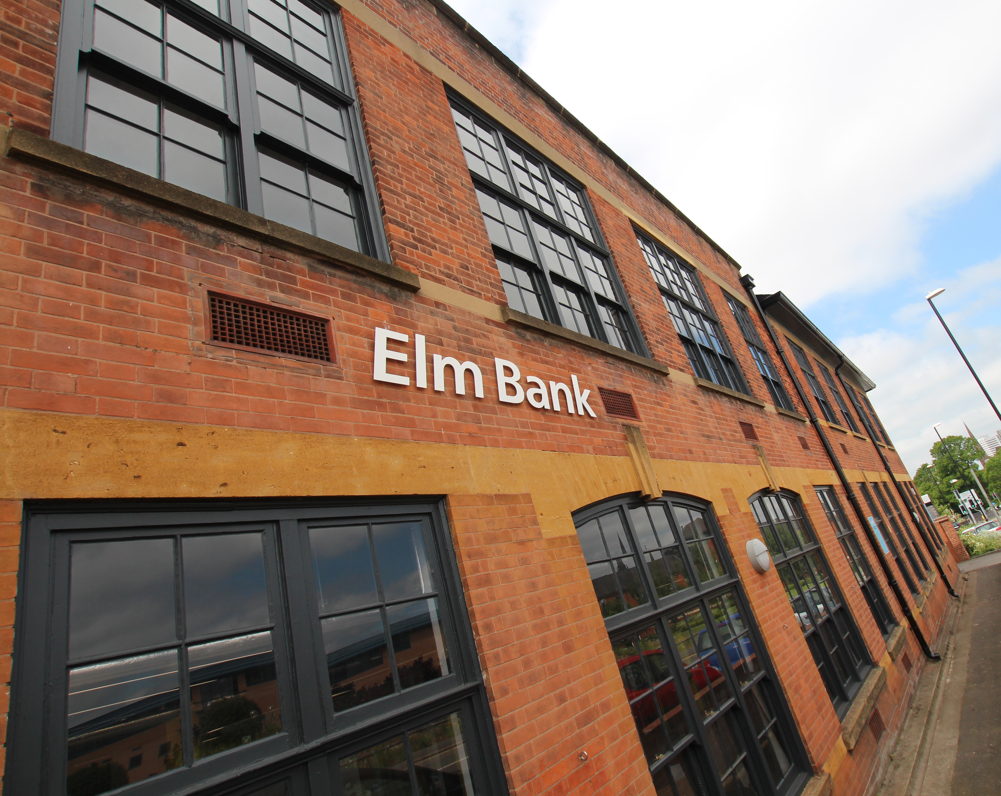
CUS Pre-sessional English
30, 15, 10 and 5 week (Summer and Autumn)
New for 2017: 10, 5 week PSE for May starts
In-sessional English
Developing overseas provision
Our students
28 nationalities
103 destination courses
60:40 UG/PG

Slide 5
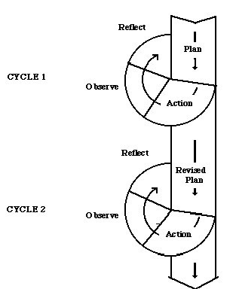
Approach = Action Research
‘A self-reflective, critical and systematic approach to exploring your own teaching contexts’.
(Burns 2010:1)
(Kemmis and McTaggart cited in Burns 2010:9)
→ We aim to prepare our students for their University courses, how can we improve the way we do so?

Slide 6
‘Student Tracking’ participants
38 participants (so far…)
13 nationalities
28 Destination courses across all faculties
Business & Law
Engineering & Computing
Arts & Humanities
Health & Life Sciences

Slide 7
Why group work?
Our students will be confident citizens who can demonstrate a range of individual, collaborative, and professional skills and attributes.
Coventry University Corporate Strategy 2021 (2016)
Assessed group work on many courses e.g.
BA International Business: group presentation
MSc Automotive Engineering: group report
Collaboration an essential component
Design – collaboration to generate ideas for projects

Slide 8
Characteristics of group work and discussions
Collaborative: contributing ideas, reading and research
Interactive
Negotiation: persuading and conceding during discussion
Problem-solving: division of labour, group dynamics
Criticality: critiquing arguments of other group members
Outcome-driven: clearly defined product required by a given deadline.
(de Chazal 2014:243-245)

Slide 9
Benefits of group work
‘…if all the members are active we can come up with a great job’
(MSc Oil & Gas Engineering)
‘It is an interesting but challenging experience. I am happy about all the things that happen when I work in a group’
(MA Interior Design)
‘Although I didn't like to work in groups I can list some benefits.…it is actually helpful tool of success because it gave us ideas how different people think, give a chance to different ideas to flow, and learn from various people with different mind-set, culture, and knowledge’
(BA Business Administration Yr 2)

Slide 10
Problematic areas
Language and communication
Attitudes and engagement
Composition of group members
Group management
Conflict management
(Spencer-Oatey and Dauber 2016: 2)

Slide 11
Language and Communication
‘One person, she couldn’t understand us, her English is very weak. She didn’t understand even what the teacher said in the classes...she couldn’t do her part’
(MSc Engineering Project Management)
‘Sometimes I cannot very clearly understand her meaning and we just do not understand what the teacher want us to do’
(MSc Finance)
‘Students from other countries rather than China, their English is not that good and the main problem is they have strong accents and it’s really hard to communicate with them’
(MSc Mechanical Engineering)

Slide 12
Language and Communication
‘It’s the first time I’ve worked with people from different countries. Actually my English is not that good, but I need to get used to it…because this is England’
(MSc Industrial Product Design)

Slide 13
Group Management
‘[The Lecturer] said ‘you are looking like two groups’ because we have divided ourselves’
(MSc Engineering Project Management)
‘We separated the topic…this topic is individual work and last is the combined part’
(BSc Nursing Yr 3)
‘I prefer to do it on my own, not group work, because I can manage my own time. I think it’s hard to work in a group and match everyone’s schedule’
(MSc Event Management)

Slide 14
Group Management: Making Decisions
‘…we couldn’t really agree to things…we have peer assessment…now everyone is hating each other, we lost marks…’
(MSc Engineering Project Management)
‘…sometimes there are some conflicts and I don’t know how to solve [them] which is one of the main problems’
(MSc Mechanical Engineering)
‘If I have idea and my classmate have idea, if she cannot agree with me and she thinks she is right, I will follow her…if we waste too much time we cannot finish on time’
(MSc Finance)

Slide 15
What can we do to help our students?
Raise awareness of challenges and possible benefits of mixed nationality group work
Support development of effective strategies for handling communication challenges in group contexts
(Spencer-Oatey and Dauber 2016: 13)
Prepare students and tutors for group work through readings and discussion
(Elliot and Reynolds 2014: 318)

Slide 16
What can we do to help our students?
Speaking Syllabus
Problem-solving language
Language of persuasion
Presentation: group presentation and reflection
Extended Writing
Group work focus
Wider study skills
Time management

Slide 17
References (1)
Alexander, O., Argent, S. and Spencer, J. (2008) EAP Essentials: A teacher’s guide to principles and practice. Reading: Garnet
Biggs, J. and Tang, C. (2007) Teaching for Quality Learning and University. 3rd edn. Maidenhead: McGraw Hill
Burns, A. (2010) Doing Action Research in English Language Teaching: A Guide for Practitioners. New York: Routledge
Coventry University (2017) ‘We Are…A Leading UK University’. Coventry University [online] available from <http://www.coventry.ac.uk/awards/] [Accessed 14 March 2017]
Coventry University (2016) Corporate Strategy 2021: Creating Better Futures Coventry University [online] available from < http://creatingbetterfutures.coventry.ac.uk/> [Last accessed 30 November 2016]
de Chazal, E. (2014) English for Academic Purposes. Oxford: OUP
Elliott, C.J. and Reynolds, M. (2014) ‘Participative pedagogies, group work and the international classroom: an account of students’ and tutors’ experiences’. Studies in Higher Education 39 (2), 307-320

Slide 18
References (2)
Kemmis, S. and McTaggart, R. (eds.) (1988) The action research planner. 3rd edn. Geelong: Deakin University Press. cited in Burns, A. (2010) Doing Action Research in English Language Teaching: A Guide for Practitioners. New York: Routledge:9
Kimmel, K. and Volet, S. (2012) ‘University Students’ Perceptions of and Attitudes Towards Culturally Diverse Group Work: Does Context Matter?’. Journal of Studies in International Education 16 (2), 157-181
Spencer-Oatey, H. and Dauber, D. (2016) ‘The gains and pains of mixed national group work at university’. Journal of Multilingual and Multicultural Development, 1-18
The Sunday Times (2016) ‘University Guide 2017’. The Sunday Times 25 September, 20
Turner, Y. (2009) ‘“Knowing Me, Knowing You, Is There Nothing We Can Do? Pedagogic Challenges in Using Group Work to Create an Intercultural Learning Space’. Journal of Studies in International Education 13 (2), 240-255
Volet, S. and Mansfield, C (2006) ‘Group work at university: significance of personal goals in the regulation strategies of students with positive and negative appraisals ‘. Higher Education Research and Development 25 (4), 341-356

