Slide 1

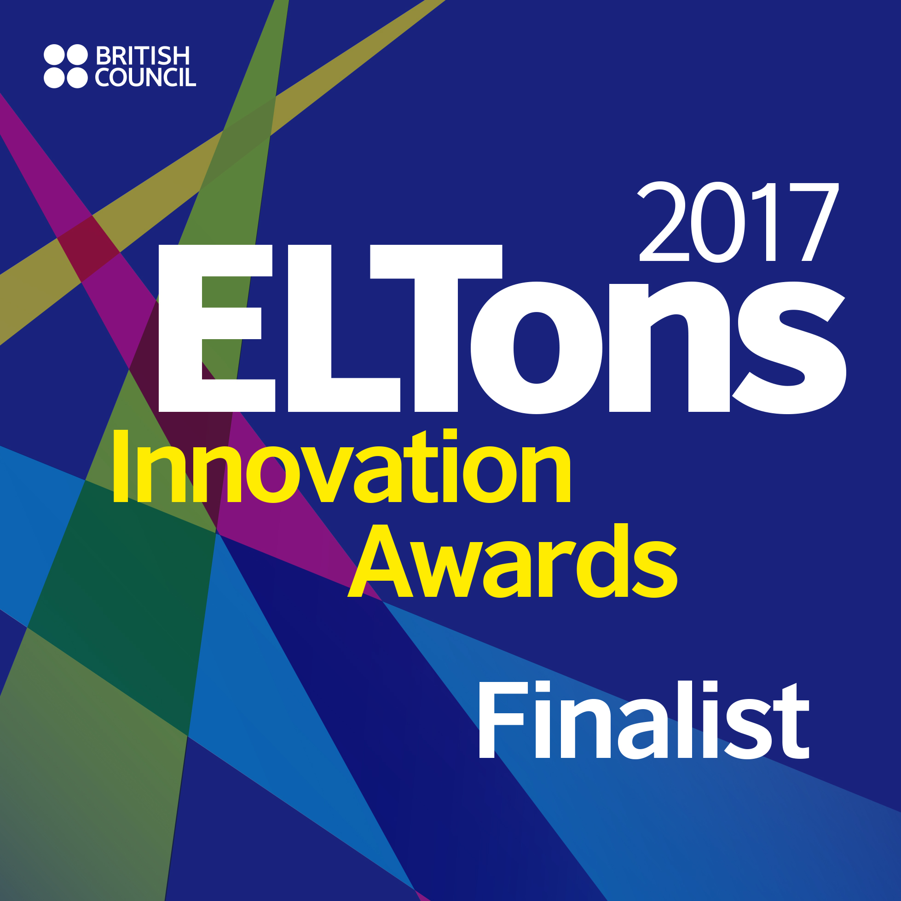
for a Sustainable EAP Course
Averil Bolster & Peter Levrai
Sunday 9th April, BALEAP 2017 Bristol

Slide 2

The Course In Question
University of Macau
Qualifying English course (CEFR B1+)
Part of General Education programme
1 Semester, 40-hour course
Cohort over 1,100 students
Multi disciplinary groups so EGAP approach preferred (de Chazal, 2012)

Slide 3
Planning the Course
Course planned using Backward Design (Wiggins & McTighe, 2005).
Stage 1 – Identify desired results
What do we want the students to know, understand and be able to do?
Stage 2 – Determine acceptable evidence
What do we want students to be able to do to demonstrate their learning?
Stage 3 – Plan learning experience and instruction
What teaching activities will lead as many students as possible towards learning?

Slide 4
Stage 1 – Identify Desired Results
Course design starts with the ‘big idea’ or lynchpin idea.
For this course the big idea came from UEfAP.com.
The aim of the course is to help students develop “the language and associated practices that people need in order to undertake study or work in English medium higher education” (Gillett, 2015, para. 1).

Slide 5
Stage 1 – Identify Desired Results
This lynchpin idea was broken down into specific outcomes in these areas.
Backward design is an iterative process (Whitehouse, 2014)
Academic discourse
Academic language
Knowledge building
Associated practices
Collaboration
argumentation, referencing, genre
tone, discourse markers, cohesion
reading & research strategies, critical thinking
goal-setting, self-reflection, time management
group work, peer review, e-tools

Slide 6
Stage 2 – Acceptable Evidence
Essay Portfolio*
Oral Presentation
Coursework
Course Reflection
*Levrai & Bolster, 2017

Slide 7
Stage 3 – Learning Experience
Primary concern was developing a sustainable course.
Sustainable
Flexible
Easy to update
Interesting
Reusable

Slide 8
Solution 1 – Pilot Year & AY 201516
A course blending a commercial listening & note-making book with in-house materials (classroom & Moodle).
Too focused on humanities (Global English, Media, Public Health, Learning Styles)
Developed a strong framework and successful blend of classroom & virtual learning activities

Slide 9
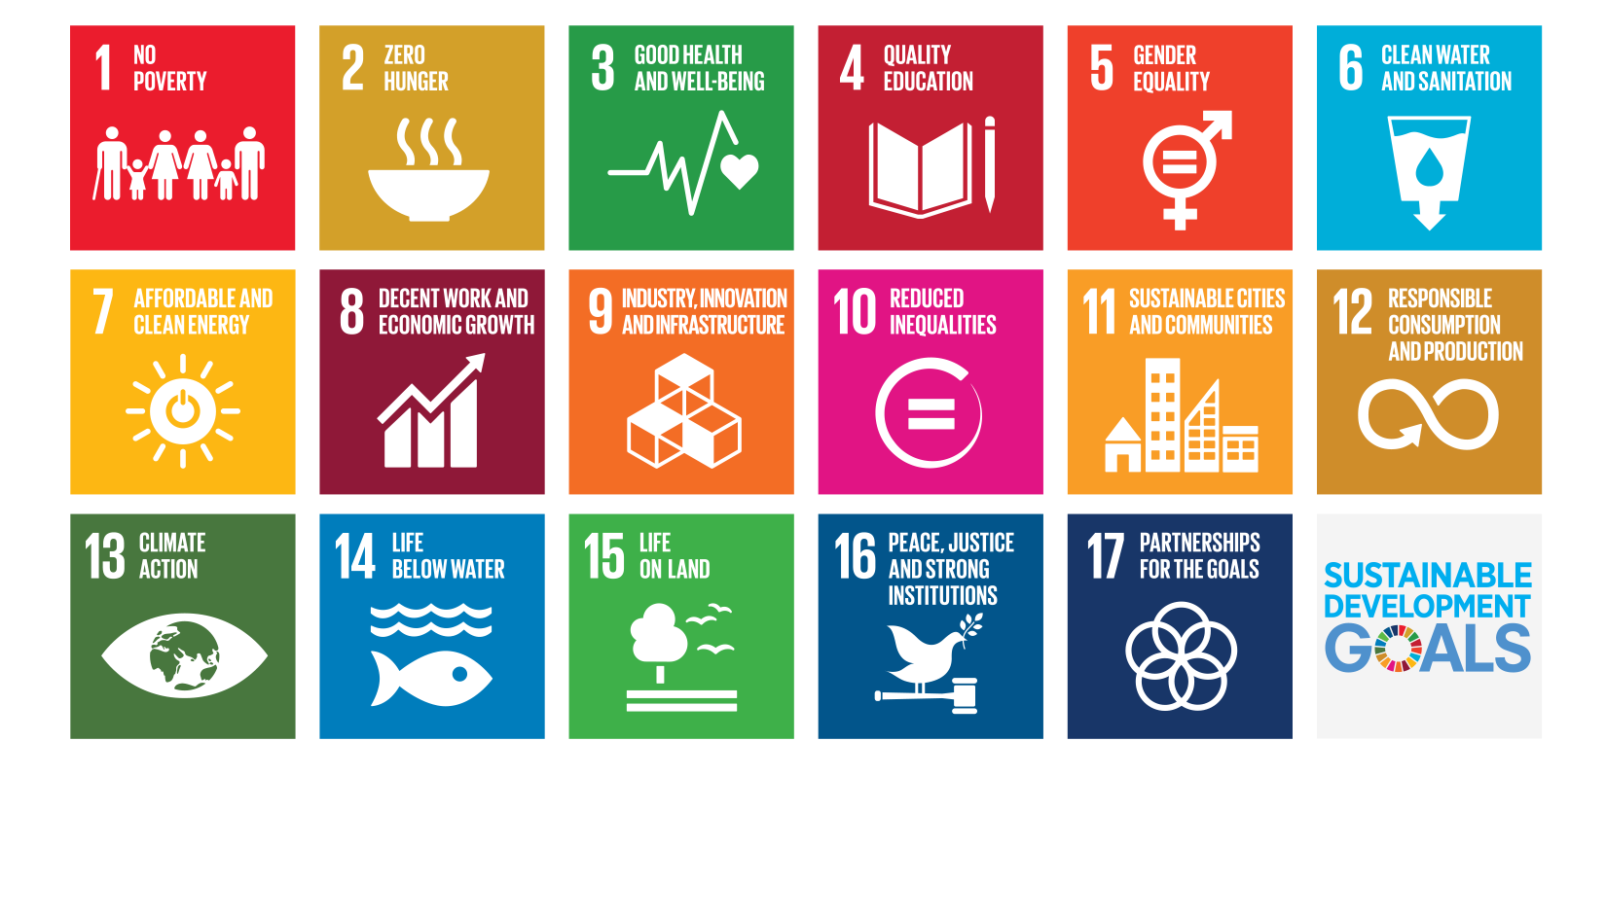
Solution 2 – AY 2016-17
Solely using in-house materials.
Basing the course on the UN’s Sustainable Development Goals 2030 (UN, 2016).

Slide 10
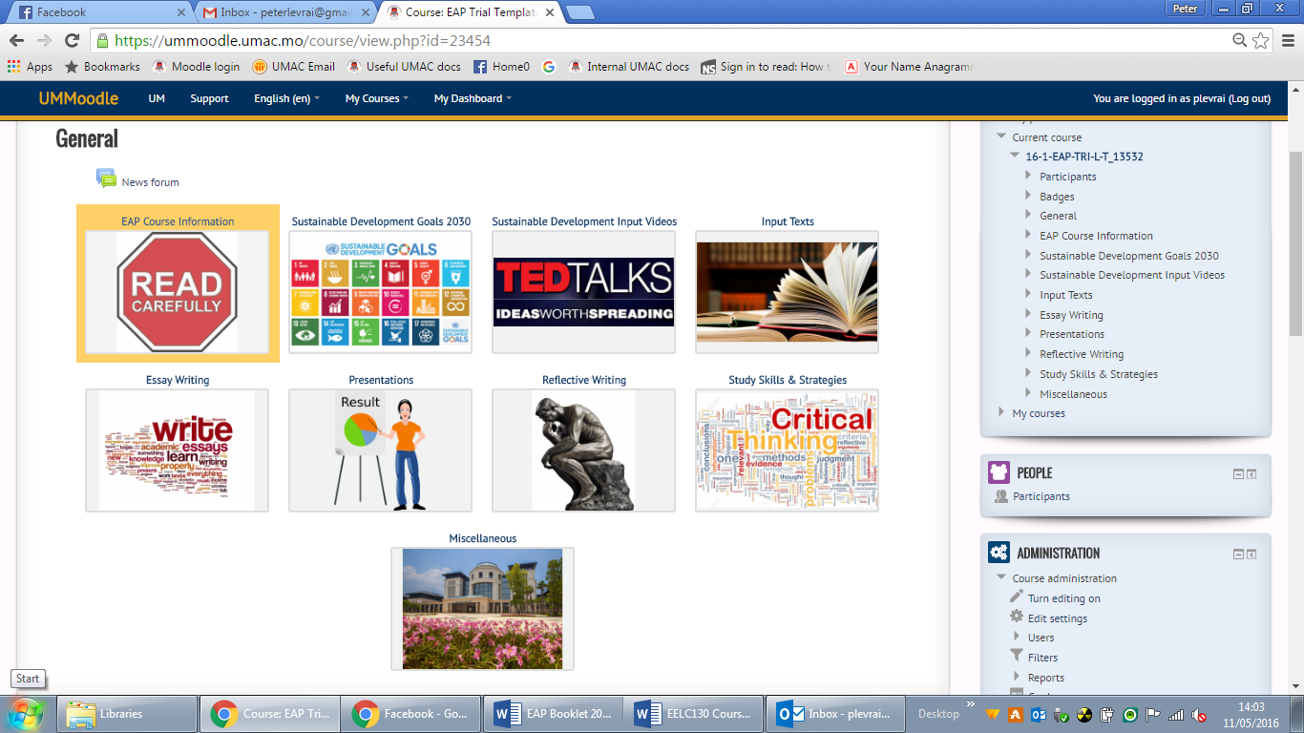
Course Materials
The course is fully blended, comprising of
  a classroom booklet
  Moodle template course.

Slide 11
Course Sustainability - Topic
17 goals, 169 targets.
Students can be given free reign or directed to particular goals.
Wide ranging topics which can be addressed from different disciplines.
Wide variety of sources available (the UN, The Conversation, News outlets)
Every year things will happen connected to the goals.
2016 US election
5: Gender Equality
7: Clean Energy
13: Climate Change
17: Partnerships for the goals

Slide 12
Course Sustainability – Delivery
Course booklet contains introductory texts which would not need to be changed so can be used for subsequent years.
Additional background reading & audio-visual texts provided through Moodle.
Students generated content (annotated bibliographies)
Course makes extensive use of QR codes to useful resources – could be used in class or autonomously
Utilises collaborative e-spaces (Stormboard, Google Docs).

Slide 13
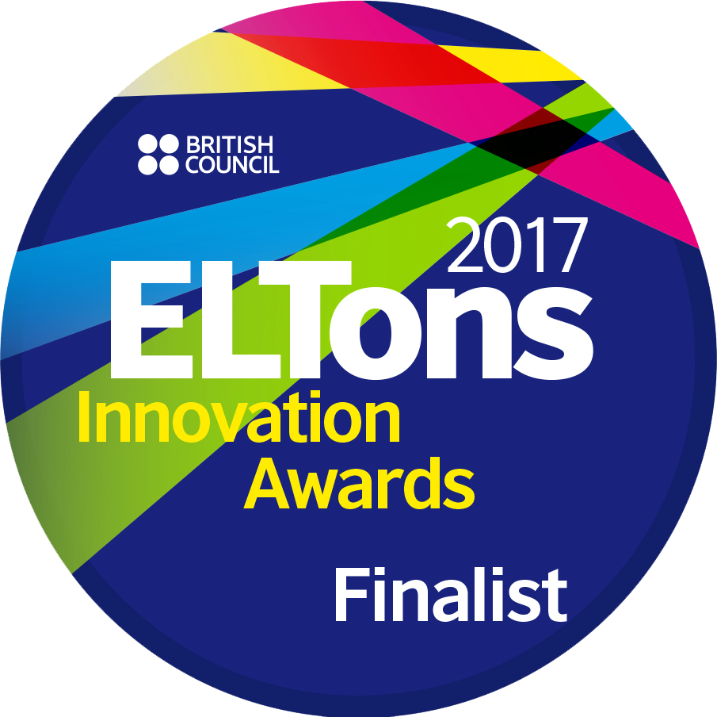
Conclusion
It’s relatively easy to update materials within the framework we developed through Backward Design.
Adopting a blended approach to materials facilitates updating.
The SDGs are a genuinely interesting topic which should engage students intellectually and academically.
https://englishagenda.britishcouncil.org/research-publications/resource-books
For an in-depth explanation see
Bolster, A. & Levrai, P. (in press). A Slow (R)Evolution: Developing a Sustainable EGAP Course. The European Journal of Applied Linguistics and TEFL, 6 (1).

Slide 14
References
de Chazal, E. (2012). The general-specific debate in EAP: Which case is the most convinc-ing for most contexts? Journal of Second Language Teaching and Research, 2(1), 135–48.
Gillett, A. (2015). What is EAP? Retrieved from http://www.uefap.com/bgnd/whatfram.htm
Levrai, P. & Bolster, A. (2017). ‘Undergraduate collaborative essays: constructive not a cop-out’, IATEFL 2016 Birmingham Conference Selections. IATEFL
United Nations. (2016). Sustainable Development Goals: 17 Goals to Transform our World. Retrieved from http://www.un.org/sustainabledevelopment/sustainable-development-goals/
Whitehouse, M. (2014). Using a backward design approach to embed assessment in teaching. School Science Review, 95(352), 99–104. Retrieved from https://www.york.ac.uk/media/educationalstudies/documents/research/uyseg/diagnosticassessment/SSR_ Mar_2014_Whitehouse.pdf
Wiggins, G. P., & McTighe, J. (2005). Understanding by design. Upper Saddle River, NJ: Merrill/Prentice Hall.

Slide 15

Thank you
averilbolster@gmail.com & peterlevrai@gmail.com
Slides available at https://www.slideshare.net/PeterLevrai/

