Slide 1
Skills Centre
Informed student voice: A four-way collaboration
Clive Lee
Evia Jin
Su Steenberg
Wentian Cao
8 April 2016

Slide 2
Skills Centre
A four-way collaboration:
the Student Ambassador Programme
Skills Centre
Student Services
School of Management
Students

Slide 3
Skills Centre
The Student Ambassador Programme

Slide 4
Skills Centre
The Student Ambassador Programme
Volunteers
Uniquely qualified
Meeting and greeting
LINC events

Slide 5
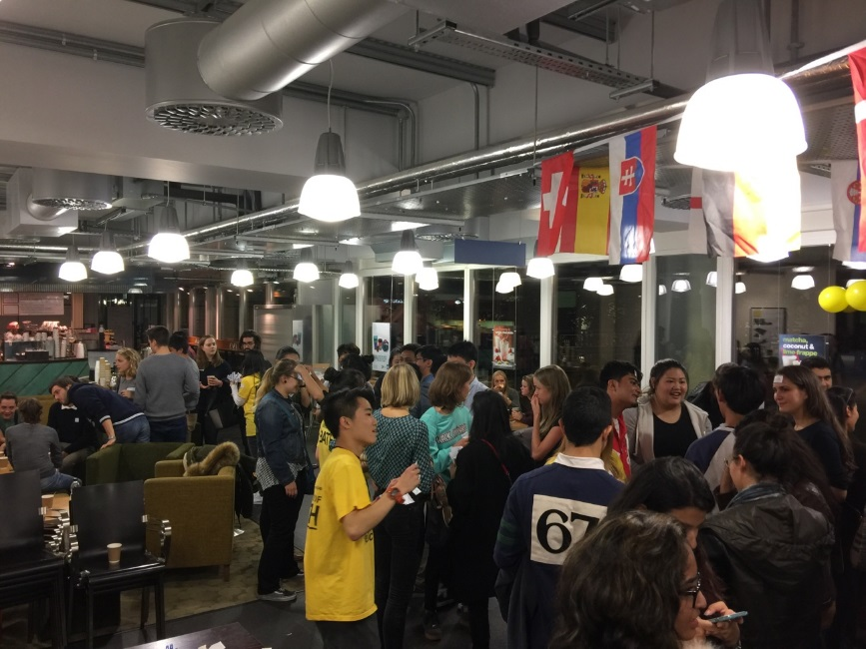
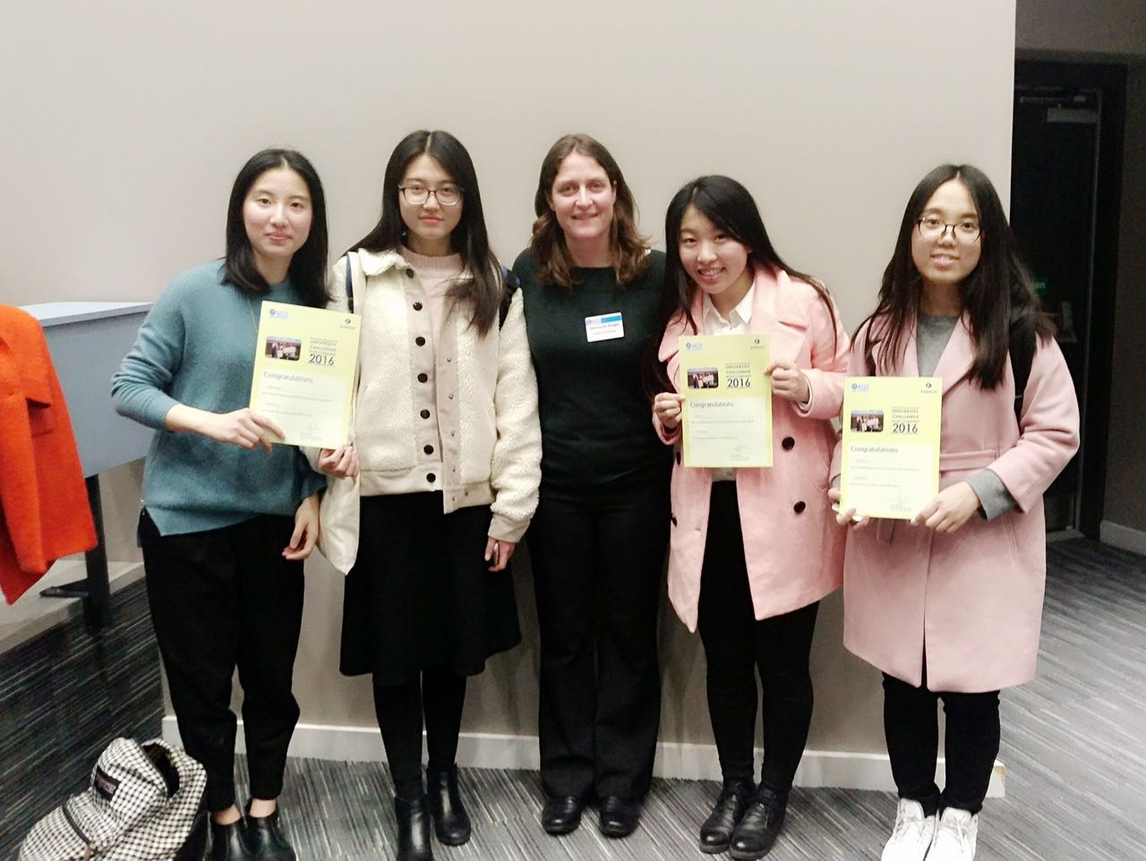
Skills Centre
Wentian
Why
Training
Zurich Challenge

Slide 6
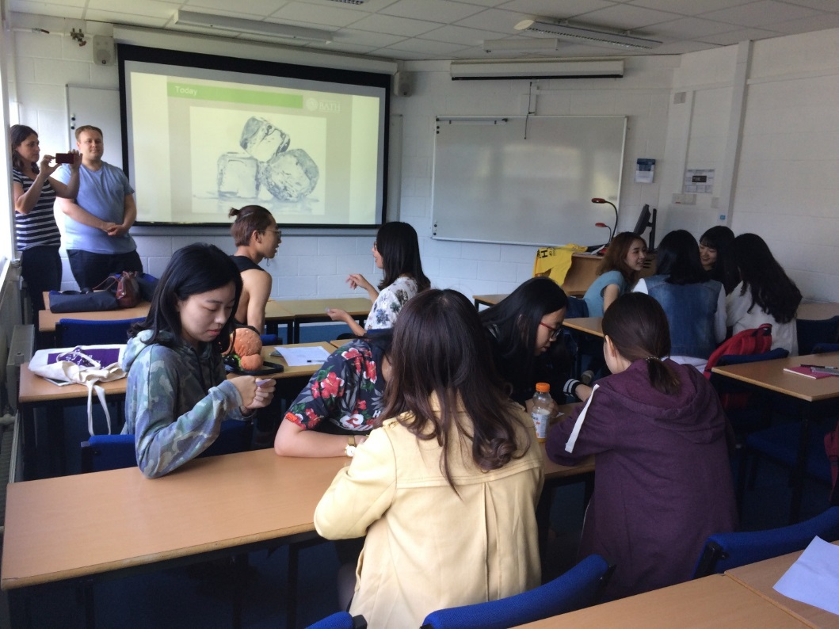
Skills Centre
Evia
Training
Welcome Week
Two roles
Holburne Museum and Oxfam

Slide 7
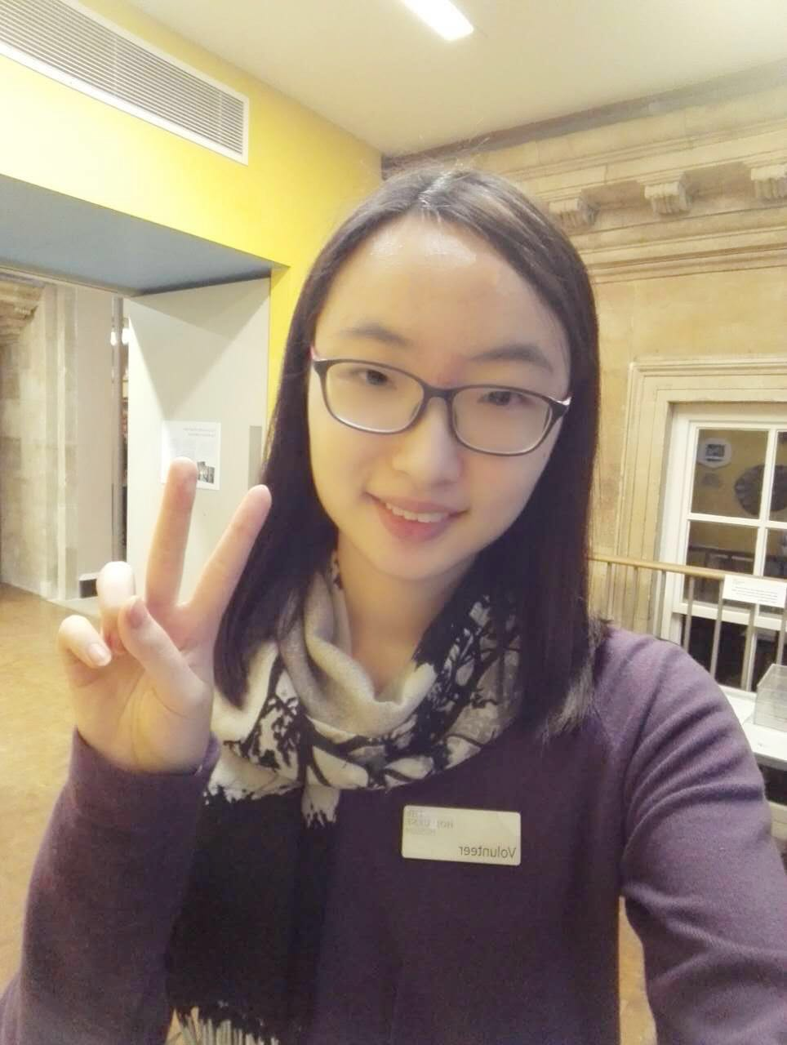
Skills Centre
Evia: Holburne Museum and Oxfam

Slide 8
Skills Centre
Value to the University
Enhancing student experience
Managing processes
Year-round support

Slide 9
Skills Centre
Value to pre-sessional programme
Practise academic skills
Resource to others
Resource to programme

Slide 10
Skills Centre
2017
Expansion
Design
Timing

Slide 11
Skills Centre
Last Word
Wentian
Evia

Slide 12
Skills Centre
Questions

