Slide 1
DEFINING COMMUNICATIVE PURPOSE:
VIEWS OF STUDENTS, EAP AND SUBJECT LECTURERS ON ASSESSED WRITING TASKS FOR BUSINESS MODULES.

Slide 2
Background
Research into academic writing for Business courses.
Corpus of non-native student writing completed in final year of Business degrees at Coventry University.
Writing collected from credit-bearing subject and EAP modules.
Corpus divided into levels of achievement (3rd to 1st). Current interest is in the successful texts (2:1 and 1st class)
The writing is in the case study genre. Students analyse an exemplar company (Tesco’s / Barclaycard) and offer recommendations.
I teach on the EAP module at Coventry and I am a part-time PhD student at The University of Birmingham.

Slide 3
Aims of research
To examine assessed academic writing on a Business content and an EAP support module.
To investigate similarities and differences in student writing on the two tasks.
To find out what we can learn from each other. Should any changes be made to assessments in either module?
To improve teaching and assessment on EAP and possibly on content modules.

Slide 4
Methodology
Analysing assignment briefs
Stages of writing (Genre Analysis / moves)
Language choices in the two tasks (Corpus Linguistics and Systemic Functional Linguistics)
Focus groups / interviews – Subject lecturers, EAP lecturers, student writers

Slide 5
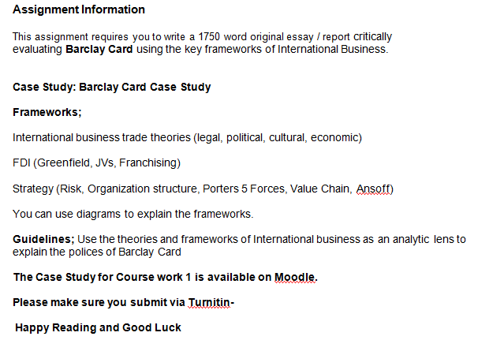
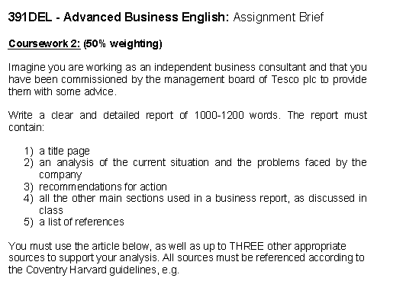
EAP task
Subject task

Slide 6
Research Questions
To what extent do these assignments share a communicative purpose?
What can we learn as EAP teachers from analysing business writing tasks and talking to Business lecturers?

Slide 7
Business writing in the BAWE corpus
The case study genre family….
1) Company Reports where students pretend
to address a business or shareholder
2) Organisation Analyses concerned with
business issues but not set in the
imagined workplace
3) Single Issue Report; more ‘overtly
academic’ with no assumed consultant role
or personal responsibility for advice
(Nesi and Gardner 2012:194)

Slide 8
The type of Business assignment affects the register used by
successful students (from more ‘academic’ to more ‘professional’)
Gardner (2012)

Slide 9
Business module
Assignment
EAP module
assignment

Slide 10
Sections and stages
Student writers on both assignments use the same section headings – Introduction / Orientation, Analysis, Conclusion, Recommendations.
Proportions are quite different though:
Analysis – 67%-83% in subject task.
31-53% in EAP writing.
Recommendations – 22% of total in EAP task,
12.5% in Business module task.
Student writers analyse more in the subject task, advise more in the EAP assignment.

Slide 11
Section headings
Section headings indicate different communicative purpose:
EAP task – Ideational / topic based headings
Subject assignment – Theoretical models, ‘textual’ function

Slide 12
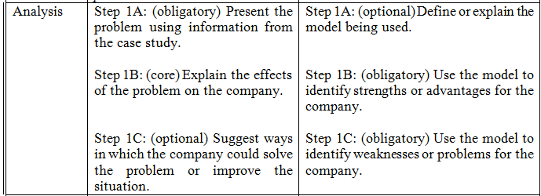
Move analysis of different sections
EAP assignment
Business module

Slide 13
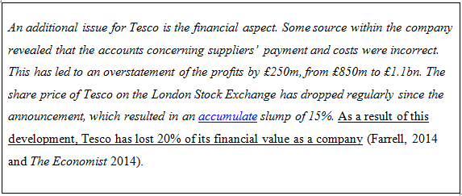
Example of steps 1B and 1C in subject corpus. Strengths in italics, weaknesses
underlined.
Example of steps 1A and 1B in EAP corpus. Cause in italics, effects
underlined.

Slide 14
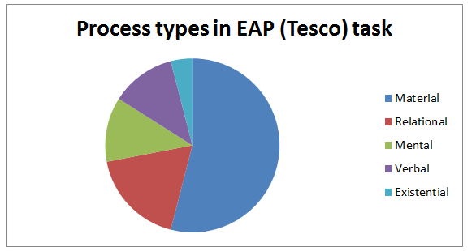
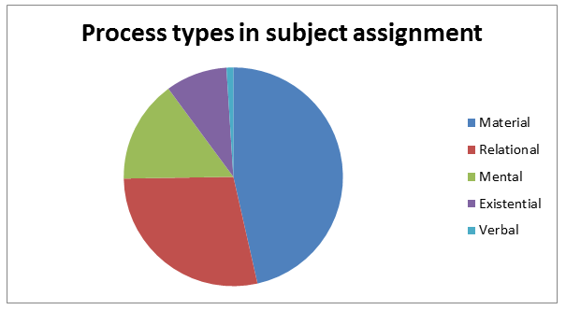
Transitivity analysis – participants and processes (field)
Material processes dominate in both
tasks
Shows a concern with describing
activity in business discourse.
Subject tasks contain more relational
processes.
Relates to the participants in the
discourse.

Slide 15
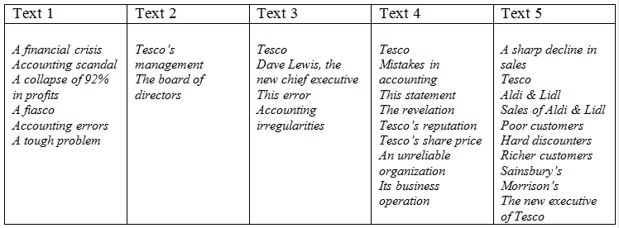
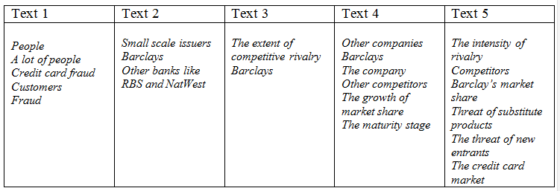
EAP texts
Business texts

Slide 16
Transitivity examples
Hypothesis – Subject writers use more abstract entities and relational processes
- EAP texts contain more human / concrete entities and material
processes

Slide 17
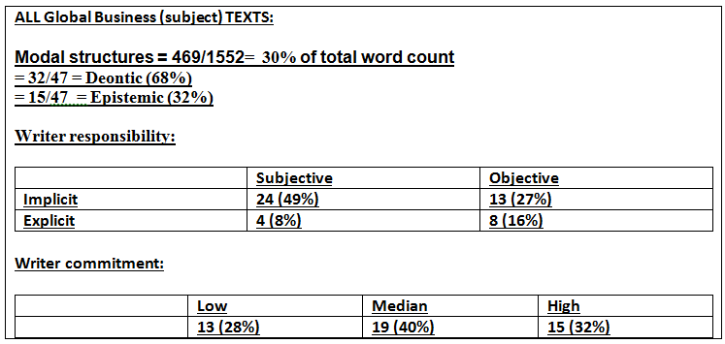
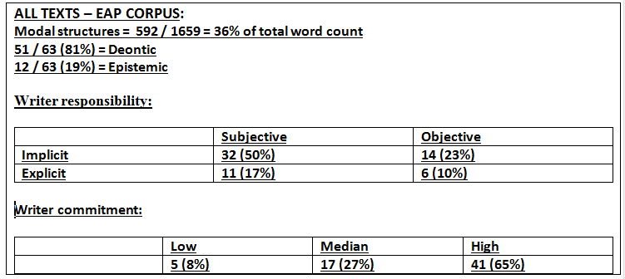
Modality in business writing (tenor)
Higher proportion of
epistemic modality in subject
writing.
EAP writers employ deontic modality more frequently.
Writer commitment is higher
in EAP writing.

Slide 18
Modality in the corpus
‘The implement of changing the strategy may meet some problem’ – Text Two (subject corpus)
Epistemic / implicit
‘Tesco should conduct a research of its internal supply chain’ – Text Three (EAP corpus)
Deontic / implicit

Slide 19
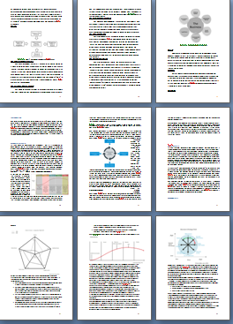
Use of frameworks and models in Business assignment (mode)
Writers on the Business task use
diagrams to represent the theoretical
models.
These are used to organise the discourse.
This has a textual function.

Slide 20
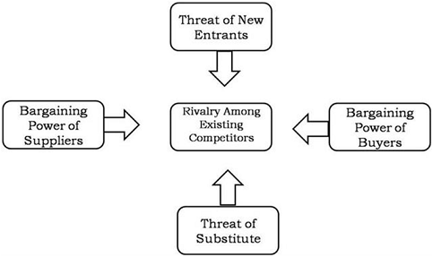
Student writers use the
visual form of the model
to organise their analysis
Components of the model
are used as sub-headings
Student refers back to the
visual data above

Slide 21
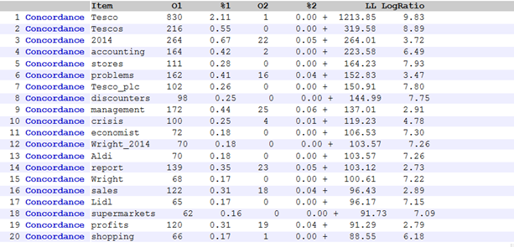
Corpus techniques (i)
Company portrayed as in
‘crisis’ or facing ‘problems’
Concerned with practical
problems (‘stores’, ‘sales’
‘profits’)

Slide 22
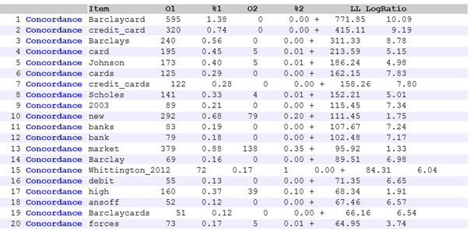
Corpus techniques (ii)
Reveals importance of
theoretical models
‘new’, ‘high’, ‘Ansoff’,
‘forces’

Slide 23
Focus groups – EAP / subject / students
Series of interviews and focus groups have been held with:
Student writers (on the same module but not of the actual texts in the corpus)
EAP teaching team (teaching on the EAP support module)
A business lecturer (who has taught and led the business module being analysed)
Focus on the business lecturer here. We discussed the task brief; the introduction, analysis and recommendations. Also, what changes could be made to either assignment.

Slide 24
Business lecturer responses – task brief
‘EAP assignment puts you in a situation, you can imagine a role’
‘Almost too many theories in the Barclays task. You should select an appropriate framework for the case study’
‘With the Barclays task there is no specific audience for the recommendation’
‘Barclays task is more academic, Tesco’s is more professional’

Slide 25
Business lecturer responses – introduction
‘Students imagine and put themselves into a situation in the Tesco task’
‘The company is portrayed negatively in Tesco task, and positive in Barclays’

Slide 26
Business lecturer responses – analysis
‘We expect students to use visual information to show the model’
‘Graphs and illustrations are missing in the EAP task. We need to direct the readers with visual support’
‘Busy execs need to find information quickly’
‘I think that a model should be used (in the EAP task). This is the base of business studies. To sharpen the analysis’
‘It’s not meeting the requirements of an academic business report’
‘In the business world models are not really used’
‘As academics we would expect the students to use theory’

Slide 27
Business lecturer responses – recommendations
EAP recommendations are clear and to the point – relates well to the crisis in the company
In the subject task the recommendations are vague
It’s easier to make recommendations when there is a current crisis
10 years is old for a case study and for a student
When I grade a student’s work I don’t place too much emphasis on recommendations
The recommendations are the ‘sugar on the top’ of the report

Slide 28
Business lecturer responses – changes to the tasks
Students like a clear structure (EAP)
Add some theories or frameworks to the EAP task
The ideal assessment would be to merge the tasks together
Discard the Barclays case study because it’s too old
Use fewer frameworks
Recommend structure to the students
Point them to some sources to get them started
Recommend one or two key frameworks (SWOT, Five Forces, PESTEL)
Use a technique / theory that you feel comfortable with
Include some visual information in the report – it needs to be visually appealing

Slide 29
Conclusion / discussion
Genre analysis, SFL, corpus linguistics and qualitative techniques each give insights into academic writing in the disciplines.
Analysing disciplinary tasks and talking to subject lecturers allows us to think together about our teaching and assignments
The study shows that we can learn from each other. EAP tasks have strengths in terms of structure and relevance of the material / immediacy of the problem.
But, EAP tasks could become more subject specific in terms of the analysis. Students could use a model or framework to do their analysis
EAP tasks could require students to include visual information in their analysis of the company

Slide 30
Selected references
Eggins, S. (2004) An Introduction to Systemic Functional Linguistics. New York. Continuum International Publishing.
Forman, J. & Rymer, J. (1999) 'Defining the Genre of the "Case Write-Up" in The Journal of Business Communication 36 (2) 103-133
Freedman, A., Christine, A. & Smart, G. (1994) 'Wearing Suits to Class: Stimulating Genres and Simulations as Genre' in Written Communication 11 (2) 193-226.
Gardner, S. (2012) ‘A Pedagogic and professional Case Study genre continuum in Business and in Medicine’ in the Journal of Applied Linguistics and Professional Practice 9:13-35
Gruber, H. (2004) 'Scholar or Consultant? Author-roles of writers in German business writing' in Analysing Academic Writing. London: Continuum
Nathan, P. (2013) ‘Academic writing in the business school: The genre of the business case report’ in the Journal of English for Academic Purposes 12:57-68
Nesi, H. & Gardner, S. (2012) Genres Across the Disciplines: Student Writing in Higher Education. Cambridge. Cambridge University Press
Swales, J.M. (1990) Genre Analysis: English in academic and research settings. Cambridge. Cambridge University Press
Yeung, L. (2007) ‘In search of commonalities: Some linguistic and rhetorical features of business reports as a genre’ in English for Specific Purposes 26; 156-179
Zhu, W. (2004) ‘Writing in business courses: an analysis of assignment types, their characteristics and required skills’ in English for Specific Purposes 23; 111-135

