Slide 1
Developing academic literacy:
A team teaching approach with the School of Health and Human Sciences (SHHS)
Dr Camille Cronin
(Senior Lecturer and Subject Lead for Foundations in Health)
Caroline Hawthorne
(EAP/Academic Skills Tutor)
BALEAP EAP Conference 7th April 2017 Bristol

Slide 2
Today’s session
Background to collaboration and student profile
The mechanics of the collaboration
Impact on students and tutors
Implications for future practice

Slide 3
Background: what prompted collaboration?
  Increased volume of students on foundation degree in Health Science programme with concerns about academic readiness
  Disparity in support offered to students at Southend campus
  Aim to embed academic literacy to help bridge the gap

Slide 4
The process
Process began with series of meetings within SHHS, then between SHHS and the Talent Development Centre (TDC), in order discuss options:
  Support SHHS lecturers across campuses
  Embed literacy by having member of TDC working with lecturer from the academic team following CEM model (Sloane and Porter, 2010)

Slide 5
Student profile
Cohort of 31 – home students – age range 24-48
Largely non-traditional students: mature, returning to education after a break, undertaking vocational qualifications (Tummons et al., 2013).
They may also be the first in their families to go to university (Roberts, 2011)
Work-based learning programme - one day a week attendance - all employed as Health Care Assistants (HCA)
Generally low level of educational achievement - no exposure to academic literacy conventions.

Slide 6
Identifying student needs
Lack of confidence in learning ability
Returning to education
Struggling with IT
English not first language
Worried about writing

Slide 7
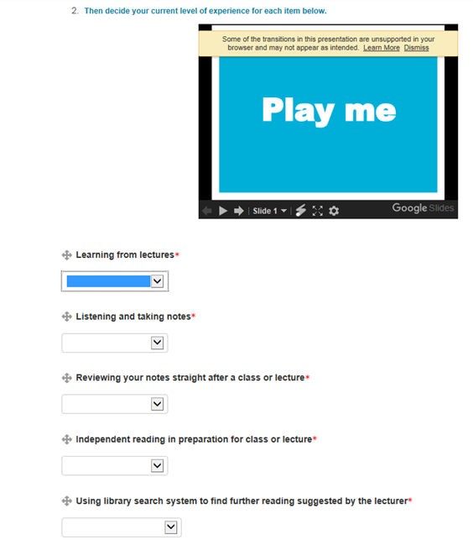
Moodle-based self-diagnostic academic skills survey
In-text referencing
Writing a long assignment
Taking initiative to get help
Learning from lectures
1= no experience yet 2= a little experience 3= some experience 4= plenty of experience

Slide 8

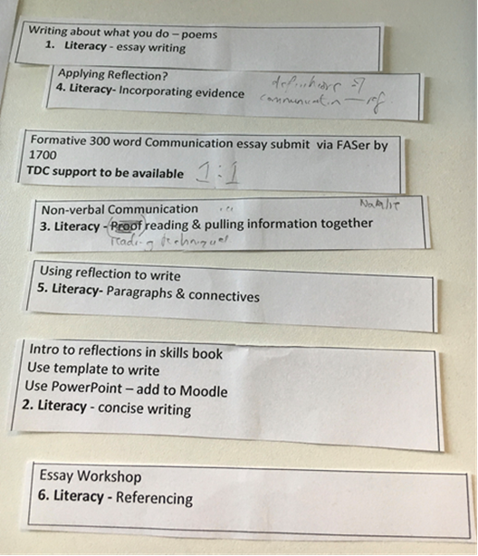
Mechanics of collaboration
Embedding option
Further planning meetings scheduled
Sequence and content of 6 sessions negotiated
Scaffolded approach to build confidence
Possible contextualisation of materials discussed

Slide 9
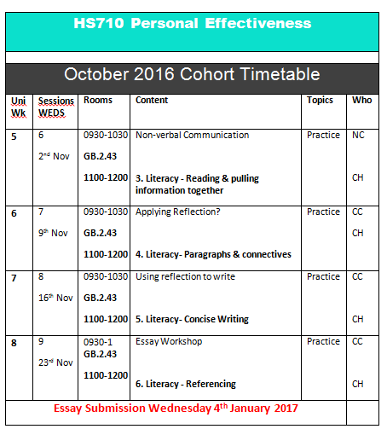

Embedding into timetable
Clear message to students Acknowledging their concerns Highlighting importance of developing academic skills Adding legitimacy to academic literacy input Following CEM model

Slide 10
The course
Six-week course
Both tutors present: Caroline observed while Camille delivered and vice versa
1 hour of subject input, followed by 1 hour of academic literacy support
Learning firmly situated within the SHHS discourse community (Wingate, 2016)

Slide 11
Session themes
Each session: Key concepts were broken down Skills practised in step-by-step activities groups/pairs Contextualised materials Linked learning to the workplace On-the-spot clarification from both tutors who monitored group work Joint presence was an integral part of the collaboration
Essay writing and note taking
Incorporating evidence
Reading and pulling information together
Paragraphs and connectives
Concise writing
Referencing

Slide 12
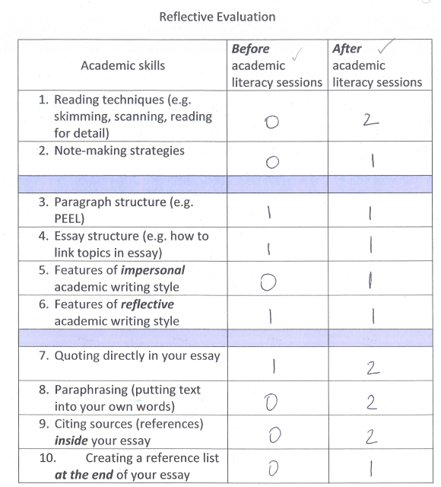
Measuring impact on student understanding
(27 respondents)
Level of understanding: 0=none, 1=some, 2=good, 3= v. good

Slide 13
Impact on student understanding
Level of understanding: 0=none, 1=some, 2=good, 3= v. good

Slide 14


End of module feedback
What we’ve learned: Communication skills (G1) Referencing (direct quotes, secondary referencing) (G1, G3, G6) Paragraphing (G1) Paraphrasing (G2, G3) To use synonyms – different words same meaning (G2) Structure of essays/layout/ what goes in the essay (G2, G3, G4) Connectives (G2) How to tidy up work (reduce jargon) (G5) Learning about 3rd person writing (G6)
What we would have liked to cover during the course: Feedback on essay 1:1 (G1) Referencing websites (G3) How we get marks on essay (G4) Exam techniques (G5) Plagiarism more earlier (G6)
What we would like to know more about: Pulling information into essay (G1) Getting it from head to paper (G1) Time frame (G1) Referencing (practice and linking references with essay) (G2, G3, G4, G6) Changing grammar (G2) How to back up arguments (G2) Essay structure (G3) Research techniques (G3) Look at more example essays (G4)

Slide 15
3. Actual student performance
Almost 50% of 31 students achieved an A or B grade.
  A – 1
  B – 14
  C – 11
  3 students failed to meet the standard
  2 had a delayed submission

Slide 16
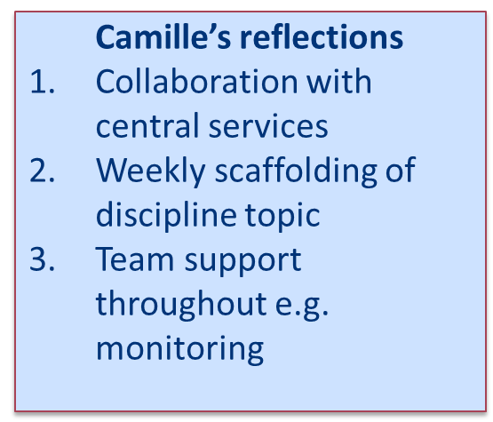
Professional development value for tutors: Individual reflections…
Caroline’s reflections
On-the-spot cross-referencing
Mapped sessions to outcomes more accurately
Helped legitimise my role

Slide 17
Shared reflections…
Insights into each other’s communities of practice
Benefits for students
Shared teaching philosophy facilitates collaboration
Instant clarification – shared meanings

Slide 18
5. Implications for Foundation degree in Health Science
Fully integrated sessions on literacy
Dedicated EAP staff on campus
More awareness training for staff

Slide 19
Implications for practice
Increased levels of understanding may not translate (immediately) into improved performance
“Getting it from head to paper”
On-going development needs of students (Yakovchuk and Ingle, 2011)
Realistic expectations of six-week course

Slide 20
Conclusions
‘Non-traditional students entering university without the requisite level of academic literacy need to be able to bridge this literacy gap in a highly accelerated way…’ (Whiteside and Wrigley, 2013, p.107).
Clear benefits of collaboration and co-teaching
Helps to close the gap between subject delivery and EAP provision

Slide 21
References
Roberts, S. (2011) Traditional practice for non-traditional students? examining the role of pedagogy in higher education retention. Journal of Further and Higher Education, 35(2), pp.183-199.
Sloane, D. and Porter, E. (2008) Changing international student and business staff perceptions of in-sessional EAP: using the CEM model. Journal of English for Academic Purposes, 9, pp.198-210.
Tummons, J., Orr, K. and Atkins, L. (2013) Teaching higher education courses in further education colleges. London: SAGE: Learning Matters.
Whiteside, K. and Wrigley, S. (2015) ‘Adapting the scaffolding academic literacy pedagogy for an EAP context'. The Janus moment in EAP: Revisiting the past and building the future: University of Nottingham, April 2013. Reading: Garnet Publishing Ltd, pp.107-116.
Wingate, U (2016) Embedding academic literacy instruction in the curriculum: The role of EAP specialists [Accessed 24 June 2016]. Available at: https://www.youtube.com/watch?v=jxITuxRwqLE&feature=youtu.be
Yavokchuk, N. and Ingle,J. (2013) ‘Working with departments to develop students’ writing: Two examples of collaborations on medical degrees at Queen Mary university of London’. EAP with the higher education garden: Cross-pollination between disciplines, departments and research: University of Portsmouth, 2013. Reading: Garnet Publishing Ltd, pp.65-74.

Slide 22
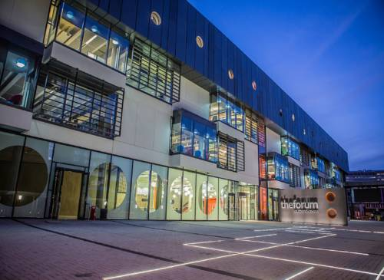
Camille.cronin@essex.ac.uk
(Senior Lecturer and Subject Lead for Foundations in Health)
Caroline.hawthorne@essex.ac.uk
(EAP/Academic Skills Tutor)

