Slide 1
Motivation, self-regulation and EAP possible selves through e-portfolios
Flordelis González-Mujico fgonzalez015@ikasle.ehu.eus

Slide 2
The Linguistic capital of English
English is widely perceived as an indispensable asset in terms of gaining upward and outward mobility; thus, English as a medium for teaching and EAP are generally perceived as a catalyst toward that goal (Doiz, Lasagabaster & Sierra, 2013).
Students may experience demotivation due to the requirement to learn EAP as a compulsory subject (Song & Kim, 2017), so how can we motivate EAP students?
Freire (2007) distinguishes between integration and adaptation. When an individual loses the ability to make choices and is subjected to the choices of others, to the extent that the decisions are no longer their own because they result from external prescriptions, they are no longer integrated, but have rather adapted.
Aim: to achieve EAP integration through the tripartite concept of motivation, possible selves and learner autonomy.

Slide 3
A Tripartite Concept
Learner Autonomy
Possible Selves
Motivation

Slide 4
1. Motivation
Motivation is one of the key factors that determine the rate and success of L2 attainment (Csizér & Dörnyei, 2005).
Focus of study since Gardner & Lambert’s (1959) theoretical construct of integrativeness to the latest volume of the international journal, System (65), which has published 3 articles on the symbiosis of motivation and language learning.
No universal technique to motivating students in any given context.
L2 learning motivation has been closely linked to perceived autonomy and competence.

Slide 5
2. Possible Selves
Possible Selves appear to be central to the conceptualization of L2 motivation and learner autonomy, within which visualisation is a cardinal component that involves tangible images and senses.
It is important that learners believe they can attempt something, referred to as self-efficacy or self-competence, in order to engage the initial requirement of a plausible possible self.
The Oxford Dictionary defines the verb ‘regulate’ as ‘to control or direct according to rule, principle, or law;’ and control is perceived as the strongest predictor of motivation for attaining or avoiding a possible self (Norman & Aron, 2003).

Slide 6
3. Self-Regulatory Possible Selves (SRPS)
The idea of SRPS was first presented in a study by Oyserman, Bybee, Terry, and Hart-Johnson (2004) that demonstrated that improved academic outcomes were likely only when a possible self could plausibly be a self-regulator, as possible selves and other self-directed goals can serve to guide and regulate behaviour, providing a roadmap that connects the present to the future.
Self-regulation beliefs and behaviours
Self-efficacy beliefs
Self-Regulatory Possible Selves (SRPS)

Slide 7
The role of Technology: e-Portfolios
Personal learning management tool that encourages individual improvement, personal growth and development, and a commitment to lifelong learning, fostering a holistic view of the learner as their motivation for language learning is part of a broader motivation to learn and develop (Ushioda, 2009).
Can foster SRPS that may lead to greater motivation, learner autonomy, and L2 acquisition gains through the design and sustainability of self-efficacy beliefs, future self-guides and reactive autonomy.
Conceptual bridge from passive to active learning that connects, synthesizes and demonstrates how motivation to language learning is connected to broader processes of life-learning (Harvey, 2017).
Fosters competitive motivation in which colleagues may be perceived as a source of inspiration (Song & Kim, 2017).

Slide 8
Motivation Intervention Programme: SRPS e-portfolio
Ultimate aim: increase motivation through effort and engagement; enhance self-efficacy; improve academic achievement.
The first step: generate self-efficacy beliefs, so that plausible and effective SRPS can be engaged.
Second: learners must set their own personal objectives. Hadfield and Dörnyei (2014) describe that to attain plausibility, it is necessary to relate the imaginative to the practical, the affective to the cognitive, and the creative to the logical; future self-guides need analysing into specific goals which are actionable, otherwise, an undefined list of goals will remain in the realms of dream and fantasy. Distal goals must be broken down into proximal goals.
Third: sustain SRPS, what Hadfield and Dörnyei refer to as keeping the vision alive, and can be nurtured via feedback and reflection.

Slide 9
Stages of the Motivation Intervention Programme
Growth mindsets
Imaging identity
Mapping the Journey
Developing identity
Role Models
Entering the L2 Community

Slide 10
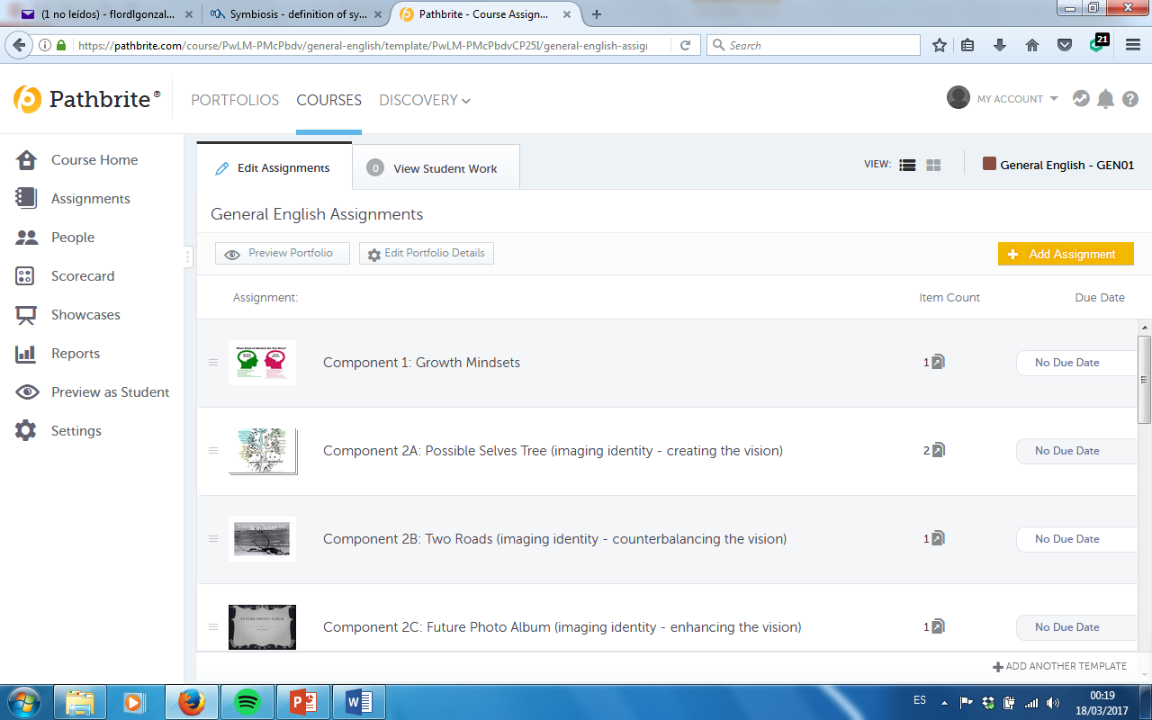
Pathbrite e-portfolio

Slide 11
References
Csizér, K., & Dörnyei, Z. (2005). The internal structure of language learning motivation and its relationshipwith language choice and learning effort. Modern Language Journal, 89, 19–36.
Doiz, A., Lasagabaster, D., and Sierra, J.M. (2013). English-Medium Instructionat Universities: Global Challenges. Bristol/NY/Ontario: Multilingual Matters.
Dörnyei, Z. 2001. Motivational strategies in the language classroom. Cambridge, UK:
Cambridge University Press.
Freire, P. 2007. Pedagogy of the Oppressed. 30th anniversary ed. New York: Continuum.
Gardner, R.C. & Lambert, W.E. (1959). Motivational variables in second language acquisition. Canadian Journal of Psychology, 13, 266–272.
Hadfield, J., & Dörnyei, Z. (2014). Motivating Learning: Research and Resources in Language Teaching. NY, New York, United States of America: Routledge.
Harvey, L. (2017). Language learning motivation as ideological becoming. System, 65, 69- 77.
Munezane, Y. (2013). Motivation, ideal L2 self and valuing of global English. In M.T. Apple, D. da Silva, & T. Fellner (Eds.) Language learning motivation in Japan (pp. 152-168). Bristol, UK: Multilingual Matters.

Slide 12
References
Norman, C., & Aron, A. (2003). Aspects of future self that predict motivation to achieve or avoid it. Journal of Experimental Social Psychology, 39, 500-507.
Oyserman, D., Bybee, D., Terry, K., & Hart-Johnson, T. (2004). Possible selves as road maps. Journal of Research in Personality, 38, 130-149.
Ruesch, A., Bown, J., & Dewey, D. (2012) Student and teacher perceptions of motivational strategies in the foreign language classroom, Innovation in Language Learning and Teaching, 6(1), 15-27.
Song, B. & Kim, T.Y. (2017). The dynamics of demotivation and remotivation among Korean high school EFL students. System, 65, 90-103.
Tanaka, M. (2017). Examining EFL vocabulary learning motivation in a demotivating learning environment. System, 65, 130-138.
Ushioda, E. (2009). A person-in-context relational view of emergent motivation, self, and identity. In Z. Dörnyei, & E. Ushioda (Eds.), Motivation, language identity and the L2 self (pp. 215-228). Clevedon: Multilingual Matters.
Wong, R. (2014). An investigation of strategies for student motivation in the Chinese EFL context. Innovation in language learning and teaching, 8(2), 132-154.

