Slide 1
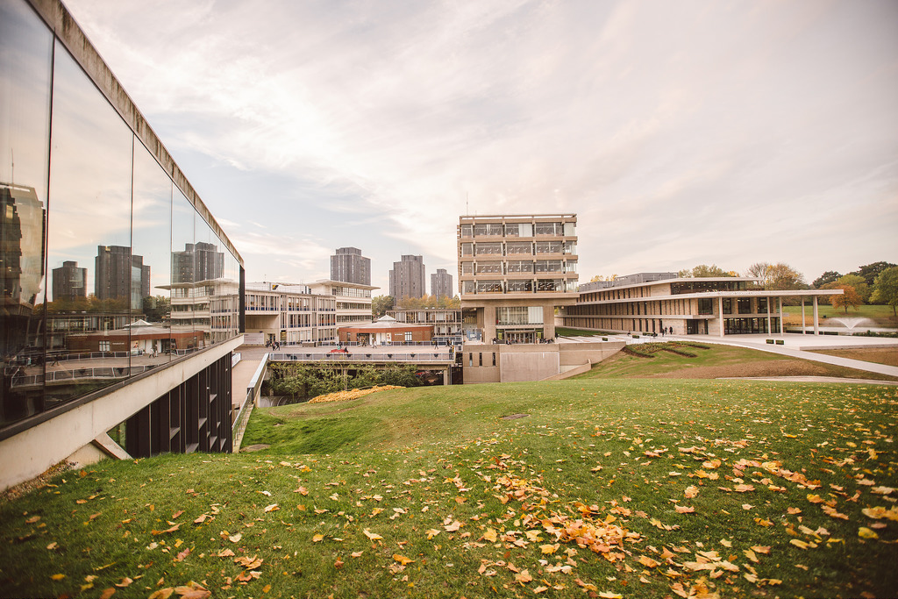
Teaching home students:
Teachers’ attitudes to a new challenge
Mick Kavanagh
University of Essex
mckava@essex.ac.uk

Slide 2
Teacher cognition
‘personal practical knowledge’ (Clandinin & Connelly, 1986)
‘teachers learning and developing within a broader context of community, institution, polity, and profession’ (Schulman & Schulman, 2004: 267-269)
England (2016):
PPK: At level of the individual, therefore idiosyncratic
Collective perspective: Shared beliefs and practices of a group of teachers

Slide 3
UoE Education Strategy
(2013-14 to 2018-2019)
The University will:
develop and implement approaches … that are focused on helping students to maximise their talents and abilities while studying at the University
[ensure] our students benefit from teaching that is innovative, effective and designed to maximise student potential

Slide 4
Teaching home students:
Teachers’ attitudes to a new challenge
… the thoughts and understandings of (TDC)
teachers who work with home students
    deliberately vague
    interviews
    7 tutors

Slide 5
Interview questions
characterise home students?
particular needs? can we satisfy them?
perception of the students: strengths, difficulties?
any difference to your teaching?
approaching a mixed class?
student background = irrelevance? tailor approaches, activities?

Slide 6
Home students?
Nationality | on the whole they are British students [T3] obvious answer - students from the UK, but it’s not that simple [T4]
Language | the more useful distinction [is] between UK and non-UK students or L1 English/not English [T2]
Educational background | anyone who has been educated from school level in the UK [T5] students who’ve gone through a British education system, but there’s quite a wide range there [T1]
Combination | have studied in the UK … for a significant period of time (over a year), been through part of school system; NS/near-NS capability; someone for whom that’s the educational culture they are from [T4] not just first language is English but that they’ve grown up in the UK so they’re familiar with the culture [T7]

Slide 7
Home students:
Characterised by diversity
Route into university [T7]
straight out of school
mature students who’ve been away from education
from a non-traditional background … less familiar or comfortable with academia
Diverse
‘incredibly diverse’ profile / ‘as diverse as any other student group’ [T3]
‘could be students who don't speak English at home’ [T1]

Slide 8
Home students and the English language
the NS student uses the language with extreme facility but doesn’t know how to describe it whereas the NNS has difficulty using it but knows how to describe it [T2]
they still clearly have academic literacy needs, but not that basic how to put a sentence together - generally speaking (laughs) generally, generally speaking [T3]

Slide 9
Home students’ needs, difficulties
Confidence
Motivation
Criticality
Transition

Slide 10
Needs, difficulties: Confidence
they tend to be quite confident [T5]
on one level, very confident … on a deeper level really not very confident at all [T5]
quite outspoken and opinionated … might be defence mechanisms [T1]
you might expect ... in their element, lacking the inhibitions … operating in a foreign language … often as shy and as unforthcoming … [no] clear … firm pattern, rule [T2]

Slide 11
Needs, difficulties: Motivation
I find them lacking in self-motivation [T5]
not much of a middle ground … some … are very capable and very motivated … a lot … 2½ years (later) don’t seem to understand why they’re here [T5]
that intrinsic motivation, that curiosity that should lead you on your own two feet towards a subject might not be there in some cases [T6]

Slide 12
Needs, difficulties: Criticality
they seem to be … lacking in, I suppose it’s critical thinking really isn’t it?, or independent thinking [T5]
think independently … have their own opinions and ideas [T1]
critical engagement with ideas … being critical rather than simply regurgitating … being able to structure their writing [T4]

Slide 13
Needs, difficulties: Transition
the starkest need is that transition from being told what to do and suddenly being expected to be independent, there’s a huge difference between the kind of reading, writing, studying at pre-HE level and now in HE [T1]
a big jump between school and university … the sort of style and the sort of level required … overwhelming … particularly ones who maybe didn’t perform brilliantly in school [T7]
always would have had the situation … needed help with transition, but now lots of students … struggle more [T4]

Slide 14
Dealing with home students in class: Different treatment?
it’s important to recognise that there’s a mixture of … students and to bring out the fact that each has their own strengths for the whole class … and try to create more of a cohesive community [T1]
you can talk about the positive things for both backgrounds [T7]
when we talk about familiarising international students with … the academic culture of the UK the … discussions that you need to have with [international students] are the same discussions that you need to have with home students [T4]

Slide 15
Dealing with home students in class: Different treatment?
I … try to engage the international students first … because they tend to be less confident at that surface level but quite often more capable at the deeper level … whereas the home students are hopefully at least gonna be more likely to participate at surface level right away [T5]
there would need to be some modification of language … but I would pitch towards the … majority need [T3]
there are things … like cultural reference that you need to be careful with, you don’t want to be teaching to the home students as if it’s a closed shop [T7]

Slide 16
Dealing with home students in class: Different treatment?
I want to make it very clear to the home students that I’m gonna treat the international students equally [T5]
my instinct would be to want to say that it should be an irrelevance [T4]
I think I pretty much do (the same) [T2]

Slide 17
Getting tutors talking:
Some observations
perceptions
reflection
interview
individual/shared views

Slide 18
References
Clandinin, D., & Connelly, F. (1986) Rhythms in teaching: The narrative study of teachers' personal practical knowledge of classrooms. Teaching and Teacher Education, 2, 377–387.
England, N. (2016) Developing an interpretation of collective beliefs in language teacher cognition research. TESOL Quarterly, 51(1), 229-238.
Schulman, L., & Schulman, J. (2004) How and what teachers learn: A shifting perspective. Journal of Curriculum Studies, 36, 257–271.

Slide 19
Teaching home students: Teachers’ attitudes to a new challenge
Mick Kavanagh
University of Essex
mckava@essex.ac.uk

