Slide 1
Experiences of student co-authorship and review in creating an inclusive and relevant study skills service
Simon Gamble
Study Skills Team, University of Bristol

Slide 2
Accessible to all
Interactive
Transition,
During,
Beyond
A centralised, academic study skills provision for the whole university which is
Bristol Futures
Flexible and adaptable
Distinctive
To Bristol
Student
Co-authored
Blended

Slide 3

In any academic institution, a project like this has a lot of stakeholders…

Slide 4
Print services
Recruitment
International office
Change
EAP
Counselling/Wellbeing
Comms
students
Local
Admin teams
Library
Services
Students’ Union
Special projects
Academics
Disability services
Teaching Practice
R&D
Careers
TEL
HR
Data security
IT security
IT support

Slide 5
The team
Amy Palmer
Digital Learning Materials developer
Mark Elliot
Study skills coordinator
Simon Gamble
Study Skills developer
University of Bristol Students
University of Bristol Staff

Slide 6
The process
“curriculum” decided through discussion with students and Steering Group
Topic discussed at input consultation workshop
Online content and workshop protocol created
Testing of content by students (focus groups and online feedback)
Review of content by academic staff, steering group
Release/delivery of content, feedback and evaluation

Slide 7
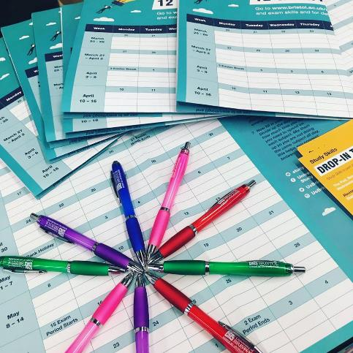
Student input
“I'm a very visual learner, so making mind maps with bright colours and doodles helps things stick in my memory.
Plus it's an excuse to buy pretty stationery.”
Beccy, BA English

Slide 8
Home/
international
BME/White
Discipline
Full/Part time
WP
On Campus/ Distance
Mature
Entry routes
Female/Male
Disability/
Learning differences

Slide 9
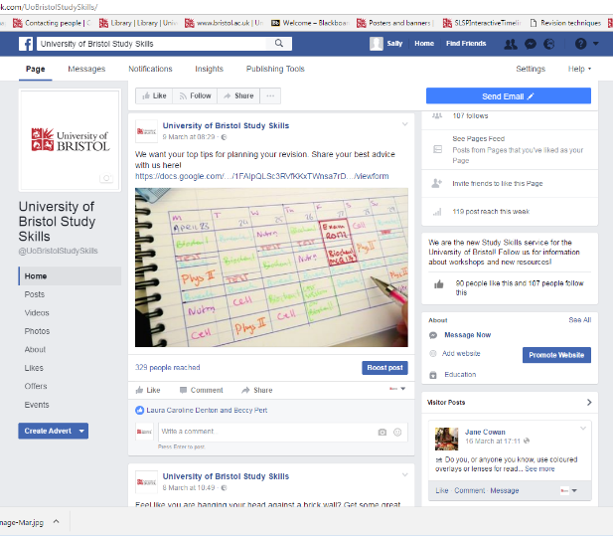
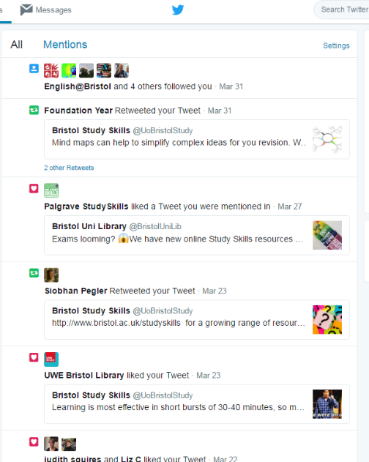
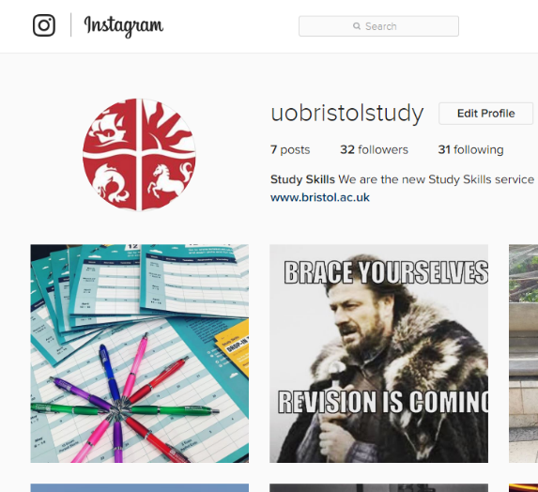
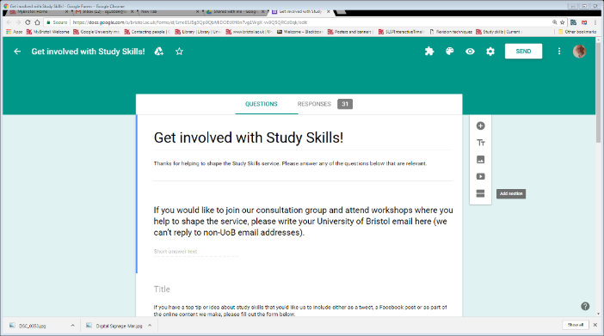
@UoBristolStudySkills
@UoBristolStudy
@UoBristolStudy

Slide 10
Modes of student involvement
Videos
Student Advisory group
Testing groups
Facebook twitter
sign up
Input groups
Online feedback sheets
Halls of residence
Peer delivery
Student Advocates
Interns
“Get involved”
Campaign

Slide 11
What’s in a name?
Academic
Hub
Learning
Bristol
Development
Literacies
What would you call it?
My…
Study
Support
Skills

Slide 12
This is what I’d type into a search engine
The name needs to be obvious
Study skills not “university” enough
Future might sound a long way off to a new student and not feel relevant
Sounds a bit “school”
If it was marketed well it would probably be ok
Vague though, would new students know what it was?
The Name
Sounds “Small”
Future skills was popular
Anything “my” is naff
Just call it what it is
“Study Skills”
My
is not good
Learning sounds a bit basic
Skills plus
(student suggestion)
Avoid acronyms!
Academic Skills sounds boring
Skills Hub is ok
Good skills is too open to interpretation

Slide 13
Ideally it should sound and look like it’s coming from other students
Avoid being too
“down with the kids”
Avoid Idiom
language
Not too formal and not technical or overly academic
Give it a professional sounding student voice
Write it as if writing to a mature (adult) person
Keep sentence structure simple
Speak plainly and directly
Professional, but clear
Avoid obscure cultural references

Slide 14
Workshops
Workshop
Participatory
Interactive
Peer learning
Facilitated
Interactive
Social
Collaborative
Empowering
The independent learner

Slide 15
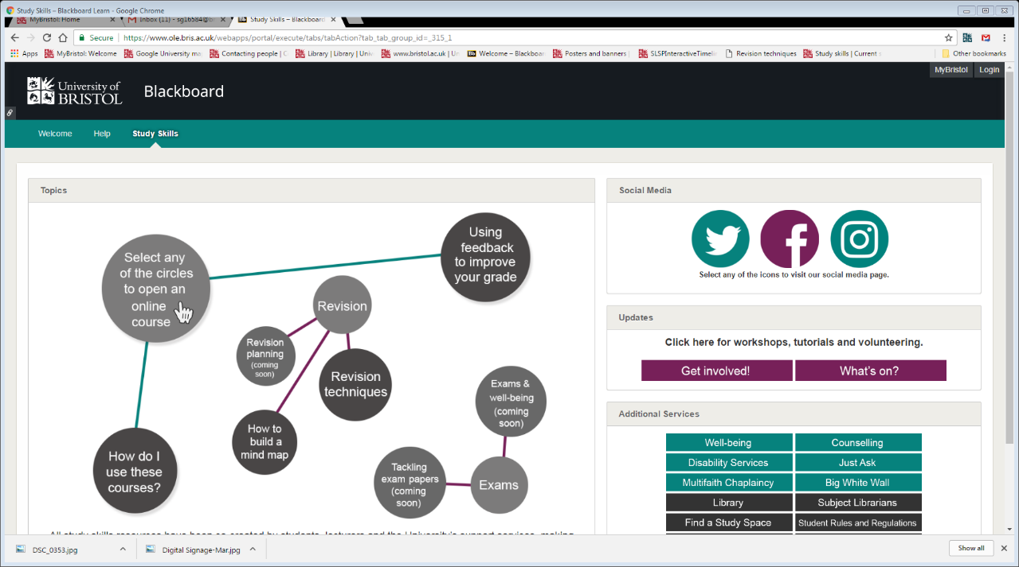
How students find it
You should be able to access it through Blackboard
I always go straight to Blackboard
Blackboard is where I go for everything

Slide 16
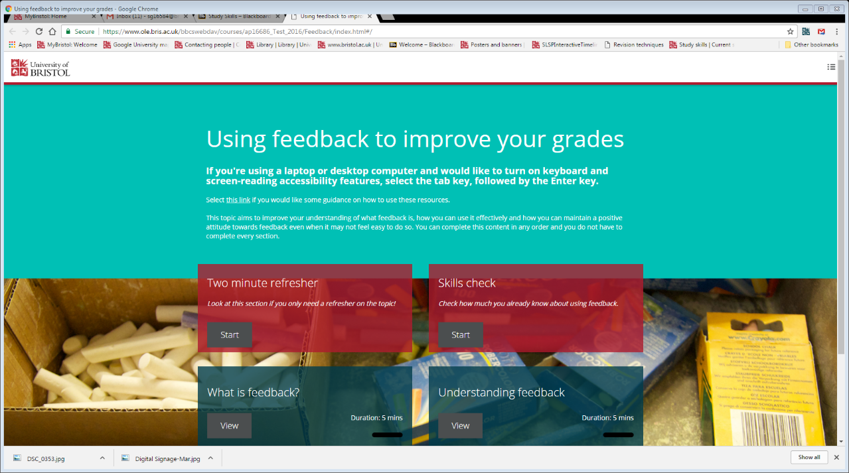
The Look

Slide 17
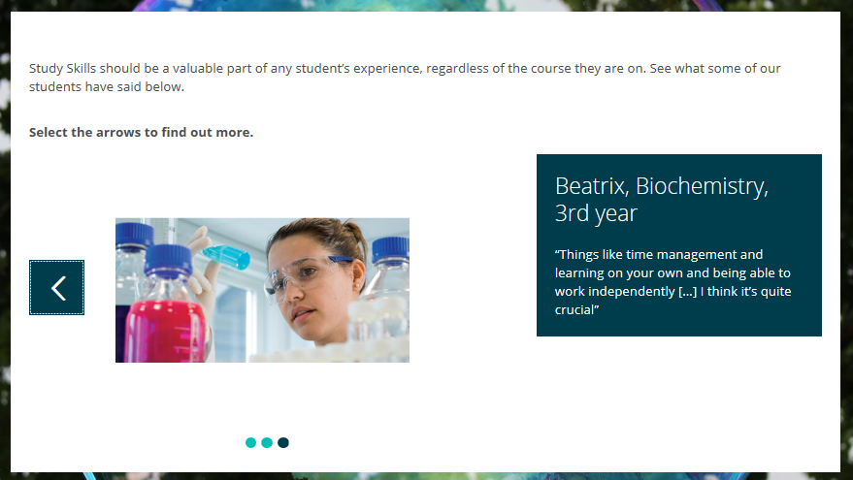
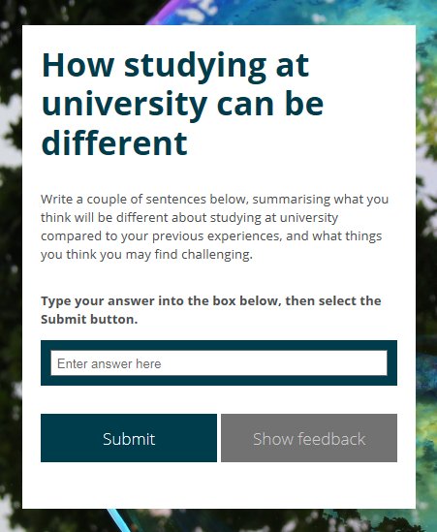
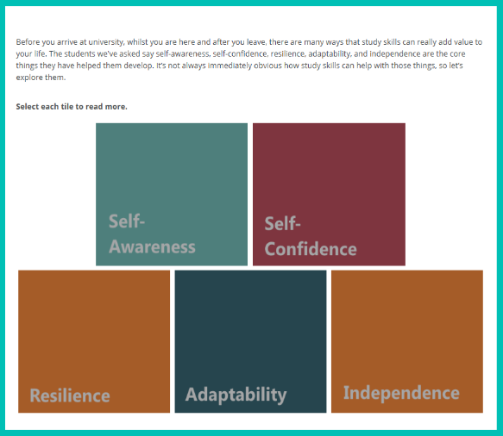
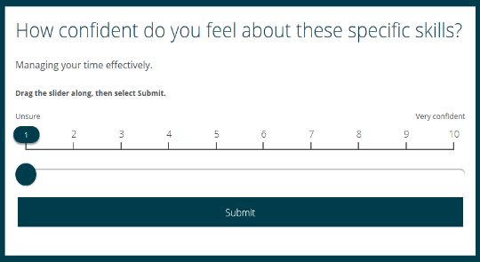
Activity led

Slide 18
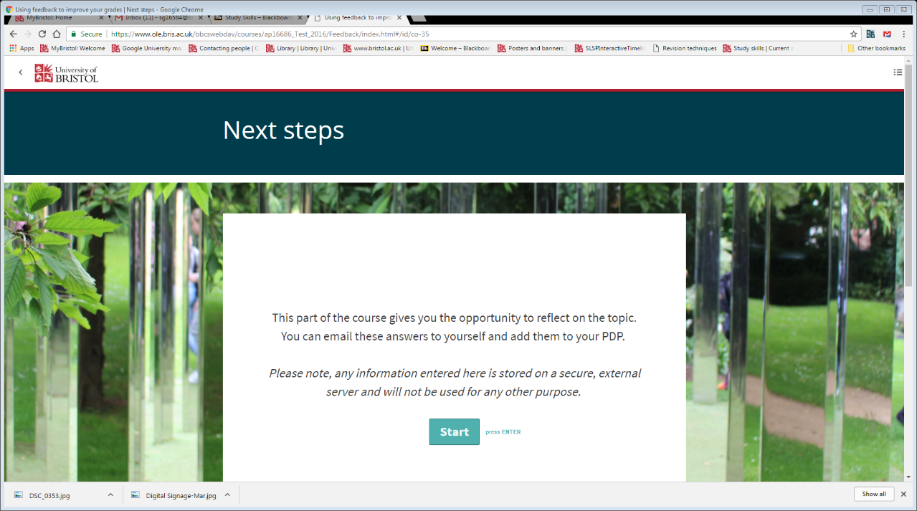
Reflective

Slide 19
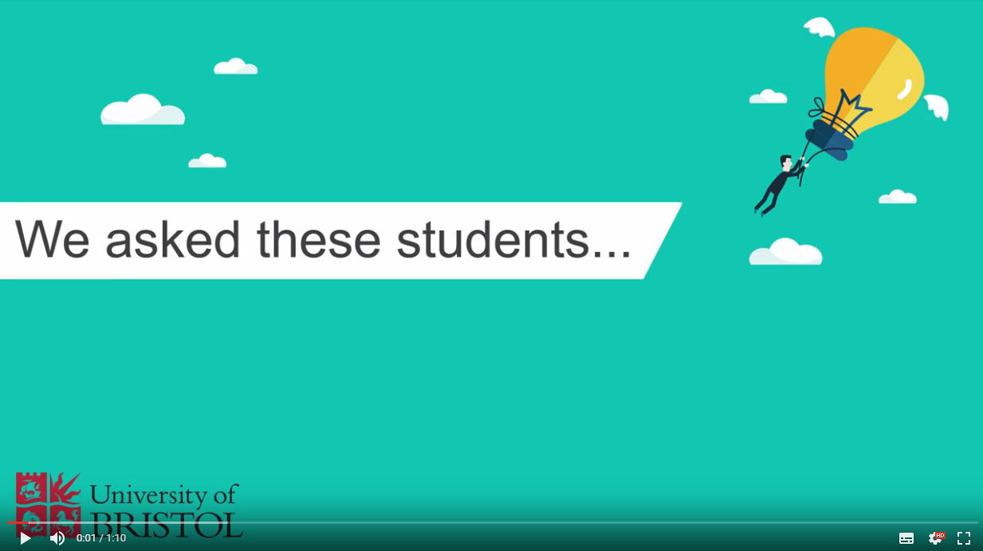
By students, for students
https://drive.google.com/file/d/0B9qUK9vwQLgkT3FZallCZEZXUkE/view

Slide 20
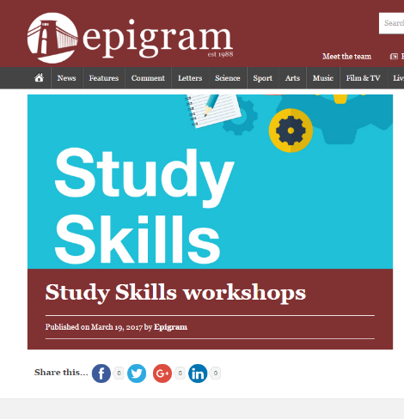
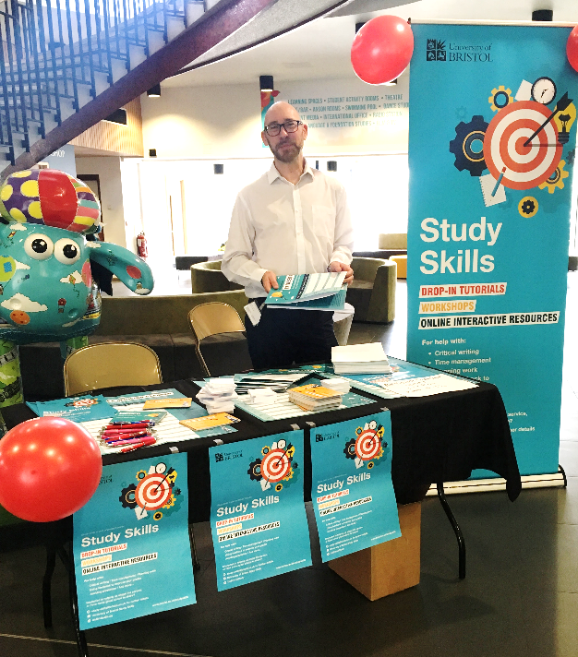
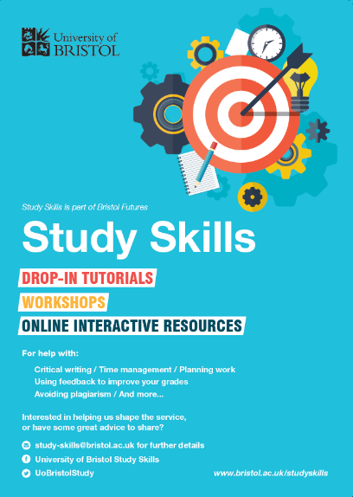
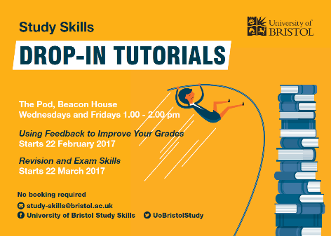
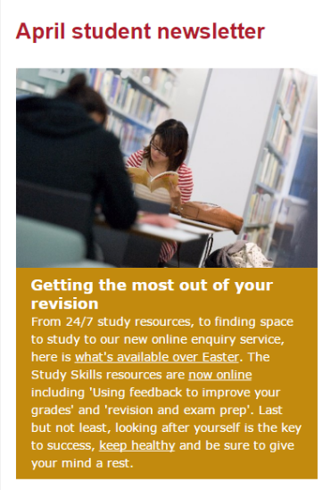
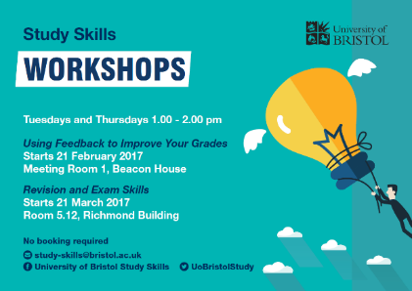
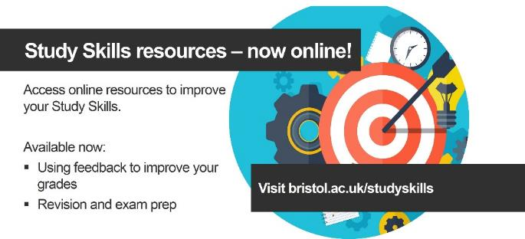
Publicity

Slide 21
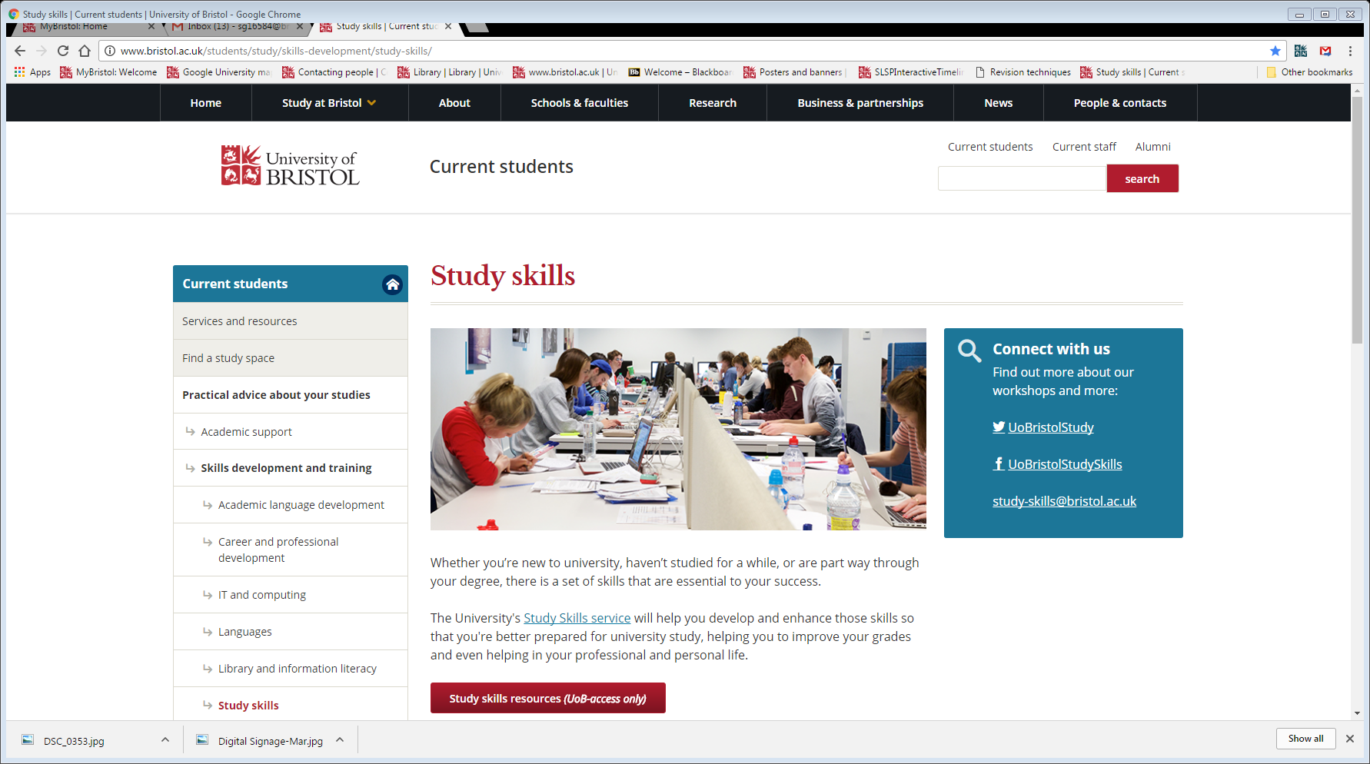
On the web- Bristol.ac.uk/studyskills

Slide 22
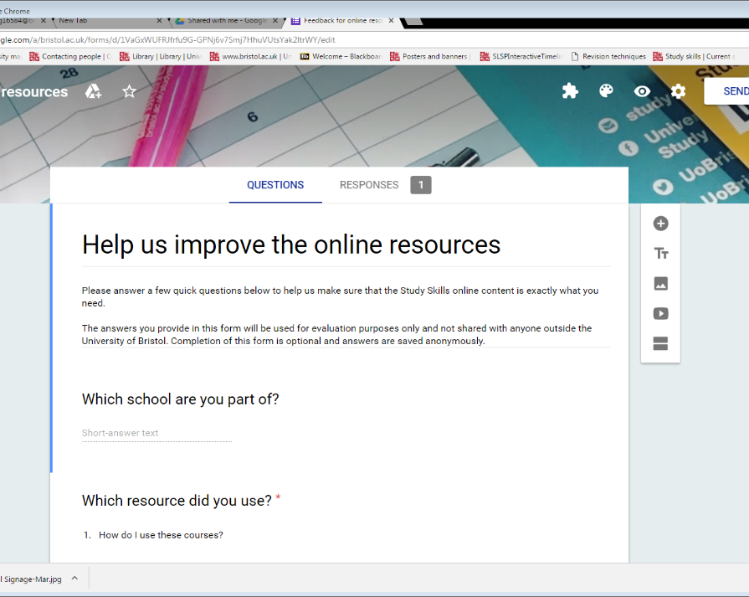
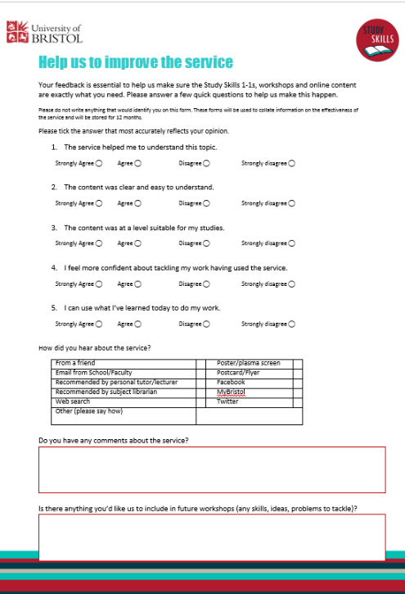
Gathering feedback

Slide 23

Feedback
I like to have something to read first
I’d like to chose what I do when. I’d like some flexibility
Things being downloadable and printable is nice
There’s too much reading to start with.
Putting stuff directly into the computer is good.
it was engaging throughout due to it's highly interactive nature.
I didn’t think it was really interactive
I like the graphics. Intuitive. Prompts to click arrows, close browser were helpful.
Being told how long the unit will last and also them being short is good.
The style of wording is just right, easy for students to understand
More examples would be good

Slide 24
Open access vs Information gathering
What *are* the benefits of open access?

Slide 25
Simon Gamble
Study Skills Team, University of Bristol
www.Bristol.ac.uk/studyskills
@UoBristolStudySkills
@UoBristolStudy
@UoBristolStudy

