Slide 1
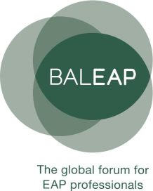
A case study on the citation skills of Chinese l1 speakers, at novice level in UK academia What can corpus-based research tell teachers?
He said …
... she said
Ian Johnson
ian.johnson@port.ac.uk / @ianjohnson168

Slide 2
Research questions
How, and to what extent, do the citation practices of Chinese L1 speakers at novice level in UK higher education, diverge from those found in ‘proficient’ exemplar writing?
How can pedagogy respond to the findings and their implications?

Slide 3
Underpinnings: Citation
Citation as:
highly complex: 21 discrete learning targets (Pecorari, 2013).
problematic: tied to ‘plagiarism’ concerns, often ‘alien’ to transitioning L1 Chinese students (Liu, 2005).
rite of passage: key to ‘dialogic’ (Bakhtin, 1981) writing, and “claiming membership of the discourse community” (Groom, 2000, p. 66).
normative: within UK HE, but (arguably) unavoidably so.
under-studied at novice level: Much previous work (e.g. Hyland, 1999; Bloch, 2010; Petric & Harwood, 2013; Nesi, 2014) but at higher proficiencies

Slide 4
Underpinnings: Pedagogy
An inclusive writing pedagogy, combining insights and ‘shared principles’ from Academic Literacies and EAP, is desirable (Wingate & Tribble, 2012)
Citation closely affects stance-taking (orientation); effective pedagogy can impact both simultaneously
Sampled writing was loosely within the Social Sciences, where writers typically treat cited claims and anticipated reader reactions with cautious deference (Hyland & Jiang, 2016)
Li and Wharton (2012) found L1 Mandarin writers, using L2 English, made language choices that led to typically more ‘assertive’ stances

Slide 5
Citation and stance
‘Non-integral’ (Swales, 1990) citation: The Earth is flat (Smith, 2010)
‘Integral’ (Swales, 1990) citation: Smith (2010) believes that the Earth is flat
Via reporting verbs, writers ‘endorse’, ‘acknowledge’ or ‘distance’ (Martin & White, 2005; Lee, 2010)
NNS use citation to showcase lexical range (Bloch, 2010) and/or literature consultation (Nesi, 2014)
While the rhetorical considerations may be outweighed when choosing reporting verbs, their rhetorical effects on the reader occur regardless…
Notes:
Terms as used/coined by Swales (1990). Endorse, Acknowledge and distance are part of the Engagement system (Martin & White, 2005)

Slide 6
Rhetorical Effects
“It is a common experience for EAP teachers to have great difficulty in identifying the point of view that a non-native speaker is trying to convey towards cited authors, or even to assume […] that a certain point of view is being conveyed, only to find this view unexpectedly contradicted in a subsequent explicit evaluation” (Thompson & Ye, 1991, p. 366)

Slide 7
Why? It’s complicated!
“As the text unfolds, patterns emerge, some of which acquire added value through resonating with other patterns in the text or context of situation… behind it lies the potential that informs every choice made by the speaker or the writer, and in terms of which these choices are interpreted by listeners or readers” (Halliday & Matthiessen, 2014, p. 63, my emphasis)
For example, X claims… would typically be challenged either by patterning with an adversative (ibid., p. 612) conjunction such as However, or by the introduction of a counter claim at a later point.

Slide 8
Sample
Analogue corpus (Chinese Learner English [CLE])
178 draft essays, on sociological topics
Produced six weeks after arrival in U.K; L1 Mandarin/Cantonese
207,000 words
Exemplar corpus (British Academic Written English [BAWE])
Social Sciences sub corpus of the BAWE corpus (Nesi, Gardner, Thompson, Wickens, et al., 2009)
1,999,130 words
Nesi’s (2014) analysis of BAWE citations acted as a model

Slide 9
Corpus Query Language
Original (Nesi, 2014)
[tag = "NP.?"] [word = "et"]? [word = "\."]? [word = "al"]? [word = "\."]? [word = "\("] [tag = “MC"] [word = "\)"] [tag = "VV|VO|VVD|VVZ|VM"]
Modified to:
[tag = "NP.?"] [word = "et"]? [word = "\."]? [word = "al"]? [word = "\."]? [word = "\("] [tag = "CD.?"] [] {0,3} [word = "\)"]? [tag = "VV.*|MD|VH.*"]
Additional capture examples
1. Present Perfect tense: X has said…
2. Follow-on citations: X also said…
3. Irregular citations X, he said…
For those who are not corpus linguistics enthusiasts, understanding of this slide is not necessary to the overall presentation! Changes to Nesi’s language shown in red allowed the additional data capture (see above) related to the irregular patterns of student citation which fell within my research remit. The changes shown in green merely reflect different notation in two different corpus tagging systems: respectively UCREL/CLAWS for Nesi’s work on the BAWE corpus, SketchEngine’s ‘Treetagger’ for my own corpus.
Sufficiency question: No CQL discovered all citation attempts
Notes:
This slide uses the CQL for integral citations: non integral also available on request.
The changes capture ‘have’ as auxiliary verb and afford up to three words in between the year and reporting verb

Slide 10
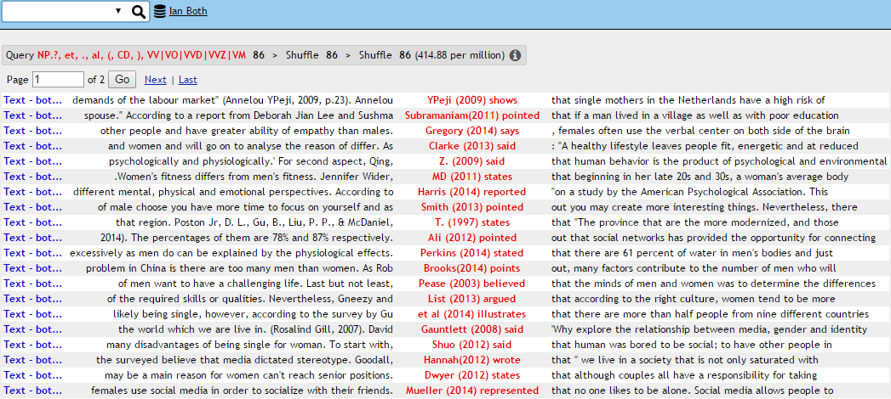

Slide 11
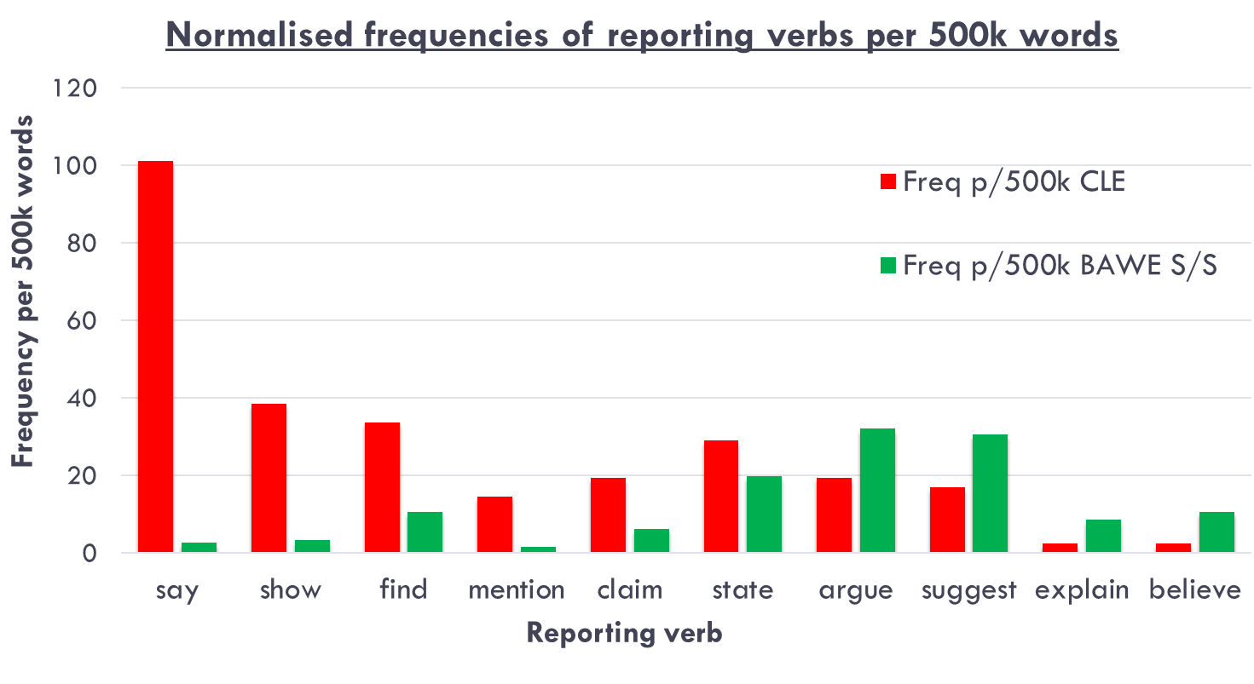
Results
Reporting Verb | Log Likelihood (Keyness)
Say | ****106.65
Show | ****36.61
Find | ***12.33
Mention | **10.12
Claim | **7.1
Argue | 3.35
Suggest | *4.14
Explain | *4.82
Believe | **6.86
Notes:
Various explanations of reporting verb selection: Random (Pecorari, 2008); Lexical variation (Bloch, 2010); Literature consultation (Nesi, 2014). Rhetorical effect may not be the intention – but the precise and subconscious rhetorical meanings for native speakers mean such stance positions are activated regardless, often unintentionally

Slide 12
Analysis
Reporting verb distribution confirmed the notion of ‘endorsement’ or ‘over-assertive’ stance-taking by novice L2 writers
Other results from my study highlighted factors that increased the same effect:
Citations in past tense: 57% novices vs. 34% at proficiency (BAWE)
‘Mental process’ verbs: 1% for novices vs. 9% at proficiency (BAWE)
Included direct quote: 31% for novices vs. 22% in journals (Pickard, 1995)

Slide 13
What should teachers know?
Scaffolding learners towards command of a limited yet useful range of reporting verbs beats striving for lexical breadth
Reporting verbs are not the only/first aspect of citations attended to
But - 5 mark average gain if using five+ reporting verb clauses versus one within essays (limitations of this finding are acknowledged)
Learners likely to default to ‘say’, ‘show’ and ‘find’ as naïve substitutes
Benefit in steering learners towards less assertive patterns
Use of the co-text is helpful, and obtainable; directly via the corpus or through online platforms such as the British Council website, which use resources based on the BAWE (Nesi et al., 2009)

Slide 14
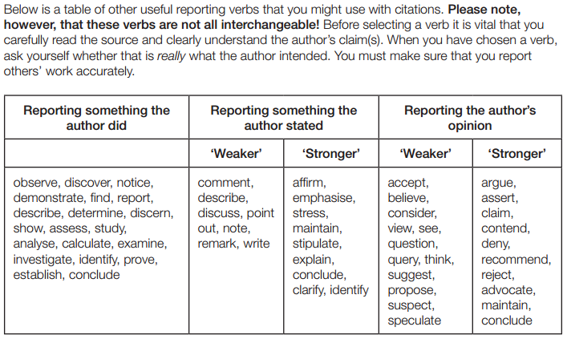
Not this way…
http://www.port.ac.uk/students/academic-skills-unit/

Slide 15
A teaching model
Low
Degree of commitment
High
Believe
Suggest
State
Find
Demonstrate
Claim
Argue
Show
The proposed teaching activities which follow aim to sensitise learners to the difference between Show (endorse), State (acknowledge) and Argue (distance).

Slide 16
Diagnostic/discussion
What, if any, meaning differences are there between:
Johnson (2016) argued that drinking green tea is good for weight loss
Johnson (2016) stated that drinking green tea is good for weight loss
Johnson (2016) showed that drinking green tea is good for weight loss

Slide 17
Exploring the corpus
Using two different colours, to the left of the reporting verbs, highlight all:
Adverbs
Noun phrases
Which of the three verbs most often comes after:
Adverbs
Noun phrases
Neither

Slide 18
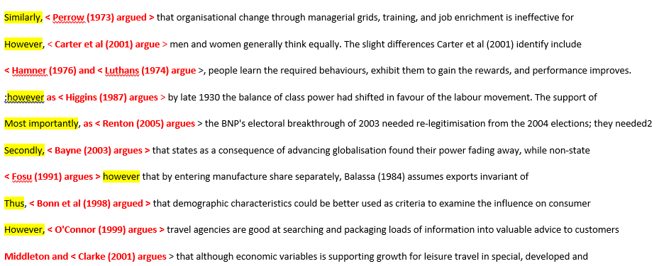
Adverbial + ‘Argue’ (BAWE: random)

Slide 19
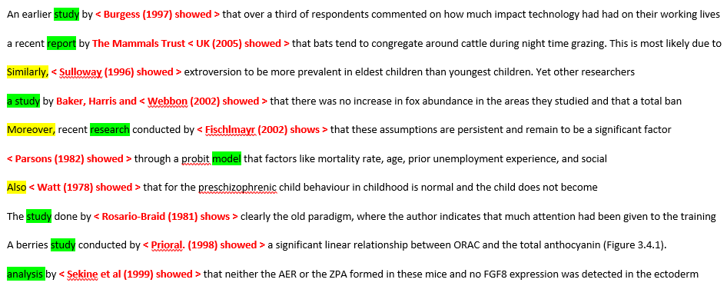
‘Show’ + ‘research’ noun phrase (BAWE: random)
Notes:
‘State’ did not seem to pattern predictably with any particular co-text elements

Slide 20
Deduction
Choose one reporting verb from show, argue and state to complete the group of sentences:
Similarly, Perrow (1973) | ? _______ | that organisational change through managerial grids, training and job enrichment is ineffective
However, Carter et al (2001) |  | men and women generally think equally
Hamner (1976) and Luthans (1974) |  | people learn the required behaviours, exhibit them to gain rewards, and performance improves
However, as Higgins (1987) |  | , by late 1930 the balance of class power had shifted in favour of the labour movement
Most importantly, as Renton (2005) |  | , the BNP’s electoral breakthrough of 2003 needed re-legitimisation from the 2004 elections
NB: there are three such blocks presented together in the real activity, one for each verb

Slide 21
Establishing rules
The verb ___________ is often used to positively report something found in academic research or study.
The verb ___________ is often used to report an idea or opinion within a wider academic debate, but not as a ‘definite fact’.
The verb ___________ is often used to report neutrally something that has been written or ‘said’.
Can you think other verbs to achieve any of the same effects?

Slide 22
Knowledge Application: gap fill
Choose the most appropriate reporting verb from argue, show or state in these sentences:
Analysis by Sekine et al (1989) __________ that neither the AER or ZPA formed in the mice
However, O’Connor (1999) ___________ travel agencies are good at searching and packaging loads of information
Fosu (1991) __________ , however, that by entering manufacturing share separately, Balassa (1984) assumes exports ….
Wright et al (2001) ________ “food taste preferences are now inextricably linked to artistic design and media manipulation”.
Parsons (1982) _________ through a probit model that factors like mortality, age ….
Beck (1992) _________ that it was after the 1950s that consumers became more conscious about their identity

Slide 23
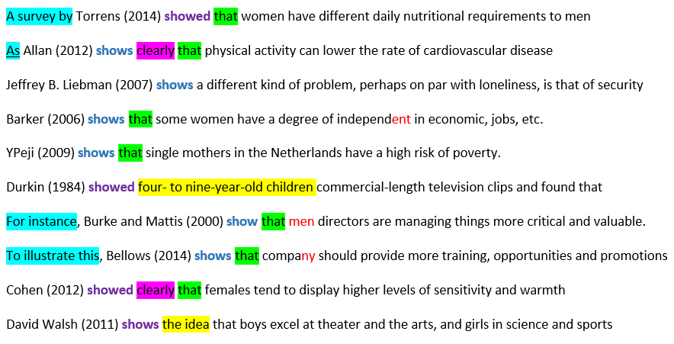
The corpus output and grammatical patterns

Slide 24
Limitations/Considerations
Students may dislike ‘fragmented’ corpus outputs
While Thompson and Tribble (2001) suggest extensions using learner corpora, such corpus outputs will likely contain unhelpful errors
Teacher mitigation by ‘hygiening’ outputs can be time-consuming
Corpus-based work may occur online and on paper; however, both require teacher and learner training
There is debate as to whether dictionary training is equally effective
Teachers being informed by the corpus and learners using it are two different things. This study emerges in stronger support of the first.

Slide 25
References
Bakhtin, M. (1981). The dialogic imagination. Austin: University of Texas Press.
Bloch, J. (2010). A concordance-based study of the use of reporting verbs as rhetorical devices in academic papers. Journal of Writing Research, 2(2), 219-244
Gardner, S. & Nesi, H. (2013). A classification of genre families in university student writing. Applied Linguistics, 34(1), 25-52
Groom, N. (2000). “A workable balance”: Self and sources in argumentative writing. In S. Mitchell & R. Andrews (Eds.) Learning to argue in higher education, (pp. 65-73). Portsmouth, NH: Boynton Cook
Halliday, M. & Matthiessen, C. (2014.) Halliday’s introduction to functional grammar. (4th ed.). Abingdon: Routledge
Hyland, K. (1999). Academic attribution: Citation and the construction of disciplinary knowledge. Applied Linguistics, 20(3), 341-367
Hyland, K. & Jiang, F. (2016). Change of attitude? A diachronic study of stance. Written Communication, 33(3), 251-274
Lee, S-H. (2010). Attribution in high- and low- graded persuasive essays by tertiary students. Functions of Language, 17(2), 181-207.
Li, T. & Wharton, S. (2012). Metadiscourse repertoire of L1 Mandarin undergraduates writing in English: A cross-contextual, cross-disciplinary study. Journal of English for Academic Purposes, 11(4), 345-356
Liu, D. (2005). Plagiarism in ESL students: is cultural conditioning truly the major culprit? ELT journal, 59(3), 234-241
Notes:
Retrieved from / DOI numbers available

Slide 26
Martin, J.R. & White, P.R.R. (2005). The language of evaluation. Basingstoke: Palgrave
Nesi, H. (2014). Corpus Query Techniques for investigating citation in student assignments. In M. Gotti & D. Giannoni (eds.) Corpus analysis for descriptive and pedagogic purposes (pp. 85-106). Bern: Peter Lang.
Nesi, H., Gardner, S., Thompson, P., Wickens, P. and associates (2009). British Academic Written English Corpus. Retrieved via SketchEngine (A. Kilgariff et al, 2017) http://www.sketchengine.co.uk
Pecorari, D. (2008). Academic writing and plagiarism: A linguistic analysis. London: Continuum.
Pecorari, D. (2013). Teaching to avoid plagiarism: How to promote good source use. Maidenhead, UK: Open University Press.
Petrić, B. & Harwood, N. (2013). Task requirements, task representation, and self-reported citation functions: An exploratory study of a successful L2 student’s writing. Journal of English for Academic Purposes, 12(2), 104–124
Pickard, V. (1995). Citing previous writers: What can we say instead of ‘say’? Hong Kong Papers in Linguistics and Language Teaching, 18(1995), 89-102
Rayson, P. (2015). Log-Likelihood and effect size calculator. University of Lancaster. Retrieved from Lancaster University website: http://ucrel.lancs.ac.uk/llwizard.html
Swales, J. (1990). Genre analysis: English in academic and research settings. Cambridge: Cambridge University Press.
Thompson, P. & Tribble, C. (2001). Looking at citations: Using corpora in English for academic purposes. Language Learning & Technology, 5(3), 91-105.
Thompson, G. & Ye, Y.Y. (1991). Evaluation in reporting verbs used in academic papers. Applied Linguistics, 12(4), 365-382.
Wingate, U. & Tribble, C. (2012). The best of both worlds? Towards an English for Academic Purposes / Academic Literacies writing pedagogy. Studies in Higher Education, 37(4), 481-495
Notes:
Retrieved from / DOI numbers available

