Slide 1


Corpus from scratch: collecting and processing a sizeable EAP corpus in a (relatively) resource-poor context
Priya Mathew, Hilary Nesi & Benet Vincent

Slide 2
Types of DIY corpus:
Corpus compilation helps students learn more about their own disciplines
Can provide good examples for data-driven learning
Fairly quick and easy
Expert writing collected by students.
Student writing collected by lecturers.
Student writing compared with expert writing
(collected by students or lecturers).
Fairly slow and laborious
May contain errors
Corpus compilation helps lecturers learn more about disciplinary requirements

Slide 3
The Middle East College DIY corpus
Created for needs analysis:
• What types of assignments to subject lecturers set?
• What genres of writing do the students produce?
• What do the best students do well, and where are they still having problems?
Created for learning activities:
Using discipline-specific key words and phrases
• Noticing similarities and differences between their own and expert usage

Slide 4

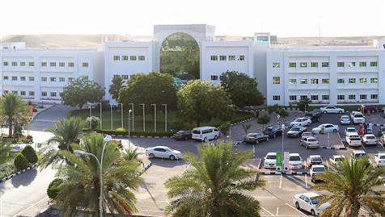
Context: MEC, Oman
Largest private college (6000 students)
Electronics, Civil Engineering, Mechanical Engineering, Computing and Business
Student population:
  90% Omani, 10% International
  Arabic background (8 years of English)
  1-year foundation before undergraduate course (IELTS 5.5)

Slide 5
Need for writing support post Foundation
Many students not able to meet disciplinary writing requirements (feedback from subject lecturers, students and external examiners, student performance)

Slide 6
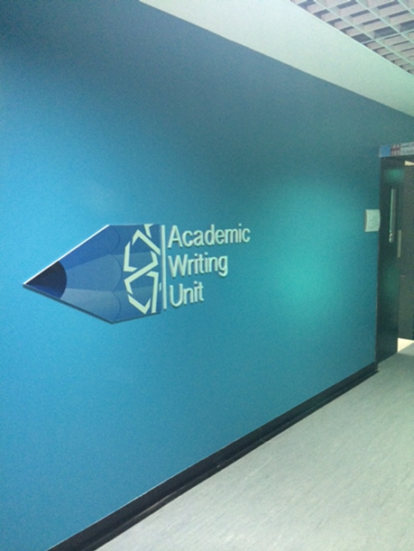
Centre for Academic Writing at MEC
Supports UG and PG students through:
  workshops
  consultations
  WID (Writing in Disciplines) courses

Slide 7
Initial questions
Texts need to be categorized into genres
How to design courses if we don’t know:
  what genres students from different disciplines write
  the lexicogrammatical features of the different stages of the texts
  what subject lecturers value in their students’ written assignments
Stages of the texts need to be marked up

Slide 8
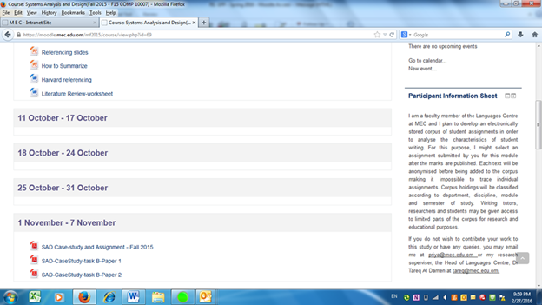
Creating the Corpus
Civil Engineering (coursework from 26 modules represented)
Obtained student consent (Consent Form on Moodle)

Slide 9

Creating the Corpus
Subject lecturers chose some proficient assignments per module
Converted texts to xml format
Texts annotated during the conversion process
<Oxygen/>

Slide 10
The MEC Civ. Eng. Corpus
MEC Undergraduate Civil Engineering Programme consists of 8 semesters
Semester | 1 | 2 | 3 | 4 | 5 | 6 | 7
Number of assignments | 10 | 10 | 12 | 22 | 41 | 15 | 23
Number of words | 30200 | 23700 | 35000 | 33600 | 68100 | 58000 | 70000

Slide 11
Genre Analysis
Categorized texts in corpus into genres based on:
  analysis of stages in texts (Nesi and Gardner 2012)
  interviews with subject lecturers
  assignment briefs
  module information guide

Slide 12
MEC Civil Engineering Corpus, by genre
Genre | No. of assignments | No. of words
Case Study | 34 | 13800
Explanation | 27 | 88600
Exercise | 14 | 18000
Lab Report | 62 | 48700
Manual | 2 | 11200
Site Investigation Report | 5 | 14400

Slide 13
Exploiting the corpus: some initial analyses
Data-driven analysis involving e.g.
key words
key terms
n-grams
can be used to suggest pedagogical interventions

Slide 14
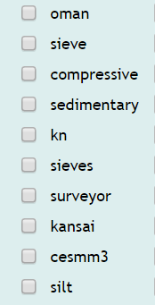
Keywords
NB Sketch Engine keywords
Wordforms that are significantly more frequent in the corpus than in a reference corpus
MEC CE Corpus vs. enTenTen13 (parameter: 1)
suggests items / categories that may be worth teaching
Includes some that definitely aren’t!

Slide 15
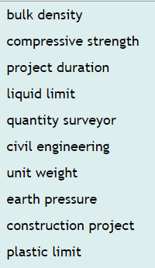
Key terms
Keyword procedure applied to MWIs
MEC CE Corpus vs. enTenTen13 (parameter: 1)
Almost all N + N / Adj + N
Measurement-related terms

Slide 16
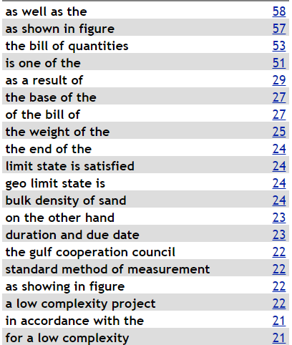
4-grams
aka 4-word lexical bundles
Useful starting point to look at categories such as:
  reference to measurement / location
  reference to visuals
This can reveal common issues

Slide 17
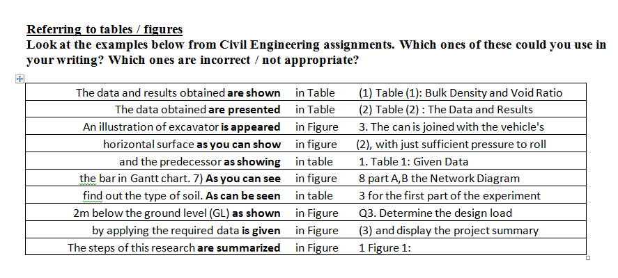
Referring to visuals teaching material
Lines retrieved using CQL

Slide 18
Further work to include…
Keywords of genres (e.g. case study) compared to rest of corpus
Comparisons of usage seen in corpus with more expert writing:
  BAWE Engineering writing
  Journal writing
  Textbook writing?
  in terms of typical collocates and other phraseological features
Probably retrieves different types of keywords
Sharing results with teachers and students

Slide 19
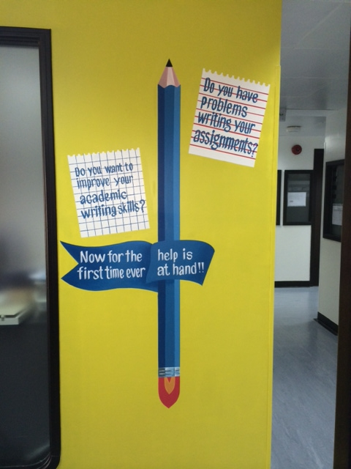

Slide 20
