Slide 1
Critical thinking and EAP writing
A meta-synthesis of research on teaching approaches to critical thinking in the EAP writing class

Slide 2
Introduction
Background to the study
  Research conducted as part of my Masters study
  Importance of CT in academic contexts vs ambiguity surrounding the concept
Overview
  Definition
  Key issues raised in the lit review
  Methodology
  Findings – implications for teaching practices
Notes:
Background – CT present in grad attributes, assessment criteria and floating in the curriculum w/o being made explicit, my own confusion about what it was/how to teach it – can you teach thinking??
Definition – attempt to unpack this complex concept
Key issues – perception that “Asian” students can’t think critically
Methodology – what/why
Findings

Slide 3
What exactly is critical thinking?
“the concept of critical thinking remains more elusive than ever” (Davies & Barnett, 2015)
Critical thinking in an academic context involves both
Skills and Dispositions:
Analysis/Evaluation
Synthesis
Argument construction
Making connections
Identifying problems/
proposing solutions
“Critical spirit”
Willingness to inquire
Self-reflexive stance
Notes:
A multitude of definitions seem to exist which overlap in places and diverge in others – every study begins by the author setting out their own definition…the huge body of lit has perhaps contributed to the ambiguity.
Include the 3 waves??? 1970s – decontextualised logic, 1980s a broadening and link with skills , disciplines, politics and creativity, third wave just beginning aims to combine first two + incorporate values & emotions
“These are difficult skills to acquire, particularly for L2 students and can only develop through extensive independent study, reading and reflection (Andrews, 2015).” p.11

Slide 4
Critical thinking and academic writing
“the skill of critical writing lies in convincing your readers to accept your claims. You achieve this through the effective communication of adequate reasons and evidence for these claims” (Wallace & Wray, 2011:7)
Student papers lack criticality due to:
  Poor reasoning/lack of argument
  Making unsupported claims
  Being predominantly descriptive
  Little or no clear stance/voice
  (Goodwin, 2014; Alagozlu, 2007, Woodward-Kron, 2002)
Notes:
Skills + dispositions above need to come together and result in action – in an academic context this often means producing a written text. Many assessment rubrics/criteria refers to terms such as demonstrate criticality/critical analysis as being indicators of strong student performance (or weak if lacking)
The link between critical thinking & academic writing remains an area where research is somewhat limited, but the key concepts/skills that occur repeatedly include argument, making supported claims, developing voice/stance – this can be seen in the definition (taken from a handbook on academic writing for students by Wallace & Wray)

Slide 5
Critical thinking across academic disciplines & cultures
Different disciplines give priority to different aspects:
  applied disciplines - reflection and connections between theory & practice
  science faculties - the importance of identifying problems and proposing solutions (Carmicheal et al, 1995)
Perception that “Eastern” students can’t think critically
Notes:
CT among the disciplines – again not a huge body of research. One extensive study carried out in Australia found while the general concept was consistent, what was given greatest priority varied depending on the discipline
The east/west question – Asian students because of the importance of conformity in society, Islamic nations like Turkey and Egypt because of their notion of the individual p.19/20
However, this has been challenged in more recent lit and more weight now given to differing educational practices/experiences and language proficiency – due to the additional cognitive challenge, lower lang prof=higher demands on the workig memory, basic comprehension issues etc.

Slide 6
Methodology
Research Questions:
What skills, dispositions and knowledge do EAP students and teachers believe constitute key aspects of critical thinking in an academic context?
What approaches are being taken with regard to developing students critical thinking skills in academic writing tasks?
Method:
Meta-synthesis of empirical studies
Studies identified through a key word search using ERIC
Studies analysed using a framework of critical thinking attributes
Notes:
Why – increasing number of small qualitative studies/action research being conducted in the field, aim was to try and identify common threads/approaches in a complex and controversial area
Criteria for selection – context (inner circle countries), peer-reviewed
Search yielded 10 studies which were closely analysed for common themes.

Slide 7
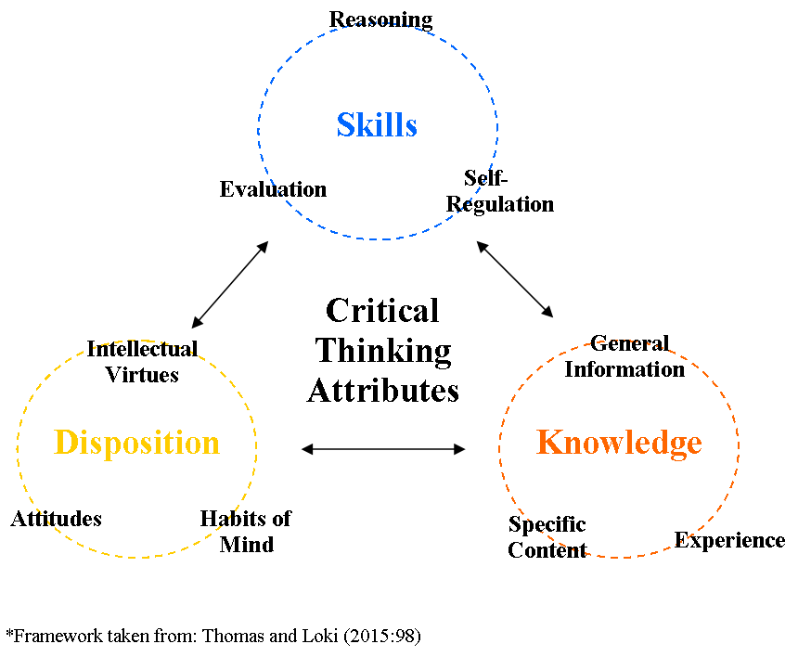
Framework
Notes:
Arrived at through an extensive analysis and synthesis from a wide body of lit.
Conceptualizes CT as a combination of skills, dispositions and knowledge

Slide 8
Findings: Misconceptions
“An author gives a theory and I say that according to my experience there is something wrong with his theory or definition”
(Durkin, 2008:21)
“Although I understand the meaning of critical writing and thinking, I still feel uneasy to criticize other people ideas, especially when they are more senior than me, for example my supervisor”
(Melles, 2009:167)
Notes:
Misconceptions lead to students being unwilling to engage in critical thinking –
Quote 1:Students link it to fault finding and associate CT with terms such as negative, problem (e.g. film critic) rather than the academic sense which is more closely linked to evaluation.
Quote 2: this then leads to reluctance to engage in CT, mismatches in S/T expectations and shows a generally lack of confidence/unwillingness to take risks
Implication – talk about it! Highlight the polysemous nature of the word

Slide 9
Evaluation & Synthesis
“I don’t see why we always have to write so much about what other people have written. Often I have a lot of individual thoughts, but I don’t find them in journals or books. What about these?”
(Durkin, 2008:22)
Key issues for international students:
struggle to find and express their own voice
linguistic demands & cognitive load
Notes:
The close link between critical reading and writing is key.
Students struggle with the skills of evaluation and synthesis – in particular with paraphrasing effectively and the role of voice – huge linguistic demands
Implications – lack of perceived criticality in writing may be based in students paraphrasing skills and the struggle to communicate their own voice when writing from sources

Slide 10
Content & Background Knowledge
Sustained content-based approach
  To question, analyse or recognise bias background knowledge is necessary
  Reflects purpose of academic writing – not purely assessment but to deepen understanding
  Builds confidence as it provides scaffolding
  (Pally, 2001)
  Advantage of embedding CT in a disciplinary-specific context
  (Melles, 2009)
  *Overall CT skills perceived as generalisable and transferable
Notes:
Issues with discipline-specific – not enough research into how diff disciplines perceive CT for EAP, most classes are still mixed.

Slide 11
Collaboration
Collaborative pre-writing activities and discussion tasks as a way to promote critical thinking
  Increases students’ willingness to question
  Builds confidence
  Helps broaden and consolidate knowledge
  (Kasper & Weis, 2005)
  Discussion in the pre-writing stage promotes critical reflection
  Role of group dynamics in this process
    (McDonough & Neumann, 2014)
Notes:
Unlike the other main findings, this did not arise in the lit review
Independence from T, doing own research made it easier to evaluate as they were not then implicitly criticizing teacher

Slide 12
Conclusion
clarifying expectations and taking time in the classroom to discuss students’ interpretations of critical thinking
not restricting the definition of critical thinking presented to the students too narrowly
Allowing time and space for collaboration in the writing classroom
Considering the role of content and discipline-specific approaches
Place of critical reflection in the academic context

Slide 13
References
Alagozlu, N. (2007). Critical thinking and voice in EFL writing. Asian EFL Journal Quarterly 9(3), pp.118-136
Carmichael, E., Cragie, D., Driscoll, K., Farrell, H., James, B. & Scoufis, M. (1995). Critical analysis – What is it? Sydney: University of Western Sydney Nepean.
Davis, M. & Barnett, R. (2015). Introduction. In Davis, M. & Barnett, R. (Eds). The Palgrave Handbook of Critical Thinking in Higher Education, pp1-26. Basingstoke: Palgrave MacMillan.
Durkin, K. (2008). The adaptation of East Asian masters students to Western norms of critical thinking and argumentation in the UK. Intercultural Education 19(1), pp.15-27
Goodwin, B. (2014). Teach critical thinking to teach writing. Educational Leadership 71(7), pp.78-80

Slide 14
Kasper, L. & Weiss, S. (2005). Building ESL students’ linguistic and academic literacy through content-based interclass collaboration. TETYC 32(3), pp.282-297
McDonough, K. & Neumann, H. (2014). Using prewriting tasks in L2 writing classes: insights from three experiments. TESL Canada Journal 31(8), pp.132-143
Melles, G. (2009). Teaching and evaluation of critical appraisal skills to postgraduate ESL engineering students. Innovations in Education and Teaching International 46(2), pp.161-170
Pally, M. (2001). Skills development in ‘Sustained’ Content-Based Curricula: Case studies in analytical/critical thinking and academic writing. Language and Education 15(4), pp. 279-305
Thomas, K. & Lok, B. (2015). Teaching critical thinking: An operational framework. In Davis, M. & Barnett, R. (Eds). The Palgrave Handbook of Critical Thinking in Higher Education, pp.93-105. Basingstoke: Palgrave MacMillan
Wallace, M. & Wray, A. (2011). Critical Reading and Writing for postgraduates 2nd ed. London: SAGE Publications
Woodward-Kron, R. (2002). Critical analysis versus description? Examining the relationship in successful student writing. Journal of English for Academic Purposes 1(2), pp.121-143

