Slide 1
Exploring student access to writing development within one institution
Alison Thomas,
English Language Education (ELE)
Jenna Mann,
Institute for Academic Development (IAD)

Slide 2
Evaluating the position of writing provision within one university.
  Connectivity
  Complementarity
  Or just complexity?

Slide 3
Two questions:
How do other institutions signpost writing support and development?
What issues have you encountered with the systems currently used in your institution?
Notes:
Simpson et al. ( 2016) – read p1?? ‘… it was clear to everyone involved in their needs were falling in the cracks between these disparate departments and campus units’ (2016; p1).

Slide 4

Background
Writing Programs Worldwide http://writingprogramsworldwide.ucdavis.edu/
Main goal is “To recognize the uniqueness of the writing program created at each university”
  To build a dialogic transnational community of writing scholars, teachers, and administrators to share their discoveries and struggles
Where and what students write in institutions – disciplines, genres, assignments
Notes:
Co-editors are from universities in California, Germany and Buenos Airies. Lisa Ganobcsik-Williams of Coventry is involved and the name we would know.
Evaluating-

Slide 5
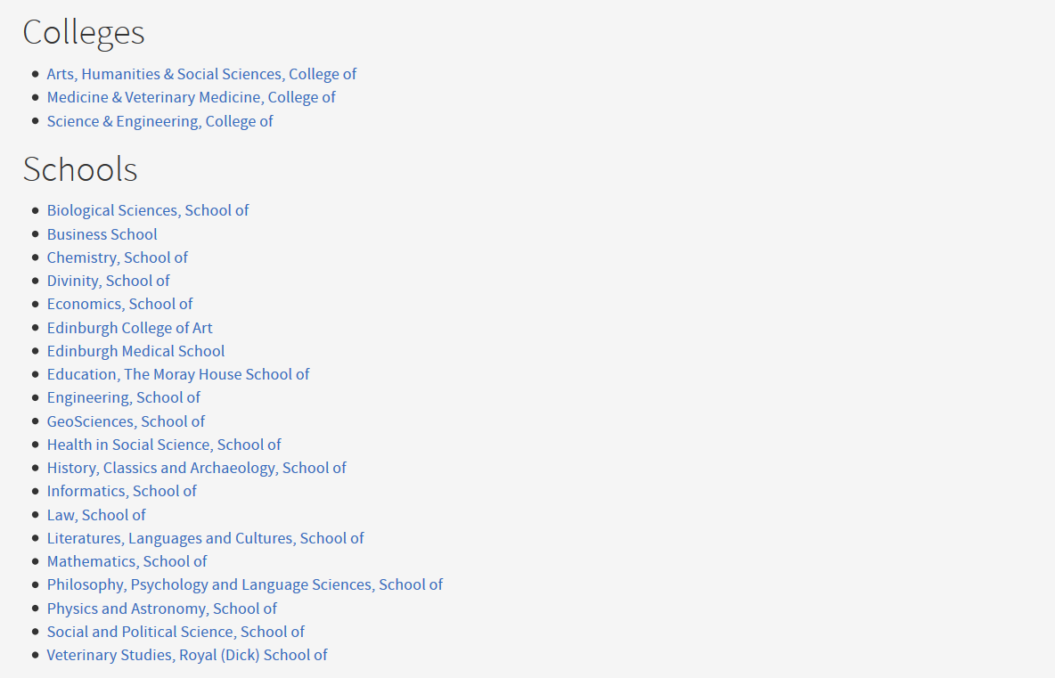
University of Edinburgh
3 Colleges
Fee status | UG | PGT | PGR | TOTAL
Scottish | 8,795 | 1,785 | 1,365 | 11,945
Other UK | 7,250 | 1,480 | 900 | 9,630
EU | 2,515 | 1,200 | 910 | 4,625
Overseas | 4,740 | 4,135 | 1,415 | 10,290
TOTAL | 23,300 | 8,600 | 4,590 | 36,490
20 Schools

Slide 6
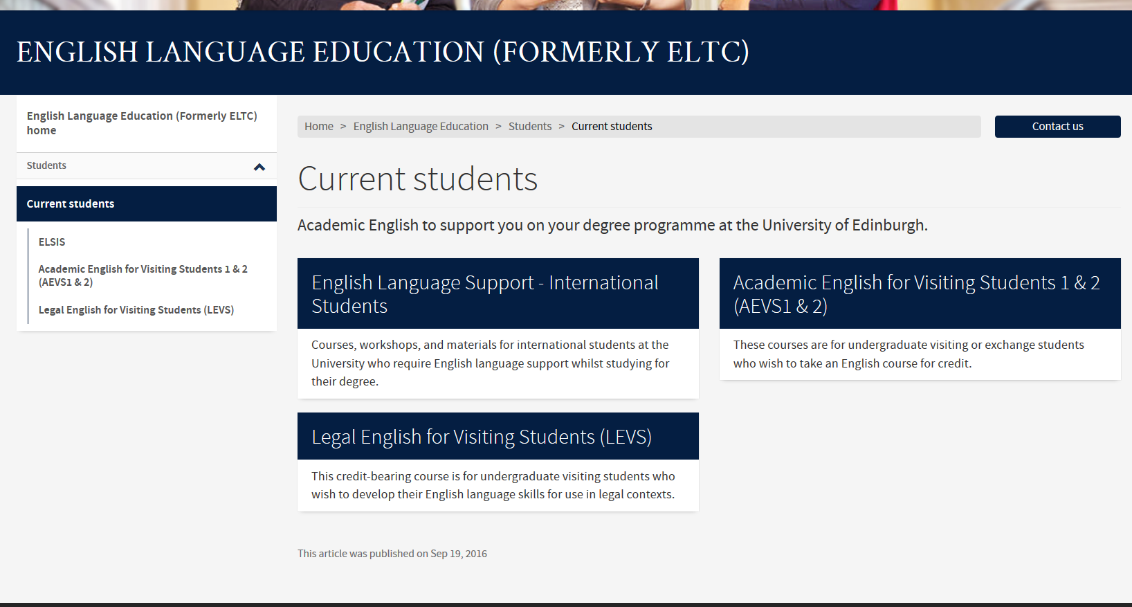
Silos of support – ELE
Notes:
In sessional support. Complementarity/ connectivity?

Slide 7
ELE In-sessional support
EGAP:
Seminar Discussion Skills
Better Pronunciation
Presentation Skills
Academic Writing for International Students
Grammar for Academic Writing
Writing your PhD: Reviewing the Literature
Writing a PhD First-Year Report
Writing up PhD Qualitative Research
Writing up PhD Quantitative Research
Online ESAP: dentists, nursing, vets, engineering, medicine.
f2F ESAP: economics, biology, sports science, engineering, education.

Slide 8
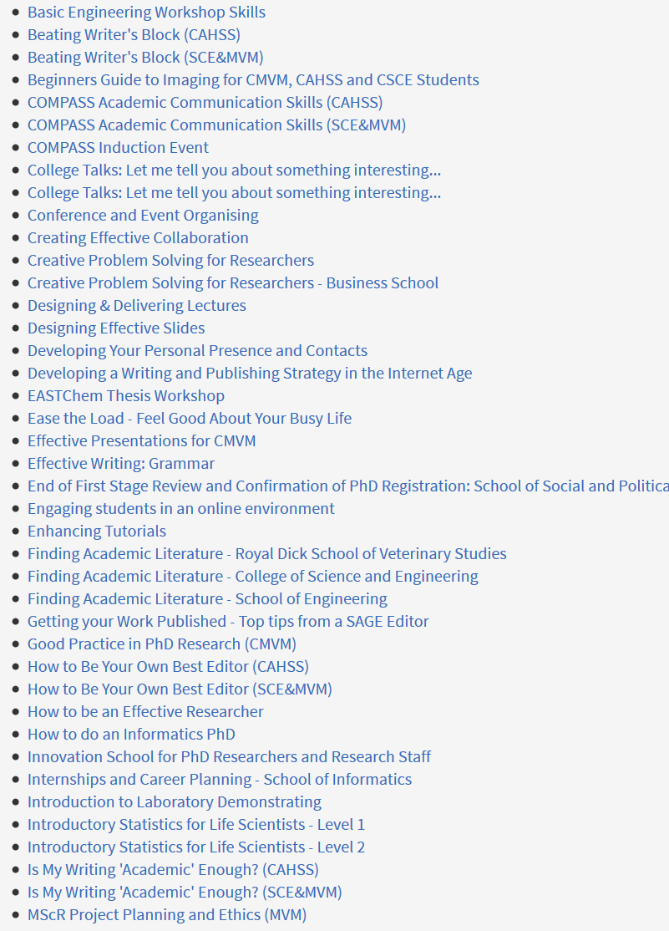
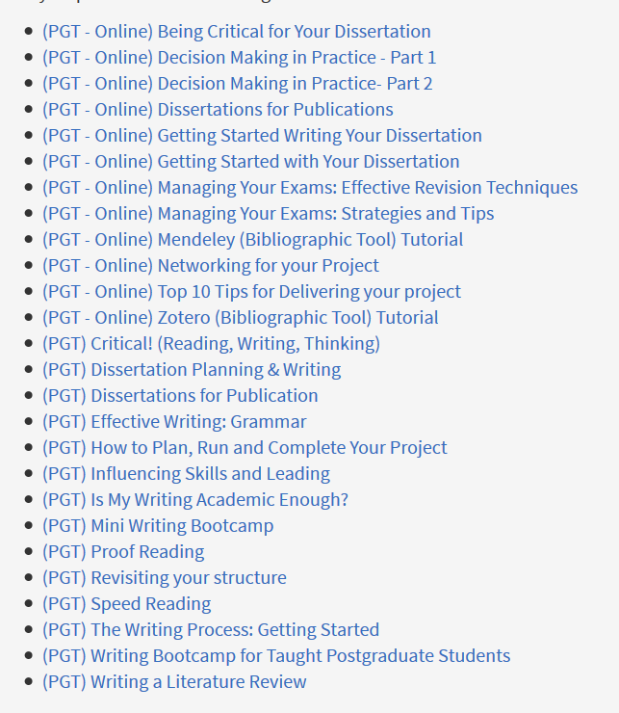
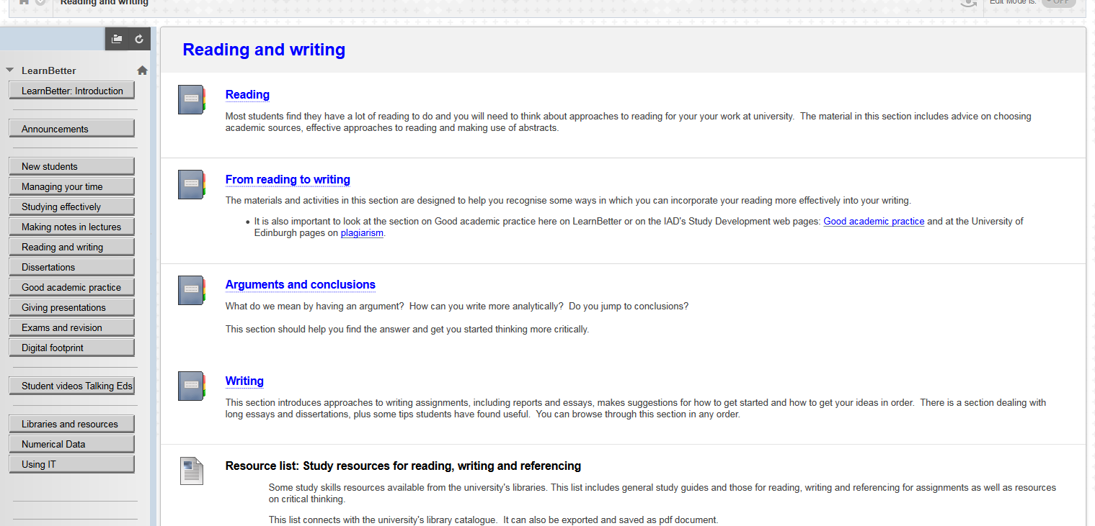
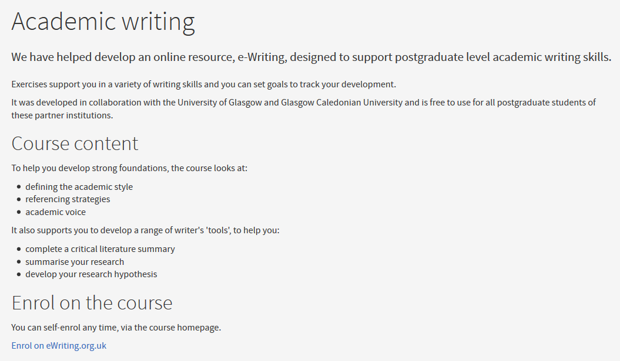

Silos of support - IAD
e.g. For PGT, AY 2016/17, 42 workshops with ‘writing’ in the title. Not including things like literature review, being critical, proof-reading etc.

Slide 9
ELE and IAD support
ELE
(Quasi-)streamed
For international students
One-to-one, workshops, self-study
Online, face-to-face
Mix of generic and subject specific
Strategy: remedial
Some CEM
IAD
Streamed (UG, PGT, PGR)
Open to all
One-to-one, workshops, self-study
Online, face-to-face
Mostly generic (not subject specific)
Strategy: development and enhancement (seen/used as remedial)

Slide 10
Silos of support – as well as…
School specific/organised
Peers (PALS)
Information Services
Library (eg. Lit review for CSE students).
Notes:
From schools who have developed their own materials as in Biology to those we hear from students who don’t have anything. As an aside a project I’m involved in asking CSE findings: How would I know who is an international std? Emulation? No writing support needed after term 1 - very

Slide 11
UoE Student Experience
What our students can expect:
Students at the University of Edinburgh will benefit from excellent teaching, both on-campus and online, and a strong academic and pastoral support framework which responds effectively to the range of individual circumstances, experience, expectations and interests.
(UoE website. Last accessed 14/03/17)

Slide 12
How will we do this?
Improve connectivity and liaison between Schools, Colleges and University-wide student support services, to better recognise and respond to the needs and expectations of our students, prospective students and graduates.
(UoE website. Last accessed 14/03/17)

Slide 13
At the moment…
Student access depends on
  Personal Tutors knowing (caring) what is available
  Self-referral
  Other referral
Notes:
There are some ‘fairs’ where staff tout their wares- but how much can you get across in typical format: 3 mins+ 1 slide ; bland blue- what can you see?

Slide 14
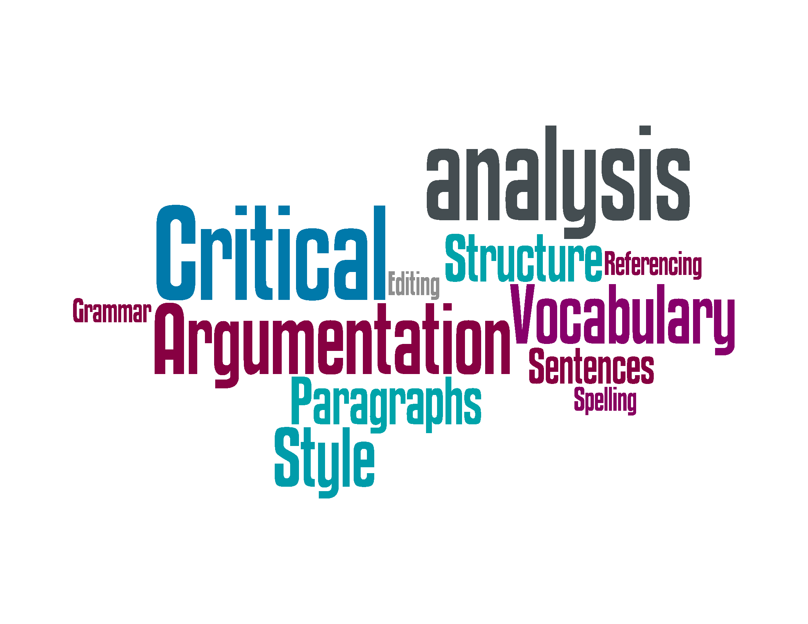
Survey results

Slide 15
Problem (?)
Large university with complex structures and processes
Students need to be able to find the support
Students need to be able to access the support
Visibility and eligibility
Notes:
Although complexity may be necessary to react to diversity which is part of the cultural identity of any HE institution these days…Our argument is the need for visibility and eligibility.

Slide 16
Our aim
We want to empower students to
Take effective steps in developing their academic writing
At a time, place and level that is meaningful to them
First step, a signposting webpage?

Slide 17
So back to the two questions…
How do other institutions signpost writing support and development?
What issues have you encountered with the systems currently used in your institution?

Slide 18

EAP and The Butler’s Stance (Raimes, 1992)
Notes:
Benesch’s notion that research and sharing ‘empowers a community’- as ts what can we do to empower stds. Critical EAP

Slide 19
Power over others need not be
‘domination’
It can be
transformational
productive

Slide 20
‘Our goal today is to start conversations on these issues and to explore roles writing teachers might play in cross- campus dialogues on (graduate) student writing support.’
( Simpson et al. 2016)
Notes:
Echoing Simpson et al. (2016)

