Slide 1
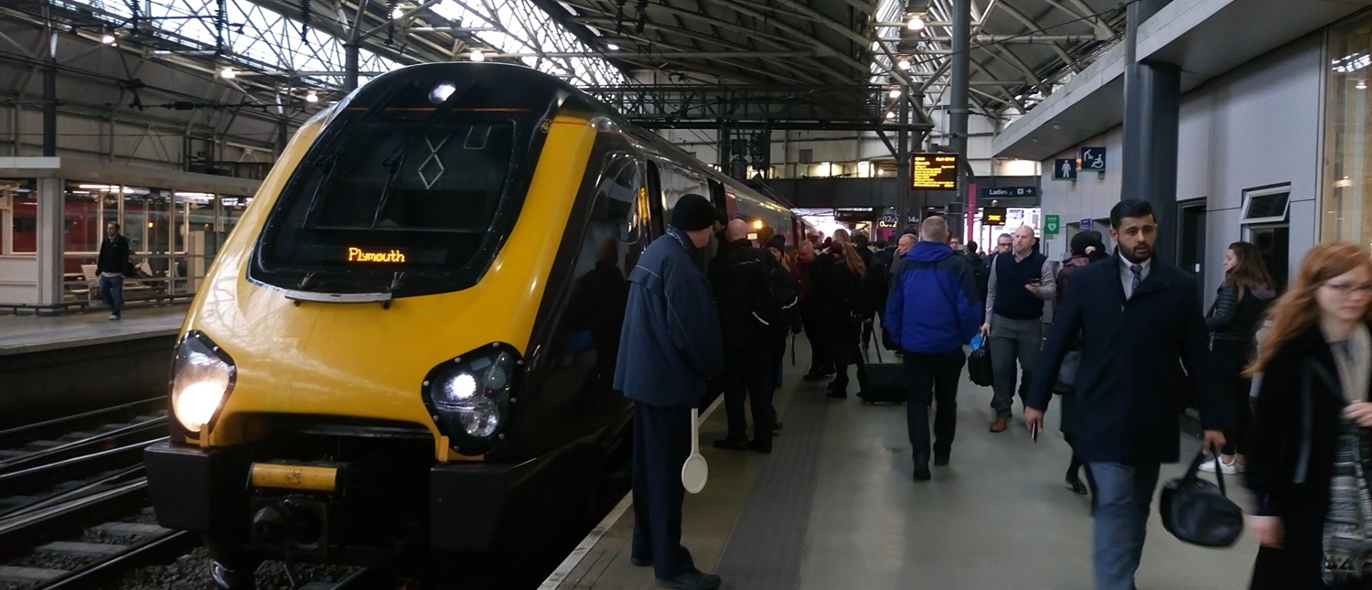
From commuters to collaborators: Using EAP approaches with home students
Karen Nicholls
Sarah Procter
Notes:
Online abstract (did we write this??)
An EAP lecturer and Early Years lecturer share a commute. They decide to apply for internal funding to try something new in their teaching. They get funding. Can EAP approaches to the development of academic language be used with work-based, part-time home students whose first language is not academic?
Karen
both
why we're at this conference
similarities working with "home" and "international" students
BALEAP jisc mail conversation about Edinburgh pim

Slide 2
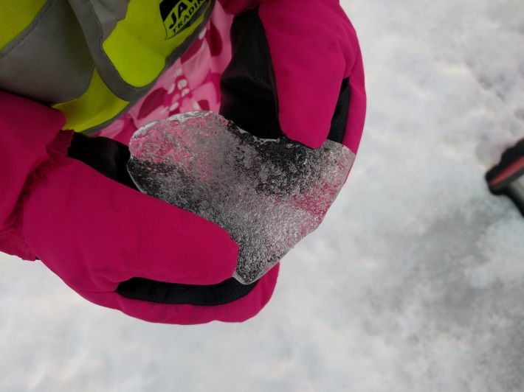
What is Early Years ?
Who are our students ?
Why work with Karen ?
Notes:
Early Years refers to a phase in a childs life from 0 years to 5 years these are also called the foundational years. The subject of great debate and theorising over many years by notable academics such as Piaget and Vygotsky. In the UK this phase in a childs has received considerable attention over the last 15 years as successive governments have assimilated research from neuroscience and come to realise that if you want successful citizens children must be supported to learn foundational skills such as social and emotional skills ie self regulation; communication and language skills and physical development. In addition successive Governments in the UK have advocated full employment as a method of alleviating poverty and therefore as system which supports parents to work is vital.
Whilst childcare has and to some extents still is seen as a low status job longitudinal research has shown that having graduates in settings helps to improve outcomes for children. There has been a programme of part time degree courses established in a number of Universities and colleges which enable staff to work and study to degree level. The Foundation degree is the first stage of the process. The majority of students have vocational qualifications to Level 3, they may not have studies for a long time and they may have other undiagnosed learning difficulties such as dyslexia which means they have labelled themselves impacting on self confidence and self esteem in terms of studying and academic writing. In addition they are usually working full time and juggling families. All this set aside they are experienced in their field and they have the practice wisdom on which to hang the theoretical perspectives which studying may help them to achieve.
Discussions on our train journey home to Leeds helped me to understand more fully Karens role and experience and questons such as 'How can I support students to write using agreed academic conventions' 'I wonder if my feedback is reaching the spot' 'Is the language I use right?' Helped us to formulate this project

Slide 3
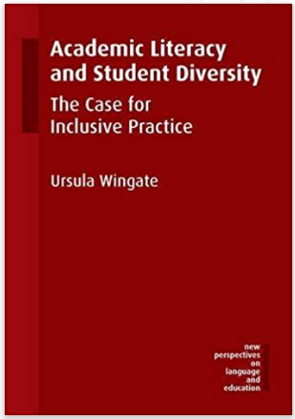
Why work with Sarah ?
Notes:
Karen
Recently excited by the use of the rhetorical triangle as a framework for making language choices
Reading about individual learning journeys
Conversation on jisc mail - so many similarities
Wingate 4 principles:
1 "literacy institution should focus on the genres that are relevant to students and make their specific social functions and communicative purposes in the discourse community visible
2 "academic literacy instruction is an entitlement for all students" because all are novice writers in this context
3 "academic literacy instruction needs to be integrated with subject teaching"
4 this requires a collaborative effort between subject and academic literacy experts

Slide 4
Key concepts
Inclusive academic literacy instruction
Feedback literacy: knowing, being and acting
- should focus on genres that are relevant
- is an entitlement for all students
- needs to be integrated with subject teaching
- requires a collaborative effort ... (Wingate, 2015)
"Feedback literacy also requires learners and teachers to address the language barriers which inhibit the capacity for learners to understand, interpret and act upon feedback." (Sutton, 2012, p39)
Notes:
Karen
We could add this? as a bit of a mini-literature intro
(any other key concepts?0
( I put it here, so I could talk about it before you go on to the objectives - what do you think??)

Slide 5
Outcomes - in relation to our objectives
Where are students in terms of their academic literacy skills?
What can be done in terms of teaching to support their development?
What can be done in terms of feedback to support their development?
To what extent will the subject specialist lecturer gain confidence in developing her students' academic literacy?
Notes:
Sarah -
Significant variation between individual students in terms of:
confidence, perceptions of literacy needs,
Teaching
Importance of the task that is set - making sure that that is really right
Whether things are overly complicated - strip back and make more straightforward
When and how to "intervene" -
Feedback
University systems - if they change part way through a course, remember the students'

Slide 6
Methodology
'Many teachers and researchers now acknowledge that wisdom can be found in the voices of individuals as they live their own experience, reflect on its meaning, and take action to change what they perceive to be in need of change '
(Hatch et al 2006)
Notes:
S
very brief explanation of what we did
importance of "action research methodology" within Early years as part of their own professional practice/ development
While action research is a subjective study of one situation, and the results may not be generalizable
post feedback 7 students
post end of module 7 students
overlap 3 students

Slide 7
Assessment Tasks
Feedback systems
Processes and practices
Notes:
Sarah
In this module students are asked to develop two case studies on health related issues which impact on children and their families. They can present their case studies from the child, family or setting perspective. Task 1 requires a presentation to be made of their work to date. Feedback from the external examiner suggested that we should ask students to prepare a powerpoint to support their presentation. Students work together in small groups to support one another and then deliver these presentations in small groups. Each presentation is audio taped and can be used for moderation and external examination processes. Presentations are marked against the assessment feedback criteria and a mark awarded. All refers and distinctions (over 70%) are second marked and a range of each other band. Marks are agreed and released with associated feedback rubrics online. Whilst marking turn around times are 3 weeks as the students were to be in at 2 weekly intervals work was graded in two weeks and marks and feedback released via BB just before the teaching session.
Due to the group size and the need to cover further content a half day was allocated for small group tutorials and feedback (perhaps should have been called feedforward) HANDOUT

Slide 8
1st Findings Perceptions of feedback Feedforward
"So she says, 'That's your question!... but I'm thinking is that my question? I just can't get it in my head for some reason." (A)
"... I kind of knew that my action plan wasn't very good so I've got to work on that. I've only just read mine [feedback] so I don't think it's sunk in yet. It's not something I normally read, I just look at my mark." (B)
"they still didn't really feel very clear about what the purpose of the task was...
They need to be careful not to do like a description of their case study ...
...all that needs to be sort of set in the context of ...literature." (S)
Notes:
K (outsider role)
After initial feedback (after presentation, before written work and before intervention)
Participants were still processing their feedback. It wasn't clear whether all had accessed/ absorbed feedback (How do they see it? Phones?)
Why did feedback not go in? eg. "evidence review of Healthy Child Programme" which is an example of how to use sources that justify or refute different approaches
student interpreted it as look at the Healthy Child Programme
(too long a document???)
Apparent gap between Sarah's perception and students' perception of feedback process and content (too strong????)
Sarah had clear perceptions of student writing development needs - (interview44)
Students have interpreted range of academic writing approaches as belonging to individual tutors
Students had misconceptions - reflective account / no it was to write up case studies but this necessarily includes reflection as part of the course is to develop as reflective practitioners

Slide 9
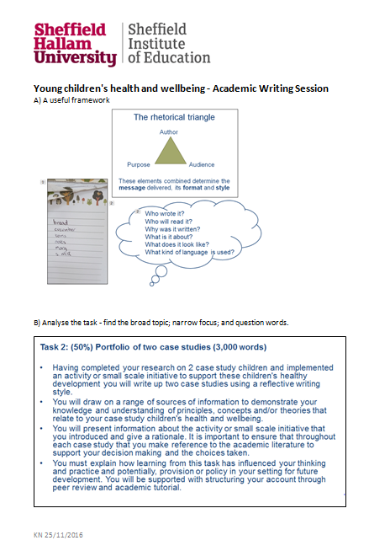
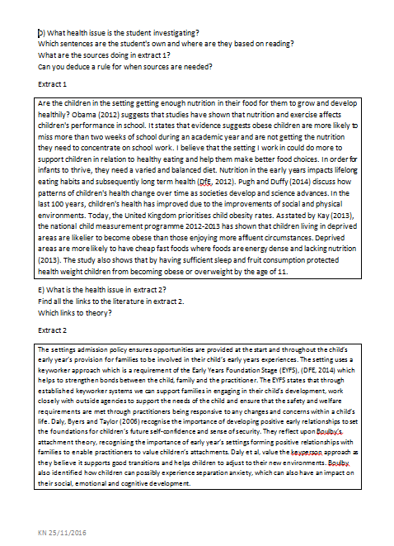
Intervention By the end of this session, students will be able to:
Specify elements of the rhetorical triangle
Understand the importance of purpose
Analyse an assignment brief
Elicit rules for source use
Integrate theory and policy with practice
Identifying description and evaluation in reflection
Notes:
K
Describe the session and why based on Sarah's and participants' comments
- understanding criteria and putting them into action
- providing a tool (rhetorical triange) that they could use to eg understanding expectations of the audience (link to criteria)
- used previous year's students' work
- this is what critical thinking looks in writing (using literature, comparing, contrasting, strengths, limitations) eg. practice linked to literature examples, practice linked to policy/ theory
Link to CEM, and Sutton language quote, + Sarah critical thinking looks like ..
(HANDOUTS of worksheet)
Incidental learning ???

Slide 10
2nd Findings Did the feedback work? Did the intervention work? Further reflections...
"I got feedback saying something about my questions was unclear, so that made me then really highlight my questions in my ... second task...I'm proper like- my questions are..." (A)
"I don't always meet that [critical bit of assessments] because I'll describe stuff but not actually do an academic argument for it, whereas that [session] brings an awareness to it I suppose. I can go back and look for that." (B)
"... it weren't as such linked into anything that we were doing as such ...
... but I think it probably would have been better right at the beginning of the course." (C)
Notes:
K - mixed results
Some students were extremely (too??) positive - had made links to work literacy practices
negative - not connected to anything we were doing
unclear why in either case -
all: it would have been useful to have done this earlier

Slide 11
2nd Findings Did the feedback work? Did the intervention work? Further reflections...
I think it’s a tool and once you've understood like the way you broke it all down, I think you think yeah…have I thought about that way, you know, your wording of things and, yeah, I think it’s a really good tool. I think I’ll use it forever in my academic work!" (D)
E: I take this on board at work as well when I'm writing at work…
… but this has just reiterated how to write in a professional academic manner and then I can pass that on to other colleagues and make sure what I've written at work is good..., so I think it’s useful for, it’s a good life skill isn't it.
Notes:
K - mixed results
Some students were extremely (too??) positive - had made links to work literacy practices
negative - not connected to anything we were doing
unclear why in either case -
all: it would have been useful to have done this earlier

Slide 12
Outcomes - in relation to our objectives
Where are students in terms of their academic literacy skills?
What can be done in terms of teaching to support their development?
What can be done in terms of feedback to support their development?
To what extent will the subject specialist lecturer gain confidence in developing her students' academic literacy?
Notes:
Sarah -
Significant variation between individual students in terms of:
confidence, perceptions of literacy needs,
Teaching
Importance of the task that is set - making sure that that is really right
Whether things are overly complicated - strip back and make more straightforward
When and how to "intervene" -
Feedback
University systems - if they change part way through a course, remember the students'

Slide 13
Recommendations
Course overview
Time for course meetings
Assessments scheduled around Christmas are always difficult !!
Notes:
Sarah
Recommendations:
Students were struggling to manage two health modules delivered by two tutors
external
have an overview of all tasks on the programme (course leader ??)
scheduling of assessments
time - when would you have that overview (cycle of minor modifications, timing - aaaaagh)
strategic view of module/course - teaching who is front of me now
internal
juggling and spinning plates
is mid-course a good time to introduce new form of feedback (institutional)
feeling empowered to flex newly introduced regulations to support students
putting students' experience first at this point (do this, but may be become desensitised when so many insitutional things to respond to
internal
have learnt some things
if you get the assessment task right
students understand expectatiosn of them
then easy to give feedback
needs stripping back -
hand over to the next module - to clarify feedback
new version of course - highlight parts of feedback that they address in a professional development

Slide 14
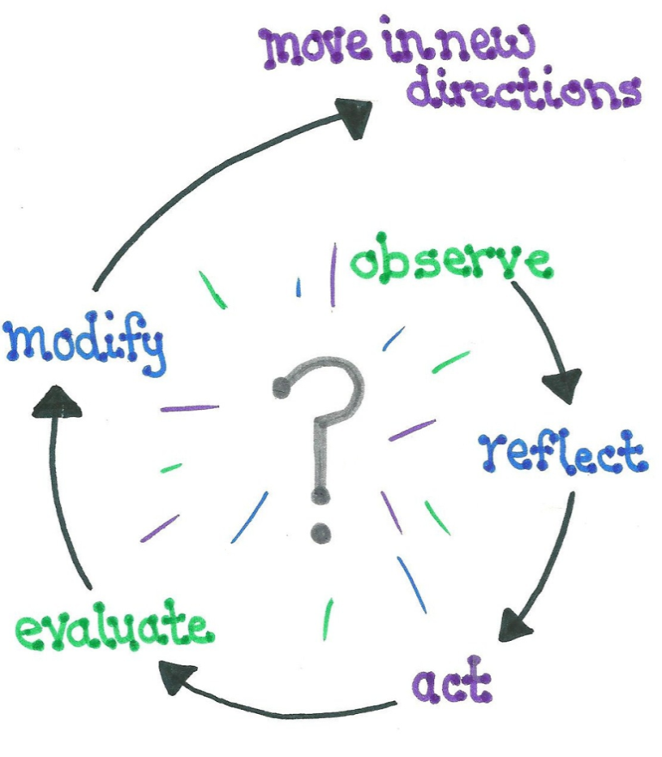
Notes:
??Sarah then Karen
Sarah ...
implemented a similar intervention in a level 4 Health module - different questions
Course leader interested
Staff development?
Karen ...
Taking this forward with other subject groups/ course teams
Question Sutton's separation of knowing, being and acting and "the language barriers which inhibit the capacity for learners to understand, interpret and act upon feedback "

Slide 15
References
Hatch,A. Greer,T. Bailey,K. (2006) Student-produced action research in early childhood teacher education: Innovations in Early Childhood Teacher Education
p205-212
Sloan, D. and Porter, E. (2010). Changing international student and business staff perceptions of in-sessional EAP: using the CEM model. Journal of English for Academic Purposes. 9. 198-210
Su, Feng (2011) Chinese Learning Journeys: chasing the dream. Stoke on Trent: Trentham Books Limited
Sutton, P (2012) Conceptualizing feedback literacy: knowing, being and acting. Innovations in Education and Teaching International. 49. 1 Feb 2012 31-40
Wingate, U (2015) Academic Literacy and Student Diversity: the case for inclusive practice. Bristol: Multilingual matters
Notes:
CHECK FORMATTING

Slide 16
Research questions - cut some??!!??
What are student and teacher perceptions of L5 Foundation Degree students writing development needs ?
How has written feedback identified and supported students to develop academic writing literacies?
What impact have specific writing development interventions had on student academic writing literacies?
What impact have writing development interventions had on lecturers' perceptions about feedback given to students ?
Have students identified improvements in writing literacy based on teacher feedback ?
Notes:
CUT THIS SLIDE
PUt on a handout

