Slide 1
Investigating student awareness of hedging in context
Benet Vincent (Coventry)
& Aleksandar Trklja (Birmingham)

Slide 2
Outline
Hedging in EAP
The study
Results
Conclusions

Slide 3
Hedging is…
‘… any linguistic means used to indicate either (a) a lack of complete commitment to the truth of a proposition, or (b) a desire not to express that commitment categorically’ (Hyland 1996: 251)
‘expressions … which make messages indeterminate… convey inexactitude, or in one way or another mitigate or reduce the strength of the assertions that speakers or writers make’ (Mauranen 1997: 115)
NB – tension between these ‘intensional’ definitions and the forms interpreted as ‘hedges’ in context
Notes:
But separate from; explain how? Stance – wider, though could arguably subsume hedging (though some aspects of Hyland’s model outside scope of stance; some overlap with epistemic modality, but that covers ‘certainty’

Slide 4
Hedging in EAP
Important because…
‘Integral part of academic discourse’ (Mauranen 1997: 115)
Use indicates membership of academic communities (Hyland, 1996)
Important element of pragmatic competence (everyone)

Slide 5
Previous EAP hedging research
Ie ‘expert’ use, maybe compared with less expert writers
Focused mainly on
identifying devices in texts
creating frameworks for interpreting hedges
Less focus on learner understanding of these
But important aspect of ‘learning together’
‘noticing’ + ‘Consciousness Raising’

Slide 6
Aims of study
How aware are EAP learners of hedging in texts?
Which ‘types’ of hedge are learners least aware of?
Texts that they might themselves write
i.e. categories, specific devices
Notes:
NB noticing, CR

Slide 7
Hedging framework (Hyland 1996, 1998)
Content-oriented
Accuracy-oriented (propositional content)
Specification (accuracy / approximation)
Verification (uncertainty – ‘epistemic’)
Writer-oriented (avoids commitment – ‘evidential’)
Reader-oriented (writer takes responsibility)
Notes:
NB in ‘scientific writing’ – biology; may need some adjustments to student writing – in fact we’re thinking of proposing one
NB2 – fuzziness inherent in the system!

Slide 8
The students
International students studying at CU (min IELTS 6)
2 groups:
Level 2: 9 students
Level 1: 16 students
Notes:
Credit bearing

Slide 9
Procedure I: extract selection
20 texts drawn at random from BAWE
Hedges identified using Hyland’s framework by AT & BV
Extracts chosen taking into account:
Density
Variety (types and forms)
Most frequently occurring ‘types’
Amount of text possible for students to process (just over 1000 words)
L1 of writer
Number of extracts: 5; no. of hedges: 47

Slide 10
Procedure II: the experiment
Concept of hedging introduced
Students given extracts to annotate
Students shown results and ‘true’ annotations 2 weeks later
Students filled in brief (4-item) survey
No time limit – took 10-20 min
Notes:
Nb voluntary – some stus took option of not taking part

Slide 11
Results: 1
Of the 47 hedges
On ave 19.44 identified (41.4%)
Range: 8-34 (17%-72%)
SD – 6.818
Notes:
NB this disregards mis-annotated hedges

Slide 12
Results by category
So even highest doesn’t reach 50%
Doesn’t show variance across participants or specific hedges
Notes:
Nb this is an average – some students did find

Slide 13
Specification (30%)
More likely to be spotted: often, tend to, relatively
Mostly missed: to the extent, not always, almost
because in combination with other hedges?
to the extent firms face fierce competition and threat of hostile takeover, they can be observed to
it may not always be possible or desirable for firms
equivalent to almost £2 million a week

Slide 14
Verification (49%)
More likely to be spotted: might, may, perhaps, seem, probably
Mostly missed: doubtful, if…
Prototypical hedges?
The link between tenure type and technology change is doubtful
the market … will probably in the next few years continue to grow, if the demand remains

Slide 15
Writer-oriented (46%)
More likely found: could be seen to, X argues/claims…, there is little evidence, it is difficult to say, … suggest that
Mostly missed: implying, … supports the idea that
Because in combination?
This, Merry Wiesner argues, supports the idea that women's work was a substitute for charity
the loss in output would scarcely have been noticed, implying a limited change in technology

Slide 16
Student comments
Why do you think you missed these expressions?
I don’t usually come across these expressions
I have missed a lot, but I did not try really hard; I was so tierd ☹ And also some of the expressions were quite unusual
I probably missed these words/expressions, because I thought that they aren’t hedging

Slide 17
Student comments
Will you try to use them?
Yes, they give leeway to my argument; a character of academic paper
I will try to use them in my essays, but I am not sure if I will not make a mistake in using thems.
I am more aware of the cautiousness required to use the above-mentioned words. I will most definitely try to use them as I like them.

Slide 18
Student comments
What questions do you still have?
Is it a positive thing to use hedging in academic texts? Because it also implies that the writer is not so sure about what is being said.
Does it usefull? Is it pertinent to me?
I generally understood what it means, but it will take time to be able to spot all the hedging terms and recognise them.
I think I know all there is to it.

Slide 19
Conclusions / summary
Students miss a surprisingly high proportion of hedges
‘Familiar’ hedges (modals, adverbs etc.) more easily spotted
Learning / investigating together encourages increased awareness of hedges
Confounding factors include hedge combinations (nesting), level, concentration etc.
may
seem to be
in some learners
possibly

Slide 20
Avenues to pursue
Factors that encourage identification or not, e.g. combinations of hedges, student level
Students in other contexts (next stop Vienna)
Investigating hedging in productive use
Discipline-specific hedging: what do students need?

Slide 21
Thanks for coming
Any questions?

Slide 22
References
Hyland, K. (1996) ‘Talking to the Academy: Forms of Hedging in Science Research Articles’. Written Communication, 13(2): 251-281.
Mauranen, A. (1997) ‘Hedging and modality in revisers’ hands’. In Markkanen, R. and Schroder, H. (eds), Hedging and Discourse: Approaches to the Analysis of a Pragmatic Phenomenon. Berlin: de Gruyter, 115-133

Slide 23
Specification
Approximation:
The isoelectric point of X is/was generally lower
X could be partially caused by Y
X decreases by approximately 60%
Standpoint
viewed in this way, X becomes obsolete because…
from a practical point of view, X could serve to produce …
return
Notes:
Precision adverbs: content disjuncts, style disjuncts, downtoners

Slide 24
Verification
X are probably an expression of this short-term Y
It is therefore possible that X might be different not only …
X is likely to be due to…
this implies that the extent to which X might effect Y could also depend considerably upon other interacting factors
return
Notes:
Main forms: epistemic lexical verbs (appear, seem?), modal verbs, epistemic adjectives
Underlined items are Hyland’s

Slide 25
Writer-oriented
The figures suggest / the evidence suggests that X
X is assumed to originate from Y
It might be speculated that the lack of X could
X argues / says / claims that….
return
Notes:
use of passive constructions, clausal subjects, ‘abstract rhetors’

Slide 26
Reader-oriented
From our investigations we conclude that the data of Wydrzynski et al can be seen in a different light
Thus we propose that...
Our interpretation of these results is that...
Questions:
could X have a physiological significance? How is it, then, that X?
return
Notes:
use of passive constructions, clausal subjects, ‘abstract rhetors’

Slide 27
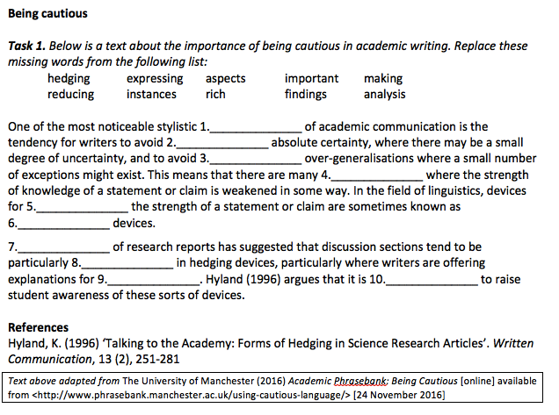
aspects
expressing
making
instances
reducing
hedging
Analysis
rich
findings
important

Slide 28
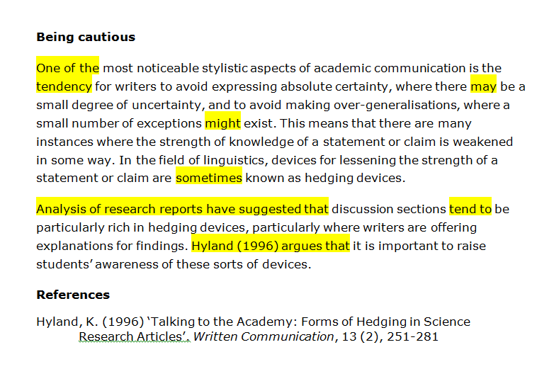
back
Notes:
NB point is not to agree that these are hedges (no IRR carried out) but to show:
What sort of thing we are talking about
That hedges may be of various types and may be MWUs as well as single items

Slide 29
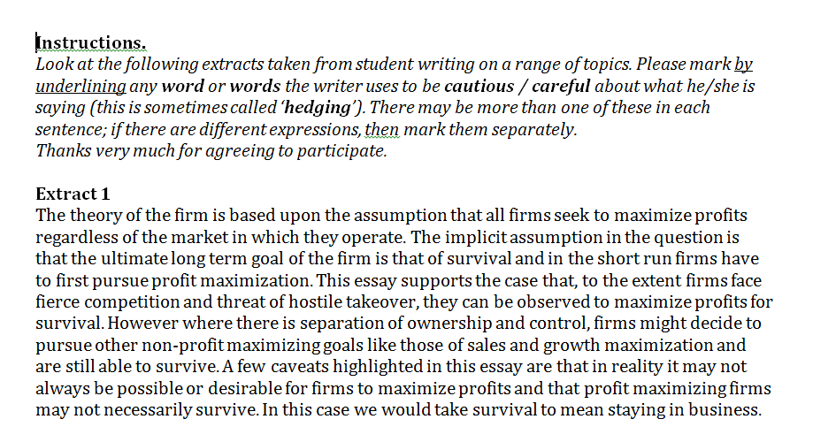
back

Slide 30
Hedges in extracts
Type | No. | Exponent
Specification | 14 | to the extent, not always, often, largely, certain, relatively, scarcely, one of the, tend to, almost
Verification | 19 | assumption (is) that, might, may, would appear, should, would , if it was not, doubtful, perhaps, can, seem, probably, if the demand…
Writer-oriented | 12 | can be observed, could be seen to, Merry Wiesner argues, … supports the idea that, Clark claims, Clark goes as far as, implying, there is little evidence (that), it is difficult to say, according to…, … suggest that…, is said to
Reader-oriented | 2 | this essay supports the case that… we would take survival to mean…
back
Notes:
Not sure if this matches distribution in texts in general; certainly somewhat matches what we have found.

