Slide 1

Widening access to higher education through EAP courses
A Report on the Refugee Project run at English for Academic Study, (EAS), University of Glasgow, in August 2016
EAS Project Tutors : Carol Irvine and Bill Guariento

Slide 2

THE BACKGROUND ; from ESOL to EAP
How did I get to where I am today ?
My practitioner identity : THEN Glasgow-wide ESOL community project 1976-79
Inspiration /innovation/pastoral role :
refugee provision = academic provision
NOW : EAP at university “Widening access”

Slide 3
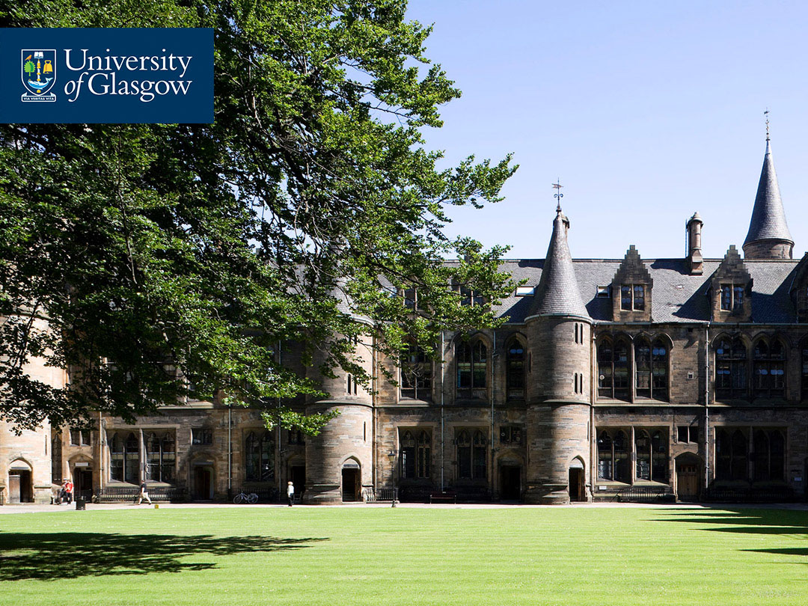
Chilean refugee provision on the ESOL Project
SUMMER SCHOOLS
1977 (adults and children) TUC Offices, Glasgow
b) 1978 Academic focus for Chilean award holders* in HE. Glasgow University premises
c) 1979 General English for spouses of Chilean award holders. Glasgow University premises
*Funded by World University Services
*

Slide 4

TODAY’S UNIVERSITY CONTEXT
The Importance of Research and Scholarship – matching these aims with the Widening Access Project aims
Scholarship :
“an umbrella term encompassing a range of activities. [Research and] modest activities...which nonetheless deliver significant public contributions to knowledge and understanding. ..Examples include case studies, exploratory research, narrative accounts, action research”
(BALEAP ResTES statement of values)

Slide 5

EAS INVOLVEMENT 2016
Specific queries and concerns raised :
Amount of funding available? Enough for one place on each of our specialist courses ?
How is this promoted as a ‘good idea’ for Glasgow University?
What is the motivating factor to the students? How is this balanced by drawbacks?
How do we decide eligibility : how can we prevent a ‘competition’ for places ?
What would we state as the minimum level (6.0 – 6.5)?
“Widening participation and access as a core value :
diversity as a resource and as a goal”

Slide 6

LIAISON/COLLABORATION WITH: People, Agencies, Departments
INTERNALLY (Glasgow University)
Refugee Champion, (Vice- Principal level)
MaRIO Marketing and Recruitment, International Office
College of Arts
GRAMNet (Glasgow Refugee, Asylum and Migration Network)
Equality and Diversity Unit
EXTERNALLY
Glasgow Clyde College, a large FE college in Glasgow with 3 campuses
The Bridges Project. The Voluntary Sector
The Scottish Refugee Council
University of Edinburgh

Slide 7


IMPLICATIONS FOR ADMINISTRATIVE SUPPORT
The project requires an administrator who will :
Make contact with the students identified to arrange meetings with the academic leads (as far in advance of the course start date as possible)
Organise a pre-course informal meeting with all students
Contact suppliers (FirstBus, Hospitality, John Smith’s Bookshop) for bus tickets, food cards and stationery. Raise Purchase Orders or ask Purchasing Officer to do so
Keep track of budgets
Send tailored induction emails to students
Be first point of contact in person and by email for students if any non-academic issues arise during the course
Arrange for financial aid to be applied to students’ accounts to cover course fees
Organise final feedback meeting
Courtesy of Jenny Munro-Hunt,
SMLC Admin Staff

Slide 8

REFUGEE STUDENTS’ FEEDBACK
Individual : Questionnaire. Group : Informal Meeting with Acting Head of Department , Professor Michael Syrotinski :
Preparation/induction
Make course longer /have an induction day to outline course aims, ideas
etc / give more information via leaflets/ provide the materials a week
before the course starts to allow us to read up on it
Social Programme
would have liked to participate but my free time was limited

Slide 9
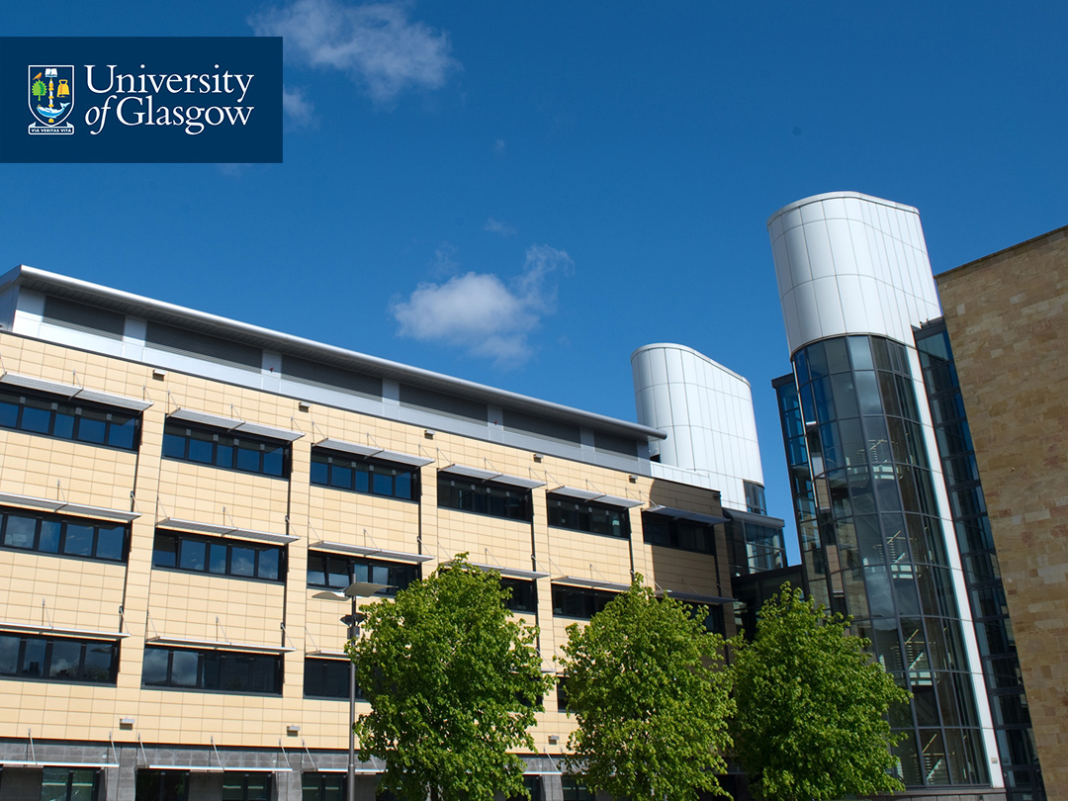
REFUGEE STUDENTS’ FEEDBACK
Database
can we register our skills somewhere, for us to post our CVs? / We
are happy to offer ourselves in any capacity
Childcare?
Women (female refugees) face the barrier of lack of child-care provision/
I was OK because my children are older [from the one female student on the course]

Slide 10

ACTION FOR 2017
Pre-Course
Establish contact sooner with FE and voluntary sector colleagues (March-April)
Cajole Careers Guidance Services to offer one end-of-course workshop on CV writing and interview skills (April/May)
Offer tutorials/ guidance sessions for refugees accepted (May-June)
Have a one-day briefing/induction for the refugee students (July)
During course Get coverage from BBC or STV (with permission). Liaise with GU’s media /press department
Post-course Seek involvement from contacts in subject departments, for mentoring and shadowing opportunities
Seek help from GRAMNet (?) to set up database of students’ skills and interests

Slide 11

AUTUMN 2017 AND BEYOND
Collaborate with EAP colleagues in the University of Edinburgh
1. to design jointly a ‘bridging course’ for ease of transition from FE into GU’s and EU’s Pre-Sessional course ;
2. to become a ‘clearing house’ for all Central Belt (Scotland) refugee access to EAP courses
Widen EAP Access/Extend to Undergraduate students
to reach younger refugees whose study (in own country) was halted by conflict
Develop links with key contacts in subject disciplines
to support the setting-up of mentoring/shadowing initiatives or employment as Guest Speakers

Slide 12

“significant contributions to public knowledge and understanding”
“The needs and priorities of refugees change as they begin to rebuild their lives…particularly as opportunities to pursue their ambitions and potential develop. It is important that they are able to access the services and support they need….to enable them to fulfil their potential and become active members of the community”
“New Scots : Integrating Refugees in Scotland’s Communities”
2014-17 Final Report of the Scottish Government, in collaboration with COSLA and The Scottish Refugee Council

