Slide 1

‘At your service’? Can collaboration between UK EAP and subject teachers obviate Raimes’ so-called ‘butler stance’?
Jonathan Smart,
University of Nottingham

Slide 2
My Background
Recovering Librarian
Collaborative work across disciplines (embedding, ‘guerrilla teaching’)
T & L (secondment)
Interest in English language, linguistics, academic skills
And then….

Slide 3
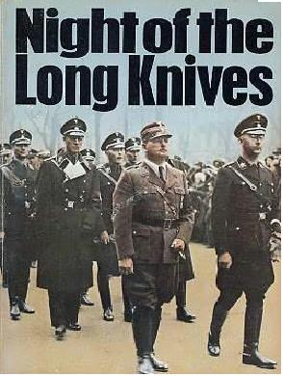
AKA redundancy

Slide 4
….but the good news is….
….paid to go away and do what I always wanted, i.e.
teach
Assisted teaching EAP (2011, 2012) – grammar, academic skills
Cert TESOL (2013)
MA TEAP (2014)
1st solo teaching presessional 2015

Slide 5
Disadvantages:
Newbie / rookie
Non-traditional (even unusual?) background
Limited experience

Slide 6
Advantages:
Newbie / rookie
Non-traditional (even unusual?) background
Limited experience

Slide 7
EAP and Professional Groundhog Day
I thought: EAP – clarity of role – established academic status as discipline, curriculum design, teaching function, continuity, autonomy, total acknowledgement, respect & acceptance from faculties / disciplines
Issues with which LD & Librarians struggle(d)
Echo chamber effect (Potter 2011) / (Bundy 2004) ‘Like all professionals, librarians tend to focus within their own professional silo, and talk to the converted’
BUT – it’s all happening again!

Slide 8
‘I think a key part of this problem - and it is a massive problem - is that
learning development is still not seen as a discipline, and institutions
don¹t value it (although some do, I’m absolutely sure).’ (LD listserv)
‘If it is any comfort, our colleagues working in learning development have very similar experiences.’ (collaboration survey)
Language? Training (Bell 1996 (63)); Support; Skills; Servicing – grist to the ‘butler stance’ mill. Are we perpetuating this situation by constant use of this language to the extent that it becomes a self-fulfilling prophesy?

Slide 9
What IS ‘the butler stance’?
‘When ESL/EFL teachers value the subject matter of other disciplines at the expense of the content inherent in our field…they adopt what I will call a butler stance…They see language courses as service courses, in service of the larger academic community’
Raimes, A. (1991)
Is the BS still alive and well?
If so, can collaborative working offset this?

Slide 10
The Literature
Confirming Raimes:
e.g.
Al-Maamari (2016); Barron (2002); Benesch (1993, 2001);
Chand & Chaudhary (2015); Harwood and Petric (2013); Hyland (2002,
2014); Turner (2004)

Slide 11
‘…EAP’s status as a subservient discipline…’ (Barron 2002)
‘…faculty actively position language teachers as handmaidens to the discipline…’ (Hyland 2014)
‘…the language/content dichotomy which positions language in the subordinate role…’ (Turner 2004)
‘…it [EAP] has..inherited some of EAP’s much discussed limitations, in particular a tendency to work for rather than with subject specialists…’
(Hyland & Hamp-Lyons 2002)

Slide 12
The Literature (cont.)
Confirming co-operation & collaboration:
e.g. Arkoudis and Starfield (2007); Arno-Macia (2015); Barron (1992, 2002); Bruce (2011); Dannatt (2014); Davison (2006); Dudley-Evans (2001); Dudley Evans and St John (1998); Evans & Green (2007); Gustaffson et al (2011); Hyland (2006), Jordan (1997, 2002), Rich & Smart (2006); Sharpling (2002); Sloan (2010), Tajino et al.(2005)

Slide 13
‘Regular contacts…establish mutual trust and form the base of cooperation, collaboration and high quality teaching.’ (Lee 2009)
One of the implications for professional development is that collaborating teachers may benefit from more action orientated teacher research with built-in opportunities for critical reflection (Davison 2006)
‘Co-operation between EAP units and specialist departments can only have a beneficial effect on the students involved’ (Jordan 2002)

Slide 14
Survey
Online survey using BOS (Bristol Online Surveys)
BALEAP
N = 56
Quantitative / qualitative
Semi-structured interviews
Business, Management, Finance/Accounting, Engineering, Soc Sci.

Slide 15
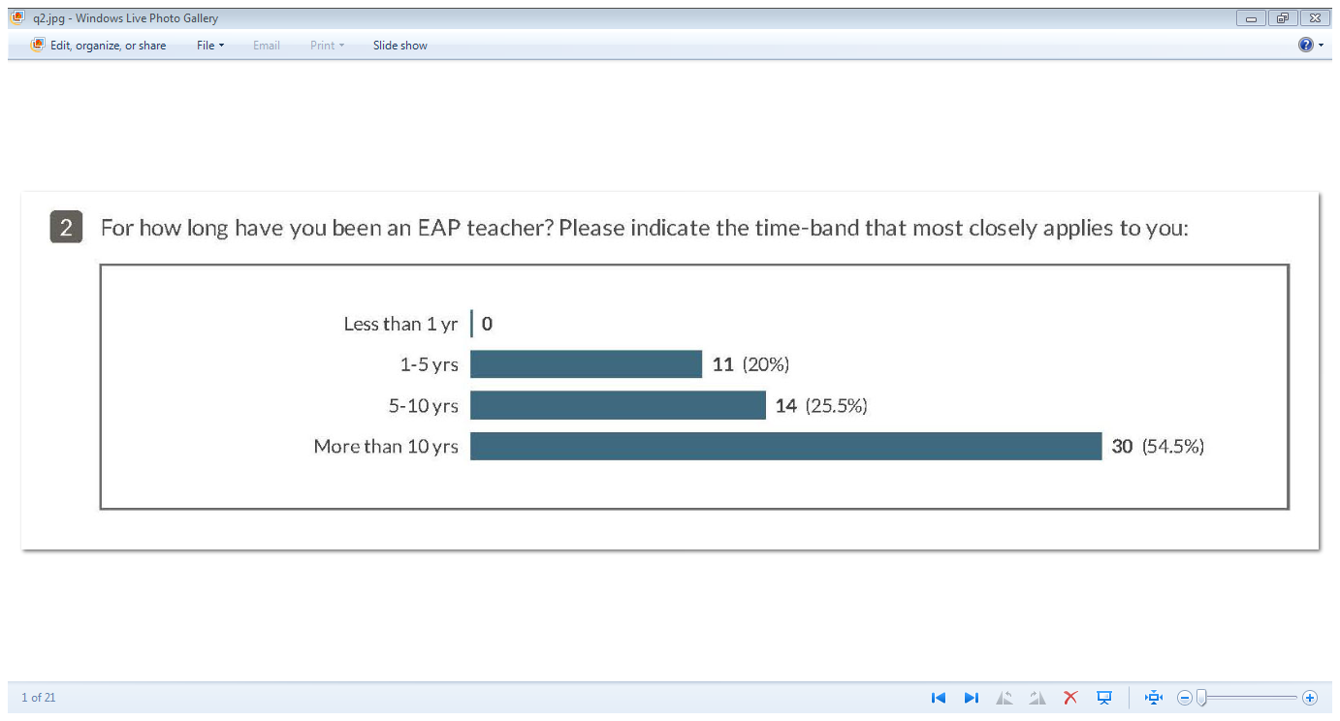

Slide 16
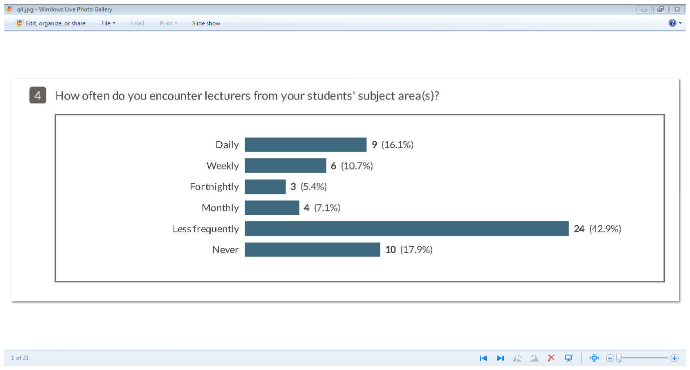

Slide 17
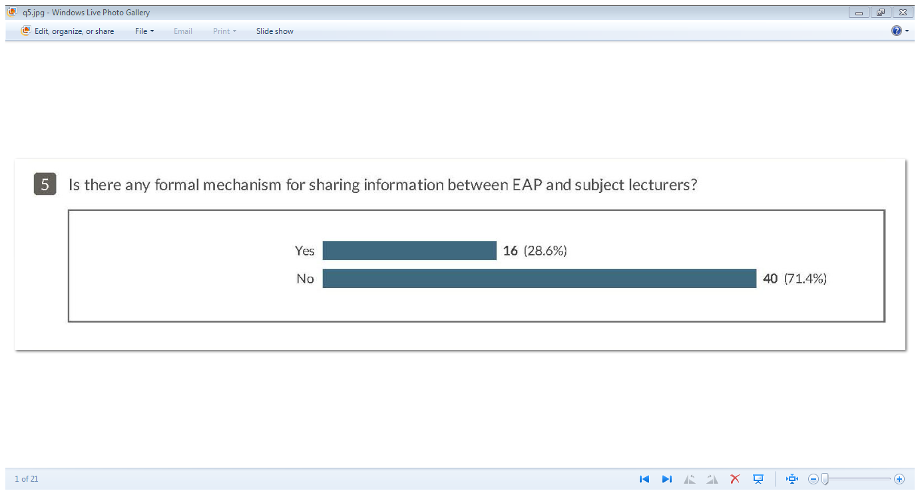

Slide 18
Comments (formal mechanisms for collab?)
‘At my institution the senior team contact subject lecturers who act as informants. The 'informants' talk to us about teaching and assessment practices and help us to find out about core texts etc’
‘EAP lecturer attendance at course committee meetings’

Slide 19
Comments (formal mechanisms for collab?)
‘There should be’
‘Two different worlds’

Slide 20
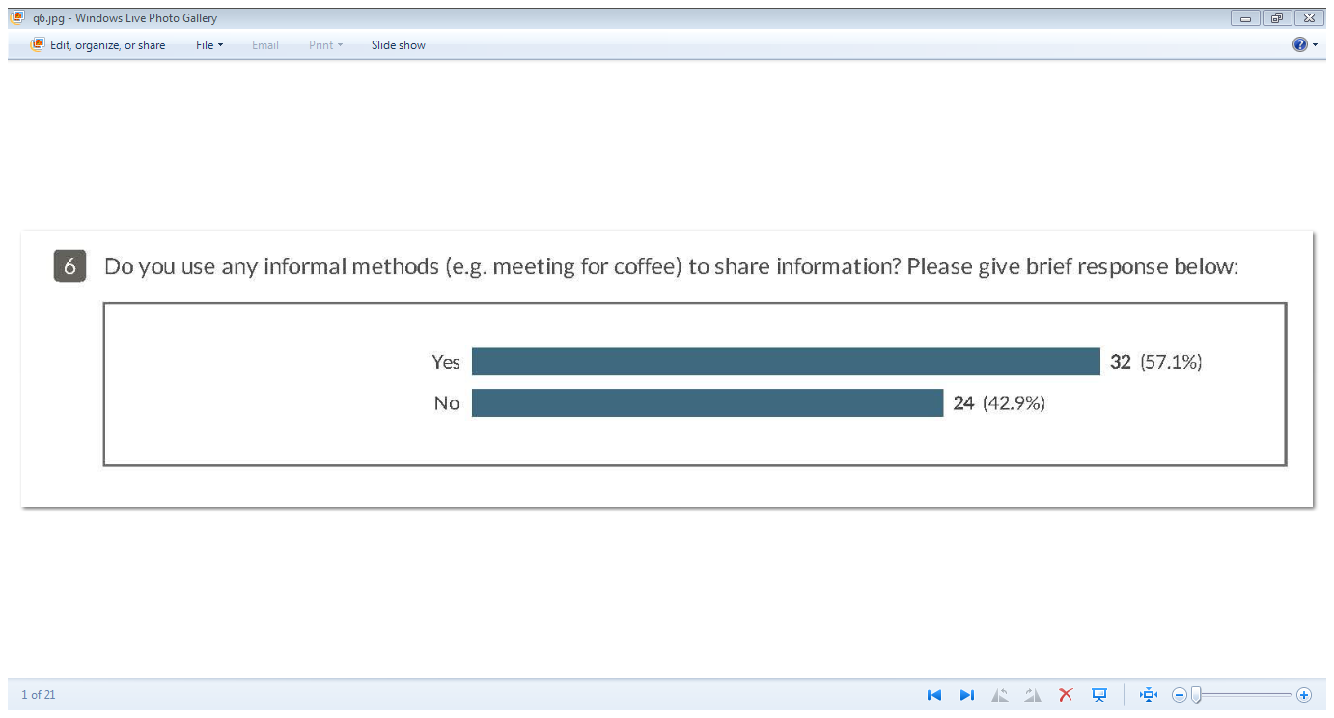

Slide 21
Comments (informal methods for collab?)
‘Meet with lecturers before class to discuss what needs to be done and make suggestions of ways to make the class more interactive.’
‘Finding them & chatting to them’
Escapes hierarchies in formal structures
‘Guerrilla teaching’ – sometimes preferred option

Slide 22
Comments (informal methods for collab?)
‘no opportunity’
‘No time! Grrr.’
‘I very much want to do this and there are no physical barriers to prevent this happening except the attitudes of some academics.’

Slide 23
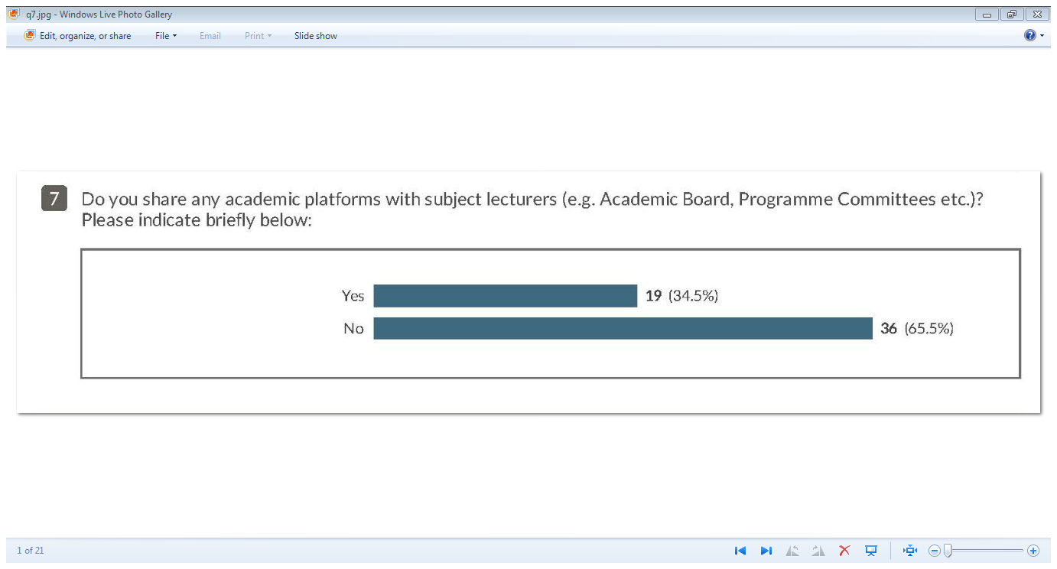

Slide 24
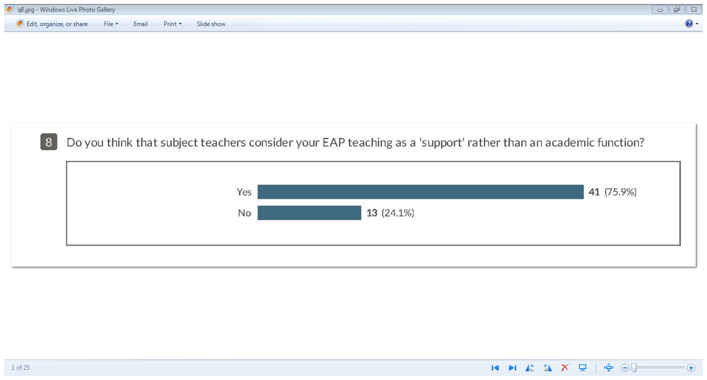

Slide 25
Comments (EAP seen as a support function?)
‘Some Faculties were great and treated one with respect as an equal but others it was very much a 'know your place' attitude.’
‘I think that institutions position EAP courses within external/subsidiary companies…This causes academic staff to see us as 'support'.’
‘The divide between 'support' and academic staff is deeply entrenched.’

Slide 26
Comments (EAP seen as a support function?)
‘We work together as a team.’ ‘Considered part of the team’
‘I don't have a problem with being seen as "support" students are here to study business, not English. It is our job to help get the best possible grades in their Business modules’
‘That is fine with me - I am a teacher, not a lecturer.’

Slide 27
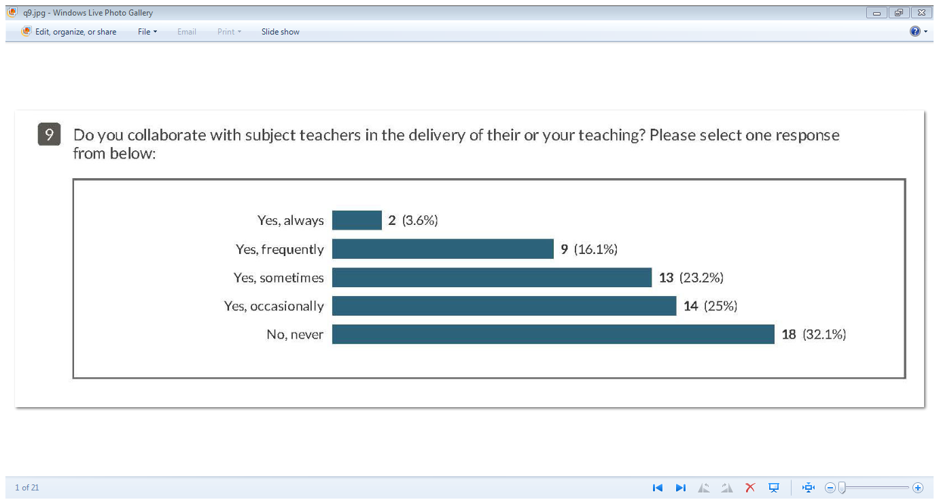

Slide 28
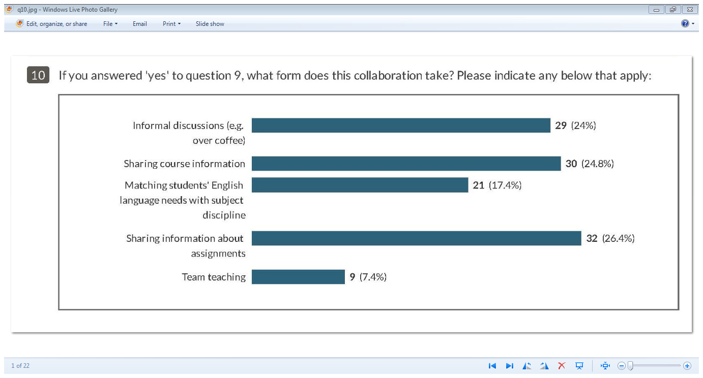

Slide 29
Comments (what form does this collab take?)
‘…at least one of my colleagues has done plenty of team teaching.’
‘Reviewing assignments
Creating diagnostic work
Discussing student course assignment outcomes’
‘This varies according to the courses. The ones where I liaise most closely are the maths courses as English for maths students is very specialised and I team teach with the GTAs.’
‘For the management courses, contact with the subject tutors is rather arms length.’

Slide 30
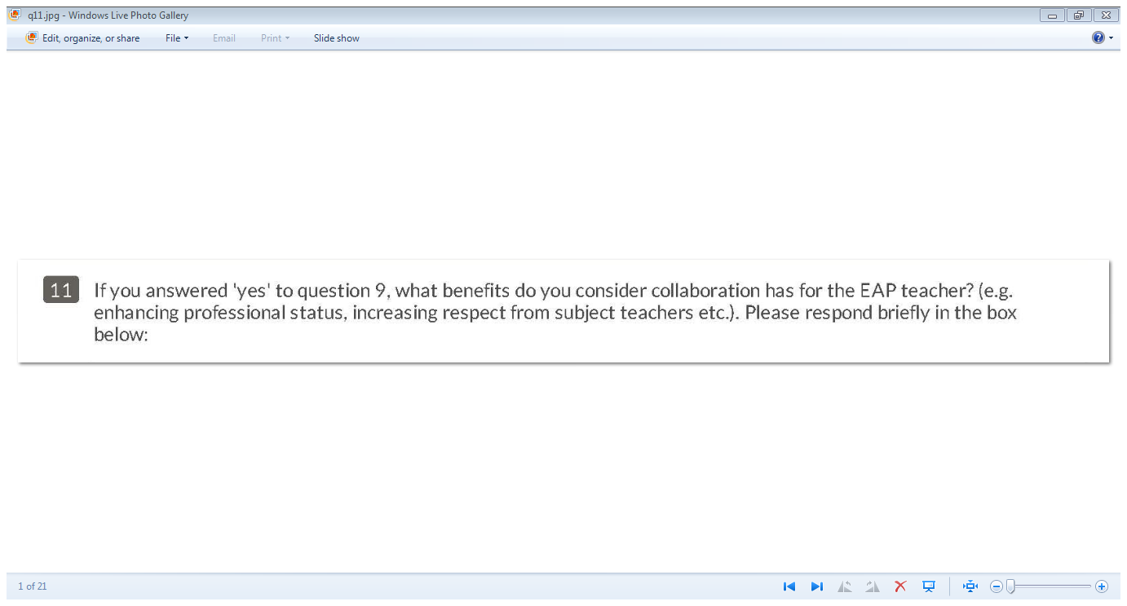

Slide 31
Comments (benefits for EAP teacher?)
‘better two-way understanding
better experience for students’
‘My knowledge of language use in various context increases.
My subject colleagues treat me as a valued peer.’
‘Greater understanding of constraints and roles of BOTH parties’

Slide 32
Cognitive authority
Wilson (1983)
Pilerot (2006)
‘Students have become aware of the ESAP/subject tutor partnership and have readily engaged in the ESAP classroom activities in the knowledge that they have been endorsed by both tutors.’ (Dannatt 2014)

Slide 33
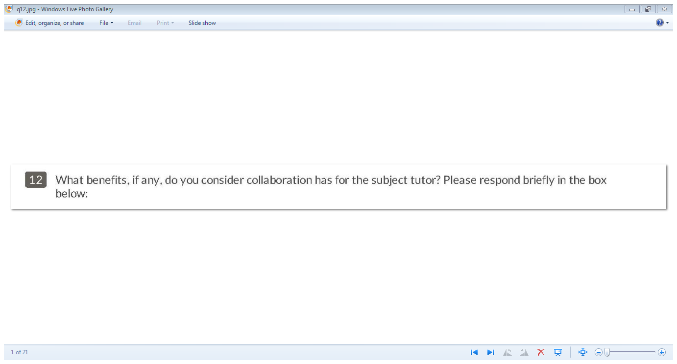

Slide 34
Comments (benefits for subject teachers?)
‘A more informed understanding of what EAP is, how we can help them rather than undermine them and hopefully a greater respect for what we do.’
‘Our lessons can be tailored to suit the needs of the department rather than having to make an educated guess at what is being covered each semester.’
‘It would have many benefits for aligning the teaching output of EAP tutors with that of the subject specialists’

Slide 35
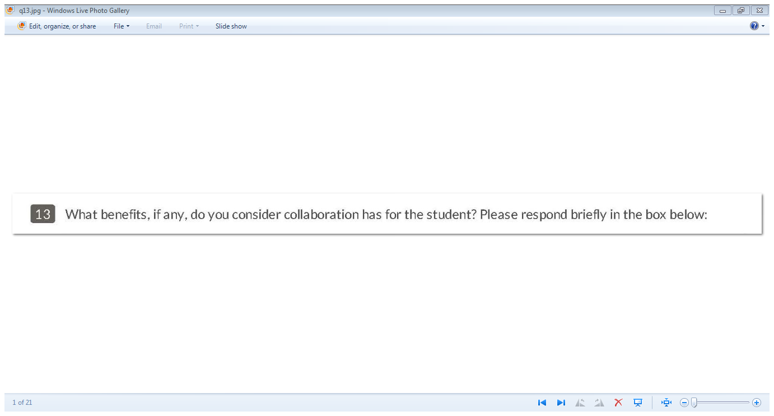

Slide 36
Comments (benefits for students)
‘Seeing that the subject tutor values what we do may reinforce the student's confidence in the relevance of what we do [cognitive auth]. The student benefits too if the collaboration has enhanced our subject knowledge /knowledge of their programmes and therefore our teaching’
‘If students can apply academic writing to 'real' assignments [authenticity] they are more motivated, see relevance and are more committed’
‘It can really help students see the connection between EAP and their subject area, and thus assist with transfer of skills learnt in language classes.’

Slide 37
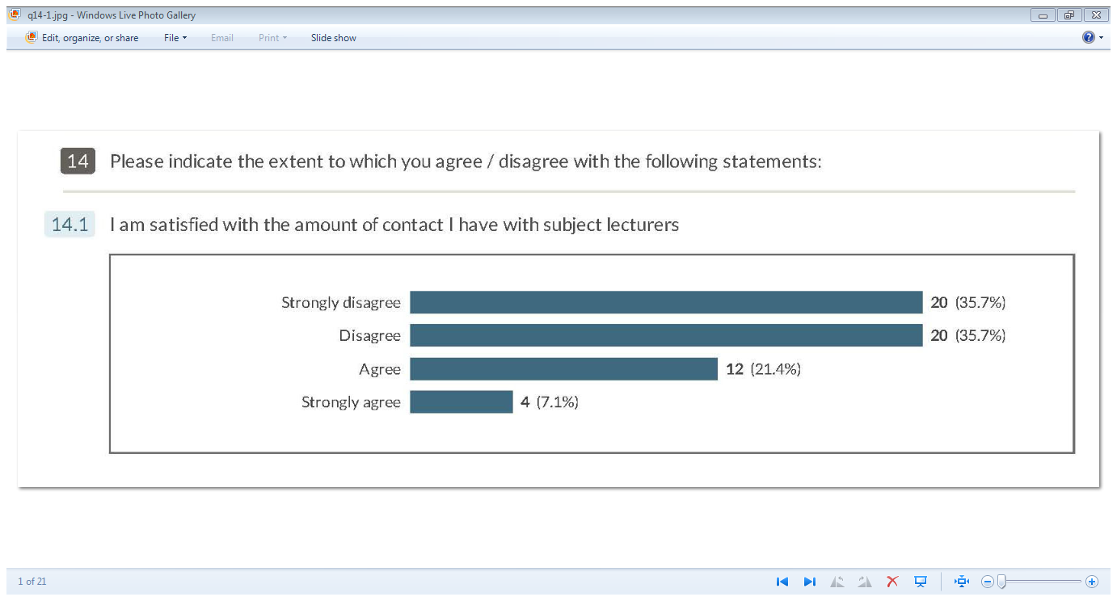

Slide 38
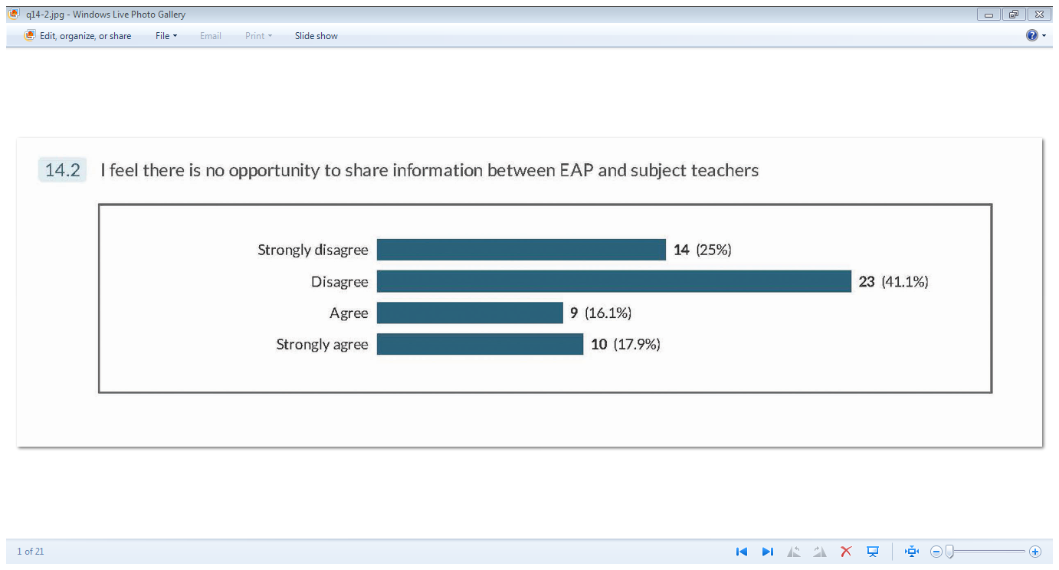

Slide 39
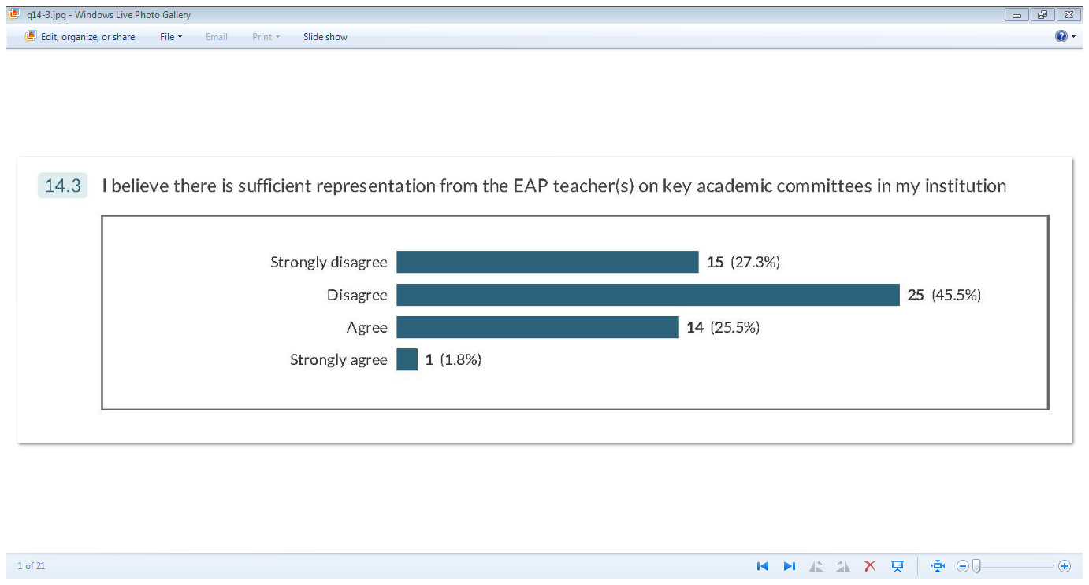

Slide 40
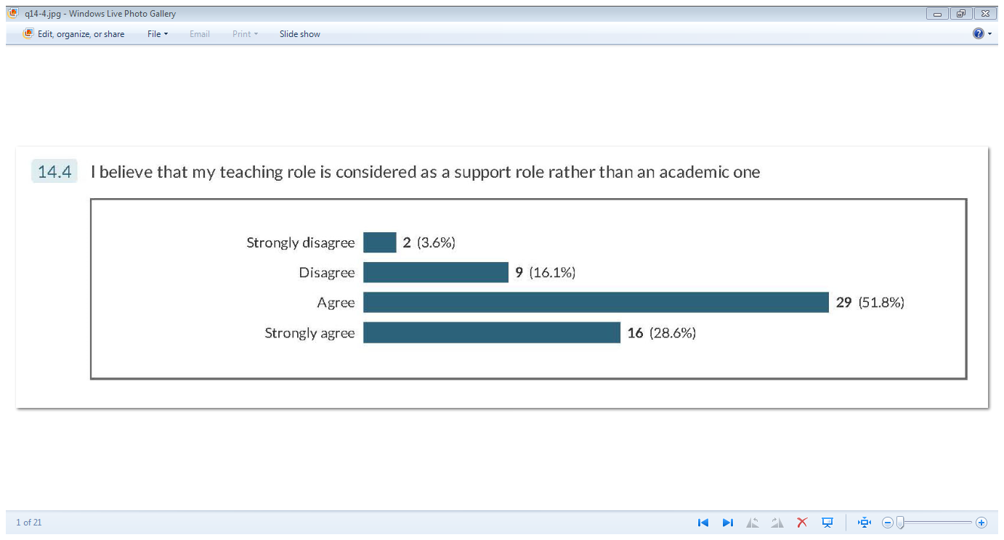

Slide 41
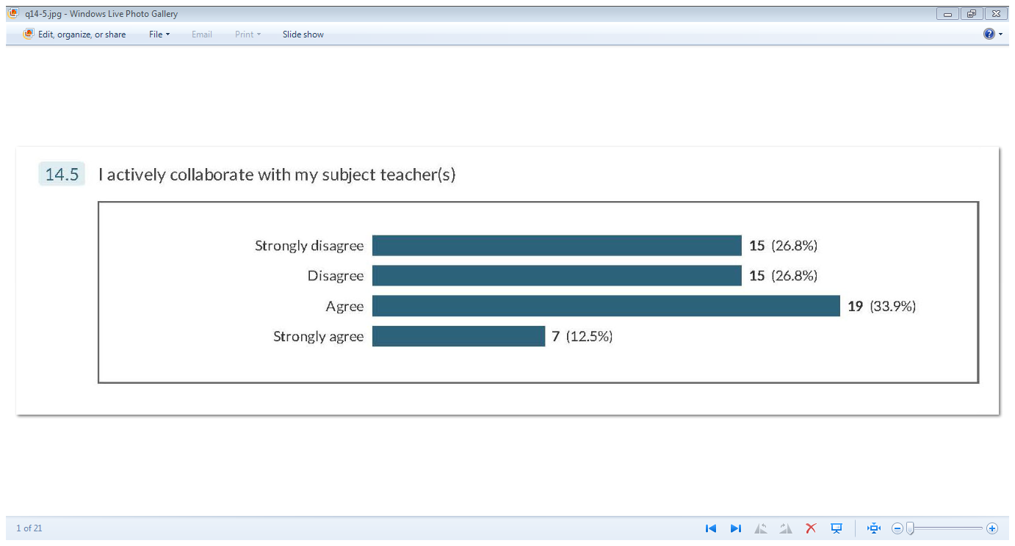

Slide 42
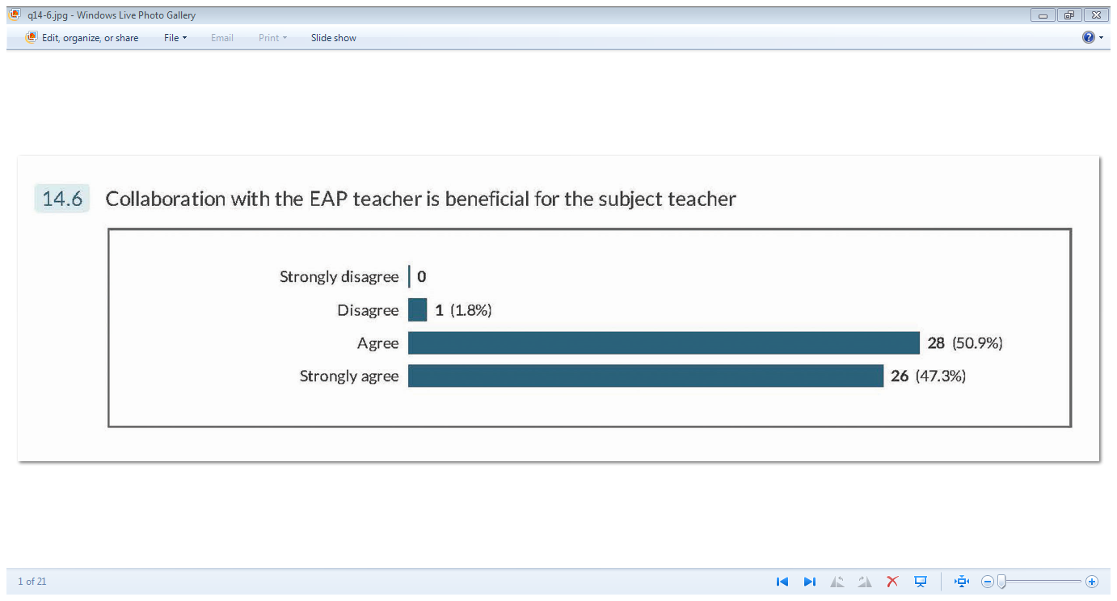

Slide 43
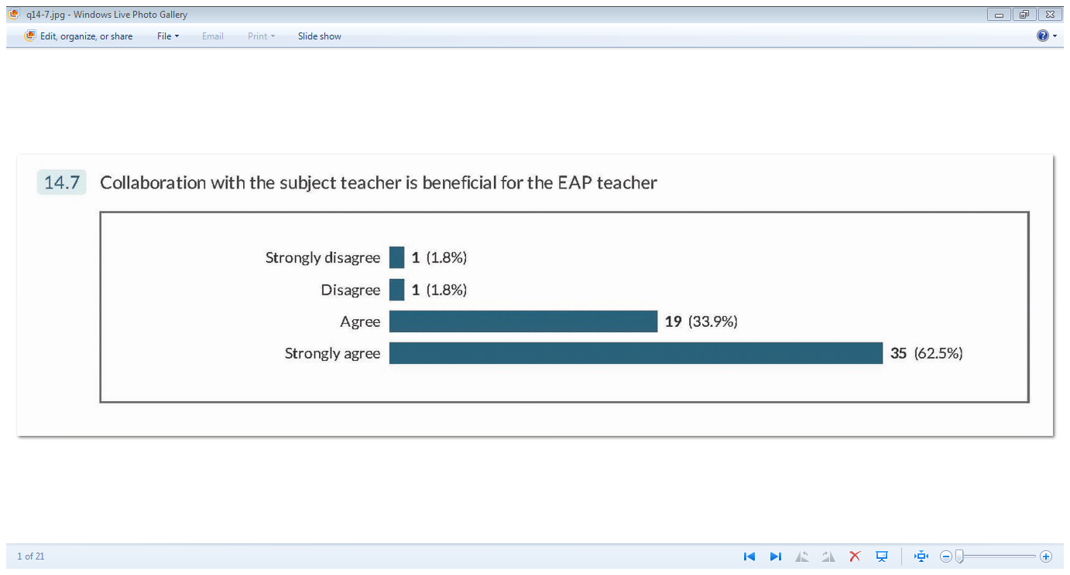

Slide 44
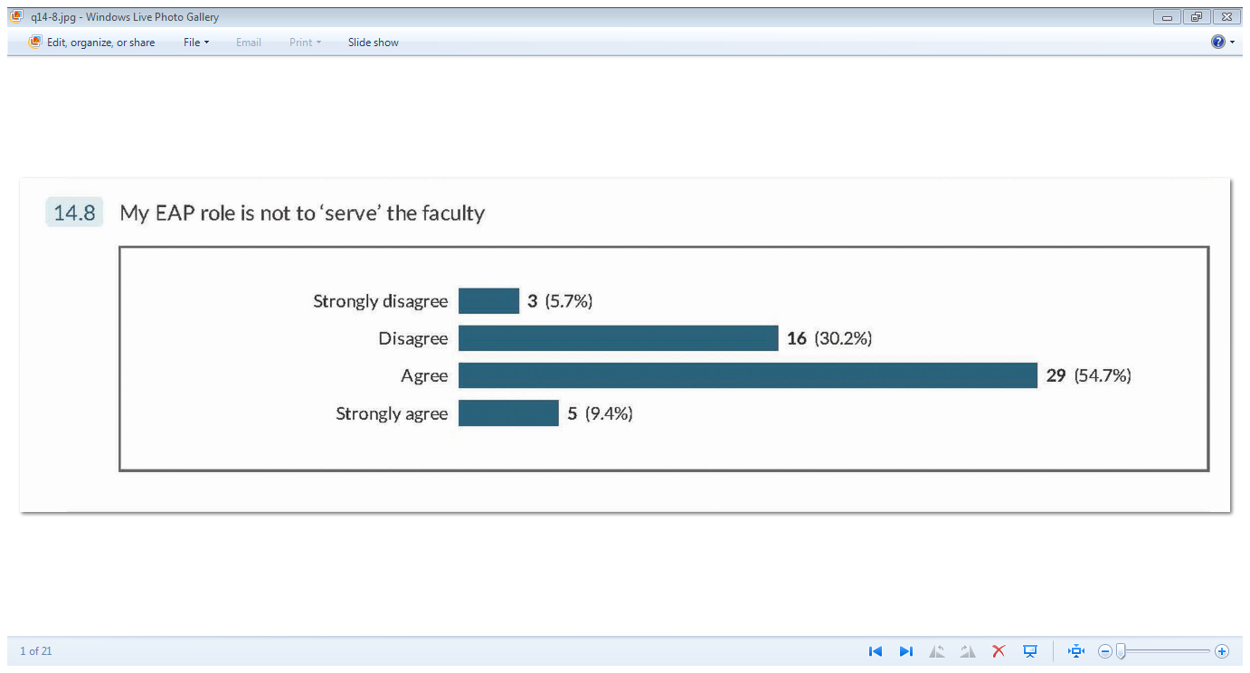

Slide 45
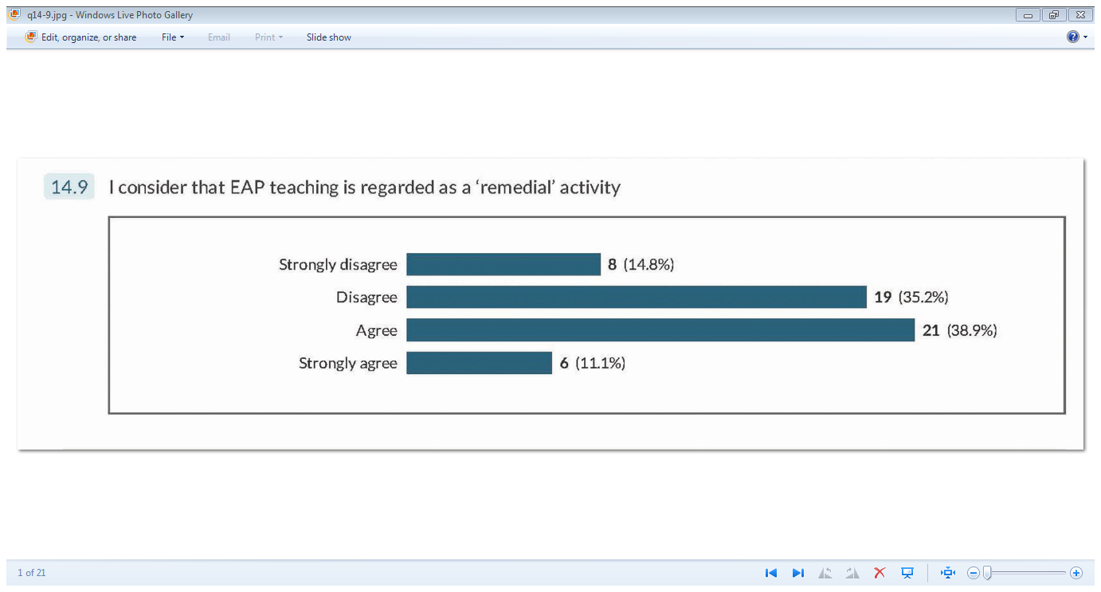

Slide 46
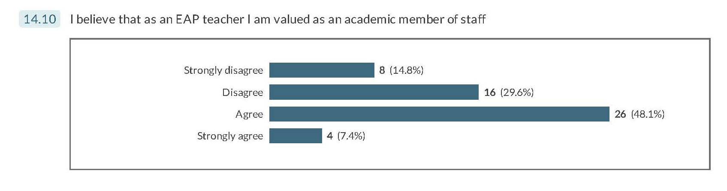

Slide 47
Some Conclusions
Notion of Raimes’ ‘butler stance’ supported in the literature and perception confirmed (though not universally) in survey
Collaboration a positive approach that mitigates against hierarchical structures (‘butler stance’)
‘It [collaboration] gives me more respect from the subject teachers.’
‘changing perceptions of professional status’
‘I also firmly believe that through this collaboration, subject teachers can understand better what EAP teachers do and have to offer and , yes, I think it increases their respect towards our profession’

Slide 48
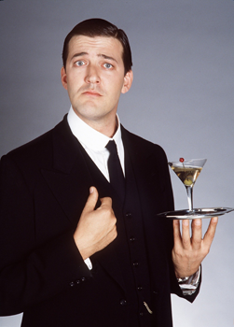
Afterthoughts: butler stance?

Slide 49
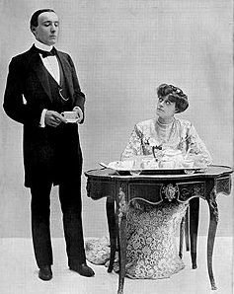

Slide 50
Positive depictions - Key roles!
Resourceful
Problem-solving / lateral thinking
In control
Managerial / leadership qualities
…and in any event….

Slide 51
Brave New HE World
Marketisation & neo liberalism
Relentless targets / KPIs – pressures on ‘academic’ / teaching staff
‘We are a separate (income-generating) unit so the first concern for the institution is money’ [from survey]
‘…the university has prostituted its academic and ethical integrity for foreign money.’ HE Bill?
Butler stance – EAP teachers not alone?

Slide 52





The shape of things to come?

Slide 53
References
Al-Maamari, F. (2016) Programme Identity in Academia: The Case of One EAP Unit in the Arabian Gulf. Arab World English Journal. [Online] 7: 3 pp. 425-444. Available at: https://papers.ssrn.com/sol3/papers.cfm?abstract_id=2859287 (Accessed 5th April 2017).
Arkoudis, S. and Starfield, S. (2007) In course language development and support: a discussion paper. National Symposium: English Language Competence of International Students, Sydney. Available at: https://internationaleducation.gov.au/research/Publications/Documents/NS_Incourse_LanguageDS.pdf (Accessed 12th July 2016)
Arnó-Macià, E. and Mancho-Barés, G. 2015. The role of content and language in content and language integrated learning (CLIL) at university: Challenges and implications for ESP. English for Specific Purposes, [Online] 37, pp.63-73. Available at: http://www.sciencedirect.com/science/article/pii/S088949061400043X (Accessed 5th April 2017).
Barron, C. (1992) Cultural syntonicity: co-operative relationships between the ESP unit and other departments. Hongkong Papers in Linguistics and Language Teaching, [Online] 15: pp. 1-14. Available at: http://files.eric.ed.gov/fulltext/ED355766.pdf (Accessed 12th July 2016).
Barron, C. (2002) Problem-solving and EAP: themes and issues in a collaborative teaching venture. English for Specific Purposes, [Online] 22 : 3 pp.297-314. Available at: http://www.sciencedirect.com/science/article/pii/S0889490602000169 (Accessed 12th July 2016).
Bell, T. (1999) Do EAP teachers require knowledge of their students’ specialist academic subjects. The Internet TESL Journal, [Online] 5 : 10 Available at: http://iteslj.org/Articles/Bell-EAPRequireKnowledge.html (Accessed 5th April 2017).
Benesch (2001)
Benesch (2016)
Chand & Chaudhary (2015)
Harwood and Petric (2013)
Hyland (2002)
Hyland (2015); Turner (2004)
Raimes, A. (1991)

Slide 54
References
Benesch S. (1993) ESL, ideology, and the politics of pragmatism. TESOL quarterly, [Online] 27:4 pp. 705-17. Available at: http://onlinelibrary.wiley.com/doi/10.2307/3587403/full (Accessed 5th April 2017).
Benesch S. (2001) Critical English for academic purposes. Blackwell Publishing Ltd.
Bruce, I. (2011) Theory and concepts of English for academic purposes. Basingstoke, UK:Palgrave Macmillan.
Bundy, A. (2004) Beyond information: the academic library as educational change agent. In 7th International Bielefeld Conference [Online] Available at: http://conference.ub.uni-bielefeld.de/2004/proceedings/bundy_rev.pdf (Accessed 5th April 2017).
Chand, P. and Chaudhary, S. (2015) Key Issues related to Coalescing English for Academic Purposes with the Mainstream English Language Teaching for Engineering Graduates. Alchemist, [Online] 3 : 3 p.6. Available at: http://www.alchemistjournal.in/originalimages/July-Complete-Isssue-2015.PDF#page=7 (Accessed 5th April 2017).
Dannatt, J. (2014) Closing the loop on the ESAP/subject partnership: from communication to co-operation and collaboration. Journal of the IATEFL ESP SIG 44, pp. 4-7.
Davison, C., 2006. Collaboration between ESL and content teachers: How do we know when we are doing it right?. International Journal of Bilingual Education and Bilingualism, [Online] 9 : 4, pp.454-475. Available at: http://www.tandfonline.com/doi/abs/10.2167/beb339.0 (Accessed 5th April 2017)

Slide 55
References
Dudley-Evans, T. (2001) Team teaching in EAP: changes and adaptations in the Birmingham approach. In: John Flowerdew and Matthew Peacock (Eds.) Research perspectives on English for academic purposes pp. 225-238. Cambridge: CUP.
Dudley-Evans, T. and St John, M. (1998) Developments in English for specific purposes. Cambridge : CUP.
Evans, S. and Green, C. (2007) Why EAP is necessary: A survey of Hong Kong tertiary students. Journal of English for Academic Purposes, [Online] 6 : 1, pp.3-17. Available at: http://www.sciencedirect.com/science/article/pii/S1475158506000634 (Accessed 5th April 2017)
Gustaffson, M. and Jacobs, C. (2013) Editorial: student learning and ICLHE – frameworks and contexts. Journal of Academic Writing, 3 (1)ii-xii. Available at: http://e-learning.coventry.ac.uk/ojs/index.php/joaw/article/view/141 (Accessed 12th July 2016).
Harwood, N. and Petric, B. (2013) English for academic purposes. In James Simpson, The Routledge handbook of applied linguistics. [Online] UK: Routledge Available at: https://books.google.co.uk/books?id=1Ypah5a7YwkC&pg=PA246&lpg=PA246&dq=the+low+status+of+the+EAP+teachers+in+some+contexts,+and+related+issues+of+power&source=bl&ots=FZpMX_Br6c&sig=Y4XZ2L8ighBjupKULU0oPd2oe7c&hl=en&sa=X&ei=xuirVIvGJ4jvaL25gsgJ&ved=0CCMQ6AEwAA#v=onepage&q=the%20low%20status%20of%20the%20EAP%20teachers%20in%20some%20contexts%2C%20and%20related%20issues%20of%20power&f=false (Accessed 6th January 2015).
Hyland, K. and Hamp-Lyons, L. (2002) EAP: Issues and directions. Journal of English for academic purposes, [Online] 1 : 1, pp.1-12. Available at: http://www.sciencedirect.com/science/article/pii/S1475158502000024 (Accessed 5th April 2017).
Hyland, K. (2006) English for academic purposes: an advanced resource book. Oxford, UK: Routledge.
Raimes, A. (1991) Instructional balance: from theory to practices in the theory of writing. In J.E. Alatis (Ed.), Georgetown University round table on languages and linguistics: linguistics and language pedagogy: the state of the art (pp. 238-249). Washington DC: Georgetown University Press.

Slide 56
References
Hyland, K. (2014) Re-imagining literacy: English in Hong Kong’s new university curriculum. In English Language Education and Assessment (pp. 139-151). Springer Singapore.
Jordan, R.R. (1997) English for academic purposes: a resource book for teachers. Cambridge, UK: CUP.
Jordan, R.R.(2002) The growth of EAP in Britain. Journal of English for academic Purposes, [Online] 1 : pp. 69-78. Available at: http://www.uefap.com/baleap/quotes/jordan_jeap.pdf [Accessed 6th January 2015].
Lee, C. (2009) Promoting interdisciplinary collaboration. HKBU Papers in Applied Language Studies, 13 Available at: http://lc.hkbu.edu.hk/book/pdf/v13_01.pdf (Accessed 5th April 2017).
Pilerot, O. (2006) How do students develop information literacy – through formal education or social participation? Paper presented at LILAC conference, Leeds.
Raimes, A. (1991) Instructional balance: from theory to practices in the theory of writing. In J.E. Alatis (Ed.), Georgetown University round table on languages and linguistics: linguistics and language pedagogy: the state of the art (pp. 238-249). Washington DC: Georgetown University Press.
Rich, M. and Smart, J. (2006a) Win-win: the benefits of successful collaboration for information professionals, teaching staff and students. Teaching and Learning in Information and Computer Sciences, 5 (4) pp.1-12. Available at: http://www.tandfonline.com/doi/abs/10.11120/ital.2006.05040220 (Accessed 12th July 2016).

Slide 57
References
Sharpling, G. P. (2002) Learning to teach English for academic purposes: some current training and development issues. ELTED, [Online] 6 (Summer): pp.82-94. Available at: http://wrap.warwick.ac.uk/3252/1/WRAP_Sharpling_V6Sharpling.pdf [Accessed 6th January 2015].
Sloan, D. and Porter,E. (2010) Changing international student and business staff perceptions of in-sessional EAP: using the CEM model. Journal of English for Academic Purposes, [Online] 9 : pp. 198-210. Available at: http://www.sciencedirect.com/science/article/pii/S1475158510000263 [Accessed 6th January 2015].
Tajino, A. et al. (2005) Beyond needs analysis: soft systems methodology for meaningful collaboration in EAP course design. . Journal of English for Academic Purposes, [Online] 4: pp. 27-42. Available at: http://www.sciencedirect.com/science/article/pii/S1475158504000025 [Accessed 6th January 2015]
Turner, J. (2004) Language as academic purpose. Journal of English for Academic Purposes, [Online] 3: pp95-109. Available at: http://www.sciencedirect.com/science/article/pii/S1475158503000547# [Accessed 6th January 2015].
Wilson, P. (1983) Second-hand knowledge: an inquiry into cognitive authority. Westport, Conn. : Greenwood.

