Slide 1
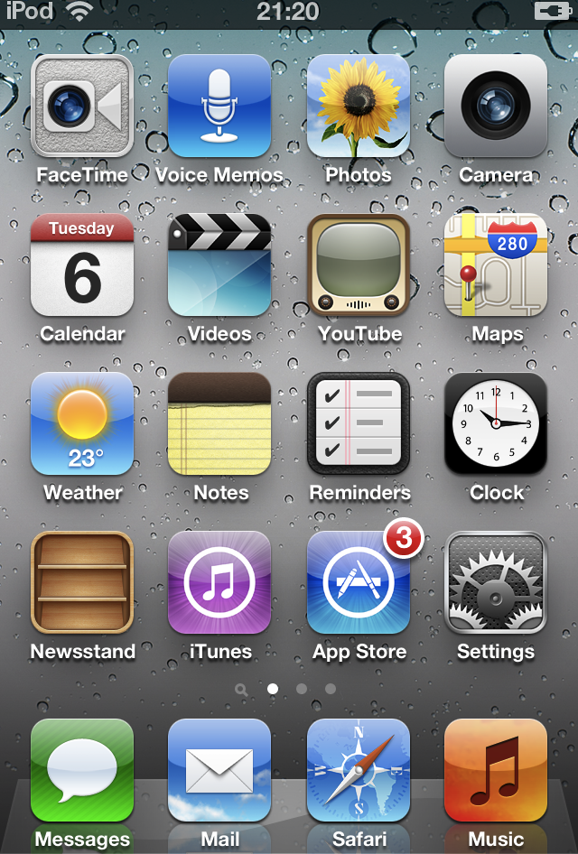
Evaluating EAP: texts, the digital and sociomaterial practice
Lesley Gourlay
UCL Institute of Education
BALEAP PIM
Edinburgh 2017

Slide 2
Modes and media of communication carry meanings between streams and flows that make up the texture of the contemporary world, and historically literacy is one of the most important channels through which meanings have crossed space and time.
(Kell 2006: 147)

Slide 3
Literacy as social practice
Critiquing literacy frameworks
Meaning-making and the digital
Text trajectories, spaces and networks
Implications for EAP

Slide 4

1) Literacy as social practice

Slide 5
‘Academic Literacies’: Background
Linguistic anthropology studies of writing in social contexts (e.g. Brice-Heath 1983)
Proposed a social, not cognitive view of literacy (Street 1984)
‘New Literacy Studies’ (Barton 1994)

Slide 6
The problem with ‘literacy skills’
Emphasises textual features not process
Analysis of grammatical / lexical features
Sees writing as generic and transferable
Assumes agreement about requirements
Sees writing as a transferable set of skills
Sees students as in deficit, faulty

Slide 7
Academic literacies
An alternative to a ‘skills’ model of academic writing (Lea & Street 1998)
Challenge to a ‘deficit’ view of students
Recognises issues of identity and power in writing (e.g. Lillis 2001)
Views writing as inseparable from content

Slide 8
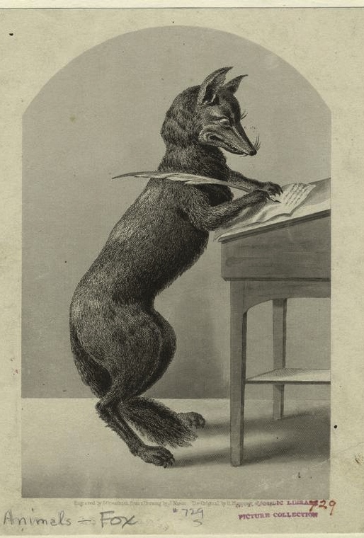
2) Critiquing literacy frameworks

Slide 9
Frameworks: cognitive or attitudinal, mixture of capabilities, skills and attributes
Literacies: assumed to be quantifiable, stable, generic and transferable entities
Seen as residing in the individual and amenable to ‘development’ of the student
Using aspirational, qualitative adjectives: ideology of the graduate as a quality-assured ‘product’.
Gives impression of ‘learner-centredness’, however social actors & situated practices are oddly ‘absent’.

Slide 10
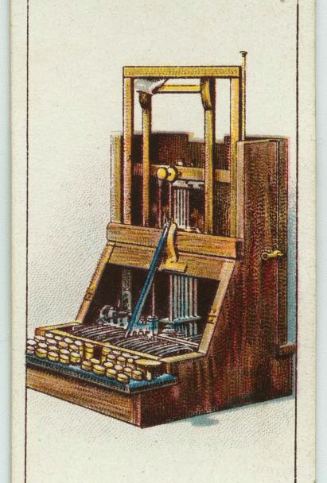
3) Meaning-making and the digital

Slide 11
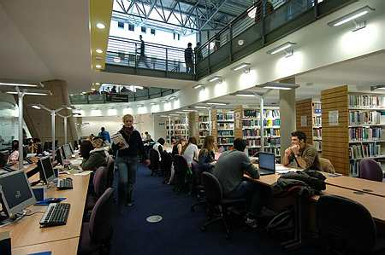
www.napier.ac.uk
Notes:
The first point I want to make concerns the centrality if texts and textual literacy practices in the university. In order to do this I want to focus on some of the iconic spaces and prototypical encounters we typically see in a face-to-face university setting.

Slide 12
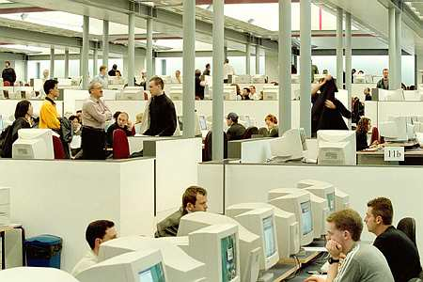
www.napier.ac.uk

Slide 13
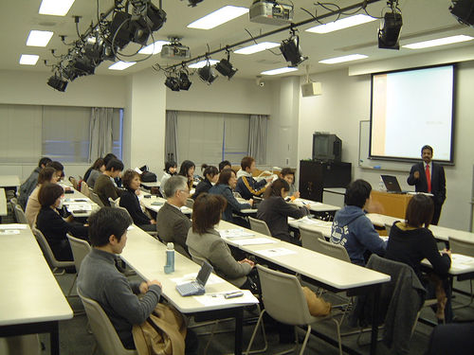
www.flickr.com/photos/sarvodaya/3861823/
Notes:
Arguably the lecture is an increasingly textualised space – powerpoint , handouts etc. Also peripheral unofficial activity - browsing, texting

Slide 14
The ‘figured world’ of literacy
Texts constitutive of knowledge & identities (e.g. Ivanič 1998, Lillis 2001)
‘…artefacts meaningful to the figured world of literacy’ (Bartlett & Holland 2002:13)
Humans & artefacts as hybrid actors (Holland et al 1998)
The university as a media system (Kittler 2004)
Material campus saturated with digital mediation (Gourlay 2013)
Notes:
Central to the fabric of the academy,
Text is central not only in discursive disciplines, comes to stand for practices, the hybrid form of speech, thought and text has emerged as ‘reflective writing’. Practice disciplines have become absorbed into the academy and have arguably become more textualised as a result.
Constitutive: Research in academic literacies has uncovered the tacit nature of norms and expectations surrounding academic writing for students. This is a lens which has been used to see academic writing as constitutive of identities a site of learning. Ivanič (1998), mature postgraduate students’ academic writing - strong relationship to individuals’ sense of selves, emphasising struggle for selfhood while engaged in writing as ‘boundary work’. Lillis (2001) investigates ‘non-traditional’ undergraduates, also finds writing inextricably linked to identity formation. She argues that ‘…meaning making is not just about making texts, but is also about the making of our selves, in a process of becoming’ (2001, 48).
Text is abundant online but valorised texts are scarce, precious and guarded by gatekeeping practices via libraries. Texts are hidden, mysterious and forbidden (such as other student’s work, previous dissertations). Texts and their features are slippery, difficult to pin down - as can be seen in the opacity and struggles surrounding guidance on writing, feedback, marking and assessment criteria.
Problematic: confusion and distress surrounding academic writing as a result of its private, implicit nature, but also arising from the commonly-held belief that reading, writing and all that is associated with it are freefloating ‘transferable skills’ which are amenable to training (e.g. Wingate 2006).

Slide 15
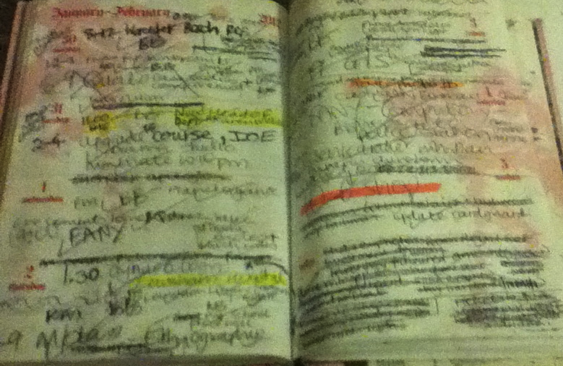
4) Text trajectories, spaces & networks

Slide 16

IOE JISC Digital Literacies Project
      2-year study
      Focus groups
      Longitudinal multimodal journalling
      Interviews & talk around texts

Slide 17
Digital literacies:
The constantly changing practices through which people make traceable meanings using digital technologies. Within this broad definition, specific aspects of digital literacies can be investigated and explored further, understood as in many ways offering a continuity to our understandings of literacies in general as social practice.
(Gillen & Barton, 2010: 9)

Slide 18
Video
http://jiscdesignstudio.pbworks.com/w/page/50732695/Digital%20Literacies%20as%20a%20Postgraduate%20Attribute%20project

Slide 19
Text trajectories
Entextualisation, where talk is lifted out of interactional setting and becomes text (e.g. Silverstein & Urban 1996)
Texts and discourses move around and are recontextualised into new interpretative spaces
In these transitions they undergo significant changes in meaning (Blommaert 2005, Ehrlich 2012, Kell 2006)

Slide 20
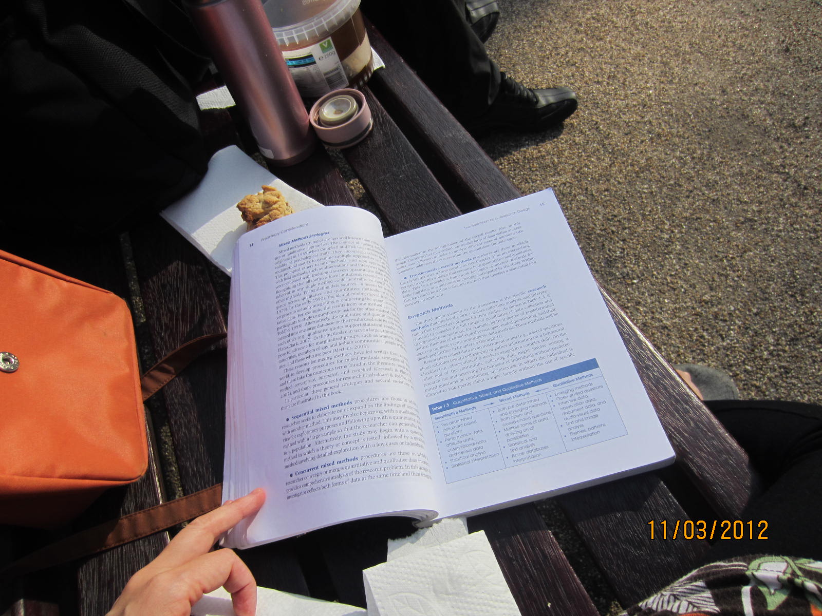
Print & digital text trajectories

Slide 21
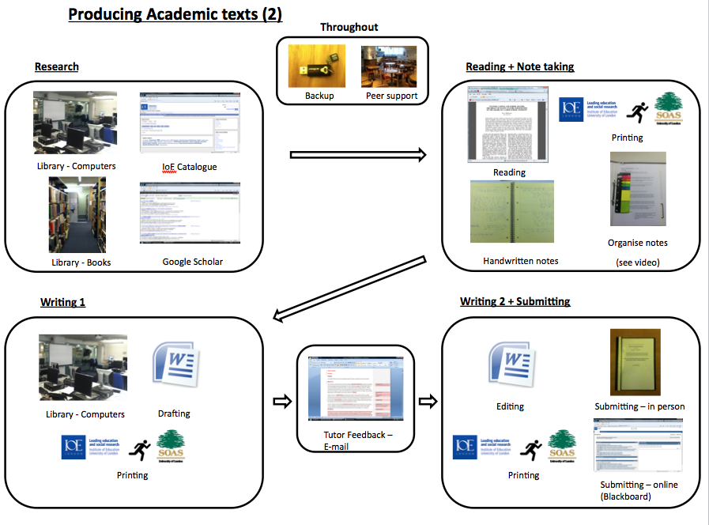

Slide 27
Spaces
We recognise space as the product of interrelations; as constituted through interactions, from the immensity of the global to the intimately tiny… We recognise space as always under construction. Precisely because space on this reading is a product of relations-between, relations which are necessarily embedded in material practices which have to be carried out, it is always in the process of being made.
(Massey, 2005: 9)

Slide 28
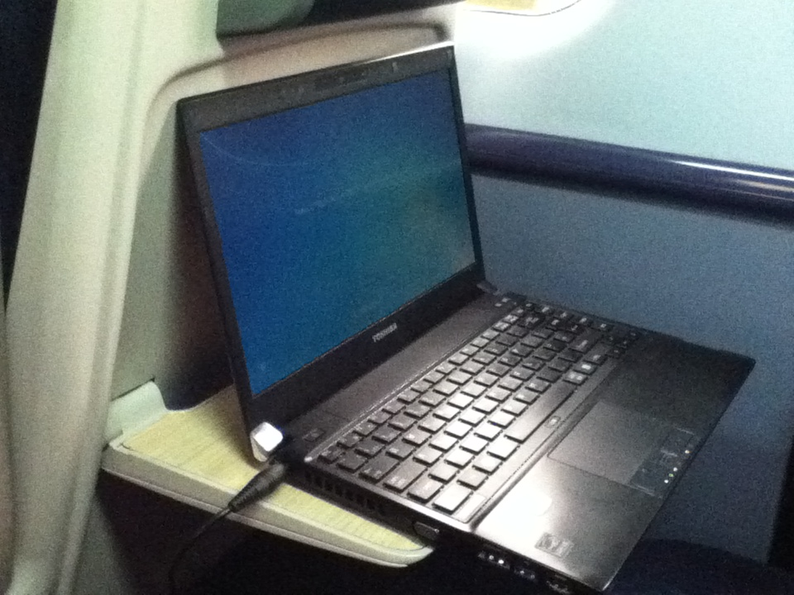
Contingent
Not a neutral backcloth or context but contingent, dynamic & engaged in meaning-making.

Slide 29
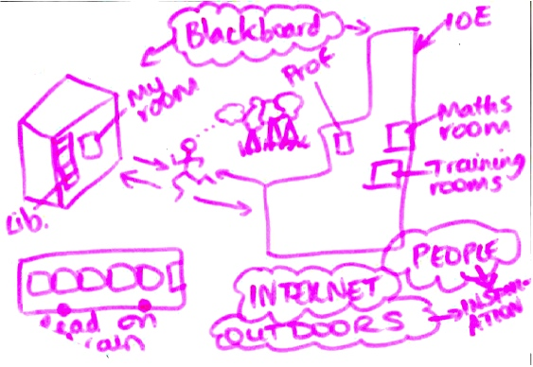
Unbounded
Notes:
lesley

Slide 30
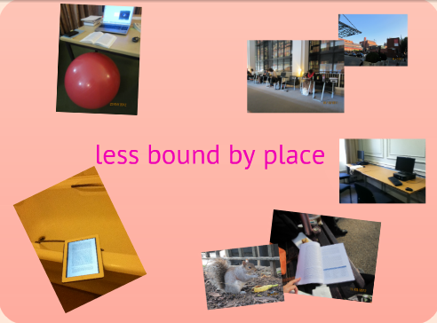

Slide 31
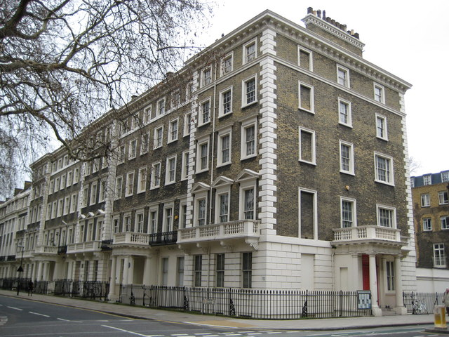
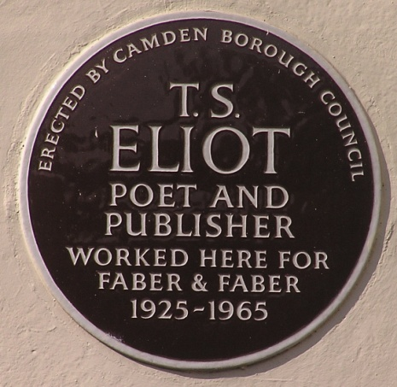
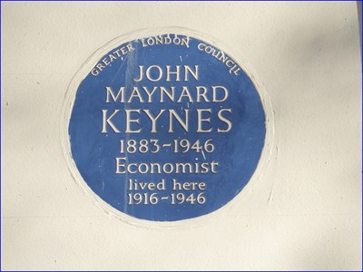

Symbolic
Bloomsbury: ‘Academic, historical, artistic, studious, important’

Slide 32
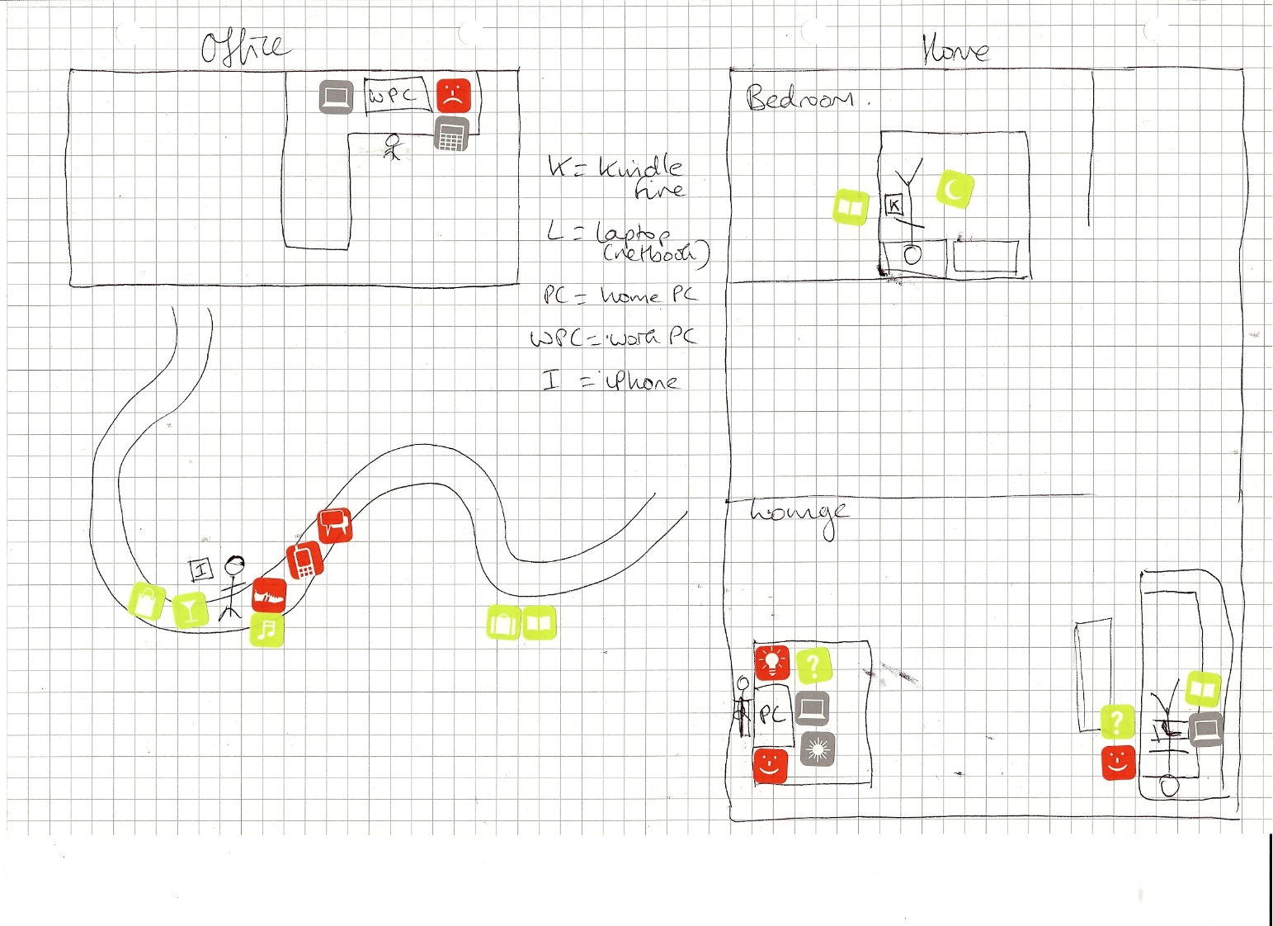
Delineating

Slide 33
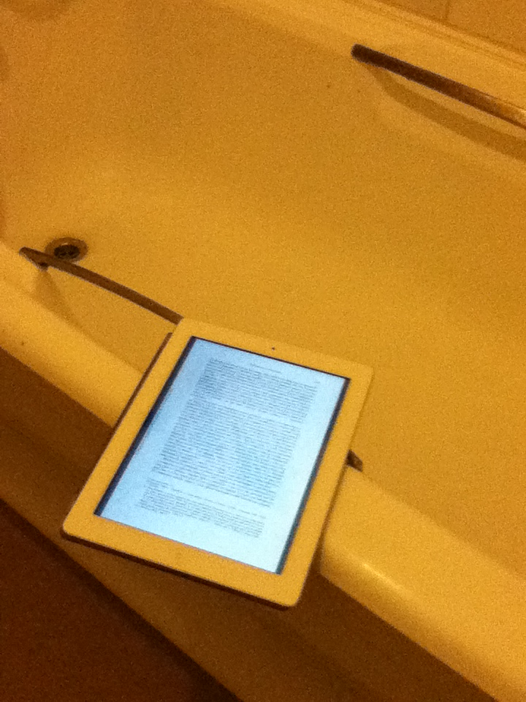
Intimate

Slide 34
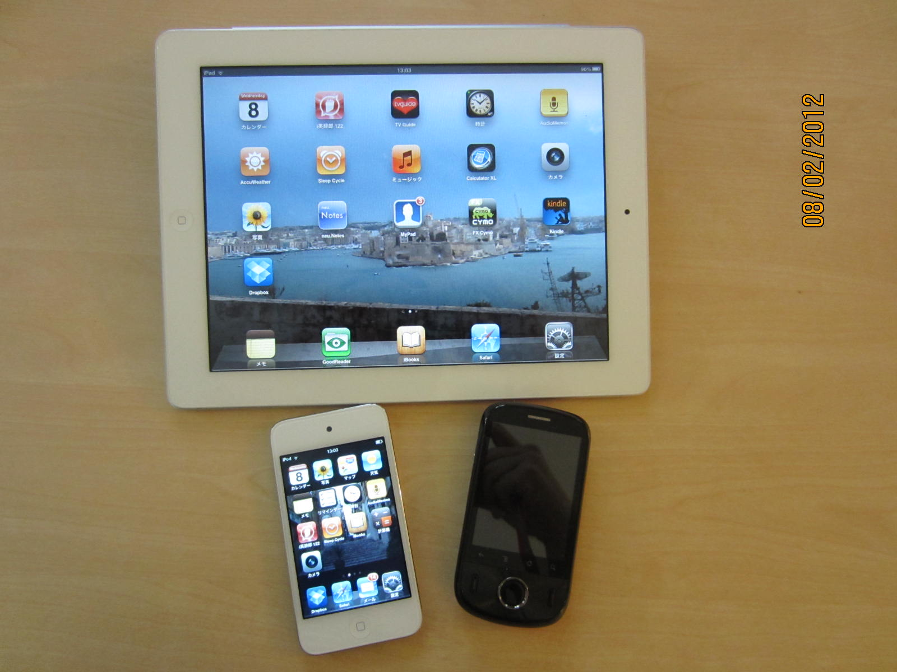
Networks and assemblages
Literacies as material assemblages of human / nonhuman actors, texts, devices, spaces & mobilities.
(Gourlay, Hamilton & Lea 2013)

Slide 35
Removing the agency of texts and tools in formalising movements risks romanticising the practices as well as the humans in them; focusing uniquely on the texts and tools lapses into naïve formalism or techno-centrism.
Leander & Lovvorn (2006: 301)

Slide 36
Humans, and what they take to be their learning and social process, do not float, distinct, in container-like contexts of education, such a classrooms or community sites that can be conceptualised and dismissed as simply a wash of material stuff and spaces. The things that assemble these contexts, and incidentally the actions and bodies including human ones that are part of these assemblages, are continuously acting upon each other to bring forth and distribute, as well as to obscure and deny, knowledge.
(Fenwick et al, 2011: vii)

Slide 37
The more one works with digital technologies…the more the keyboard comes to seem an extension of one's thoughts rather than an external device on which one types. Embodiment then takes the form of extended cognition, in which human agency and thought are enmeshed within larger networks that extend beyond the desktop computer into the environment.
(Hayles 2012:3)

Slide 38
An intermediary is ‘…what transports meaning or force without transformation: defining its inputs is enough to define its outputs’, while mediators ‘transform, translate, distort, and modify the meaning or the elements they are supposed to carry’
(Latour 2005: 39)

Slide 39
Nonhuman actors / mediators
I feel like, also that Google is equally watching you. You know, they’re all watching you, they’re all trying to sell you things […] You know, I don’t want my friends to spy on me, I don’t want my friends to know what I listen to on YouTube. (Sally Int. 1)
My third half of my brain is Google scholar. (Frederick Int. 2)
I think they (the technologies) control me as well, because I can’t really do anything without them (Faith Int. 1)

Slide 40
…It’s not necessarily the working with, sort of, the traditional practices, but much more about the, you know, our physical bodies in space, rather than… And thinking about online environments as being… the iPhone, or whatever it is, connected to a projector, or working then with the iPad, and connecting, so you’ve got this kind of circuit within a physical space.
(Django Int. 1)

Slide 41
Conclusions
Literacy is always situated social practice
Situated practice needs to include the sociomaterial
Networks enrol nonhuman actors
Space is contingent, emergent, symbolic & intimate
This standpoint destabilises ‘commonsense’ binaries such as user/ device, author / text, practice / context.

Slide 42
Measures of success in EAP?
Degree of challenge to insessional division between ‘home’ and ’international’ student provision
Degree to which digital media use in provision reflects its use in academic practice
Degree of ‘entanglement’ and dialogue with students, academics and specific contexts of academic practice
Degree of engagement with academic content in addition to writing processes
Degree of challenge to assumptions around EAP / academic roles and responsibilities
Degree of emphasis on qualitative / ethnographic institutional scholarship and research

Slide 43
Implications for Practice
Writing Centre model as an alternative
EAP provision using digital media throughout, digital expertise a requirement for EAP professionals
Information literacy education: joint provision with library professionals
Strong links with academic departments and programmes at the level of provision
Subject knowledge and epistemological awareness required from EAP professionals
Robust support for doctorates and institutional research built in to EAP work patterns
Institutional strategic buy-in and adequate resource, grade 8 minimum contracts

Slide 44
Questions and comments?

Slide 45
References
Bartlett, L. & Holland, D. 2002. Theorizing the space of literacy practices. Ways of Knowing 2(1), 10-22.
Beetham, H. & Sharp, R. 2010. Current Issues and Approaches in Developing Digital Literacy. JISC. www.slideshare.net/jisc-elearning/current-issues-and-approaches-in-developing-digital-literacy
Belshaw, D. 2011. What is ‘digital literacy’? A pragmatic investigation. Doctoral Thesis, Durham University. http://neverendingthesis.com/doug-belshaw-edd-thesis-final.pdf
Blommaert, J. 2005. Discourse: A Critical Introduction. Cambridge: Cambridge University Press.
Ehrlich, S. 2012. Text trajectories: legal discourses and gendered inequalities. Applied Linguistics Review 3(1), 47-73.

Slide 46
Fenwick, T., Edwards, R. & Sawchuk, P. 2011. Emerging Approaches to Educational Research: Tracing the Sociomaterial. London: Routledge.
Kell, C. 2006. Crossing the margins: literacy, semiotics and the recontextualisation of meanings. In Pahl, K. & Rowsell, J. Travel Notes from the New Literacy Studies: Instances of Practice. Clevedon: Multilingual Matters, 147-171.
Holland, D., Lachicotte, W.,Skinner, D. & Calin, C. 1998. Identity and Agency in Cultural Worlds. Cambridge MA: Harvard University Press.
Kothari, U. 2001. Power, knowledge and social control in participatory development. In B. Cooke & U. Kothari (Eds.) 2001. Participation: The New Tyranny? London: Zed Books, 139-152.

Slide 47
Kittler, F. 2004. Universities: wet, hard, soft and harder. Critical Inquiry 31(1), 244-255.
Latour, B. 2005. Reassembling the Social: An Introduction to Actor-Network-Theory. Oxford: Oxford University Press.
Lea, M. 2005. ‘Communities of practice’ in higher education: useful heuristic or educational model? In Beyond Communities of Practice, D. Barton, & K. Tusting (Eds.) Cambridge: Cambridge University Press, 180-197.
Leander, K. & Lovorn, J. 2006. Literacy networks: following the circulation of texts, bodies and texts in the schooling and online gaming of one youth. Cognition and Instruction 24 (3), 291-340.
Massey, D. 2005. For Space. London: Sage.
Silverstein, M. & Urban, G. (Eds.)1996. Natural Histories of Discourse. London: University of Chicago Press.

